Slide 1
Student Employment
2025-2026

Slide 2
Presenter and Contact Resources
Kaitlin Villarreal, Student Employee Coordinator
  villarrealk@wou.edu
  8-8677
Sharon Fitzsimmons, Payroll Coordinator
  fitzsimmonss@wou.edu
  1-4149
Emily Herb, Director of Faculty & Staff Access Services
  herbe@wou.edu
  8-8420
Kella Helyer, Director of Financial Aid
  @helyerk@wou.edu
  8-8679

Slide 3

Agenda
Supervisor Resources & Responsibilities
Web Time Entry
Federal Work Study
Question and answer period

Slide 4
Hiring a Student Employee
Departments must use Handshake to post all open positions. Contact the Center for Professional Pathways for questions about Handshake.
Supervisors refer to the Student Employment Checklist for Supervisors to complete all the necessary actions and paperwork related to hiring student employees.
Supervisors must complete Student Employment Authorization and can provide student employee paperwork.
  New Student Employee Packet for students who are brand new
  Returning Student Employee Packet for students who need to update their contact info or starting with new department
Notes:
Returning student employees, or students who have worked on campus before but are new to your department, complete the Returning Student Packet.
This packet includes the Student Employee Information form and Student Employment Authorization Form.
Returning student employees with new contact information also complete the Returning Student Packet.
If they submit the forms to HR, the Employment Authorization Form must be returned to you. If you email a scan of the completed Student Employee Information form, no Authorization Form is needed.

Slide 5
Student Employment Authorization
The Student Employment Authorization will function as an official position offer that will establish Student Employment across campus.
A supervisor will visit the Google Form link and input all the relevant information to submit a Student Employment Authorization.
  Access to the Student Employment Authorization is available from HR Student Supervisor Page.
  Effective Date of use 9/15/2025.
  All New and Returning Student Employees require SEA to be submitted since this will activate WebTime entry positions.
This will be in place to reinforce webtime entry to pay students based on individual positions & allow for a streamlined process for Supervisor, Student Hires, & HR.

Slide 6
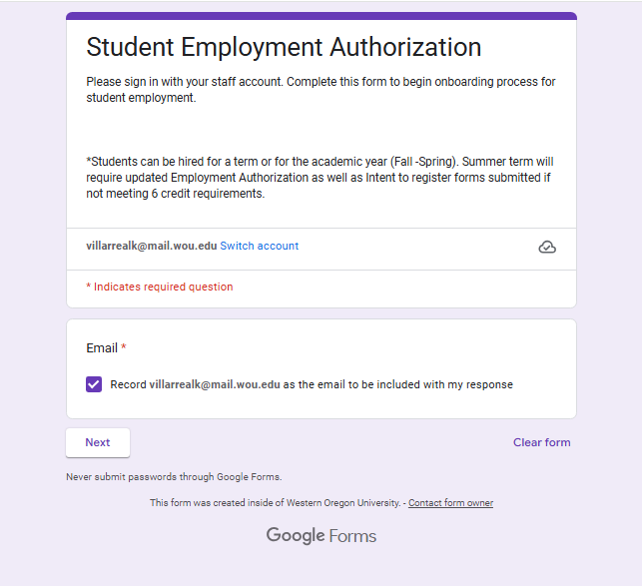
The automation process starts with a google form submission.
  Student Employment Authorization
  PDF for Overview
Information Needed to complete:
  Student Information
    Name, V#, WOU Email
  Supervisor Information
    Timesheet approver if different
  Position Information
    Start Date, title, pay rate, use of FWS, etc.
  Index to Charge

Slide 7
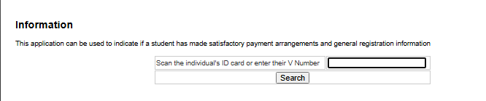
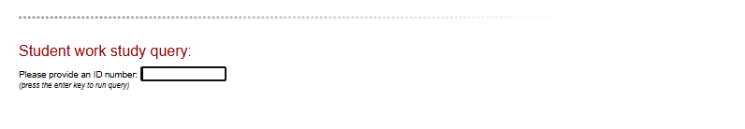
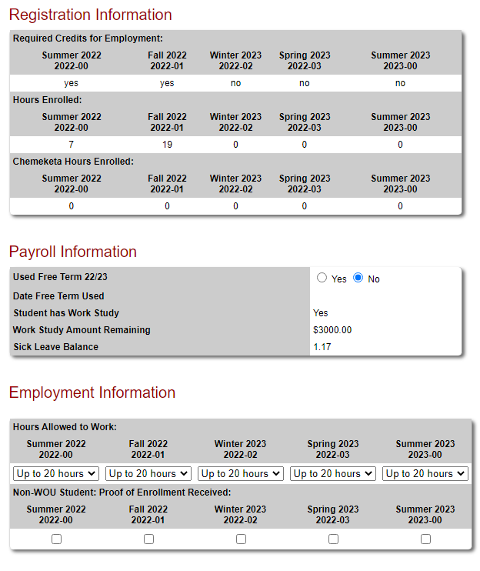
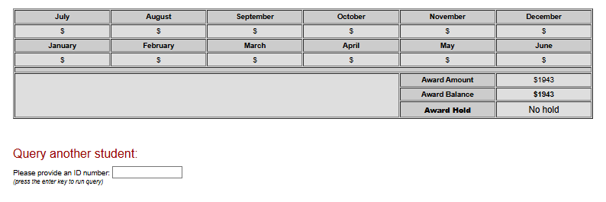
Supervisor Review for Student Employment (Portal Access Required)

Slide 8
Background Checks
Our office will continue to conduct Background checks internally.
Time frame depends on various factors:
  Submitting Student Employment Authorization
  Students completing Background check request approval
Background Check Emails include:
Notice | Secondary Review
Approval | Unmet Requirements

Slide 9
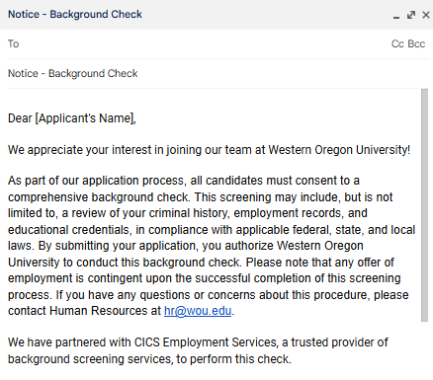
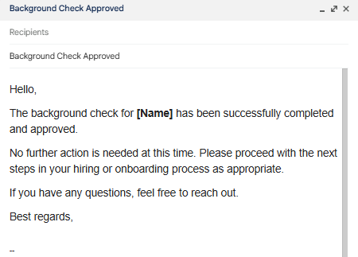
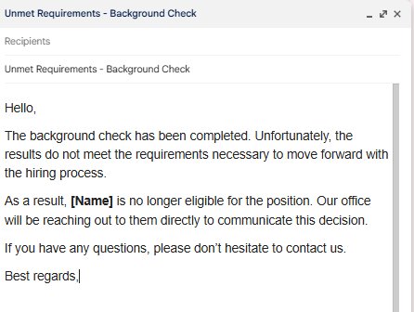
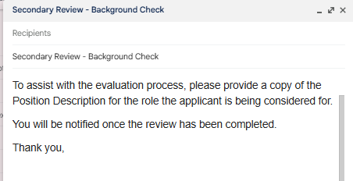
=
=

Slide 10
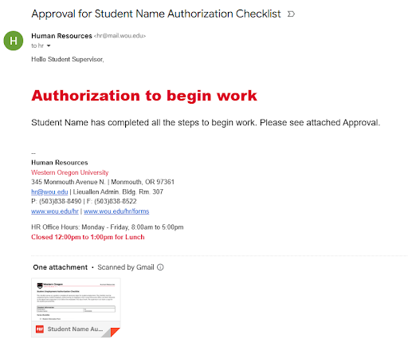
Student Authorization Emails
This email will replacing the stamped Authorization page.
Students are authorized to work on campus when HR emails the Approved Student Employment Authorization form stamped and signed by an HR representative to their supervisor.
Fully Approved
  Student Employment Authorization
  Background Check
  Student Paperwork Submitted

Slide 11
Student Employment
20 Hours per Week
Students are only allowed to work up to 20 hours per week.
  Exceptions granted by the the Student Affairs office
  International students CANNOT EXCEED 20 hours per week.

Slide 12

Oregon Sick Leave Law
1 hour of sick leave for every 30 hours worked.
May accrue up to 80 hours per fiscal year.
  Limit of 40 hours per fiscal year will roll over into the
next fiscal year.
Work study earnings are exempt from accruing sick leave.
Supervisors must establish protocols for students using sick leave.
Notes:
80 hours = 46 hours/week of work

Slide 13

Student Employment Practices
Accidents on the Job
Student employees, while working, are covered by SAIF
Injuries should be reported immediately to supervisors
Form 801: Student sees a doctor for their injury
Occupational Injury Form: Injury occurs but no outside treatment is sought

Slide 14
Federal rules
Federal Medical Leave Act (FMLA)
Guarantees an employee 12 weeks of unpaid job protected leave.
Students are considered eligible.
  Must have worked 1,250 hours in past 12 months (~24 hrs/wk).
Request Form completed
Michelle Sides can assist students with FMLA rules and usage.
  sidesm@wou.edu
Federal Insurance Contributions Act (FICA)
Social Security and Medicare.
Employee and Employer contributions.
Students taking 6+ credits (half time or more) are exempt from FICA taxes.

Slide 15
Accessibility & Accommodations
Student Employees with Disabilities can request workplace accommodations through the Human Resources Department.
Reach out to Emily Herb, Director of Faculty and Staff Access Services
herbe@mail.wou.edu or 541-231-5721
Fill out Forms
Reasonable Accommodation Request Form
Medical Provider Form – Accommodation Request Form

Slide 16
Web Time Entry - Overview
What is Web Time Entry?
What is changing?
  1) Pay Period
  2) Student Position Numbers
  3) Web Time Entry
  4) Communication to Payroll
What is NOT changing?
  Student employment practices (as discussed previously)
  35-Day Rule and Final Roster
Web Time Entry Functions/Example
  Submission / Approval Deadlines
  Proxy Function
  Clock - In / Clock - Out
  Selecting the correct position number
  Earn Codes
Resources
Troubleshooting

Slide 17
What is Web Time Entry?
Web Time Entry is the Banner timekeeping system that all of campus will begin utilizing on 09/16/2025.
It allows for employees to submit their timesheet / leave report 100% electronically.
Submitted time is automatically routed to the supervisor on record for approval.
The supervisor can review all time submitted and either 1) approve or 2) return the timesheet to the employee for correction.
Once the supervisor approves the timesheet / leave report, it is automatically routed to payroll and loaded to the next payroll cycle.

Slide 18
What is Changing?
Pay Period
  As of 09/16/2025, all employees will change to the 16-15th pay period. For example, time worked from 09/16 - 10/15 will be paid on October pay day.
Student Position Numbers
  Web Time Entry requires that each position number have a unique index and supervisor.
  Each student working in your department must be assigned the specific position number assigned to your department.
  All available student position numbers can be found here or via the HR Forms page under the New Student Employee Hire section

Slide 19
What is Changing? (Cont.)
Work-Study vs. Regular Student
  Each department has been assigned a regular student position (ends in “S”) and a work-study position (ends with “W”).
  If a student has accepted a fin. aid award package that included work-study, then they will be assigned both the “S” and “W” positions in your department. Only work-study hours should be recorded on the “W” position, as this correlates with the work-study 25/75 index split and 10503 acct. code.
Web Time Entry
  All employees will begin utilizing Web Time Entry on 09/16/2025.
  Students will need to clock in / out of Web Time Entry for each shift.
Communication to Payroll
  New Students & Terminating Students: If HR is not notified of new or terminating employees timely, then the positions available to record Web Time Entry on will not be accurate.
  Changes to Department Structure, Index, and Supervisors: If you have changes to the index or supervisor(s) for student positions, alert HR ASAP.

Slide 20
What is NOT Changing?
Student employment practices (as discussed previously)
  Web Time Entry changes how time is recorded and submitted to payroll. It does not change the nature of student employment.
35-Day Rule and Final Roster
  Web Time Entry only replaces the regular pay period roster that was submitted monthly for each department.
  In addition to student Web Time Entry hours supervisors will still need to submit a 35-Day Rule Roster/List and Final Roster as usual.
ALL time will be entered into Web Time Entry regardless if additional rosters are submitted.

Slide 21
Web Time Entry Functions
Submission / Approval Deadlines
  Employee: Submit by 16th at midnight
  Supervisor: Approve by 18th at midnight
Proxy Function
  If you anticipate you will be out and unable to approve time, you can assign a proxy approver who can approver on your behalf.
Clock - In / Clock - Out
  Students will clock-in / out for each shift.
Selecting the correct position number
  “W” - Work-Study
  “S” - Regular Student
Earn Codes
  Regular Student Pay, Rate 1
  Regular, Work-Study, Rate 1
  Oregon Sick Leave Taken
  Overtime Worked - Extra Pay

Slide 22
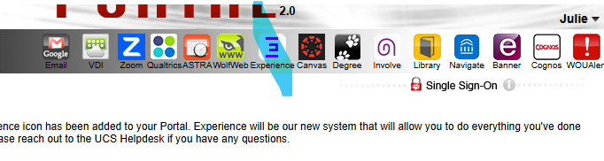
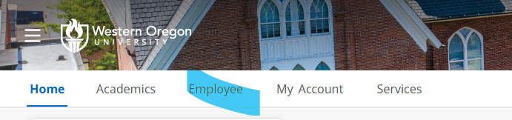
Web Time Entry Example - Student
Go to Portal and click on Experience icon
In Experience, click on Employee menu

Slide 23
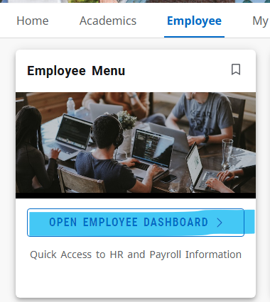
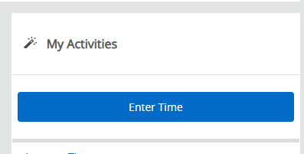
Web Time Entry Example - Student
3) Click “Open Employee Dashboard”
4) On Employee Dashboard click “Enter Time”

Slide 24
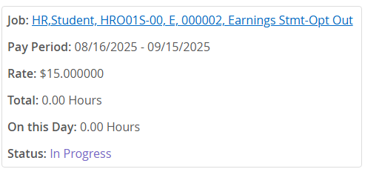
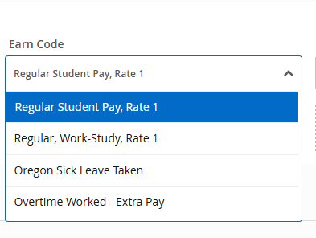
Web Time Entry Example - Student
5) A calendar will appear. Click on today.
6) A pop-up box will display all available positions for Web Time Entry. Click the applicable position.
7) Select the appropriate earn code from the drop-down.

Slide 25
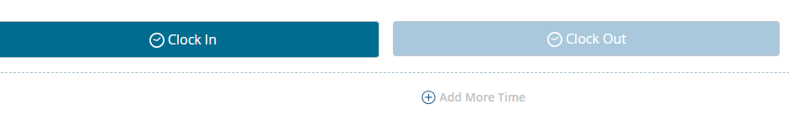
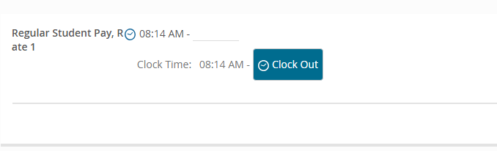
Web Time Entry Example - Student
8) Clock In

Slide 26
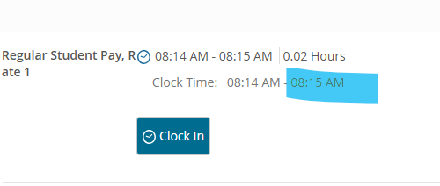
Web Time Entry Example - Student
9) Clock Out

Slide 27
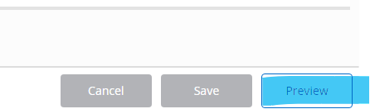
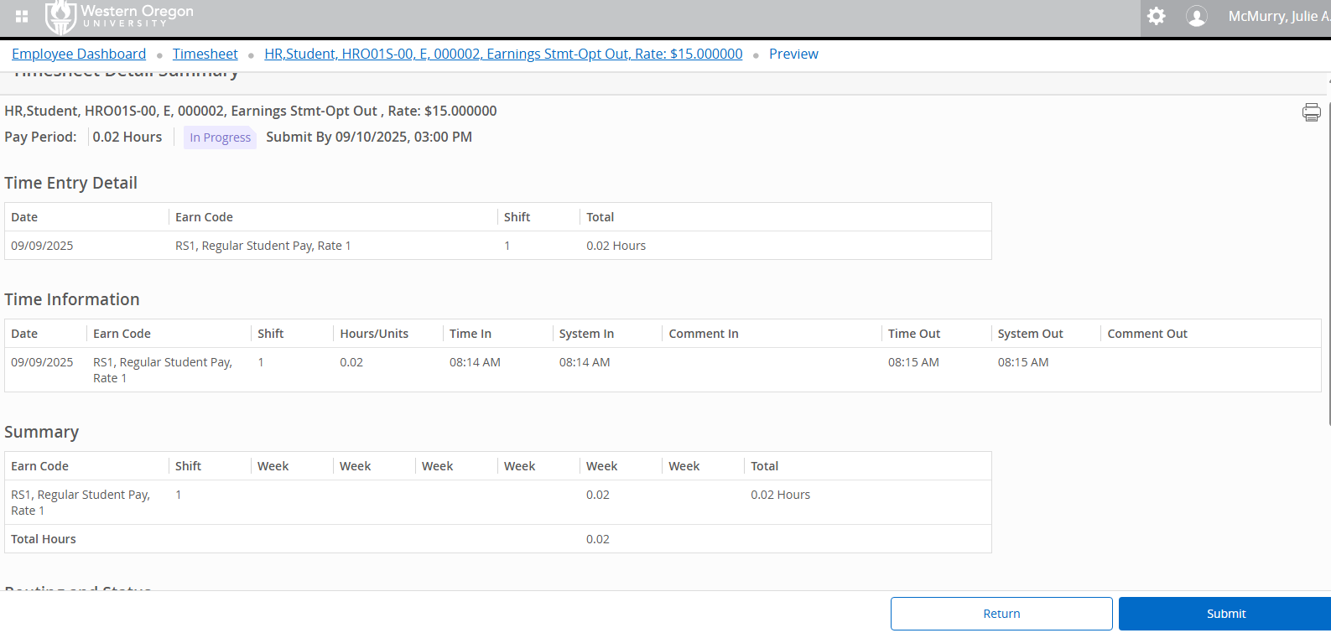
Web Time Entry Example - Student
10) At the end of the pay period, click Preview.
11) Review your time for the pay period. If accurate, click “Submit”. This will route your timesheet to the supervisor for approval.

Slide 28
Web Time Entry Example - Supervisor
Go to Portal and click on Experience icon
In Experience, click on Employee menu

Slide 29
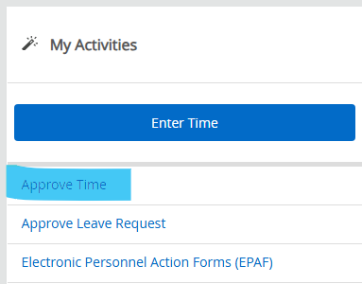
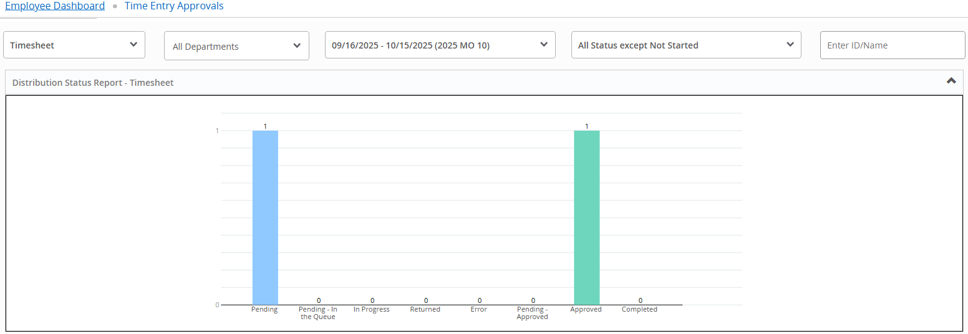
Web Time Entry Resources - Supervisor
3) Select “Approve Time”
4) Review your dashboard. “Pending” means it is ready for your review/approval.
5) Click on the “Pending” column

Slide 30
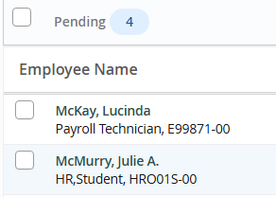
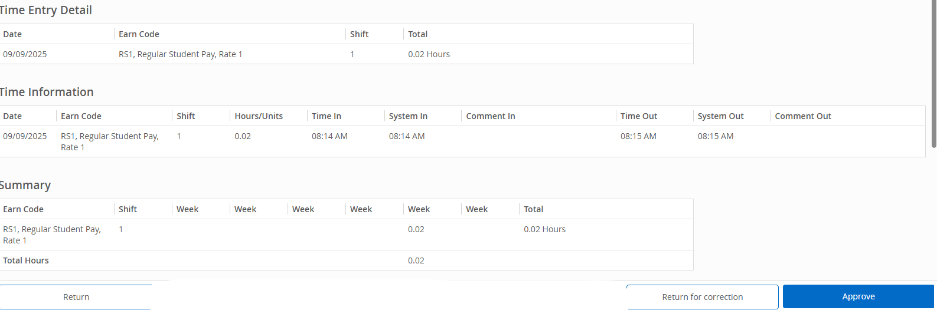
Web Time Entry Resources - Supervisor
6) Select a timesheet.
7) Review the timesheet for accuracy, and either Approve or Return for Correction.

Slide 31
Web Time Entry Resources
All trainings, FAQs, actions/shortcuts, submission timing, common errors/solutions and more can be found at the WOU Web Time Entry website.
We highly recommend that all employees visit this site to familiarize themselves with Web Time Entry.

Slide 32
Web Time Entry Troubleshooting
What if my student doesn’t have the needed position number available on Web Time Entry?
  They need a position set-up in NBAJOBS. Make sure to submit Student Employment Authorization for that position & contact hr@wou.edu.
What if my student received the wrong pay?
  Their pay needs to be reviewed. Contact Sharon.
What is the timesheet is routing to the wrong supervisor?
  The position needs to be updated. Contact payroll@wou.edu.
Missed clock-in/out.
  If a student misses a clock-in or clock-out, they can go back to the missed entry and enter the time by hand. Web Time will require a comment/reason for any hand-entered time.

Slide 33
Paying Student Employees
Students are paid monthly on the last business day of the month
  Pay period is 16th of the prior month – 15th of the current month. This is a change that is effective 09/16/2025.
Other than 35-day rule and Final rosters, all pay for students will be submitted by students, approved by supervisors, and loaded to payroll via Web Time Entry.

Slide 34
Paying Student Employees
Student overtime (> 40 hrs/wk) is paid at one and one-half times the normal rate. Ensure student knows when they are working overtime and have them record it on Web Time Entry.
  Students can only work up to 40 hrs/wk during school breaks.
Federal Work Study (FWS) can be used to pay students. Ensure that students know when they are utilizing work-study.
  Web Time Entry: All hours for work-study should be logged on Web Time Entry using the Work-Study Earn Code on the Work-Study position (ends in “W”)
  Student must have received work study in Financial Aid package. Check Student Employment Verification page.
  Department must have Work Study budget distributed by Financial Aid.
  Students paid using work study funds cannot use sick leave charged to FWS funds. Sick leave must be charged to another department account code (not 10503).
Departments are not required to offer pay increases.

Slide 35
Student Pay Cycle - September Hires
Hire Date | Student Action | Supervisor Action | September Pay Date/ Receipt Method | October Pay/ Receipt Method
Prior to 09/10 | As of 09/16, begin to record time in Web Time Entry | September: Submit September Pay Roster for hours worked from 08/11-09/15 October: Approve September/October timesheet by 10/18 at midnight | Last Business Day of September via Direct Deposit (8/11-9/15) | Last Business Day of October via Direct Deposit (9/16- 10/15)
09/11 - 09/25 | As of 09/16, begin to record time in Web Time Entry | September: Submit 35-Day Rule roster for hours worked from 09/11-09/25 October: Approve September/October timesheet by 10/18 at midnight | By October 10th via Manual Check (Hire-9/25) | Last Business Day of October via Manual Check (9/26-10/15)
If a student is new to your department but has worked in another department the prior month (August) a 35 Day Rule Roster/List is not needed. They will be paid out through the regular payroll cycle.

Slide 36
Reminders for Student Rosters
PLEASE…
Double check the date, department, contact at the top of the roster is current
Make sure that there are no frozen rows and that all students are on the spreadsheet
Double check V#’s
Use legal names. No nicknames or preferred names.
Double-check Work Study balances.
Verify sick leave when applicable.
Enter "SICK" for Sick Leave in Earn Code column on a line separate from regular hours.
All hours should be on one spreadsheet. Do not use multiple tabs in the same spreadsheet.
Please email your roster to payrollrosters@wou.edu
Notes:
Please do not drag the V# as this changes the last digit and causes issues
A student's sick leave rate is identical to hourly rate for the shift they missed due to illness.
Make sure the student has funds to use.
Please only enter SICK in Earn Code.

Slide 37
Departing or Terminating Students
Students are considered “at-will” employees.
  Subject to termination with or without cause at the discretion of WOU or the employee.
  Documentation must be maintained in the student’s personnel file specifying the business reason for termination.
Students separating from WOU due to medical withdrawal may continue working through the end of the term of withdrawal.
If a student resigns or is terminated, a final roster must be submitted ASAP.
  Terminated = check is due on last day.
  Student resigns < 48 hours notice = check due within five (5) business days.
  Student resigns > 48 hours notice = check due on last day.

Slide 38

Question & Answer

Slide 39
Future Training/ Development
General Overview - Student Supervisor Training
September 23rd @3:20 pm - 3:50 pm in RWC 201
Invitations will be sent out over email.

