Slide 1

NWCCU ACCREDITATION
UPDATE: Preparing for upcoming reviews
Faculty Senate
November 24, 2020

Slide 2

2022: Year Six: Policies, Regulations, and Financial Review
All the elements in Standard 2 of the NWCCU 2020 Standards: The inputs and infrastructure that support our mission
Governance, Academic Freedom, Policies & Procedures, Institutional Integrity
Financial Resources
Human Resources, Student Support Resources, Library & Information Resources, Physical and Technology Infrastructure
Remote review: If issues are identified, an area expert will follow-up in our Year Seven review in 2023

Slide 3
2023: Seven Year Evaluation of Institutional Effectiveness
Student Success, Institutional Mission and Effectiveness
Mission
Improving Institutional Effectiveness
  Goals, objectives, indicators related to student success and academic excellence

Slide 5
2023: Seven Year Evaluation of Institutional Effectiveness
Student Success, Institutional Mission and Effectiveness
Mission
Improving Institutional Effectiveness
  Goals, objectives, indicators related to student success and academic excellence
  Evidence of assessment & continuous improvement as an institution-wide practice
  Evaluation and participatory planning to allocate resources in support of student learning and achievement

Slide 6
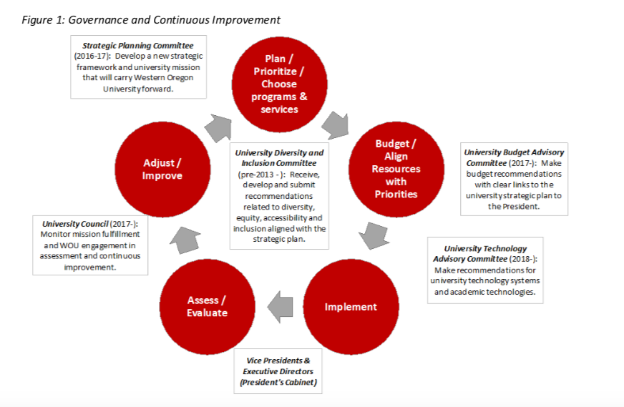

Slide 7
Student Learning – Evidence of:
  appropriate content and rigor for degree designations and disciplines and of identified and published programmatic and student learning outcomes demonstrating appropriate breadth, depth, sequencing and synthesis of learning for programs.
  admissions and graduation requirements widely published and easily accessible.
  an effective system of assessment of student learning in programs with faculty establishing curricula, assessing student learning, and improving instructional programs.
  institutional level outcomes, core competencies, or General Education curriculum for undergraduate programs.
  the use of assessment efforts to inform planning and practices, and to continuously improve student learning outcomes.
  published and easily accessible transfer of credit and credit for prior learning policies to safeguard academic quality.
  distinction of graduate programs from undergraduate programs in depth of study, creative or intellectual capacity, knowledge of field, and student engagement in research, scholarship, creative expression, and/or relevant professional practice.

Slide 8
Student Achievement – Evidence of
  recruitment and admission of students with the potential to benefit, along with orientation for students sharing academic requirements and policies.
  established and widely shared student achievement indicators disaggregated in meaningful categories for the purpose of promoting continuous improvement in student achievement and closing barriers to academic excellence and success (equity gaps)…
  …in comparison with regional and national peer institutions.
  transparent processes and methodologies for collecting and analyzing indicators of student achievement to inform and implement strategies to mitigate perceived gaps in achievement and equity.

Slide 9
Criteria for comparators
Public
Masters colleges and universities
Undergraduate array is a mix of professional and arts/sciences, with some graduate overlap
High or very high undergraduate emphasis
Between 1000 and 9999 students
Undergraduate acceptance rate between 79% and 89% (WOU was 84%)
Core revenues between $70m and $120m (WOU was $95m in 2018)
Percent Pell Eligible (+ 12 percentage points, WOU was 43% in 2018)

Slide 10
Public Masters Regional Comprehensives
(n=256, Carnegie Basic code = 18, 19, 20)
Select for undergraduate instructional programs and enrollment profile
Arts & Sciences + Professional
(n=225)
(Code = 10, 13, 16)
High or very high undergraduate
(n=214)
(Code = 3 or 4)
WOU is in “2” (1000-4999) but we aspire to be in “3” (5000-9999), leaving us with 149 potential peers.

Slide 11
149 public, regional, masters-granting universities, with between 1,000 and 9,999 students, and high/very high undergraduate service, Arts & Science/Professional program array
Acceptance rate of 79-89%
(n= 41)
(+ 5 percentage points from WOU’s 84% rate)

Slide 12
Core revenues between $70m and $120m (WOU = $95m in 2018) and Pell (+ 12 percentage points, 31% - 55%): n = 17
Arizona State University-West
Arizona State University-Polytechnic
Indiana University-South Bend
Plymouth State University
University of Washington-Bothell Campus
University of Washington-Tacoma Campus
Emporia State University
University of Wisconsin-Green Bay
Longwood University
Western Oregon University
Edinboro University of Pennsylvania
Northwest Missouri State University
Westfield State University
East Stroudsburg University of Pennsylvania
Shippensburg University of Pennsylvania
Colorado Mesa University
Western Connecticut State University

Slide 13
Comparators when Pell range is narrowed to 37%-55%
Shippensburg University of Pennsylvania
Northwest Missouri State University
Colorado Mesa University
Emporia State University
Edinboro University of Pennsylvania
East Stroudsburg University of Pennsylvania
University of Washington-Tacoma Campus
AND
add Oregon regional peers:
Southern Oregon University
Eastern Oregon University
Add one more peer from the west (from list of 17):
Arizona State University-West

Slide 14
Ten Comparators Proposed
Shippensburg University of Pennsylvania
Northwest Missouri State University
Colorado Mesa University
Emporia State University
Edinboro University of Pennsylvania
East Stroudsburg University of Pennsylvania
University of Washington-Tacoma Campus
Southern Oregon University
Eastern Oregon University
Arizona State University-West

Slide 15
NWCCU standards: https://www.nwccu.org/accreditation/standards-policies/standards/
NWCCU Teach-Out Policy: https://www.nwccu.org/wp-content/uploads/2017/05/Teach-Out-Plans-and-Teach-Out-Agreements-Policy.pdf
Notes:
Mr Bill

