Slide 1
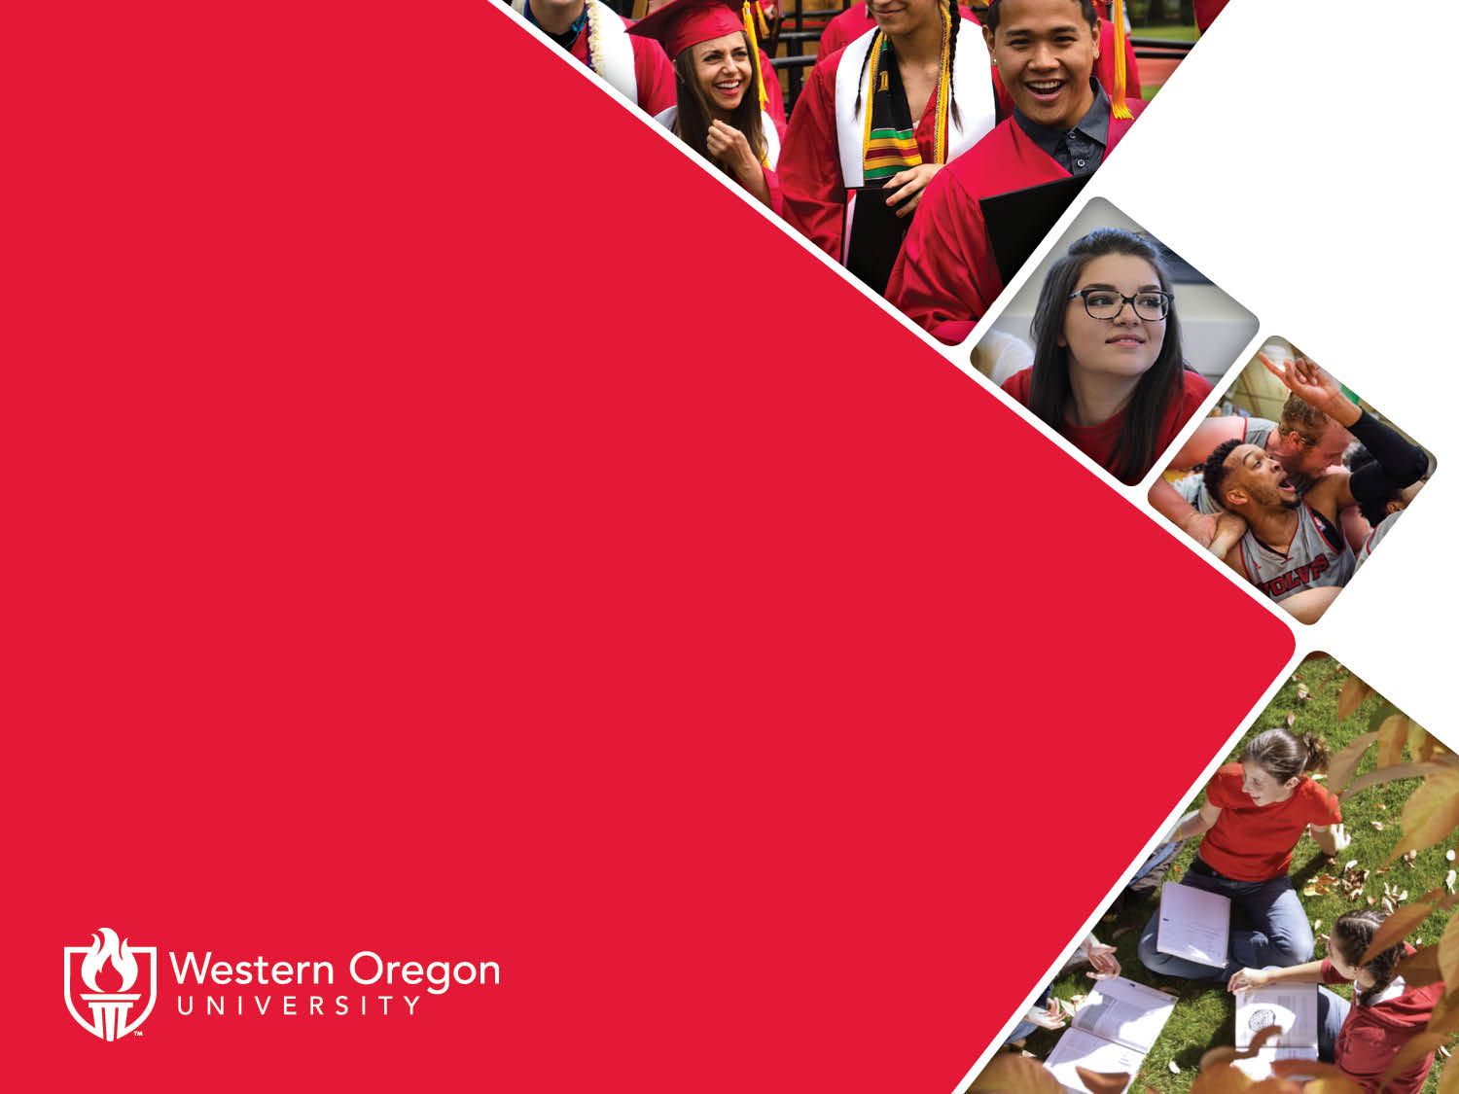
Proposed New Graduate Programs in the Criminal Justice Sciences Division
Vivian Djokotoe | Misty Weitzel | Taryn VanderPyl

Slide 2

Proposed New Graduate Programs
Graduate Certificate in Advanced Juvenile Justice Studies
Graduate Certificate in Social Justice
Master of Science in Justice Studies

Slide 3

Graduate Certificate in Advanced Juvenile Justice Studies
Provides students with advanced knowledge of research, theory, and practice that addresses challenges with youth, family, and community impacted by delinquent behavior and the juvenile justice system.

Slide 4
Motivation
As practices in juvenile justice progress to include trauma-informed care, alternatives to incarceration, and restorative justice, practitioners are requiring more education and training. The Bureau of Labor Statistics and the State of Oregon Department of Employment reflect this change in approach to working with youth in that positions for correctional officers (e.g., guards) are declining while careers for behavioral counselors, probation and parole officers, and those who are trained to work with youth in settings beyond incarceration are increasing in demand.
Students will be prepared to advance in their existing careers or begin anew in the field of juvenile justice. Careers in this field may be in juvenile corrections facilities, parole and probation, mentorship, advocacy, community organizations, gang interventions and suppression, and more. In addition, completion of this certificate will allow students to enter either the Master of Arts in Criminal Justice or the proposed Master of Science in Justice Studies at WOU to complete their graduate degree in just one additional year if they should so choose.

Slide 5

Program Outcomes
Explore the complexities of youth as a unique group of offenders with separate needs within the criminal justice system.
Understand the immediate and long-term effects of justice system involvement on youth, families, and communities.
Critically evaluate and analyze methods of responding to delinquent behavior and youth crime in the juvenile and criminal justice systems.
Dissect the causes and consequences of youth crime and evidence-based practices for addressing delinquency and offending.

Slide 6

Required Courses (28 credits)
CJ 612 Research in Criminal Justice (4)*†
CJ 618 Theory of Criminal Law (4)†
CJ 660 Advanced Theory and Research in Crime and Delinquency (4)†
CJ 653 Advanced Theories and Models in Corrections (4)†
CJ 551 Youth Crime & Society (4)
CJ 563 Topics on Juvenile Issues (4)
CJ 656 Contemporary Issues in Criminal Justice (4)†
Alternative to CJ 656: CJ 609 Practicum (for those with no field experience) (4)
*Also required in Graduate Certificate in Social Justice and Master of Science in Justice Studies
†Also required or is an elective in Master of Arts in Criminal
Justice

Slide 7

Graduate Certificate in Social Justice
Provides students with in-depth knowledge of complex social challenges and tools for addressing issues in social justice through research, theory, organizing, and affecting change.

Slide 8
Motivation
This graduate certificate is timely in light of recent events including nationwide and global protests concerning police brutality, white supremacy, and systems of oppression. Student interest in how to address these topics and make substantive and lasting change is peaked. The graduate certificate is being proposed alongside a new master’s program as a faster route for students not seeking a full master’s degree and those who want to earn an accommodation in a shorter time frame.
The certificate program will be deliverable fully online, making it accessible to a wider and more diverse student population. Students in the certificate program will learn from experienced faculty not only in courses, but by participating in research and in community action opportunities. The Criminal Justice Sciences Division has a history of partnering with multiple state and community organizations to enhance our students’ experience through hands-on learning to the benefit of the community. Taking action to better society is at the heart of the certificate program and can only be learned by doing.

Slide 9

Program Outcomes
Gain knowledge of complex social justice issues and how different systems interact around and within these realms.
Analyze interdisciplinary theories and approaches to complex social justice challenges and concerns.
Examine strategies for addressing complex social justice issues through activism, policy, practice, and intervention.

Slide 10
Required Courses (28 credits)
CJ 612 Research Methods in Criminal Justice (4)*†
CJ 627 Quantitative Methods in Social Science (4)*†
JS 658 Justice and Social Theory (4)^
JS 659 Social Problems (4) ^
JS 628 Justice Organizations, Ethics, and Change (4) ^
JS 629 Social Movement, Community Organizing, and Social Justice (4) ^
CJ 545 Race and the Justice System (4) or JS 655 Convict Criminology (4) ^
*Also required in Graduate Certificate in Advanced Juvenile Justice Studies and Master of Science in Justice Studies
†Also required or is an elective in Master of Arts in Criminal
Justice
^Also required or is an elective in Master of Science in Justice Studies

Slide 11
Master of Science in Justice Studies
The MSJS provides an interdisciplinary approach to social justice issues (both including and beyond criminal justice) for students who wish to focus on advocacy, policy, and research in the administration of justice.
Students will learn strategies for conducting consequential research, evaluating and shaping policies and practices, and seeking and affecting change by addressing complex social challenges.
The curriculum will expose students to a variety of social justice components and issues, while helping them progress toward scholarly work that allows them to focus on their individual areas of concern and passion.

Slide 12
Motivation For The Program
The MSJS is for students who wish focus on advocacy, policy, and research in the administration of justice. This new degree broadens the current Criminal Justice Sciences Division’s graduate program offerings to meet the diverse and evolving needs of students. CJS currently offers the Master of Arts in Criminal Justice which emphasizes criminal justice in the applied areas of the administration of justice and crime control. The MSJS, on the other hand, will allow us to appeal to those who plan to be activists, and change agents seeking to positively impact various social justice arenas. Students will learn strategies for conducting consequential research, evaluating and shaping policies and practices, and seeking and affecting change by addressing complex social challenges.
Interdisciplinary curriculum in criminal justice, sociology, and political science will expose students to a variety of social justice components and issues, while helping them progress toward scholarly work that allows them to focus on their individual areas of concern and passion. Students will be prepared for careers in community organizing and advocacy, criminal justice, research and policy centers, NGOs, public and private agencies, nonprofit leadership, and to enter doctoral programs. Students will gain hands-on, advanced research, theoretical, and practical skills and experience working alongside scholars in social justice agencies.

Slide 13
Market Demand
In 2010, the president of the Academy of Criminal Justice Studies called for the advancement and broadening of the discipline of criminal justice and criminology. “By complementing criminology and criminal justice with Justice Studies, we include the other explanations needed (political, economic, legal, administrative, etc.) to address the relevant issues within our discipline.”
As higher education becomes more interdisciplinary in nature to meet the demands of an ever-evolving job market, a student body that expects and deserves a high-quality and valuable education, and institutions become increasingly financially strained, the MSJS program meets needs across several areas.
This program is also especially timely in light of recent events including nationwide and global protests concerning police brutality, white supremacy, and systems of oppression. Student interest in how to address these topics and make substantive and lasting change is peaked.

Slide 14
Feedback From The Community
Oregon Department of Corrections
Oregon Youth Authority
FBI Portland Office
National Crime Victim Law Institute
Lewis and Clark Law School
Oregon Justice Resource Center
Youth Justice Initiative
Light My Way Ministry and Reentry Program
CREATE Programs
Resolutions Northwest
Partnership for Safety and Justice
Multnomah County Probation and Parole
Washington County Community Corrections
Washington County District Attorney
Washington County Sheriff’s Office Jail and Patrol
Washington County Drug Court

Slide 15
Program Outcomes
Gain knowledge of complex social justice issues and how different systems interact around and within these realms.
Analyze interdisciplinary theories and approaches to complex social justice challenges and concerns.
Employ appropriate methods of social science research to investigate targeted problems and questions of justice.
Demonstrate an understanding of strategies for addressing complex social justice issues through activism, policy, practice, and intervention.

Slide 16
Core Courses (25 credits)
CJ 608 Workshop (1)^
CJ 612 Research Methods in Criminal Justice (4)*†^
CJ 627 Quantitative Methods in Social Science (4)†^
JS 658 Justice and Social Theory (4)†
JS 659 Social Problems (4)†
JS 628 Justice Organizations, Ethics, and Change (4)†
JS 629 Social Movement, Community Organizing, and Social Justice (4)†
*Also required in Graduate Certificate in Advanced Juvenile Justice Studies
†Also required in Graduate Certificate in Social Justice
^Also required or is an elective in Master of Science in Justice Studies

Slide 17
Elective Courses (8 credits)
JS 655 Convict Criminology (4)
CJ 544 Restorative Justice (4)
PS 594 Human Rights (PS 494) (4)
PS 579 Constitutional Law (4)
SOC 515 Social Stratification and Inequality (4)
SOC 554 Sociology of Deviant Behavior (4)
CJ 545 Race and the Justice System (4)
SOC 507 Prison Policies in Latin America: Comparative Perspectives (4)
SOC 509 Latinx Mentor Program (4)

Slide 18
Capstone Series (12 credits)
CJ 623 Program Evaluation in Criminal Justice - Capstone Part I (4)
CJ 624 Applied Research in Criminal Justice - Capstone Part II (4)
CJ 625 Research Writing in Criminal Justice - Capstone Part III (4)
Total program: 45 credits
All these courses are also required in the Master of Arts in Criminal Justice.

Slide 19
Similar Programs
All the public Oregon universities have at least one undergraduate program that will prepare students to continue their education in the MSJS program at WOU. Of the seven state universities, only two offer related graduate programs, however none of these programs directly compete or compare with the MSJS.
Portland State University offers master’s degrees in Conflict Resolution, Criminology and Criminal Justice, Nonprofit Leadership, and Social Work, a master’s or doctorate in Urban Studies, as well as a doctorate in Social Work and Social Research. Each of these degrees covers some aspect that is also addressed in the new MSJS program, but none directly compete. Further, graduates of the MSJS program could consider continuing their education by earning doctorates in Social Work and Social Research or Urban Studies.
University of Oregon offers master’s degrees in Conflict and Dispute Resolution or Nonprofit Management, and a doctorate in Critical and Sociocultural Studies in Education. As with PSU, these programs cover some aspects of what is addressed in MSJS, but do not directly compete.

Slide 20
Meeting Statewide Needs
The MSJS program will be deliverable fully online, making it accessible to a wider and more diverse student population.
Students in the MSJS program will learn from experienced faculty not only in courses, but by participating in research and in community action opportunities. The Criminal Justice Sciences Division has a history of partnering with multiple state and community organizations to enhance our students’ experience through hands-on learning to the benefit of the community.
Taking action to better society is at the heart of the MSJS program and can only be learned by doing.

Slide 21
Supporting the University’s Mission
WOU’s Vision
Adapting to the changing world through continuous institutional improvement, evolving pedagogies, and expertise, sustained
scholarly and creative activities, and delivery of critical and innovative programs.
Challenging students, faculty and staff to grow profoundly through inspiring, thought-provoking educational experiences.
Connecting students with communities through engagement in service, experiential learning, creative problem-solving opportunities and co-curricular collaborations.
WOU’s Values
Accessibility (program all available online)
Collaboration (cooperative exploration via interdisciplinary curriculum)
Community (cultivation of peace, civility, and social justice; connections extending beyond the classroom, across campus and into our local and global communities)
Diversity and Respect (equity and inclusion, appreciation for the complexity of the world)
Empowerment (critical thinking and strategies for application of theory to practice)
Excellence (co-curricular activities, advancement of knowledge, analytical skills, creativity and innovation)
Sustainability and Stewardship (leadership in service of the public good, responsibility for preserving and enhancing the natural, structural, financial, intellectual, and human resources entrusted to us)
WOU’s Purpose
The knowledge and abilities cultivated in our graduate programs meet compelling needs for work, service and leadership beyond our campus.
WOU’s Institutional Priorities
Student success
  1.3 Strengthen programs that support graduates’ career, professional, and graduate school preparedness
Academic excellence
  Academic program initiatives
    4.4 Promote interdisciplinary courses and degree programs that support collaborative and multidimensional educational experiences and pathways
    5.2 Create opportunities for all graduate programs to include high-impact activities that support attainment of graduate learning outcomes
Community engagement
  2.6 Strengthen partnerships with community organizations and businesses and local, regional and state government agencies
  3.1 Expand activities and partnership with local and regional organizations

Slide 22
Implementation
No additional faculty FTE or resources needed.
Existing facilities and LMS are appropriate for this program.
WOU already has the facilities, library, and other resources in place to fully support the courses offered.

Slide 23
Any questions?

