Slide 1

Articulation Manual
Faculty Senate Presentation
Amy Clark and Kristin M. Mauro, Ph.D.
March 12, 2019

Slide 2
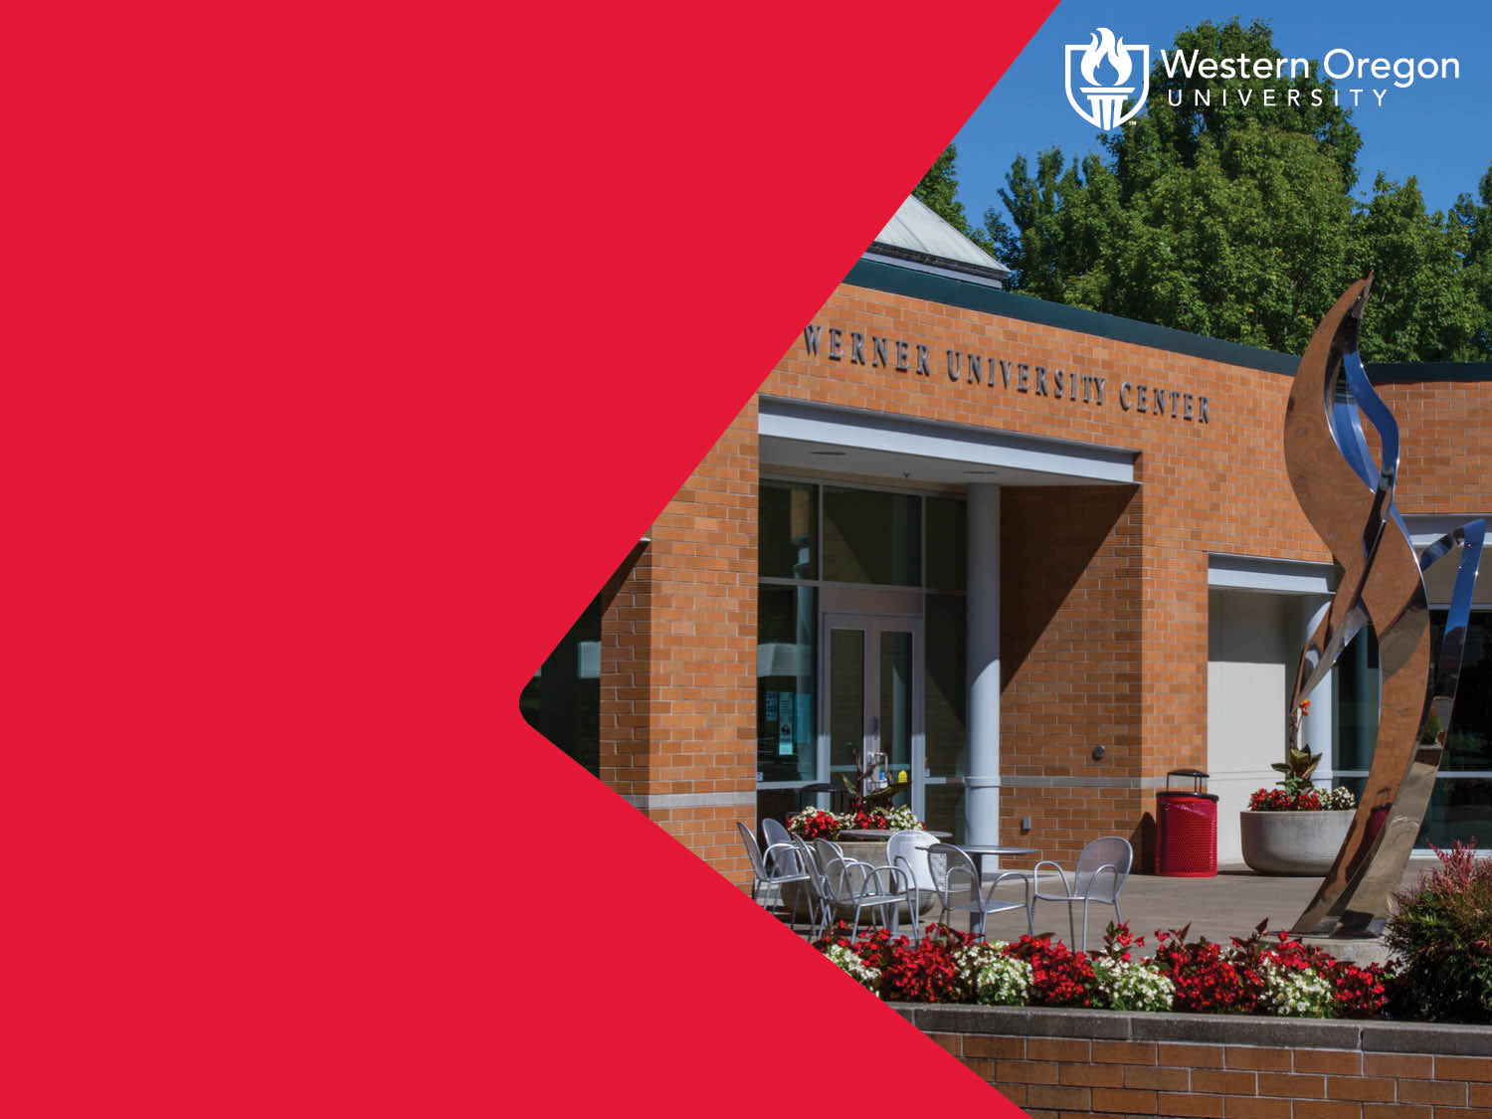
Why and How to Use It

Slide 3

Why Use the Manual
Western is committed to maintaining a well-designed, effective process for developing and implementing articulation pathways with two and four year institutions to ensure an orderly transfer of academic credit for the students that we serve.
Western solicits partnerships and articulation opportunities that will improve student success and increase their access to advanced educational opportunities.

Slide 4

How to Use the Manual
Process Overview:
Primary Considerations
Development of Agreement in collaboration with Dr. Mauro
Content Development
Initial Notice of Intent
Approval
Communicate/Disseminate
Promotion/Marketing
Regular Review
Agreement Renewal
Notes:
The first stage in the process is to assess how the agreement aligns with the institution’s guiding principles for creating new agreements.
Proposals that are not in alignment with the guiding principles may not become approved, implemented agreements. Proper consultation with all impacted departments is a prerequisite requirement before initiating any agreement.
The second stage is the Agreement development stage and consultation with the University Transfer Specialist is recommended.
I function as the coordinator of considerations around articulation agreements and ensure that everyone is on the same page before an agreement is initiated.
The third stage is Content development. This stage is to ensure quality and consistency of agreements, the following areas should be addressed in all articulation agreements into which Western Oregon University enters.
Stage four is the submission of the Initial Notice of Intent to the University Transfer Specialist. The request for an articulation agreement may be generated from either an internal (WOU curriculum team, department or division) or external (originating from another institution) source.
Regardless of the origin of the agreement, all requests to initiate developments of transfer agreements must be communicated in writing, via the “Notice of Intent” form, to the Transfer Specialist. The Department Head/Program Coordinator, Division chair, or Dean’s office will generate the request of the "Notice of Intent" (Appendix C of the Articulation Manual) to the University Transfer Specialist.
Stage 5 is the approval stage. After the agreement is finalized, signatures and copies will be made in accordance with the procedure laid out for the type of agreement being established (see appropriate checklist, appendix A- Course-to-Course or Program-to-Program or appendix B- Administrative). NOTE: applicable agreements are not valid until the Partner Institution has returned a signed copy to WOU. Upon receipt of the signed copy from the applicable partner, implementation will be as scheduled or in the next feasible term, depending on the nature of the agreement.
Stage 6 is the communicate/disseminate stage. Following approval by obtaining the appropriate signatures, the original agreement is archived, in the Provost’s office repository, by the University Transfer Specialist and posted to the WOU Transfer Resources website. Course Articulation Agreements and Degree maps are also posted to the Transfer Resources website (http://www.wou.edu/transferresources/articulation-manual/). The University Transfer Specialist will notify and provide copies to the appropriate parties as outlined in the manual.
Stage 7 is the Promotion/Marketing stage. Relevant departments/divisions will coordinate promotion and marketing of transfer articulation agreements to students in several ways:
● Inform academic advisors and curriculum teams of new agreements at departmental meetings, and/or training sessions.
● Ensure that Course Articulation Agreements and degree maps are posted on the WOU website by the University Transfer Specialist.
● Consider, in coordination with MarCom, other printed venues to promote agreements, (e.g., brochure, college catalog, etc., and appropriate websites.
Stage 8 is the Regular Review stage. Curriculum changes initiated by WOU must be communicated to and resulting changes coordinated with the Partner Institution. Likewise Partner Institutions must communicate and coordinate with WOU upon initiating curricular changes that impact agreements. The University Transfer Specialist and the Registrar may prompt departments to do an annual or bi-annual review with the transfer institution.
Any revisions to the program transfer agreement will be reviewed and approved by:
● Program representatives,
● Office of the appropriate dean.
● President and VP, Finance (If applicable) Please keep in mind the impact academic curriculum changes have on Articulation Agreements.
If a curriculum change will affect an Articulation Agreement, the department initiating the Articulation Agreement will need to connect with community colleges and those individuals/units to ensure that changes are communicated. Each reviewed Articulation Agreement will be dated to reflect the date of the review and to assist in maintaining the most current agreements.
Stage 9 is the Agreement Renewal Stage. Articulation agreements typically expire after three years.
One year prior to expiration, the University Transfer Specialist will notify departments that an agreement is about to expire. At this time, the department works with the Partner Institution to review and revise the Articulation Agreement as appropriate. Departments update (as needed) the Articulation Agreement form, the Course Articulation Agreement and Degree Map.
All updated forms are submitted for review and approval following the standard process found in Appendix C.
All of this information can be found on pages 8-12 of the Articulation Manual.

Slide 5

Unsure of the Agreement Types
The Table on Pages 6 & 7 of the Articulation Manual explain which types of agreements exist.

Slide 6

Most Important
Individual Western schools/colleges are not authorized to enter into an articulation, degree partnership agreement or reverse transfer agreement without Provost approval.
Agreements are only valid if they are executed by persons authorized to bind the Party (Western) in contract. The three people who are authorized to do so are the University President, VP Finance, or VP/General Counsel.

Slide 7

Questions or Assistance?
Please contact Kristin Mauro at maurok@wou.edu
Thank you!

Slide 8

SUBTITLE: ARIAL BOLD/REGULAR
Body copy in Arial, use normal sentence case.
Bullet list
Bullet one
Bullet two
Bullet three

