Slide 1

AB in Liberal Studies
New Program Proposal

Slide 2
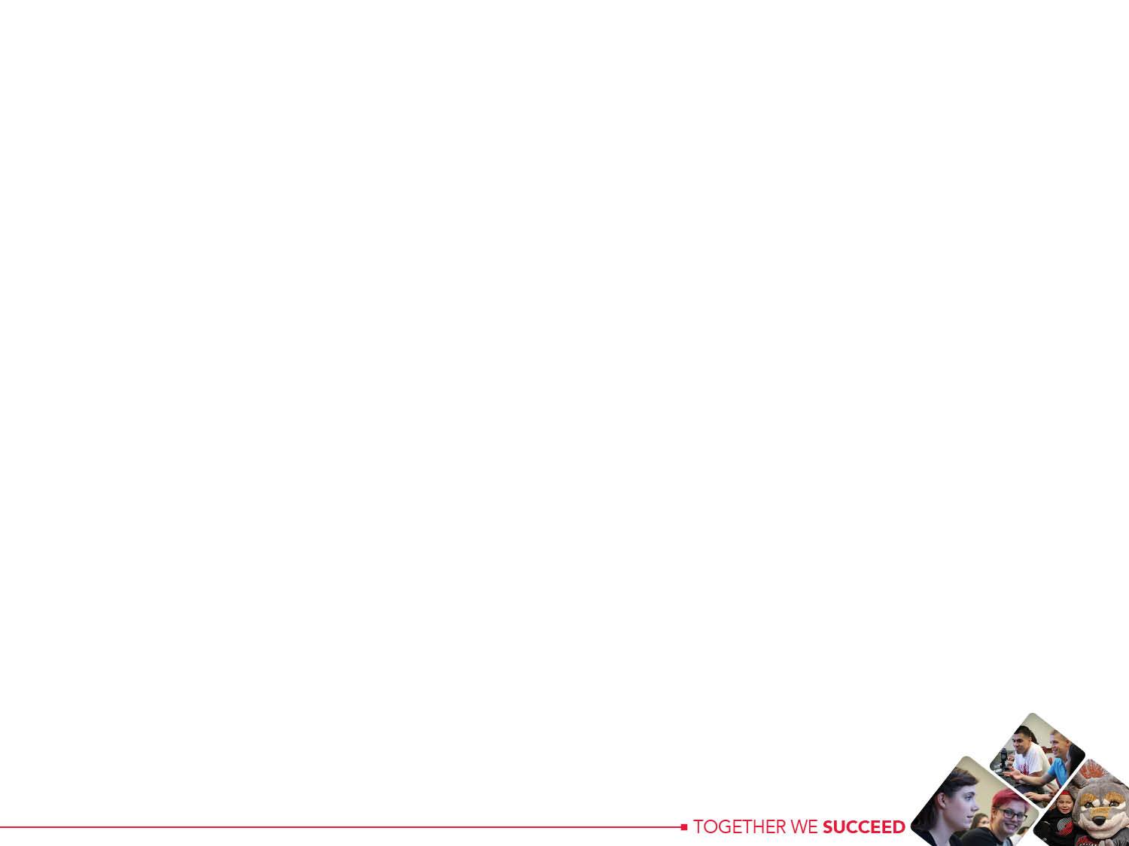
NEED: WHO and WHY?
Working adults with a career-related Associate’s degree
A.A.S. in Health Records Management, Horticulture, Law Enforcement, Business Technology, Process Control, etc
In 2015-16, almost 4000 AAS (or equivalent) degrees were granted at WOU’s seven largest feeder community colleges
In 2015-16, almost 500 AAS (or equivalent) degrees were awarded at Chemeketa
AAS students face barriers to completion of a 4-year degree
Already have a career-related specialization
To earn a traditional 4-year degree, they need (lower-division) general education, a major, upper division credits
In many ways, AAS degree holders start over to earn a 4-year degree

Slide 3
While also:
US High School Graduates, 1976-2026
(Data aggregated by WICHE, Knocking on the College Door, 2016)
After 20 years of rapid growth (from 1990-2010), number of high school graduates has hit a plateau nationwide.

Slide 4
DEVELOPMENT: HOW?
March 3, 2017 Faculty Retreat on Transfer
An interdisciplinary faculty group
All faculty invited and 21 faculty attended
Both colleges and library represented, 6 academic divisions
17 tenure-track and 4 non-tenure track faculty attended

Slide 5
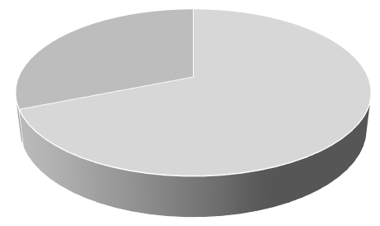
Build a 90 credit program
28 Lower Division Credits
62 Upper Division Credits
Breadth of Education
  Knowledge of human cultures and the physical and natural world: Through focused study in the sciences and mathematics, social sciences, histories, languages, and the arts, and by engagement with big questions, both contemporary and enduring
Essential Skills
  Inquiry and analysis (applied critical thinking)
  Written communication
  Quantitative literacy
  Diversity-Related Skills
  Civic knowledge and engagement—local /global
  Intercultural knowledge and competence
Integrative and applied learning
That achieves these
undergraduate learning
outcomes (ULO’s)
What students need
90 credits, including 62 upper division
Breadth of Education
W, D, Math/CS/Q
To meet WOU’s ULO’s

Slide 6
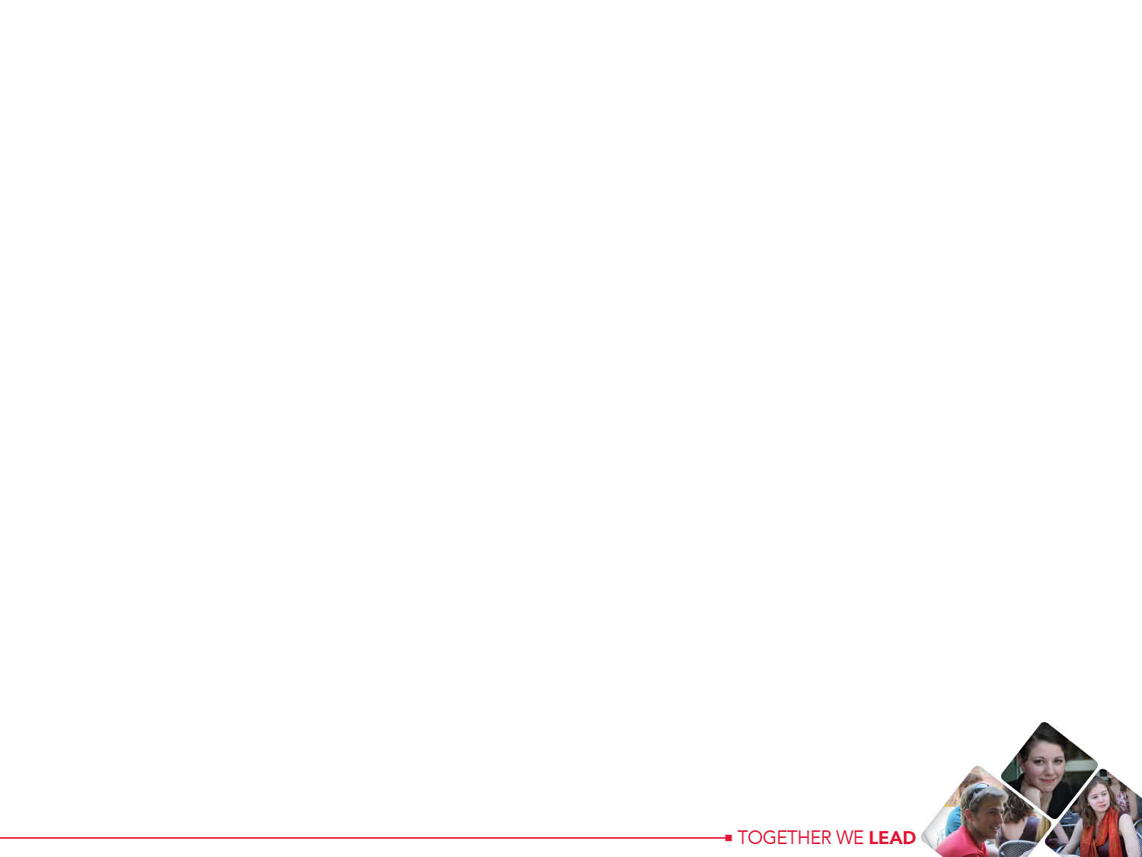
DEVELOPMENT: HOW?
The group identified principles of design for the program:
Flexibility of curriculum, delivery, student services
Integration of the educational experience across disciplines, AAS and WOU program, WOU experience and work lives
Coherence of curricular offerings
Breadth of education, and ways to build distribution requirements into the model for an upside down degree
Facilitating community building among working adult students
Transparency of programs and services for these students
Confirming the needs of this student population and working closely with our community college partners and local employers (esp. state government)

Slide 7
DEVELOPMENT: HOW?
Follow up
Given the opportunity to respond anonymously, all participants indicated that WOU should continue to develop an upside down degree program for AAS degree holders
10 participants volunteered to continue to work on the proposal for the program
Target for curriculum proposal to be submitted to the Curriculum Committee: Fall 2017
Additional investigation of need for the program (among AAS students, community colleges, employers including Oregon state government)

Slide 8
LEARNING OUTCOMES: WHAT?
AB-LS1: Practice different and varied forms of knowledge, inquiry, and expression that frame academic and applied learning (GE1: Intellectual Foundations and Breadth)
AB-LS2: Articulate the challenges, responsibilities and privileges of belonging in a complex, diverse, interconnected world (GE2: Citizenship; ULO: Diversity)
AB-LS3: Demonstrate the ability to evaluate information and develop evidence-based conclusions. (GE 3: Critical Thinking; ULO: Inquiry & Analysis);
AB-LS4: Integrate perspectives and strategies across disciplines to answer questions and solve problems. (GE 4: Multi-disciplinary learning; ULO: Integrative Learning);
AB-LS5: Demonstrate reflection and self-assessment in completing the self-defined, multidisciplinary program of study that achieves your learning goals (Program-specific)

Slide 9
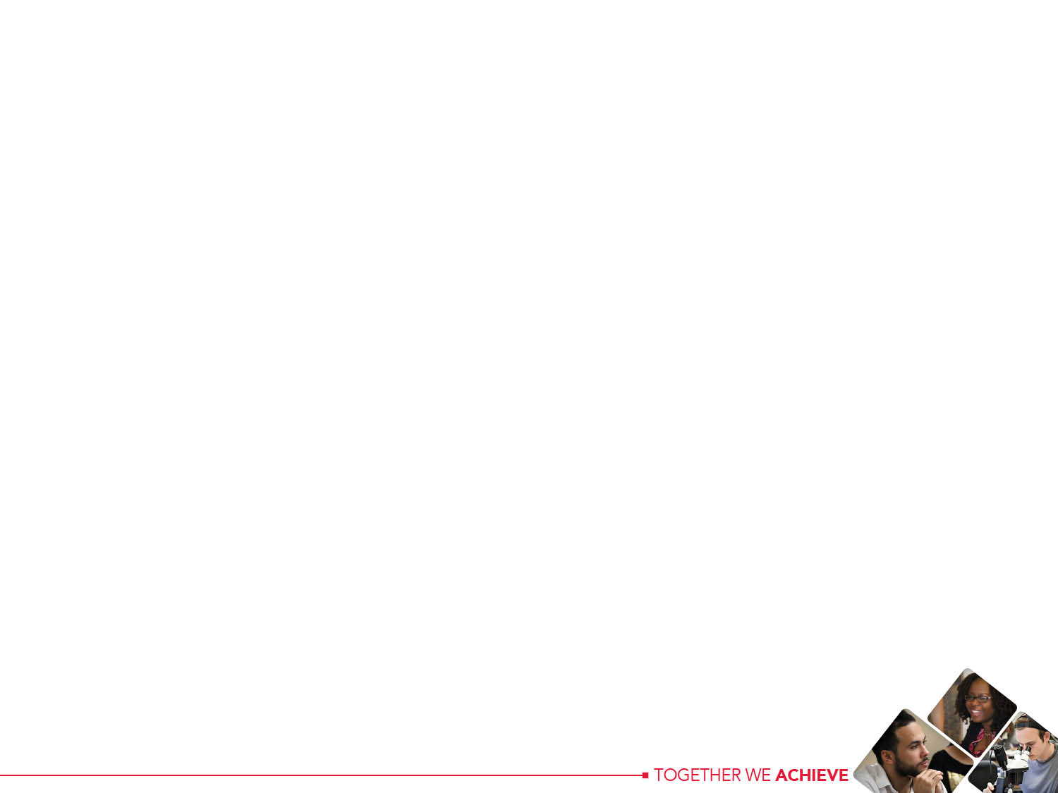
COMPONENTS: WHAT?

Slide 10
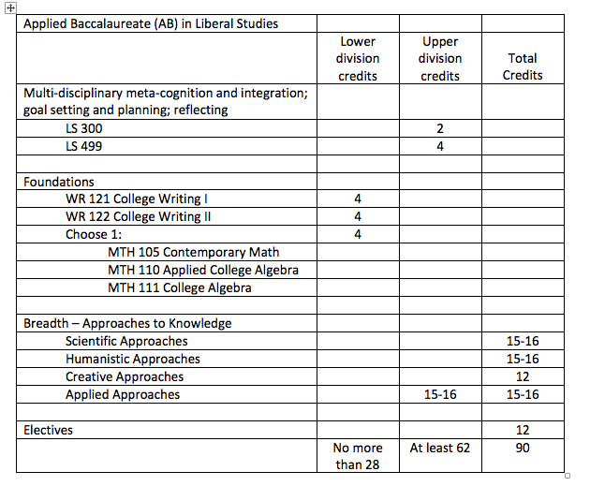

Slide 11

DELIVERY: WHERE, WHEN AND HOW?
Flexible delivery convenient to working adults
Hybrid courses in Salem: Coherence through thematic thread(s)
  Sequences or clusters of existing and/or newly developed upper division courses
Also existing online and on-campus courses
Schedule consistency & growth - for example
2018-19: Tuesday, Thursday, 6-8 pm; 8-10 pm
2019-20: expands to include Wednesday and/or Saturday (9-11 am; 11-1 pm)
2020-21: expands to include multiple offerings in a single time slot
Faculty participation
AB in LS Professional Learning Community around working with adult learners and AB in LS thematic threads
Hybrid course development support

Slide 12
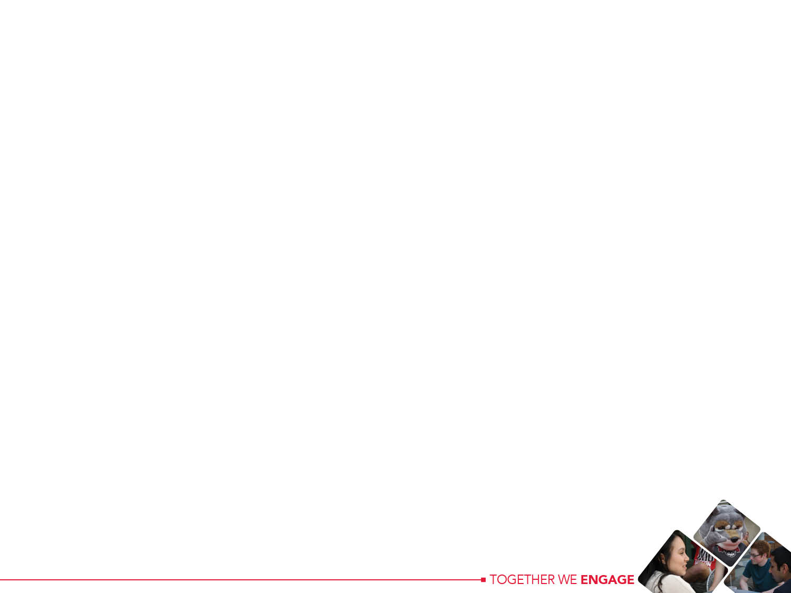
GOVERNANCE, ADMINISTRATION, ASSESSMENT & CURRICULUM DEVELOPMENT: More HOW?
Governance: AB in LS Advisory Board, a committee with by-laws
Administration: Faculty Chair of IDS Advisory Board, reports to Provost or designee
AB Courses: LS 300, 499 taught by AdBoard members; faculty developed and delivered, AdBoard approved, Salem-based disciplinary courses (including thematic clusters/sequences of courses); existing WOU offerings
Advising: TBA (Faculty Chair/Coordinator, program staff)
Assessment and curriculum development: AdBoard reviews and acts upon assessment data provided by AB in LS Chair and faculty assessment committee

