Slide 1
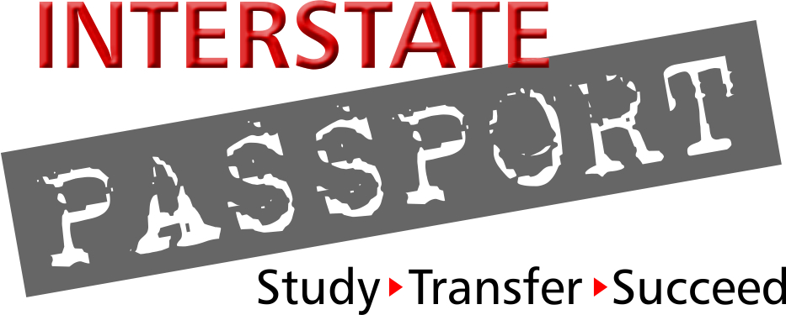
The Interstate Passport
Bob Turner
Passport State Coordinator, WICHE
Sean Pollock
Oregon Passport State Facilitator, HECC

Slide 2

What is the
Interstate Passport?
A new framework to advance friction-free student transfer
A grass-roots initiative originated by academic leaders in the WICHE region
Lower-division general education
Block transfer based on learning outcomes & proficiency criteria developed by multi-state faculty negotiation
Tracking student academic progress designed by registrars and institutional researchers
…focusing on ensuring quality
and streamlining pathways to graduation…

Slide 3
Purpose of the Passport
Reduce unnecessary repetition of academic work after students transfer.
…focusing on ensuring quality
and streamlining pathways to graduation….

Slide 4
Student Mobility and Transfer
Today’s students are increasingly mobile ...
but the transfer process gets in their way ...
33% of students transfer before graduation.¹
14.6% of the 2014 graduates with bachelor’s degrees started studies in another state.²
Only 58% of transfers are able to bring all or almost all of their credits with them.³
Transfer students who earn a B.A. take 1.2 years longer.⁴
80% of community college students say they want to earn a bachelor’s degree but only 1 in 10 do within 6 years.⁵
... and too many simply give up

Slide 5
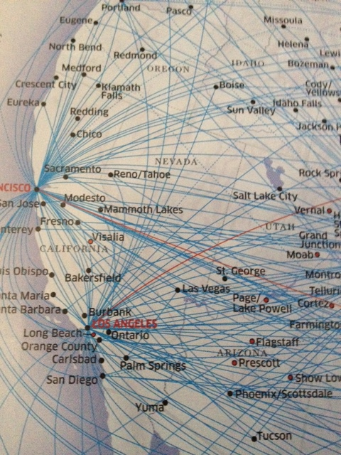
Design of the Passport
Passport is Interstate –
  Ubiquitous Academic Program: General Education
  Course-to-Course
  Transfer Agreements
  Focus is on Learning Outcomes
Design Principles –
  Honor Institutional Individuality
  Designed by those who will operationalize
  Faculty, Registrars, Institutional Researchers,
  and Advisors

Slide 6
Major Components of Passport
1. Passport LDGE Areas (from LEAP outcomes) by PSFs/staff
2. Passport Learning Outcomes in each area by FACULTY
3. Transfer-Level Proficiency Criteria per PLO by FACULTY
4. Passport Blocks learning experiences; address all PLOs by FACULTY
5. Tracking System: Student Academic Progress REGISTRARS/IR
6. Application and MOU
Funded by: Carnegie Corporation of New York – 2011-2014
Bill & Melinda Gates Foundation and Lumina Foundation – 2014-2016
First in the World Department of Education – 2015-2019

Slide 7



Passport 9 GE Areas – from LEAP ELOs &
                WICHE research
Human
Society
and the
Individual
Natural
Sciences
Human
Cultures
Foundational Skills
Knowledge of
Concepts
Teamwork
and
Value
Systems
Creative
Expression
Critical
Thinking
Cross-Cutting
Skills
Oral
Communi-
cation
Written
Communi-
cation
Quantitative
Literacy

Slide 8
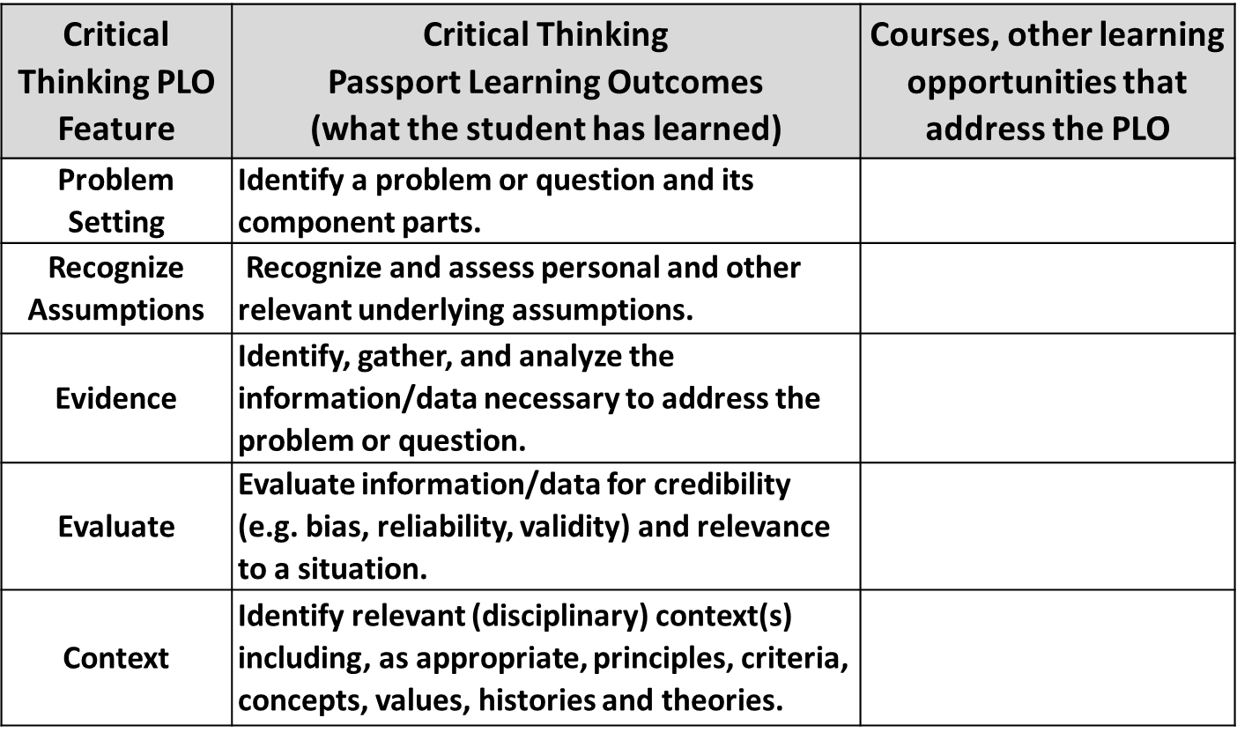
2. Passport Learning Outcomes for each Knowledge/Skill area
ACCEPTABLE to Every Passport Institution

Slide 9
Consensus Lower-Division GE Learning Outcomes and Proficiency Criteria
Passport Learning Outcome (PLO):
Statement of what student must know and/or be able to do to attain LDGE proficiency in each feature.
e.g., Critical Receiver (listening): Listen and critically evaluate the speaker's central message and use of
supporting materials
Transfer–Level Passport Proficiency Criteria:
Statement of an assignment currently used for student to show transfer-level proficiency with the PLO.
e.g., Critical receiver (listening): Complete appropriate, constructive peer evaluations; summarize speech’s
main points

Slide 10
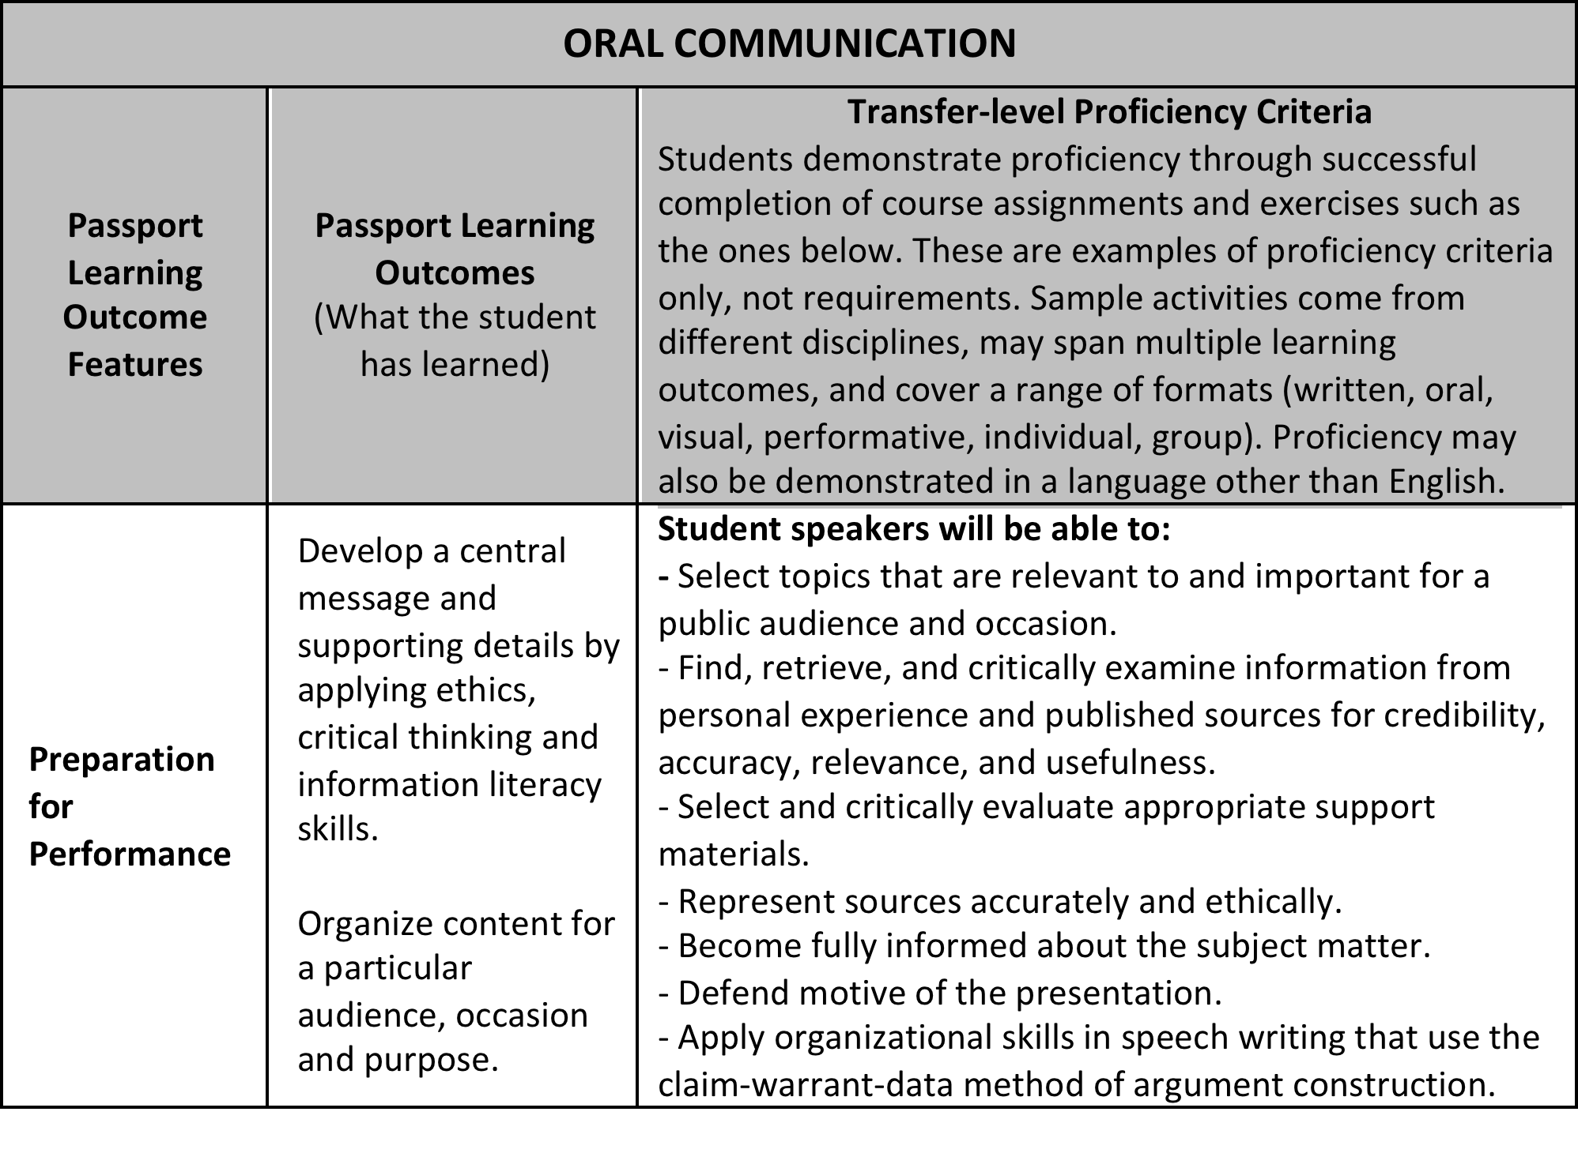
3. Transfer-Level Proficiency Criteria
ACCEPTABLE to Every Passport Institution
    One example: Fundamental Skill Area - Oral Communication (excerpt)

Slide 11
4. Passport Block
From Passport Learning Outcomes
Unique to each institution

Slide 12

4. Sample Passport Block:
Foundational Skills
Uniquely Defined by Faculty at Each Passport Institution
EXAMPLE: North Dakota State University
ORAL COMMUNICATION
  COMM 110 Fundamentals of Public Speaking
WRITTEN COMMUNICATION
Two courses from the following:
  ENGL 110 College Composition I OR
  ENGL 111 Honors Composition I OR
  ENGL 112 ESL College Composition AND ENGL 120 College Comp II OR
  ENGL 121 Honors Composition II OR
  ENGL 122 ESL College Composition II
QUANTITATIVE LITERACY
One course from the following:
  Math 103 College Algebra OR
  Math 104 Finite Mathematics OR
  Math 146 Applied Calculus I OR
  Math 165 Calculus I OR
  STAT 330 Introductory Statistics

Slide 13

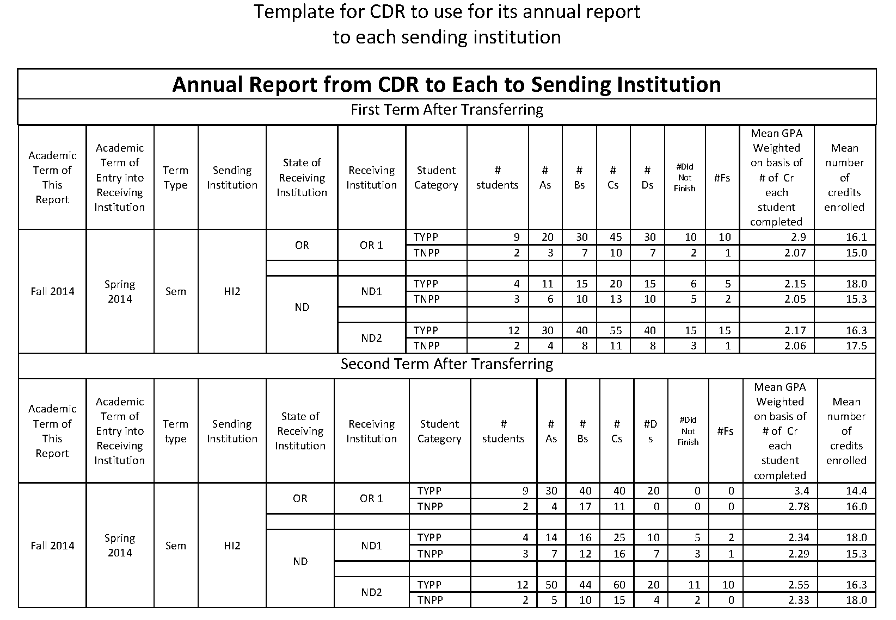
5. Tracking Academic Progress
Developed by Registrars and Institutional Researchers
Every Passport institution
  Awards Passport - Passport on student academic record
Every receiving institution
  Submits grades for transfer students (Passport and non-Passport) for first two terms after transfer
  Submits grades for native students for two terms after earning Passport
Every sending institution receives
    Annual report on academic progress
    of former students
Passport Review Board receives
  Annual report of aggregated results to evaluate overall program
  OCT ‘16 – NSC automated process

Slide 14
Developing PLOs and PC for each Passport Knowledge/Skill area
THIS WORK IS DONE! –
not required of institutions
joining Passport
Human
Society
and the
Individual
Natural
Sciences
Human
Cultures
Foundational Skills
Knowledge of
Concepts
Teamwork
and
Value
Systems
Creative
Expression
Critical
Thinking
Cross-Cutting
Skills
Oral
Communi-
cation
Written
Communi-
cation
Quantitative
Literacy

Slide 15
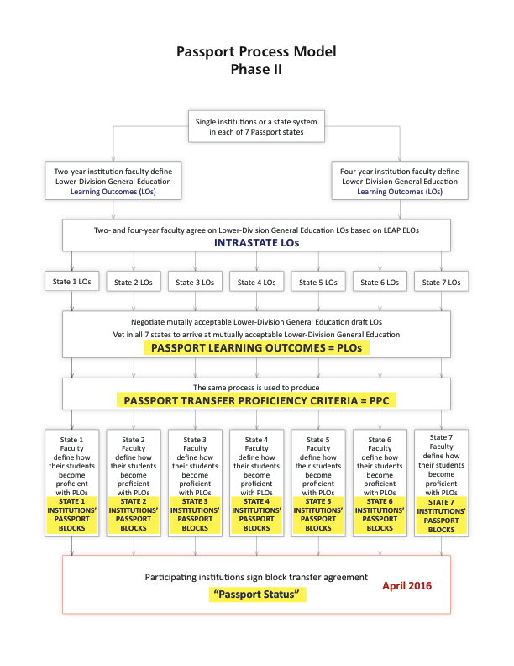
Passport Process Model
THIS WORK IS DONE! - not required of institutions joining Interstate Passport Network
Produces Crosswalk
(example next
slide)
Today and
Tomorrow

Slide 16
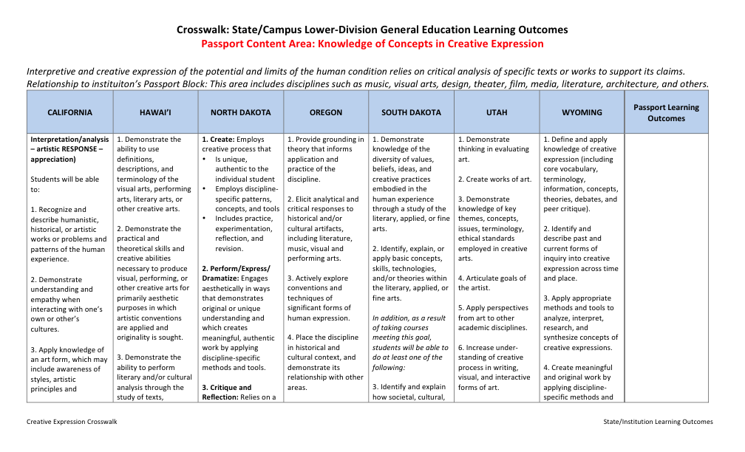
Crosswalk of State Sets, Learning Outcomes

Slide 17
Writing PLOs and PC
1. Intra-State PLO/PC
Intra-state meetings of two- and four-year faculty – mutually acceptable; submit to Passport Staff to assemble crosswalk
2. Crosswalk and Interstate Negotiation (Today and Tomorrow)
Passport staff compile all in-state PLOs/PC into one crosswalk document, distribute to negotiation meeting attendees; use to find common PLOs/PC, and to negotiate consensus draft
3. Return to State and Vet
Obtain peer faculty feedback on draft PLOs/PC
Up to four Conference Calls
Negotiate final PLOs/PC
Passport Review Board
Monitor feedback and effectiveness; distribute for editing
and redraft

Slide 18
Participants in 16 States
Develop & Test Passport
State Facilitators:

Slide 19





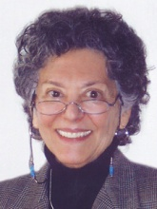
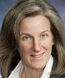
Participants in 16 States
Develop & Test Passport
Developing the Passport Learning Outcomes
State Facilitators:
CA
HI
ND
OR
SD
UT
WY

Slide 20





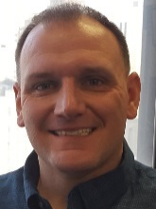
Participants in 16 States
Develop & Test Passport
Developing the Passport Learning Outcomes
Testing
the block construction process
State Facilitators:
CA
HI
ND
OR
SD
UT
WY
AR
ID
IN
KY
OH
VA

Slide 21
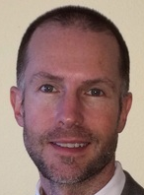
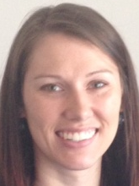

Participants in 16 States
Develop & Test Passport
Developing the Passport Learning Outcomes
Testing
the block construction process
Piloting critical assignment mapping
State Facilitators:
CA
HI
ND
OR
SD
UT
WY
AR
ID
IN
KY
OH
VA
CO
MT
NM

Slide 22
Passport Quality Assurance
Minimum grade of C
Tracking student progress after transferring:
  Central Data Repository Utah State University
PRB monitoring of Passport efficacy
Evaluation Research Study of Passport impact
Education & Employment Research CTR at Rutgers University School of Management
& Labor Relations

Slide 23
Mapping Assignments to PLOs
Model the Mapping of Critical Assignments to PLOs
GOALS
  expand faculty understanding and choices of critical assignments in designated courses
  share ideas in competency assessment among institutions.
PROCESS
  Establish Passport Blocks
    By Faculty in 2 institutions in each of CO, MT and NM
  Map Critical Assignments
    By faculty from Passport Block courses to PLOs
    By Peter Ewell from National Center for Higher Education Management Systems (NCHEMS)

Slide 24


Mapping Project: Primary Deliverables
Critical Assignments and De-Identified Student Artifacts
  Home institution
  5 Other institutions
Scored for match to Passport Learning Outcomes
Employ Rubrics developed by Peter Ewell at NCHEMS
Use TaskStream Platform for scoring
Scoring Starts December 2016

Slide 25
Benefits of the Passport - 1
(for Students, Institutions, and States)
• For students - fewer unnecessary courses
Means greater motivation to complete, faster time to degree,
lower cost, less debt, and lower foregone earnings
• For institutions - improves performance metrics
Due to greater student motivation to complete and faster time to degree
• For institutions - no course-by-course GE articulation Less resources spent picking through syllabi to articulate courses
Easier to maintain state-level transfer websites

Slide 26
Benefits of the Passport - 2
(for Students, Institutions, and States)
• For institutions - map to Passport Learning Outcomes
Reduces equivalency renegotiation as courses/disciplines evolve Allows greater curricular flexibility
Could eliminate negotiation of course-by-course or course-based block transfer with new partners
• For institutions and states - adds data useful for student success initiatives
By tracking persistence, completions, and time to degree of Passport students relative to other transfer students

Slide 27
Why Become a Passport Institution?
  Facilitates transfer across state lines and within states
    Eliminates a major obstacle to transfer student success
    Eliminates necessity for review of lower-division GE course changes in articulation agreements
  Focuses on quality for positive impact on completion
  Based on what students should learn and be able to apply
    Generates data on academic success after transfer
    Provides data for use in continuous self-improvement
  Adapts to higher education’s changing landscape
    Embraces assessments determined by department/program/institution
    Includes non-course-based educational experiences

Slide 28
Timeline for Implementing Passport
March 2016: Faculty work on PLOs and PC complete
Spring/Summer 2016: Faculty construct institution’s Passport Block
Spring 2016: Last term for Phase I Passport
Summer 2016: Institutions can apply to join Passport
October 2016: National Student Clearinghouse’s automated services are live
Fall 2016: First term students can earn Passport
Spring 2017: First term Passport students can transfer
5 years FREE for 1st 100

Slide 29

Interstate Passport Network
Institution and System/State Signatories agree to…
  Construct their Passport Block: A list of courses and/or learning experiences addressing the Passport Learning Outcomes in nine knowledge and skill areas
  Award the Passport to those students who earn it; notate it on their student records
  Recognize the learning of incoming transfer students with a Passport as having met their LDGE requirements
  Track and share data on academic progress
  Term of five years

Slide 30
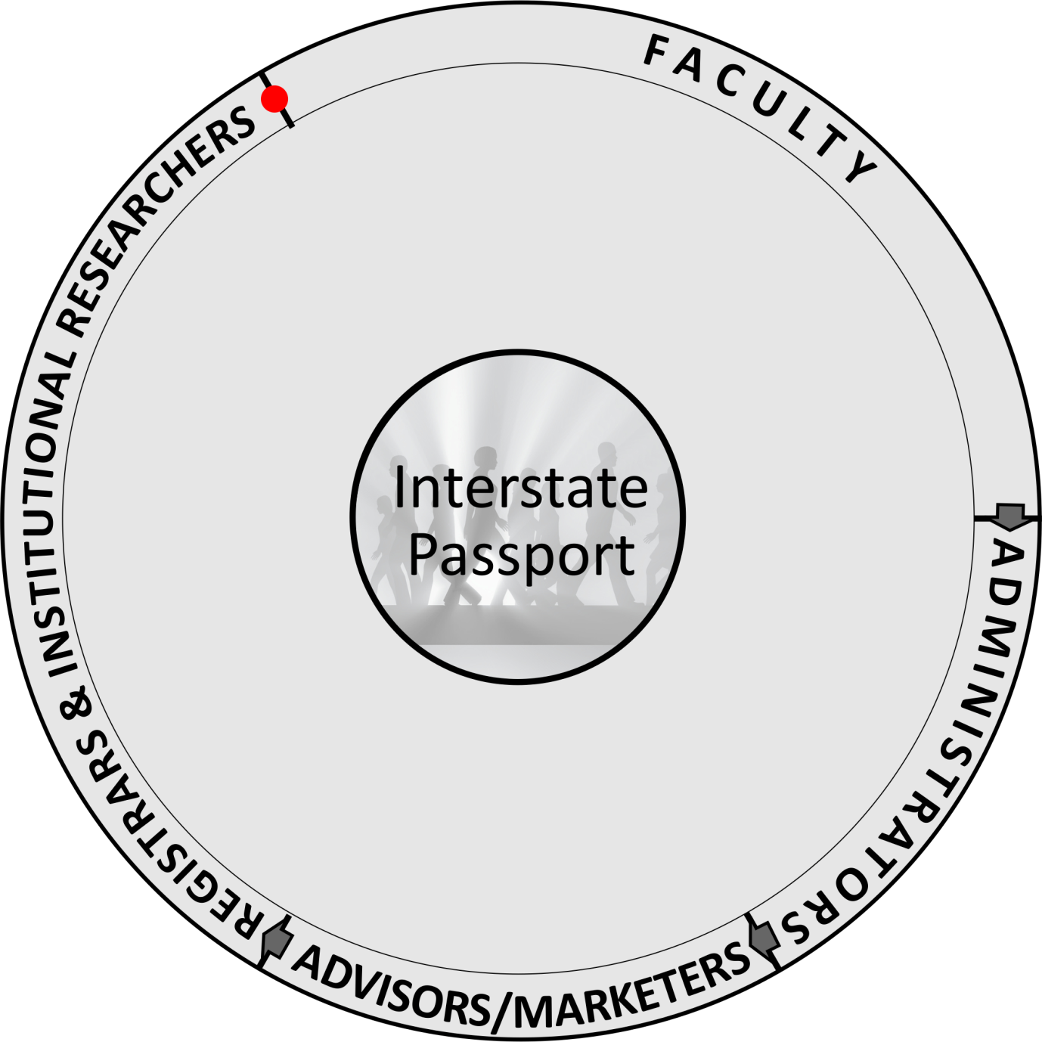
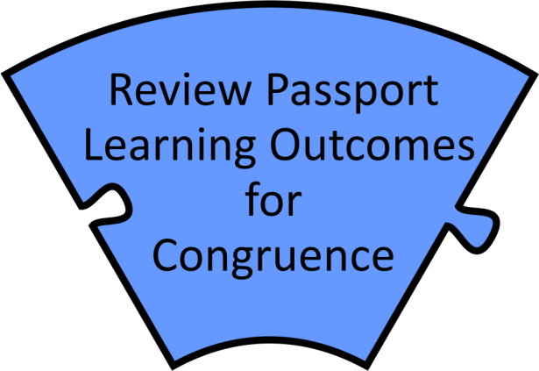

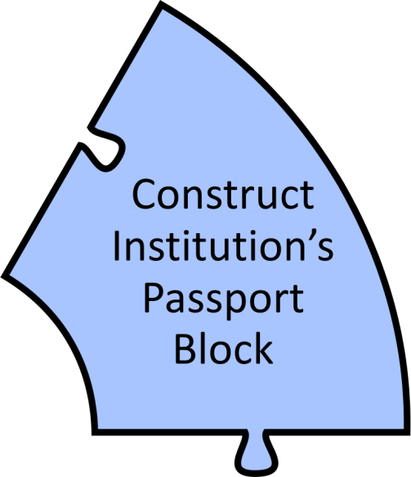
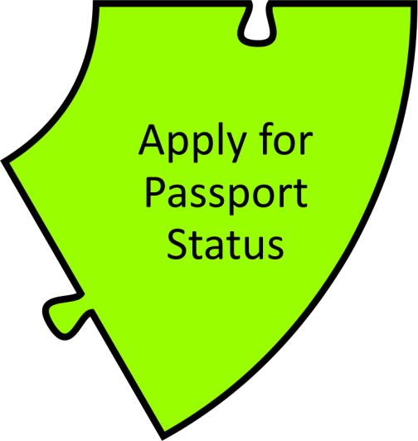

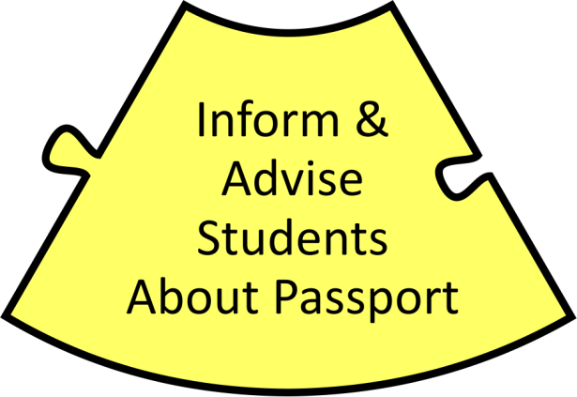
Becoming a Passport Institution…

Slide 31
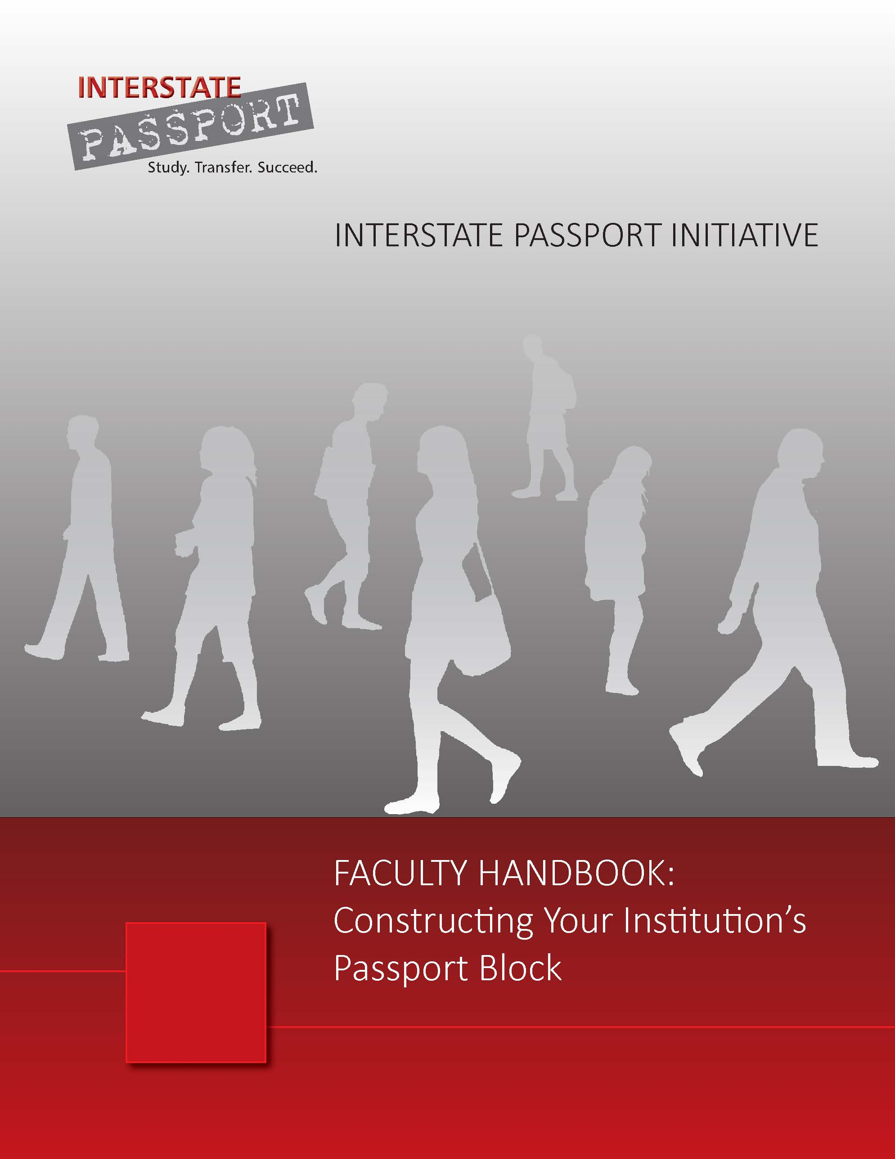
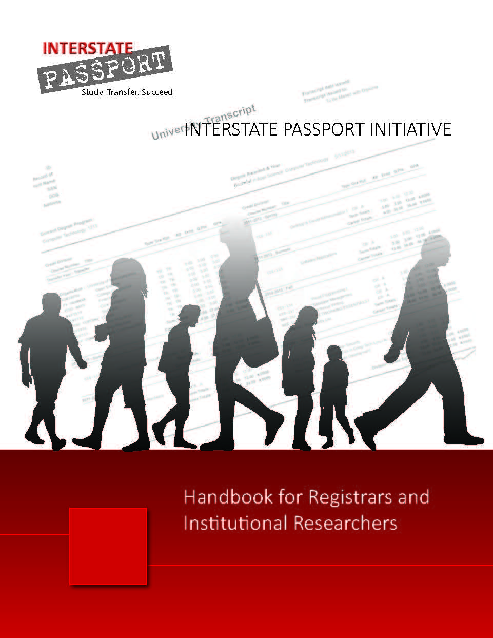
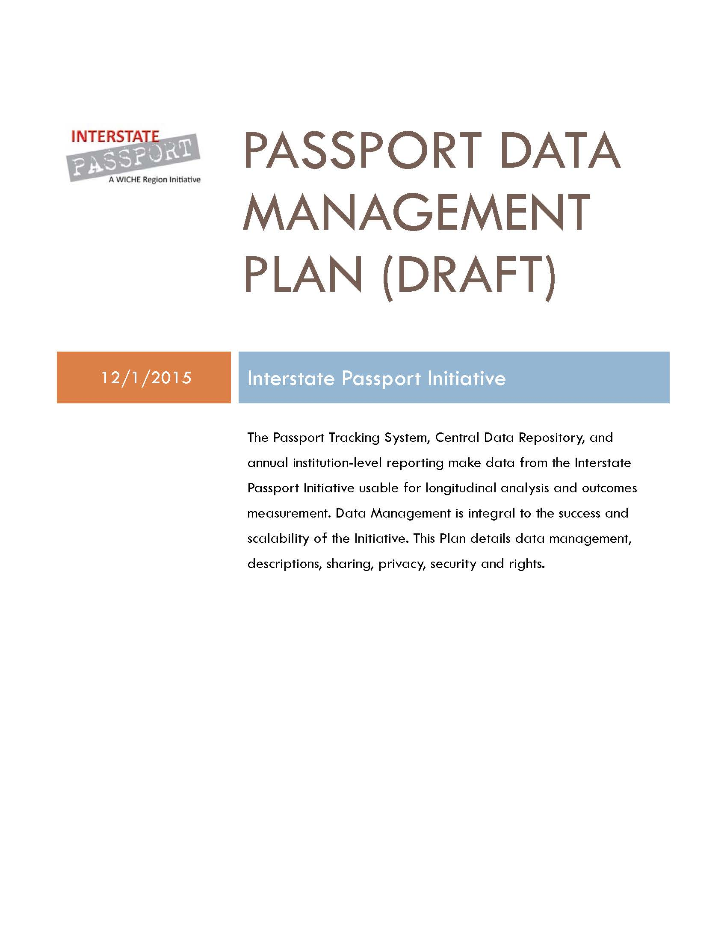
Resources
www.wiche.edu/passport

Slide 32

Questions?
www.wiche.edu/passport
INTERSTATE PASSPORT
Pat Shea, Director, Academic Leadership Initiatives, WICHE, pshea@wiche.edu
Jane Sherman, Passport Tri-Region Coordinator, WICHE, jsherman@wiche.edu
Bob Turner, Passport State Coordinator, WICHE, bturner@wiche.edu

