Slide 1
Service Learning & Career Development
Renee Eaton, Director
Donna Banwarth, Assistant Director
Service Learning and Career Development
Werner University Center 119

Slide 2








What SLCD Offers
Service Learning Programs and Volunteer Opportunities.
Career Counseling and Guidance
Wolflink
Student Employment
Internship Programming
Career Events
Website
Classroom Presentations
Red Couches
Service Learning & Career Development
WUC 119 ~ www.wou.edu/slcd
503-838-8432 ~ slcd@wou.edu
www.wou.edu/wolflink

Slide 3
Service Learning
Promotes learning through active participation
Provides structured time for students to reflect
Provides an opportunity to use skills and knowledge in real-life situations
Fosters a sense of caring for others
Integrated into curriculum
Adapted from the National and Community Service Act of 1990
Service Learning & Career Development
WUC 119 ~ www.wou.edu/slcd
503-838-8432 ~ slcd@wou.edu
www.wou.edu/wolflink

Slide 4
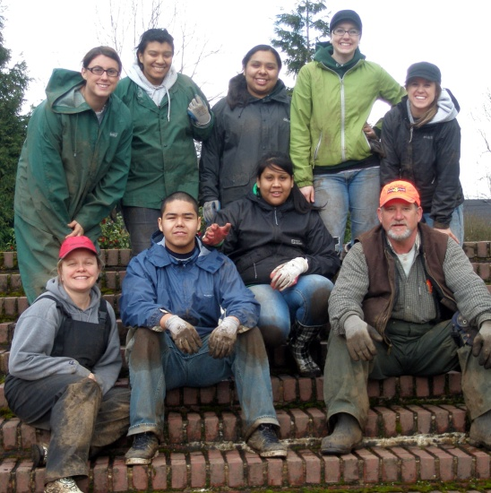
Alternative Break Program
WOU students help to alleviate common societal issues.
Teams of students have gone all across the country, and the world to directly serve
Trips take place during Winter and Spring, and are week-long trips
Service Learning & Career Development
WUC 119 ~ www.wou.edu/slcd
503-838-8432 ~ slcd@wou.edu
www.wou.edu/wolflink

Slide 5

Other Volunteer Opportunities
SEEK joins WOU with Monmouth Senior Center and Dallas Retirement Village
  www.wou.edu/seek
SIS
Volunteer Days
  Fall, Winter and Spring
Service Learning & Career Development
WUC 119 ~ www.wou.edu/slcd
503-838-8432 ~ slcd@wou.edu
www.wou.edu/wolflink

Slide 6
Career Counseling Includes…
“What can I do w/my Major” and “What do I want to Major in”
“What do I want to do when I Grow Up?”
Career Paths
Job/Internship Search Help
Mock Interviews
Resume/Cover Letter Assistance
Grad School Assistance
Networking
Branding Your Experience
Career Liftoff
Meyers-Briggs Type Indicator
StrengthsQuest and Kolb Learning Styles
Many other things – website feedback, start-up advice, etc!
Service Learning & Career Development
WUC 119 ~ www.wou.edu/slcd
503-838-8432 ~ slcd@wou.edu
www.wou.edu/wolflink

Slide 7




Wolflink
On-Campus, Off-Campus, Part-Time, Full-Time, Workstudy, Non-Workstudy Jobs
Internships
Volunteer Opportunities
Center for Service Learning & Career Development
Located in the lower level of WUC, room 119
slcd@wou.edu | www.wou.edu/slcd | 503-838-8432
www.wou.edu/wolflink
Service Learning & Career Development
WUC 119 ~ www.wou.edu/slcd
503-838-8432 ~ slcd@wou.edu
www.wou.edu/wolflink

Slide 8
Fairs, Dinners and Events!
Blazer’s Sports Internship Fair
Education Services Fair
Criminal Justice/Govt Svcs Fair
PsychNight
First Avenue Career & Grad School Fair
Majors Fair
Health Services Fair
Career Insight Dinner
Etiquette Dinners
World After WOU Dinner
Career Bootcamp
How to Network
Grad School Week
Internship Week
Career /Grad School Panels
Information Booths & Interview Sessions
Volunteer Days
Power Breakfasts
Nonprofit Tours
Seattle Career Trek
Service Learning & Career Development
WUC 119 ~ www.wou.edu/slcd
503-838-8432 ~ slcd@wou.edu
www.wou.edu/wolflink

Slide 9
SLCD Website: wou.edu/slcd
Handouts and Resources for students, professors, employers, and parents
Career search sites
Internship information
Volunteer information
Links to Wolflink and Career Liftoff
Our contact info
Service Learning & Career Development
WUC 119 ~ www.wou.edu/slcd
503-838-8432 ~ slcd@wou.edu
www.wou.edu/wolflink

Slide 10
Class Presentations and Support…
Presentations
iCareering – a career overview
Resumes/Cover Letters
Interviewing
Networking
Job Searches
Internships
MBTI
StrengthsQuest/Kolb Learning
Service Learning
Graduate Schools
Events/Center Support/Sessions
Dinners
Fairs and Theme Weeks
Resume Critiques
Mock Interviews
Company Visits
Counseling Sessions
Videos
Career LiftOff
…. And more!
Service Learning & Career Development
WUC 119 ~ www.wou.edu/slcd
503-838-8432 ~ slcd@wou.edu
www.wou.edu/wolflink

Slide 11
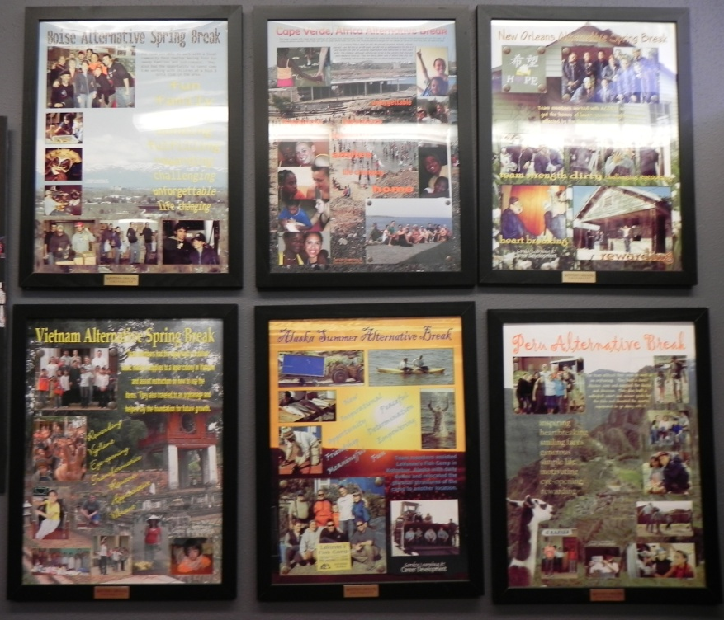
Fall Opportunities!
Senior Kickoff
Grad School Week
Career Insight Dinner
Fall Volunteer Day
Nonprofit Career Tour
Seattle Career Trek
Service Learning & Career Development
WUC 119 ~ www.wou.edu/slcd
503-838-8432 ~ slcd@wou.edu
www.wou.edu/wolflink

Slide 12
Questions?
Service Learning & Career Development
WUC 119 ~ www.wou.edu/slcd
503-838-8432 ~ slcd@wou.edu
www.wou.edu/wolflink

Slide 13
Come See Us!
Renee Eaton Donna Banwarth
Director Assistant Director
eatonr@wou.edu banwartd@wou.edu
Charisse Jolliff
Service Learning Coordinator
jolliffc@wou.edu
Center for Service Learning & Career Development
Downstairs in Werner Center 119
(503) 838-8432
www.wou.edu/slcd
Open 8-5, Monday-Friday
Service Learning & Career Development
WUC 119 ~ www.wou.edu/slcd
503-838-8432 ~ slcd@wou.edu
www.wou.edu/wolflink

