Slide 1
Quantitative Literacy at WOU

Slide 2
LEAP
In November, Faculty Senate recommended that WOU adopt LEAP's (Liberal Education & America's Promise) learning outcomes.
One of those learning outcomes is Quantitative Literacy

Slide 3
Quantitative Literacy
Quantitative Literacy (QL) is a 'habit of mind' competency, and comfort in working with numerical data. Individuals with strong QL skills possess the ability to reason and solve quantitative problems from a wide array of authentic contexts and everyday life situations. They understand and can create sophisticated arguments supported by quantitative evidence and they can clearly communicate those arguments in a variety of formats (using words, tables, graphs, mathematical equations, algorithms, etc., as appropriate). (AACU).

Slide 4
My Task
This year I was tasked with developing a rubric that supports assessment of quantitative literacy in general education for both Bachelor of Arts and Bachelor of Science students at WOU.
I sought to identify elements of quantitative literacy that are most important to faculty and the levels of competency that are expected in general education from BA and BS graduates.

Slide 5
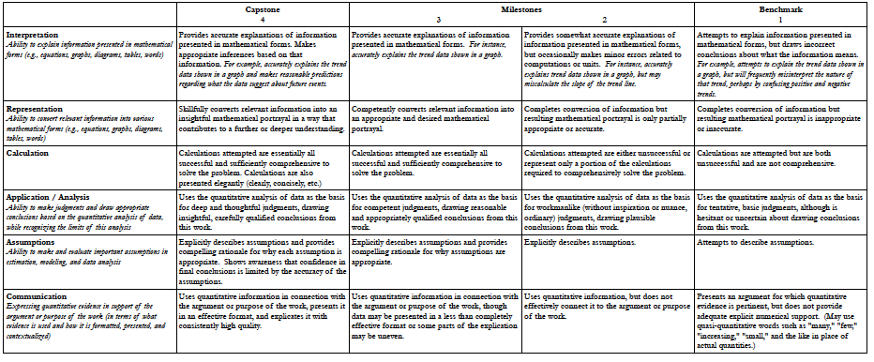

Slide 6
QL LEAP Rubric Categories
Interpretation
Representation
Calculation
Application/Analysis
Assumptions
Communication

Slide 7
Interpretation Competency Levels
4 – Provides accurate explanation of information presented in mathematical forms. Makes appropriate inferences based on that information.
3 – Provides accurate explanations of information presented in mathematical forms.
2 – Provides somewhat accurate explanations of information presented in mathematical forms, but occasionally makes minor errors related to computations or units.
1 – Attempts to explain information presented in mathematical forms, but draws incorrect conclusions about what the information means.

Slide 8
Bachelor of Arts
The general education course with QL that students consistently while seeking a BA is MTH 105 Introduction to Contemporary Mathematics
So I spoke with the MTH 105 team to develop a QL rubric for general education for BA students

Slide 9
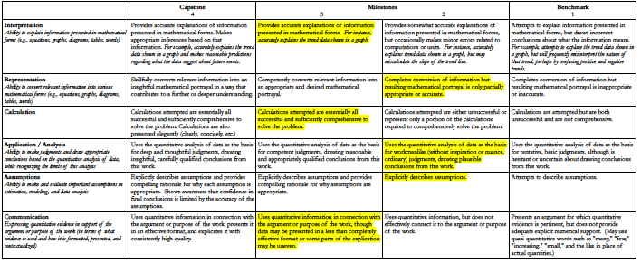
Bachelor of Arts

Slide 10
Bachelor of Science
There are many stakeholders of QL in general education for BS students
I sent out a survey to 48 faculty members
  Math department
  CS department
  Dean Monahan’s QL group
  Anyone identified by their division chair as being a stakeholder in QL

Slide 12
Survey
The survey asked to rate the importance of each LEAP rubric category
It asked the level of competency expected in each category in general education from a BS graduate
It asked if there was any elements of QL missed in the LEAP rubric

Slide 13
Results
With 5 being very important, 3 being moderately important, and 1 being not important, each category had a mean between 4 and 4.5
In each category, the faculty seemed to mostly agree on a competency level
There wasn’t a common thread in the comments about any missed elements on the QL rubric

Slide 14
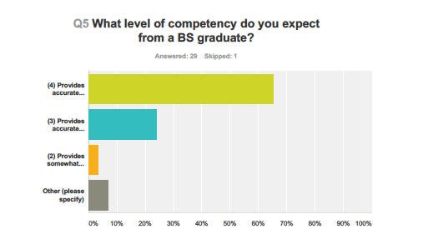
Results for Interpretation

Slide 15
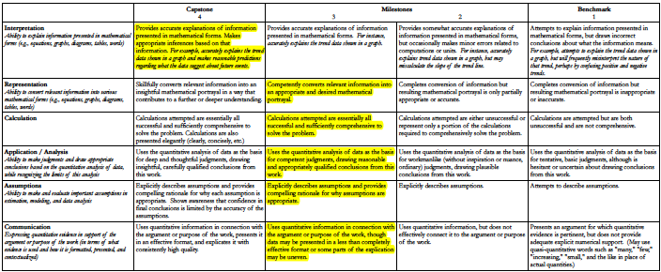
Bachelor of Science

Slide 16
Thank you for listening
Questions?

