Slide 1

Elementary Mathematics Instructional Leader
Specialization Program
EMIL
Division of Teacher Education
and
Mathematics Department
Submitted by:
Dr. Cheryl Beaver
Dr. Laurie Burton
Dr. Rachel Harrington
collaboration

Slide 2
Our Goal
To design a program that will allow us,
once all requirements are complete,
to recommend a candidate to TSPC
for EMIL Specialization
This is not a WOU Certificate
Students take the coursework at WOU
TSPC grants the specialization

Slide 3
TSPC Requirements
To be eligible for the EMIL specialization, the licensed teacher must have all of the following:
TSPC-approved Multiple Subjects Examination;
Three complete years of teaching mathematics
Demonstrated competency in Elementary Math Specialist standards as determined by a program approved to offer the Elementary Mathematics Instructional Leaders specialization

Slide 4
TSPC Requirements
EMS standards competency evidenced by :
24 hours of a TSPC-approved EMIL program
(including)
EMIL practicum working with a
range of students and teachers.

Slide 5
Our Program
Our courses are aligned to the TSPC recommended Association of Mathematics Teacher Educators (AMTE) standards in:
Teacher content
Pedagogy
Leadership
Our course are also aligned to the (student)
Common Core State Standards for Mathematics
Content standards
Practice standards

Slide 6
Our Course of Study
(24 credits)
MTH 611 Counting and Whole Number Operations (3)
MTH 612 Fractions and Proportions (3)
MTH 613 Geometry and Measurement (3)
MTH 614 Statistics and Probability (3)
ED 637 Advanced Content Pedagogy (3)
ED 673 Elementary Mathematics Leadership Practicum I (3)
ED 609 Elementary Mathematics Leadership Practicum II (3)
Choose one
MTH 615 Patterns and Algebraic Thinking (3)
MTH 616 Algebra and Functions (3)
[MTH 61*: ____ :K - 8 Learning and Teacher Practices]
New
(existing)
New
New

Slide 7
Program Comments
Courses will serve several populations
EMIL program
Electives for: MSEd & MSEd: C & I programs
Continuing education for practicing teachers
Delivery
Hybrid courses (Moodle and three-five times per term at WOU)
Designed to serve the scheduling needs of working teachers
CTL, Moodle team actively engaged in design

Slide 8
Program Comments
Quality and Program Assessment
We will seek program approval by TSPC (March 2014 meeting)
College of Education will regularly review program (part of NCATE accreditation)
Enrollment
10 – 20 students enrolled in each course
10 – 20 EMIL specialization recommendations to TSPC approximately every other year

Slide 9
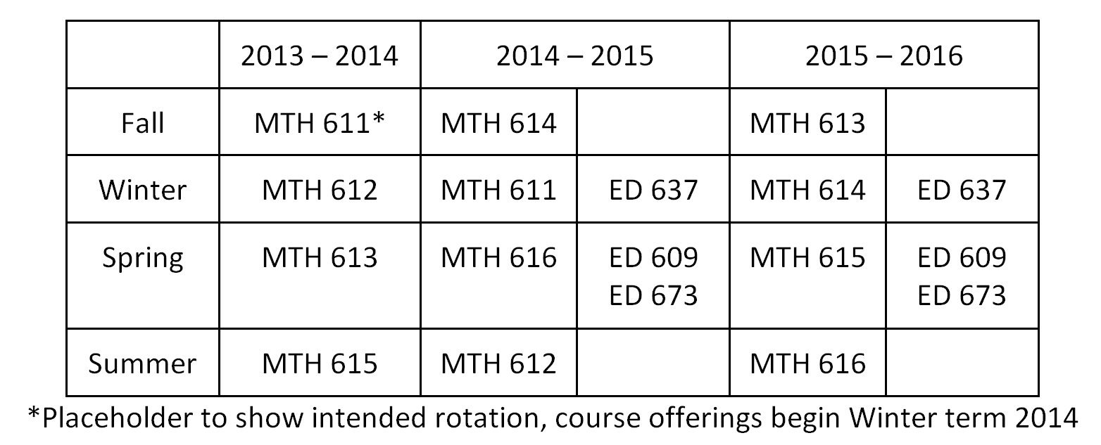

Course Rotation (planned)

Slide 10
Last Slide
Special thanks to Dean Mark Girod, COE. for his help with designing this program
Special thanks to Elayne Kuletz and Dan Clark. DEP/CTL. for their help with designing the delivery of this program
Special thanks to VP Stephen Scheck, Academic Affairs and Dean Sue Monahan, LAS, who have both been very supportive of this project
QUESTIONS?

