Slide 1
Foundations of Biochemistry
1.3 Chemical Foundations
Notes:
In this section, we will explore major chemistry foundations that will help us with our discussions of biochemistry.

Slide 2
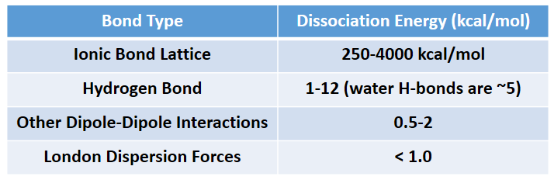
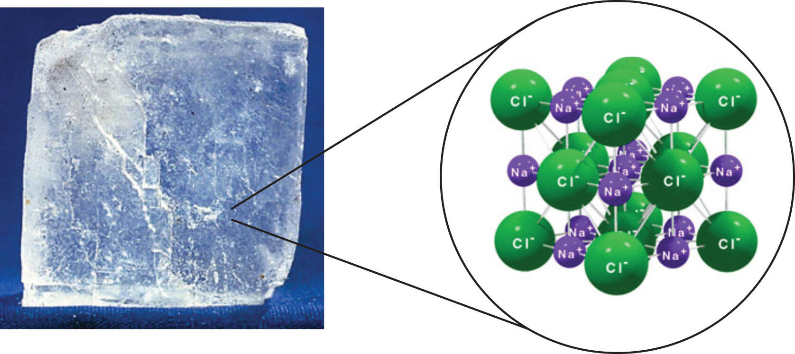
Intermolecular Forces
Notes:
Recall that major intermolecular forces between molecules includes ionic interactions (where fully charged ions are attracted to eachother), dipole-dipole interactions (where partial charges from one molecule that have permanently formed in covalent bonds due to the unequal sharing of electron pairs are attracted to partial charges from another molecule), and London Disperson Forces (which form from the momentary dipoles that are created in covalent bonds that share electrons more equally). Also recall that Hydrogen bonding is a special form of dipole-dipole interaction that is stronger than other common dipoles. This occurs between a partial positive charge forms on H (when it is covalently bonded to N or O in biological systems) and is attracted to a partial negative charge of an O or N atom from another molecule or bond. For a complete review of intermolecular forces, please watch the separate review video that is posted in Canvas.

Slide 3
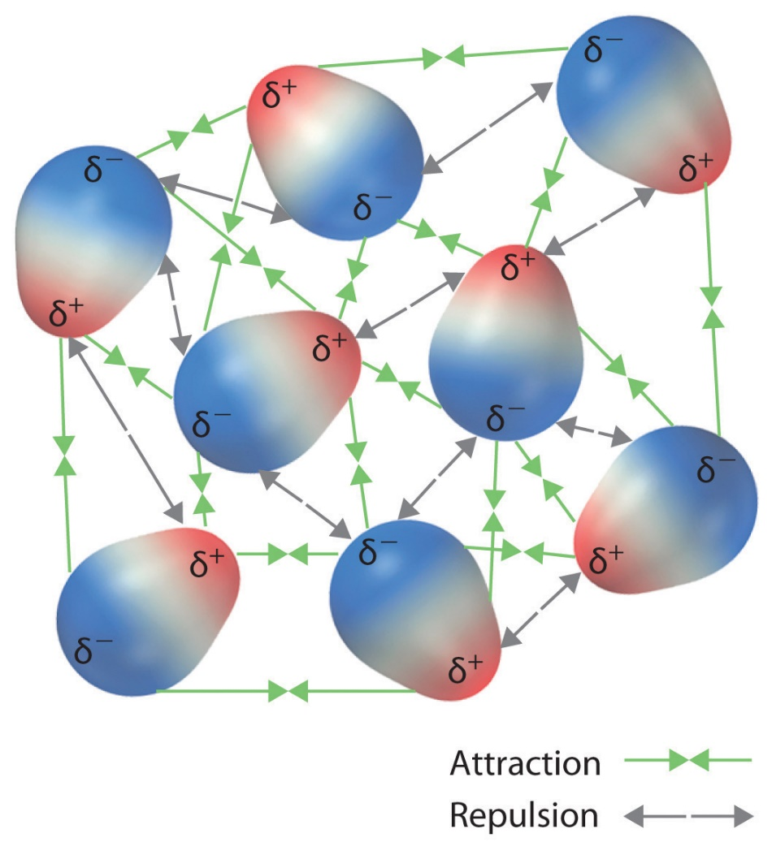
Intermolecular Forces
Notes:
dipole-dipole interactions (where partial charges from one molecule that have permanently formed in covalent bonds due to the unequal sharing of electron pairs are attracted to partial charges from another molecule)

Slide 4
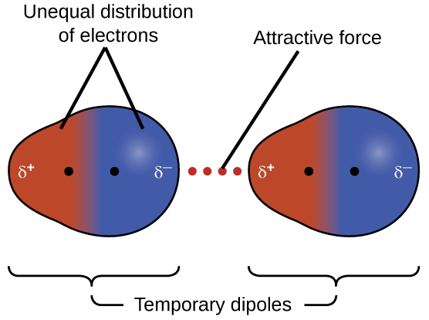
Intermolecular Forces
Common of C-H and C-C bonds
Notes:
and London Disperson Forces (which form from the momentary dipoles that are created in covalent bonds that share electrons more equally).

Slide 5
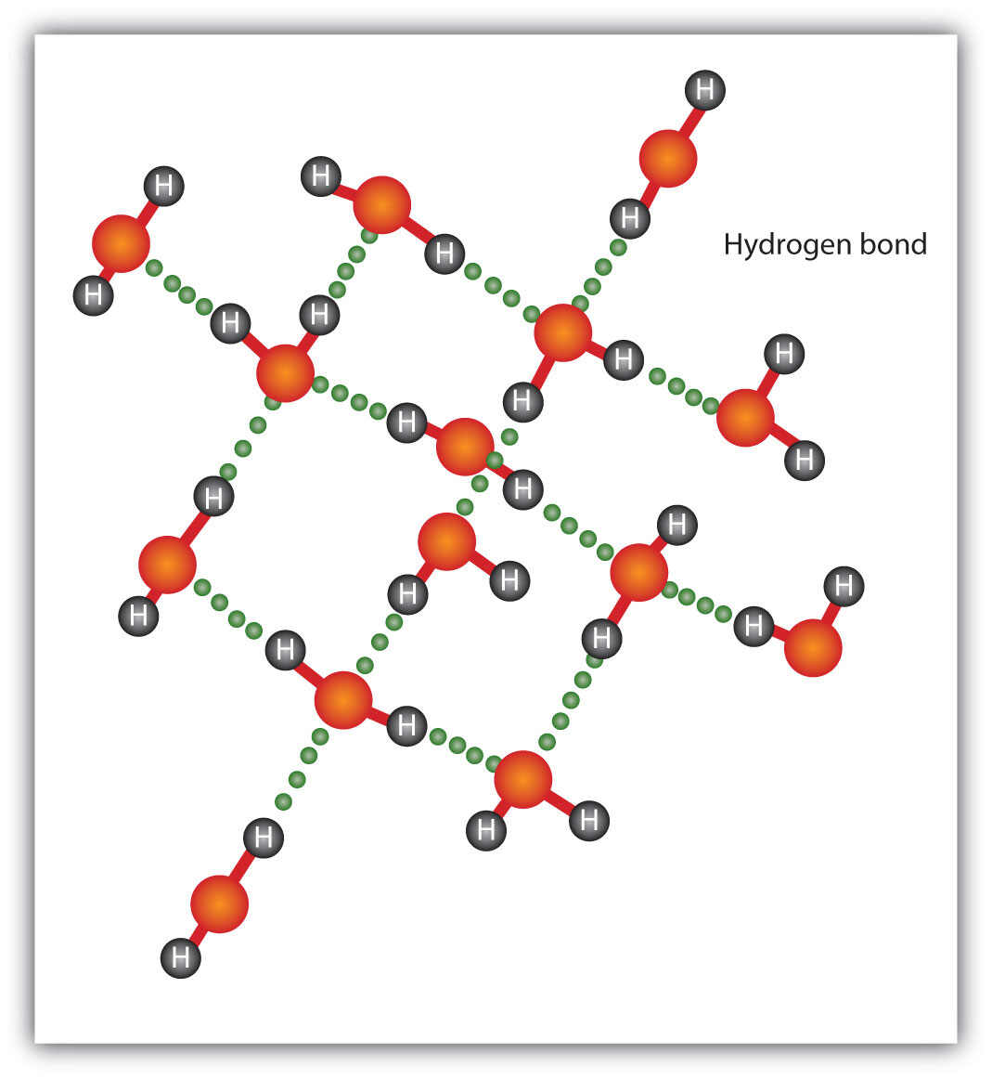
Intermolecular Forces
Notes:
Hydrogen bonding is a special form of dipole-dipole interaction that is stronger than other common dipoles. This occurs between a partial positive charge forms on H (when it is covalently bonded to N or O in biological systems) and is attracted to a partial negative charge of an O or N atom from another molecule or bond. For a complete review of intermolecular forces, please watch the separate review video that is posted in Canvas.

Slide 6
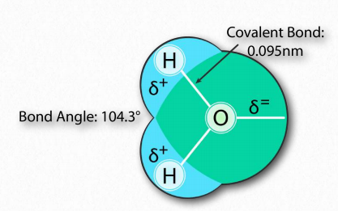
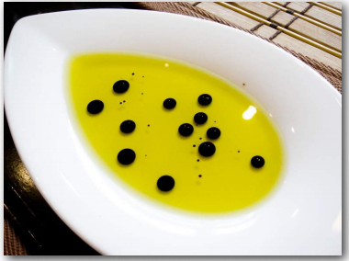
1.3 Chemical Foundations
Mixing of Water with Nonpolar Substances
Notes:
Let’s consider mixing a hydrophilic molecule (water) with permanent hydrogen bonding dipoles and a hydrophobic molecule (oil) that only has London Dispersion Forces.

Slide 7
1.3 Chemical Foundations
Mixing of Water with Nonpolar Substances
ΔG = ΔH – TΔS
Notes:
The non-polar molecules of the oil don’t really interact with water. They are not strong enough to disrupt the normal hydrogen bonding of the water. In fact, around each non-polar molecule, water gets very organized, aligning itself regularly. This would cause entropy to decrease, causing the Temperare Delta S term of the Gibb’s free energy equation to become positive (a negative of a negative)

Slide 8
1.3 Chemical Foundations
Mixing of Water with Nonpolar Substances
ΔG = ΔH – TΔS
Notes:
Since mixing a non-polar substance with water doesn’t generally have any significant heat component, the overall ΔG is positive. This means, then, that dissolving a non-polar compound in water is not favorable and does not occur to any significant extent. The oil stays separated from the water.

Slide 9
1.3 Chemical Foundations
Mixing of Water with Nonpolar Substances
Notes:
Further, when the nonpolar material associates with itself and not water, then the water molecules are free to mix, without being ordered, resulting in an increase of entropy. Entropy therefore drives the separation of nonpolar substances from aqueous solutions.

Slide 10
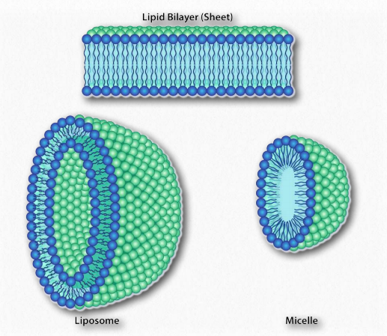

Mixing Water with Amphipathic Molecules
Soap ions arrange themselves into micelles
Biological phospholipids form a lipid bilayer
Notes:
Since we know fatty acids dissolve in water, there must be something else at play. There is. Just like the nonpolar molecules in the first example associated with each other and not water, so too do the non-polar portions of the soap ions associate with each other and exclude water. The result is that the soap ions arrange themselves as micelles

Slide 11
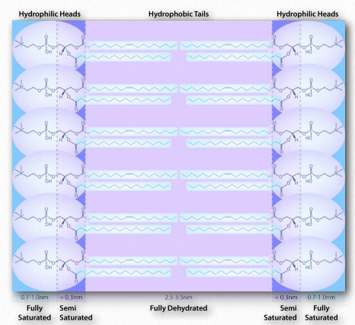
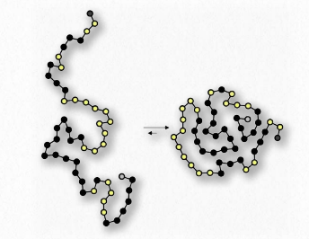
Water is important in the shape of Biological molecules
Lipid Bilayer
Protein Folding
Notes:
Interactions with water also help to drive the formation of lipid bilayers and the folding of proteins and other biological molecules.

Slide 12
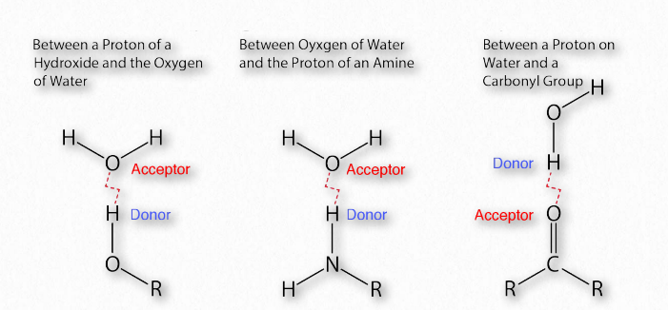
Hydrogen Bonding
Notes:
The importance of hydrogen bonds in biochemistry is hard to overstate. Linus Pauling himself said,
“ . . . . I believe that as the methods of structural chemistry are further applied to physiological problems it will be found that the significance of the hydrogen bond for physiology is greater than that of any other single structural feature.”
We are after all about 70% water! In the body, it forms the biological solvent in which all molecules must move through.

Slide 13
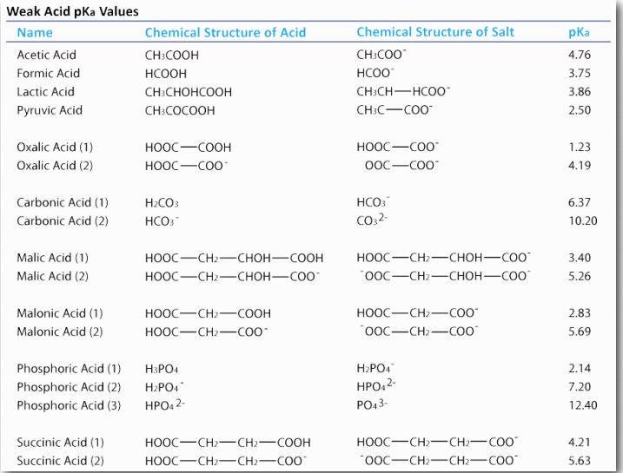
Buffers in Biological Systems
pH = -Log[H+]
pOH = -Log[OH⁻ ]
pH + pOH = 14
Notes:
Water can ionize to a slight extent (10⁻⁷ M) to form H⁺ (proton) and OH⁻ (hydroxide). We measure the proton concentration of a solution with pH, which is the negative log of the proton concentration. If the proton concentration, [H+]= 10⁻⁷ M, then the pH is 7. We could just as easily measure the hydroxide concentration with the pOH by the parallel equation, In pure water, dissociation of a proton simultaneously creates a hydroxide, so the pOH of pure water is 7, as well. This also means that pH + pOH = 14. The presence of acids or bases within a solution, can therefore have profound effects on the pH of a system. Thus, the importance of buffers within biological systems that can stabilize solution pH is critical for maintaining life. Within biological systems, weak acids often behave as this buffering system.

Slide 14
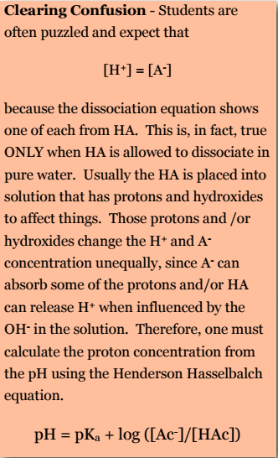

Calculating pH Change
pH = pKa + log ([Ac– ]/[HAc])
Notes:
Students are often puzzled and expect that [H⁺] = [A– ] because the dissociation equation shows one of each from HA. This is, in fact, true ONLY when HA is allowed to dissociate in pure water. Usually the HA is placed into solution that has protons and hydroxides to affect things. Those protons and /or hydroxides change the H+ and A concentration unequally, since A- can absorb some of the protons and/or HA can release H+ when influenced by the OH- in the solution. Therefore, one must calculate the proton concentration from the pH using the Henderson Hasselbalch equation.

Slide 15
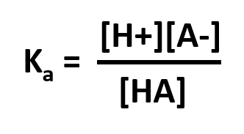
pKa
For a general acid, HA, which dissociates as
HA ⇄ H⁺ + A –
then,
and
pKa = -Log K_{a}
Notes:
Recall that the Ka is the acid dissociation constant and is a measure of the strength of an acid. For a general acid, HA, which dissociates as HA to H+ and the conjugate base, then the Ka is equal to the concentration of the products of the dissociated acid over the reactants (or concentration of acid). Thus, the stronger the acid, the more protons that will dissociate from it when added to water and the larger the value its Ka will have. Large values of Ka translate to lower values of pKa. As a result, the lower the pKa value is for a given acid, the stronger the acid.

Slide 16
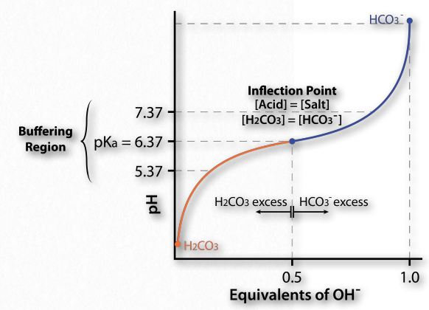
Buffers
Notes:
Let’s get back to buffers! A buffer is a solution that can resist pH change upon the addition of an acidic or basic components. It is able to neutralize small amounts of added acid or base, thus maintaining the pH of the solution relatively stable. It is essentially a substance that can act as both an acid or a base depending on the circumstances. This is important for processes and/or reactions which require specific and stable pH ranges. In biological systems, maintaining pH values is critical for maintaining life. The normal physiological pH of mammalian arterial blood is strictly maintained at 7.40; A decrease of more than 0.05 units from the normal pH results in acidosis.
Now, how does this translate into stabilizing pH? Figure 1.34 shows a titration curve. In this curve, the titration begins with the conditions at the lower left (very low pH). At this pH, the H₂CO₃ form predominates, but as more and more OH- is added the pH goes up, the amount of HCO₃– goes up and (correspondingly), the amount of H₂CO₃ goes down. Notice that the curve “flattens” near the pKa (6.37).
Flattening of the curve tells us is that the pH is not changing much (not going up as fast) as it did earlier when the same amount of hydroxide was added. The system is resisting a change in pH (not stopping the change, but slowing it) in the region of about one pH unit above and one pH unit below the pKa. Thus, the buffering region of the carbonic acid/ bicarbonate buffer is from about 5.37 to 7.37. It is maximally strong at a pH of 6.37.
This is consistent with the Henderson Hasselbalch equation and the titration curve. If a buffer has more than one pKa, then each pKa region will display the behavior.

Slide 17
Organic Functional Groups
Name common ones
Identify them from structures
Understand biological reactions for common ones, especially the carboxylic acid series of reactions.
Notes:
Another key chemistry area that you will need to review is basic organic chemistry, as all biological molecules are organic in nature. Thus, it is very useful to have good working vocabulary for naming common organic functional groups, being able to identify these groups from larger molecular structures, and understanding the common reactions for the major functional groups, especially the reactivity of carboxylic acids and amines

Slide 18
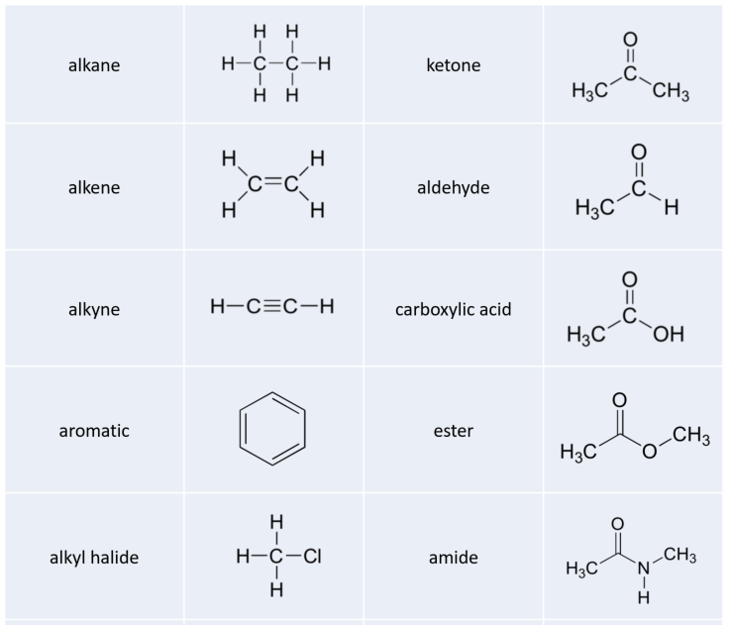
Notes:
You should be able to identify the major functional groups on these next two slides….

Slide 19
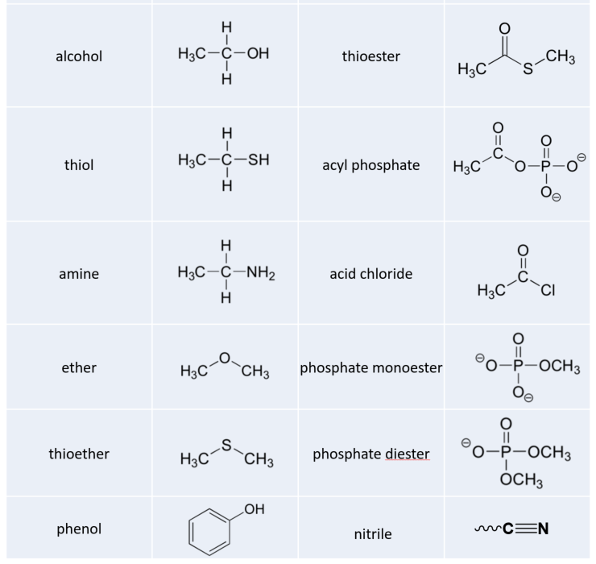
Notes:
Nitriles are rare and are the least important.

Slide 20
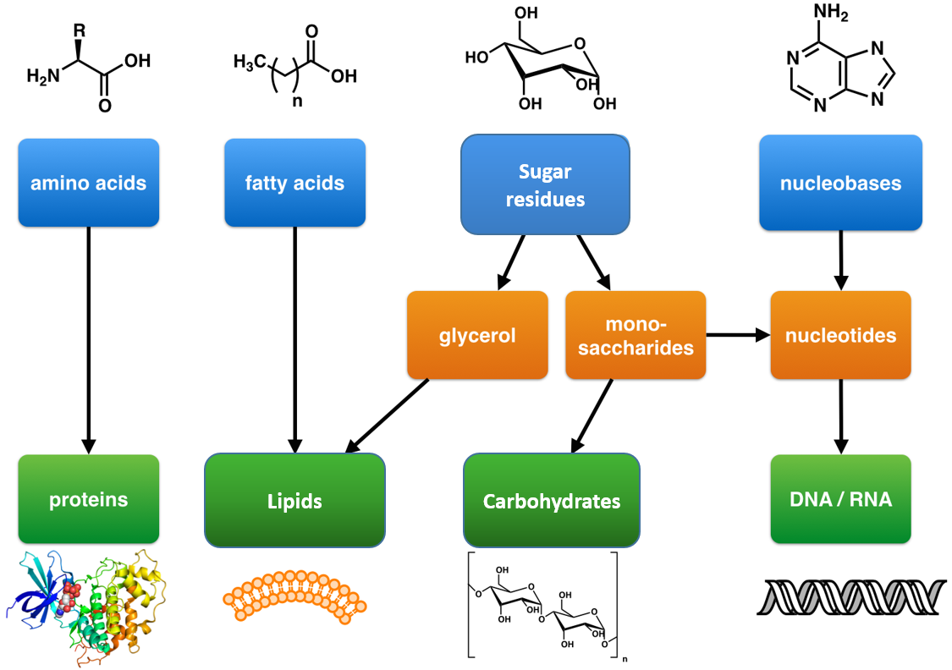
Notes:
All of the major macromolecules are put together using dehydration synthesis. The two major macromolecules that we will focus on this term are proteins and nucleic acids (DNA & RNA).

Slide 21
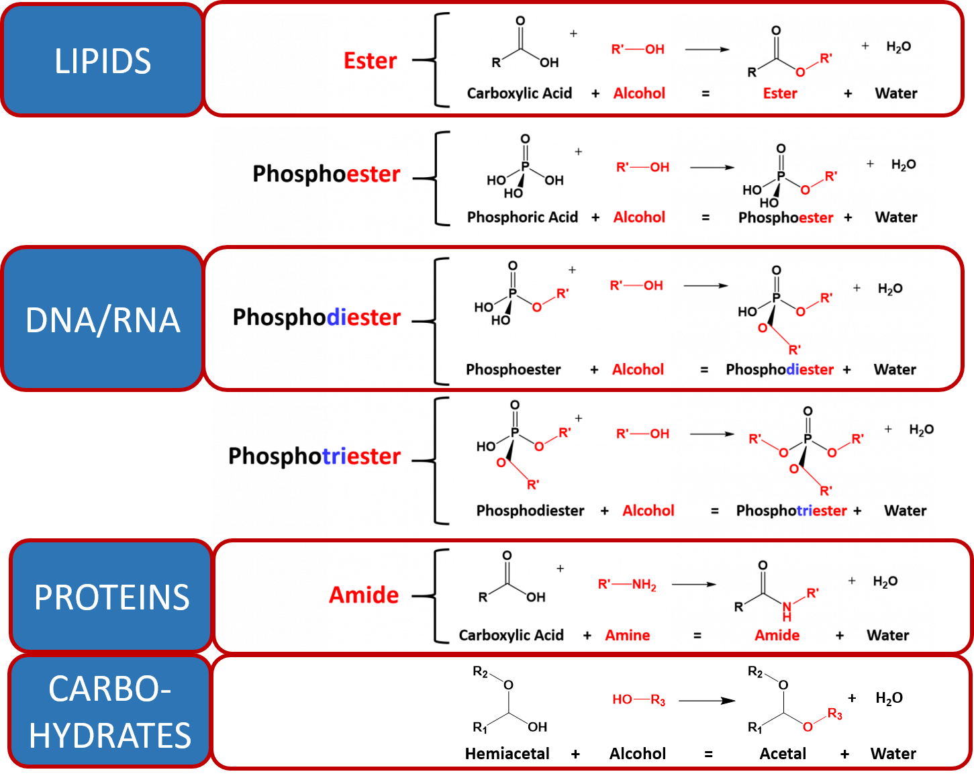
Notes:
The major dehydration synthesis reactions for each of the major macromolecules is noted here. They are all related to the formation of an ester bond, with the loss of the hydroxyl from the carboxylic acid functional group and a proton from the alcohol donor in this case. The oxygen from the alcohol mediates attack on the carbonyl carbon and the alcohol functional group of the carboxylic acid is displaced to form the water molecule. This reaction requires the activity of an enzyme.

Slide 22
Notes:
For proteins and nucleic acids, the reactions are similar, however, in the case of proteins the amine nitrogen mediates the attack at the carbonyl carbon of the carboxylic acid to displace the alcohol from the carboxylic acid and release the water molecule. This forms an amide linkage between the two amino acids. For nucleic acids, phosphoric acid functional groups are used instead of carboxylic acids which will form the phosphoester linkages inherent to the DNA and RNA backbones. Two phosphoester linkages (a phosphodiester) are required to link two nucleotides together. In the next section, we will discuss the foundations of evolution and genetics, before we begin to explore biochemistry in detail.

