Slide 1
CH450 Biochemistry I
DNA and Proteins
Notes:
Welcome to CH450 Biochemistry I. The focus of our lectures this term will be on the macromolecules of DNA, RNA, and Protein. We will take an in depth look at the structure and major processes associated with these molecules. By the end of the term, you will be familiar with (1) Major biochemistry techniques used in the lab to study DNA, RNA, and proteins, (2) The chemical structure of these major macromolecules and their biosynthesis through the processes of DNA Replication, Transcription, and Translation, (3) Major enzyme classes and enzyme kinetics, and (4) regulatory mechanisms controlling the expression and activity of proteins within the body. Where possible, we will relate these topics to health and medicine.

Slide 2
Key Topics in Chapter 1
1.1 Cellular Foundations
1.2 Physical Foundations
1.3 Chemical Foundations
1.4 Genetic, Epigenetic and Evolutionary Foundations
Notes:
In the first chapter, we will focus on an overview of the cellular, physical, chemical, and genetic foundations that provide the underpinnings for studying the processes of biochemistry. Most of this chapter should feel like review material that you have visited before in previous classes. If you find you are struggling with content in these areas, please talk with me and I can provide you with some additional background information. Having a solid foundation will help you with the in depth material covered in later chapters.

Slide 3
Foundations of Biochemistry
1.1 Cellular Foundations
Notes:
Biochemistry studies the cellular processes of living organisms at the molecule level. Thus, it is critical to know your way around the cell to help you keep track of where and when specific reactions are taking place.

Slide 4
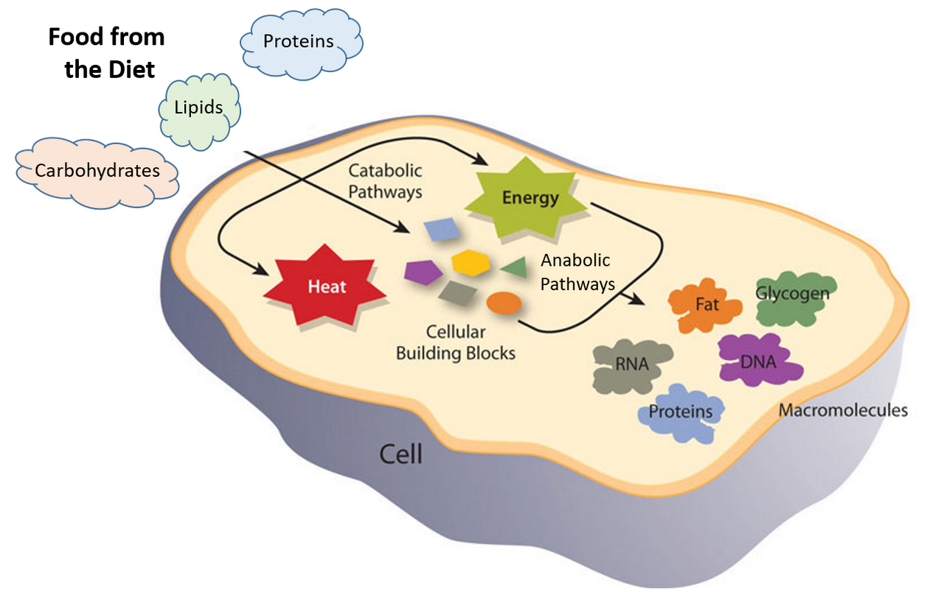
1.1 Cellular Foundations
Catabolic Reactions
Anabolic Reactions
Figure is modified from Metabolism Overview
Notes:
All living cells have basic properties that help us define them as living. Cells can replicate themselves, they can evolve, and they perform basic metabolic functions (ie eating, creating energy, creating building resources, and disposing of waste products). Catabolic reactions involve the breakdown of molecules into smaller components (ie the breakdown of food molecules into their basic components – such as proteins to amino acids), whereas anabolic reactions build larger molecules from smaller molecules (ie building new proteins from amino acid building blocks). Catabolic reactions usually release energy whereas anabolic processes usually require energy.

Slide 5
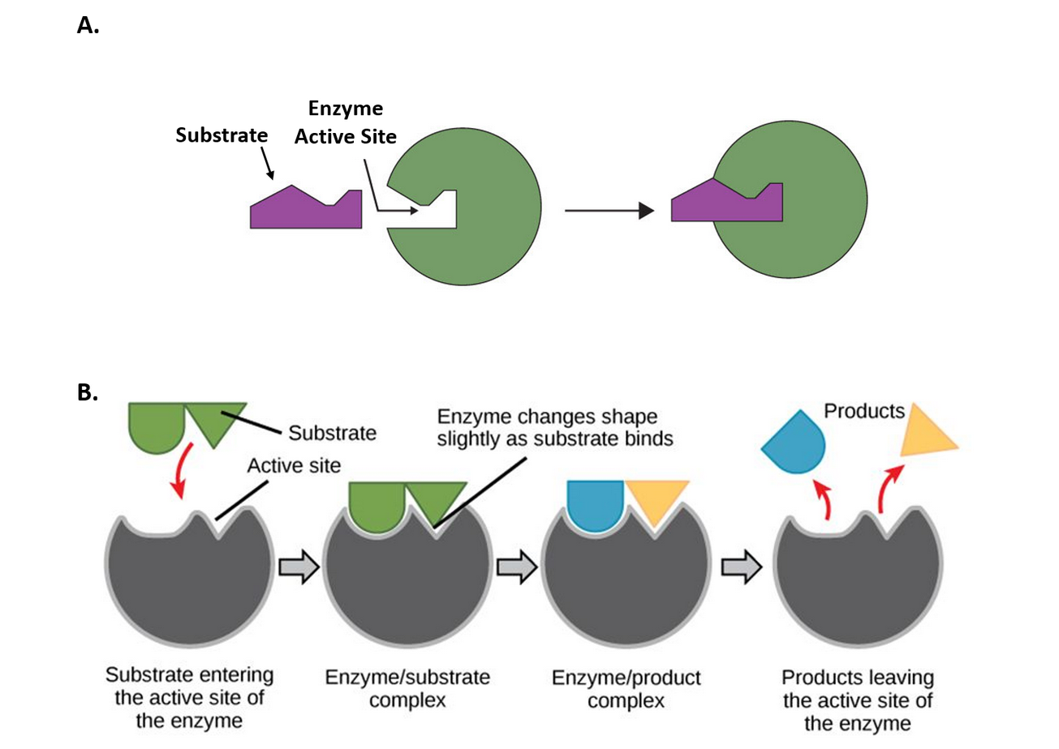
Enzymes – Catalyze Chemical Reactions
Lock and Key
Induced Fit
Figure 1.2A was modified from Socratic and Figure 1.2B was modified from Concepts in Biology
Notes:
Very few chemical reactions that take place within the body occur without the aid of a catalyst to help speed up the reaction. Biological catalysts are referred to as enzymes. Most enzymes are proteins, but some RNA molecules also have catalytic properties. To function, enzymes must be able to bind very specifically with their substrates. We will find that shape is critical to their function, and will spend a lot of time talking about the key features of protein folding and 3-dimensional structure. Overall, enzymes use two prominent mechanisms to achieve substrate binding. In diagram (A) the Lock and Key Model, is shown. Here the substrates fit into the active site of the enzyme with no further modifications to the enzyme shape required. Essentially the shapes of the molecules match just like a key has been designed very specifically to open a specific lock. Figure (B) shows the Induced Fit Model, where the initial interaction of the substrate with the enzyme causes the shape of the enzyme to change to better fit the substrate and mediate the chemical reaction. Enzymes can use either of these models to perform their biological activity within living systems.

Slide 6
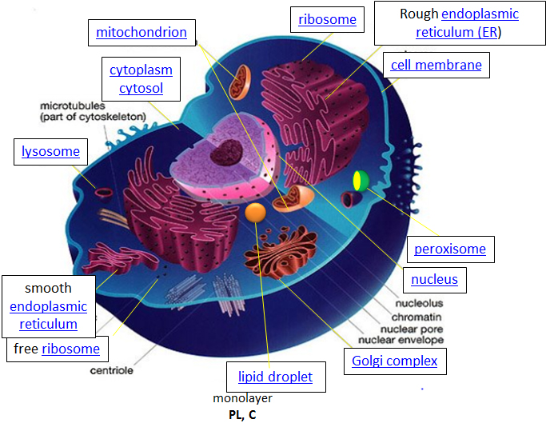
Cell Structure and Function
The original figure was acquired from Liliana Torres
Notes:
The location of biochemical reactions is also very important to maintain biological processes that will support life. For example, oxygen must be taken up in the lungs and delivered to all the cells of the body, and insulin must be made in the pancreas and delivered to the liver when blood glucose levels are high. Thus, cells are highly organized places. Eukaryotic cells (the cells of animals, plants, fungi, and protists) are the largest and most complex types of cells. Since they are so large, they contain small compartments, called organelles, that do specialized functions. You should review and be able to recall the different organelles and their functions shown in diagram of the animal cell on this slide. Even the simplest prokaryotic, bacterial cells that do not contain organelles are far from bags of liquid goo. They are not simple homogenous mixtures of proteins, sugars, nucleic acids, and lipids. Reactions within cells are highly specific and localized to small regions within the cells and are carried and transported by specific cellular machinery to their correct locations.

Slide 7
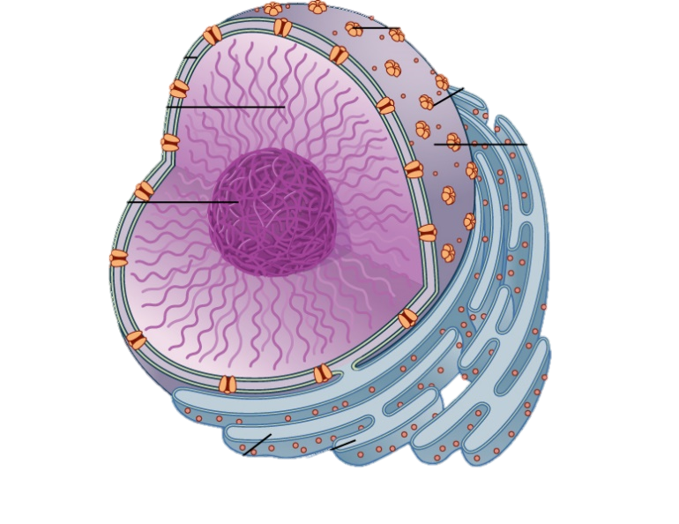
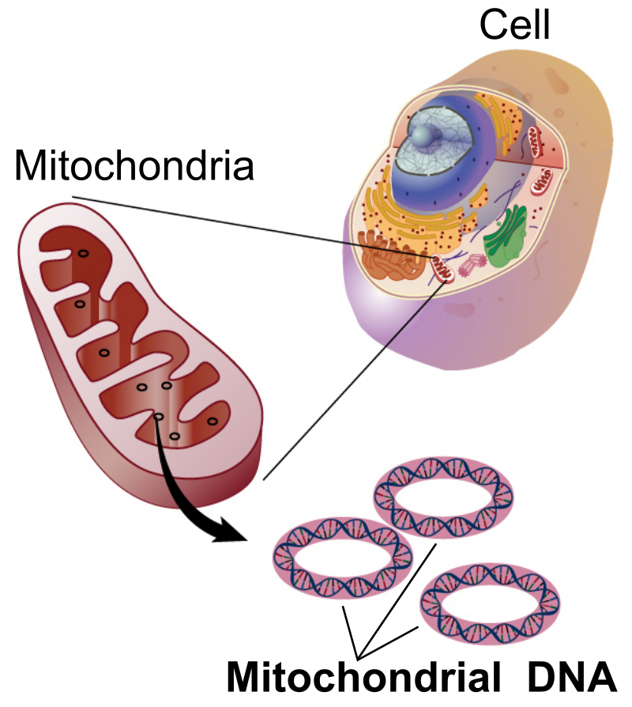
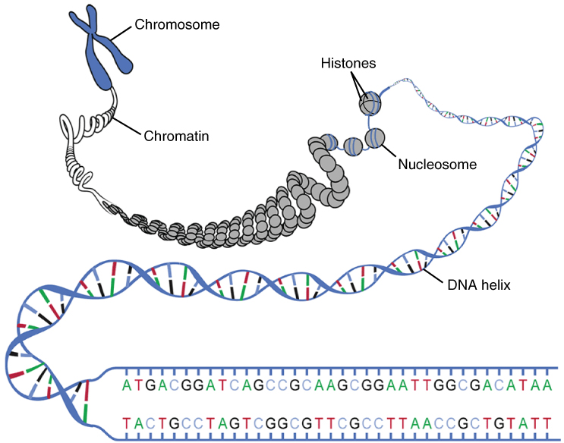
Cellular Design
Nucleus
Chromatin
Nuclear
Pores
Nucleolus
Chromosomal DNA
Images modified from: National Human Genome Research Institute at NIH and OpenStax Anatomy and Physiology
Notes:
Within all eukaryotic cells, the genetic material that houses the blueprint for making all the proteins found in the cell is found within two of the major organelle structures. The primary site for most of the eukaryotic DNA is found in the structure of the linear, double-stranded chromosomes that are located in the nucleus of the cell. This is known as chromosomal DNA. Genetic material is also found within the mitochondria of the cell. This organelle is thought to have been derived from a bacteria that was originally engulfed by an early pre-eukaryotic cell. The subsequent bacteria, then became a required symbiont within the organism, and evolved into the many eukaryotic cells found throughout the major kingdoms of life. Mitochondrial DNA is the small circular chromosome found inside mitochondria. These organelles found in cells have often been called the powerhouse of the cell, as energy in the form of ATP is created here. In mammals, the mitochondria, and thus mitochondrial DNA, are passed almost exclusively from mother to offspring through the egg cell.

Slide 8
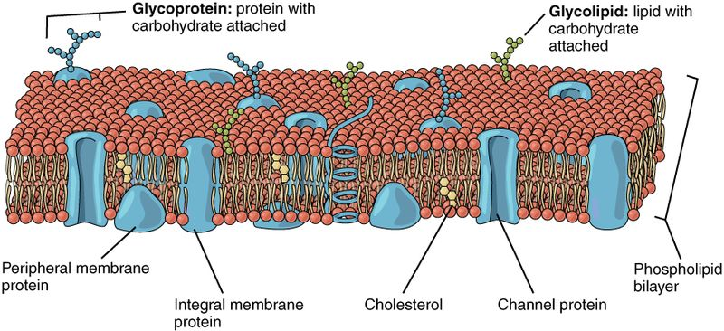
The Lipid Bilayer
Images from: Openstax
Notes:
Cells and the organelles that they contain are surrounded and defined by lipid bilayer barriers. Lipid bilayers are defined by the phospholipid structure that contains a polar head group on one side, shown as the red balls in the diagram and the two hydrophobic lipid tails that face inward into the membrane structure. Embedded within the lipid bilayer are proteins and cholesterol. Notable features of the membrane is that it behaves much like a liquid or a semi-solid. The proteins embedded within it can float around and move in a dynamic way laterally through the membrane. This is known at the fluid mosaic model. The lipid bilayer provides barrier structures to the cell and internal organelles that determines what molecules can pass into or out of the cell or organelle structure. Thus, lipid bilayers are critical structures for cellular communication and cellular transport of goods.

Slide 9
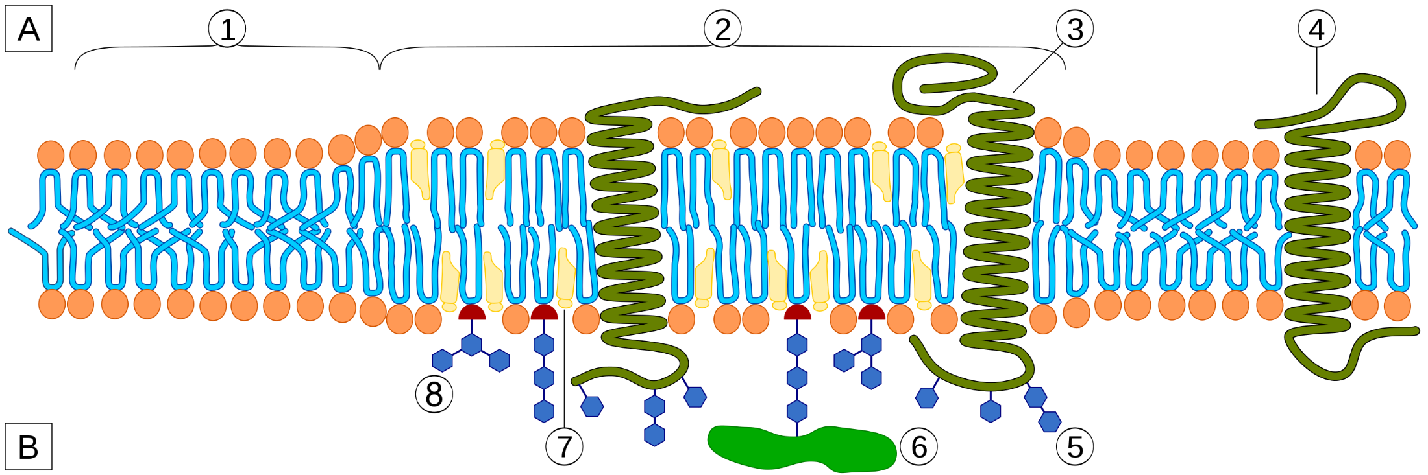
Cellular Substructure Formation
Can occur due to phase transitions/separations
Normal Plasma
Membrane
Lipid Raft
Notes:
Due to the dynamic and fluid nature of the membrane structure, substructures within the membrane can occur within localized regions. Thus, compartmentalization of functions can even occur at this level of cellular structure. Essentially, one part of a membrane is not exactly like another part of the membrane. Thus, some molecules may only pass through the membrane within a select region of the membrane and be blocked from entry in other regions. Areas called lipid rafts, have a high density of proteins and cholesterol compared with surrounding plasma membrane. Lipid rafts can be sites where cellular signaling and communication are heightened.

Slide 10
Cellular Import/Export Across Membranes
Diffusion – Movement down concentration gradient; no energy required.
Simple Diffusion – Nonpolar molecules; No protein required
Facilitated Diffusion – Polar molecules; Protein required
Active Transport – Movement against concentration gradient; requires energy input and a protein pump
Notes:
Due to the hydrophobic nature of lipid bilayers, only small, nonpolar molecules can cross the membrane by simple diffusion. This would include molecules like oxygen or carbon dioxide, as well as some steroid hormones such as estrogen. Recall that diffusion is the movement of molecules down their concentration gradient from an area of high concentration to an area of low concentration. This process does not require energy and will happen spontaneously. Larger or more polar molecules cannot cross the membrane without the aid of transport protein. If a polar molecule is moving through a transport protein, down its concentration gradient, this is known as facilitated diffusion (ie the movement of the molecule is facilitated by the transport protein). No energy is required for this process and it will also proceed spontaneously as long as the transport protein is present and open. Alternatively, molecules are sometimes transported against their concentration gradient from an area of low concentration to an area of high concentration. This is known as active transport and is a process that requires energy in form of ATP.

Slide 11
Cellular Import/Export Across Membranes
Channel Proteins
Carrier Proteins
Protein Pumps
Pores
Endocytosis
Exocytosis
Facilitated Diffusion
Active Transport
Facilitated Diffusion or Active Transport
Typically Active Transport
Notes:
Import and export of molecules from the cell or within cellular compartments utilizes many different processes and cellular features. This includes the protein transporters we have already discussed in our examples of facilitated diffusion and active transport. In addition protein complexes can form large pores to allow the transport of larger molecules across membrane boundaries. Larger amounts of material can also be transported in small lipid bubbles that can bleb off from or fuse with existing membrane structures. These processes are known as endocytosis and exocytosis.

Slide 12
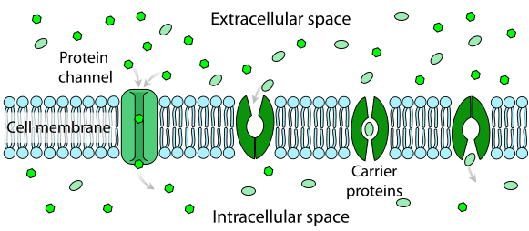
Membrane Channels and Carriers
Image from: LadyofHats
Notes:
Here are some examples of protein channels and carrier proteins. Typically channels contain a large opening that allow molecules to pass all the way through the protein and across the membrane. Carrier proteins typically bind to a molecule on one side of the membrane and then have to undergo conformational changes to open up to the other side of the membrane where they will release their load.

Slide 13
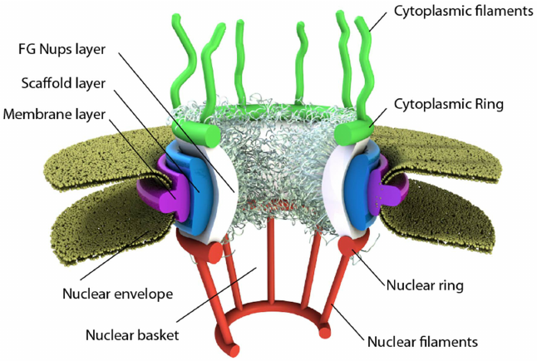
Nuclear Pore
Image from: Azimi, M. and Mofrad, M.R.K. (2013) PLoS One 8(11):e81741
Notes:
This is an example of a pore complex located in the nuclear membrane. The pore is anchored to the nuclear envelope by a membrane layer that surrounds the scaffold layer. This scaffold layer provides structure and serves as an anchor for Nups (nuclear pore proteins) that contain both structured domains as well as highly unstructured domains that are thought to form a barrier that excludes non-interacting molecules while allowing for selective transport of others. This central channel exhibits eight-fold rotational symmetry and has eight cytoplasmic filaments as well as eight nuclear filaments protruding into the cytoplasm and nucleoplasm respectively. The nuclear filaments are bound via a ring, resulting in a basket structure. Pores allow for the selective transport of larger molecules through membrane structures, including molecules such as mRNA.

Slide 14
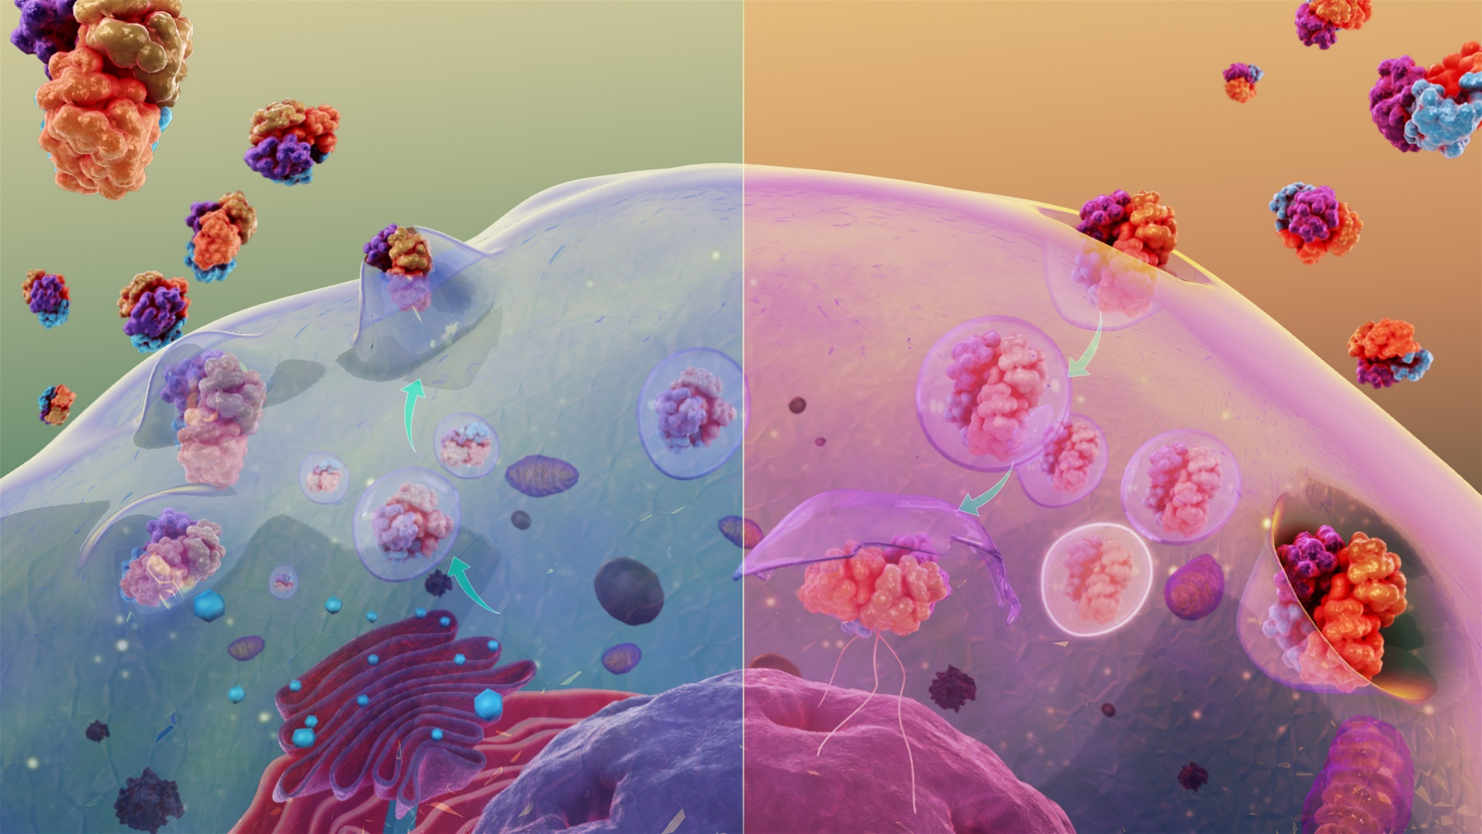
Endocytosis and Exocytosis
Image from Scientific Animations
Notes:
Exocytosis (shown on the left) is an active transport process that requires the fusion of secretory vesicles with the plasma membrane to export molecules into the extracellular matrix or embed molecules into the plasma membrane. Endocytosis (shown on the right) is the opposite process of engulfing materials from outside the cell through the invagination of the plasma membrane and the formation of membrane-bound vesicles within the cytoplasm.

Slide 15
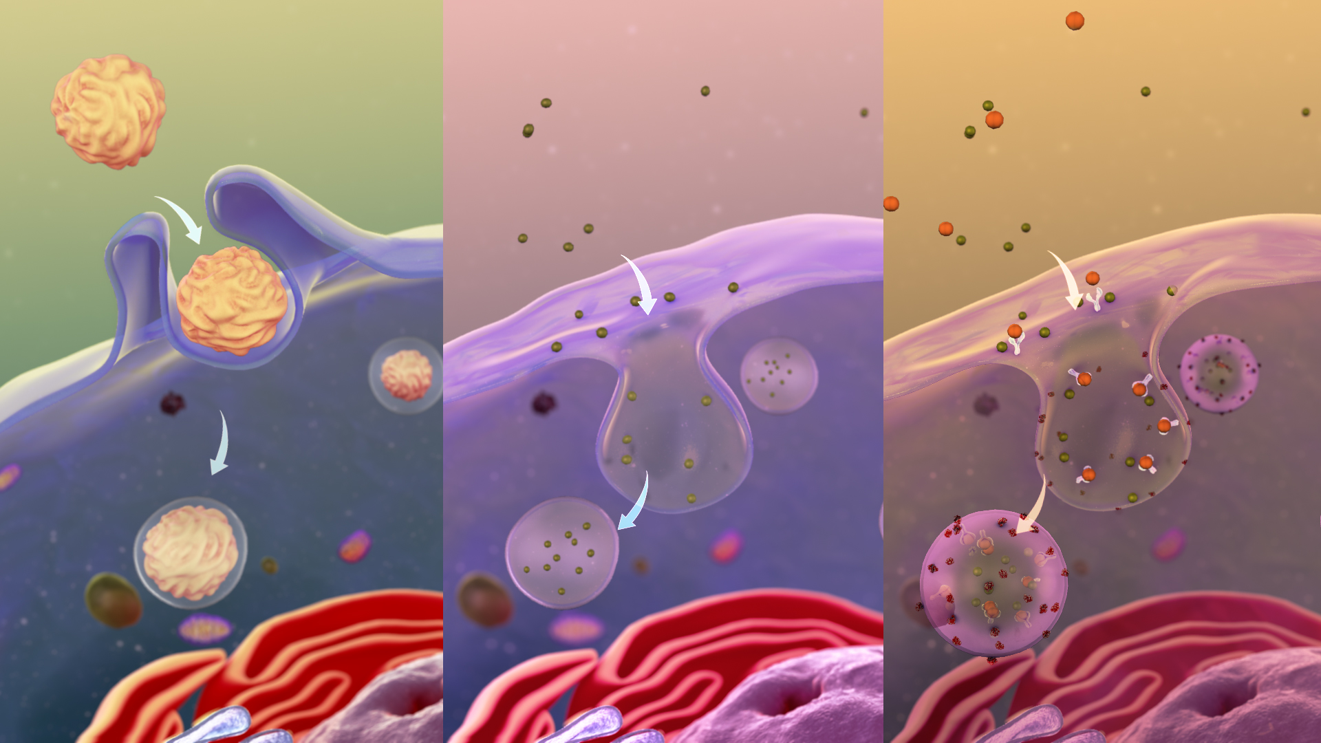
Endocytosis
Image from Scientific Animations
Notes:
The endocytic pathway of mammalian cells consists of distinct membrane compartments, which internalize molecules from the plasma membrane and recycle them back to the surface or sort them to degradation. Endocytosis can occur as Phagocytosis (shown on the left), Pinocytosis (in the middle), or Receptor-mediated endocytosis (shown on the right). Phagocytosis meaning 'to eat', is the process by which a cell uses its plasma membrane to engulf a large particle (≥ 0.5 μm), giving rise to an internal compartment called the phagosome. Pinocytosis is a mode of endocytosis in which small particles suspended in extracellular fluid are brought into the cell. Receptor-mediated endocytosis (RME), also called clathrin-mediated endocytosis, is a process by which cells absorb metabolites, hormones, proteins – and in some cases viruses – by endocytosis. Only the receptor-specific substances can enter the cell through this process (the receptors are shown in white, and the molecules being transported in red).

Slide 16
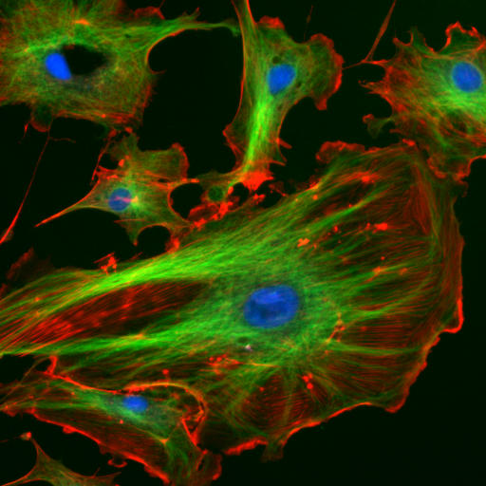
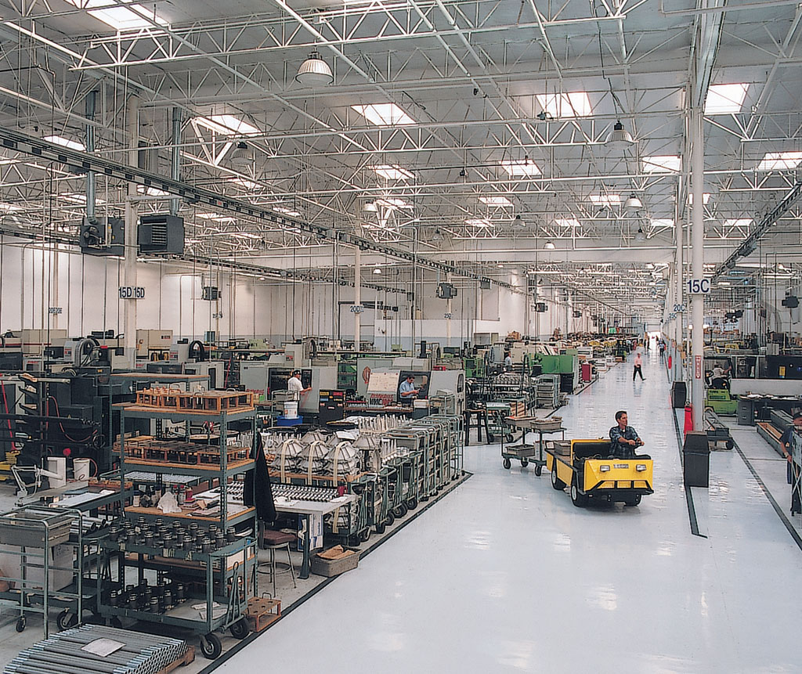
Cells have Internal Framework
Notes:
As we noted previously, cells are not bags of unorganized goo…they are more like a highly scaffolded and organized warehouse. Cells contain protein scaffolds such as tubulin and actin that create a cytoskeleton. The cytoskeleton is strong and rigid, providing shape for the cell, while also being dynamic in nature, so that the cell is in construct dynamic flux and can change shape dynamics based on its environment.

Slide 17
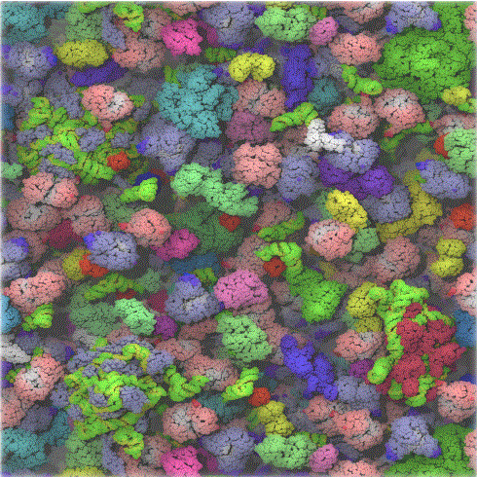
Cells are Crowded Places….
Notes:
Finally, cells are crowded places. They are like large cities with millions of people moving around. There is a lot of traffic…thus, cells must be very organized so that the correct molecules are trafficked to the correct locations for key biological activities to occur. Overall, cells are highly organized, highly compartmentalized, and contain complex machinery for the transport of molecules.

Slide 18
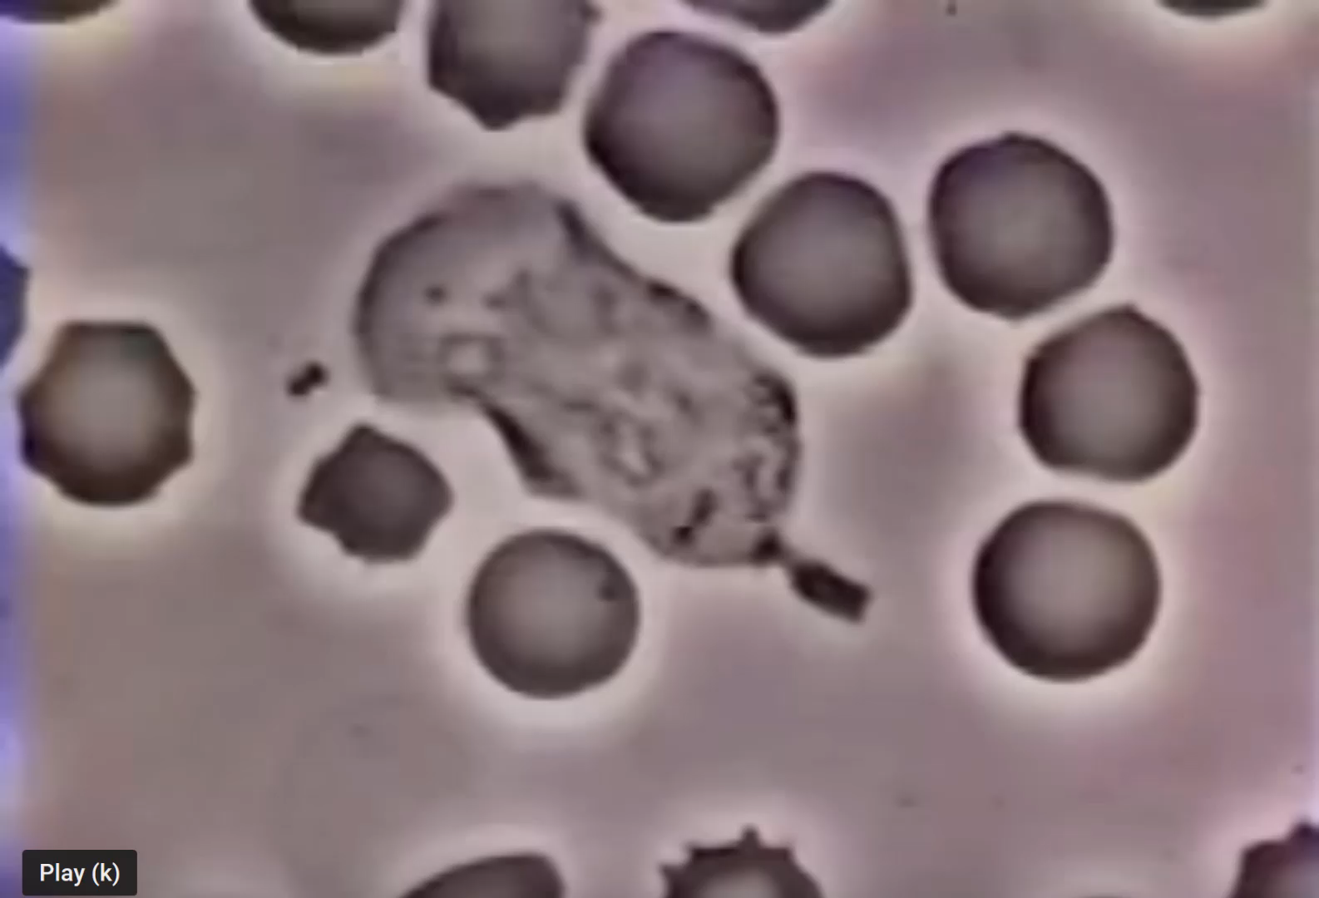
Neutrophil Chasing a S. aureus Bacteria
Video by David Rogers from Vanderbilt University
Notes:
Overall, in this section, you have reviewed the cellular framework important for our exploration of biochemistry. You have reviewed the major types of cells (prokaryotic and eukaryotic) that make up both the smallest and largest living organisms. You have reviewed the major organelle structures found in eukaryotic cell types and explored the movement of molecules across the plasma membrane boarders that define both cellular and organelle boundaries. Overall, cells are very rich and dynamic places that are capable of doing very specialized functions, such as this white blood cell chasing a bacteria! In the next section, we will review the physical foundations that help lay the groundwork for the field of biochemistry.

