Slide 1
Chapter 9: DNA Replication
9.1 DNA Replication is Semiconservative
Notes:
Chapter 9 deals with the process of DNA Replication. In this first section, we will discuss the semiconservative nature of DNA replication

Slide 2
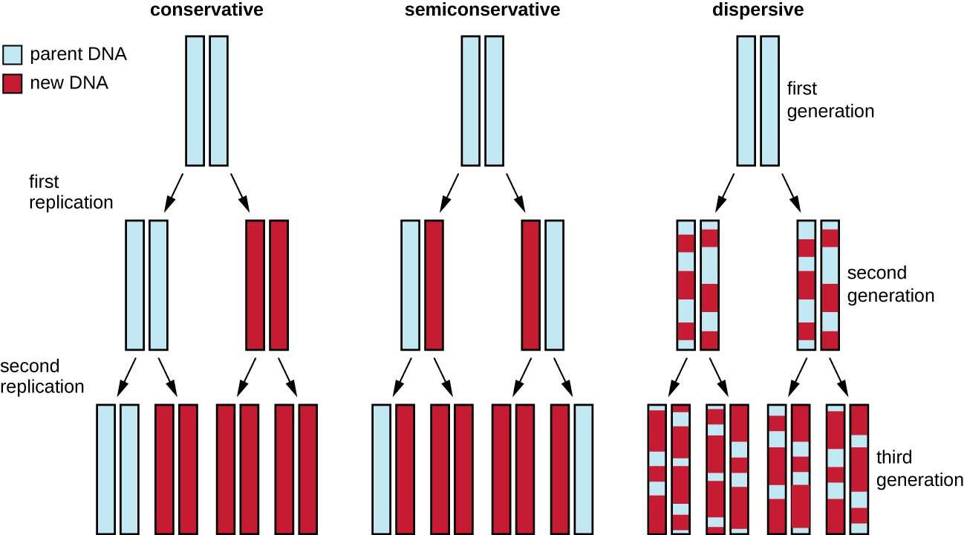
DNA Replication is Semiconservative
Notes:
Before the nature of DNA replication was known, there were three putative hypotheses that could describe the nature of the DNA replication process. In the fist hypothesis, the daughter strand is created in a completely new manner while retaining the structure of the original parent strands. This is a conservative replication model. The second model is a semiconservative model, where the resulting products each contain one parent strand of DNA and one new strand of DNA. The third model for DNA replication is dispersive, where the parent DNA would be interspersed with newly replicated sequences of DNA.

Slide 3
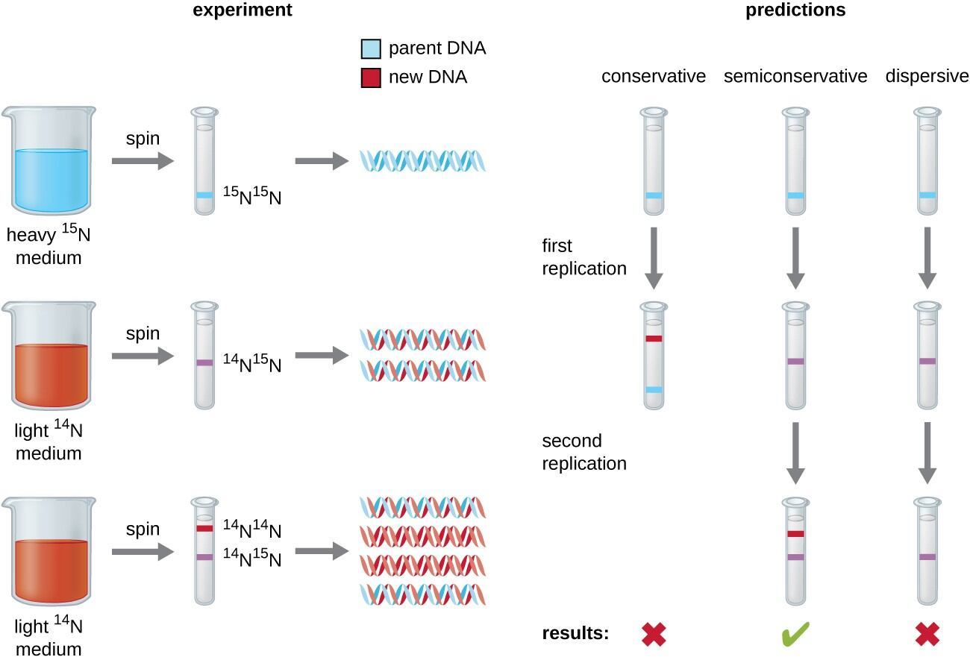
DNA Replication is Semiconservative
Notes:
The semiconservative nature of DNA was discovered through a labeling experiment using different isotopes of Nitrogen. In the first part of the experiment, the entire parental DNA is labeled with heavy nitrogen (15N, nitrogen), the culture is then shifted and grown in 14N, nitrogen. If the DNA replication is conservative, all of the heavy nitrogen will stay together and the lighter 14N nitrogen would also stay together after one round of replication. If the DNA is replicated in a semiconservative or a dispersive model, the first round of replication would create a single band of DNA that has both the 14N and 15N mixed together within the product. However, after one round, you wouldn’t be able to tell the difference between the semiconservative and the dispersive models. For this, you would need to do a second round of synthesis. In this case, the semiconservative model would result in products that would either have a mixture of the 15N and 14N or be completely 14N, whereas after a second round of replication, the dispersive model would still only have a single band of DNA that has mixed 15N and 14 N content. What was observed was the semiconservative predictions of a single band after the first round of replication and two bands after the second round. This was the first indication that the parent DNA molecule serves as a template for the creation of the new daughter strand.

Slide 4
Chapter 9: DNA Replication
9.2 DNA Replication in Prokaryotes
Notes:
And with that introduction to one of the earliest studies about DNA replication, we will now dive into some of the key details of prokaryotic replication.

Slide 5
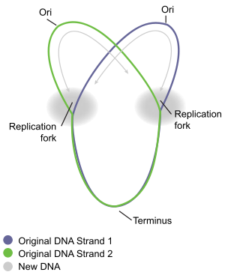

Prokaryotic DNA is circular
Notes:
One of the major features of prokaryotic DNA is the it is circular in nature, and the size of the chromosomal DNA is much smaller than eukaryotic counterparts. Thus, replication is typically characterized by having one origin of replication, called Ori, in the diagram. The ori is the site where the DNA double helix opens up and each of the strands is used as a template to synthesize the new daughter strands (shown as the dashed circles in the diagram on the right. Notice the replication is bidirectional and moves outward from the Ori in both directions..

Slide 6
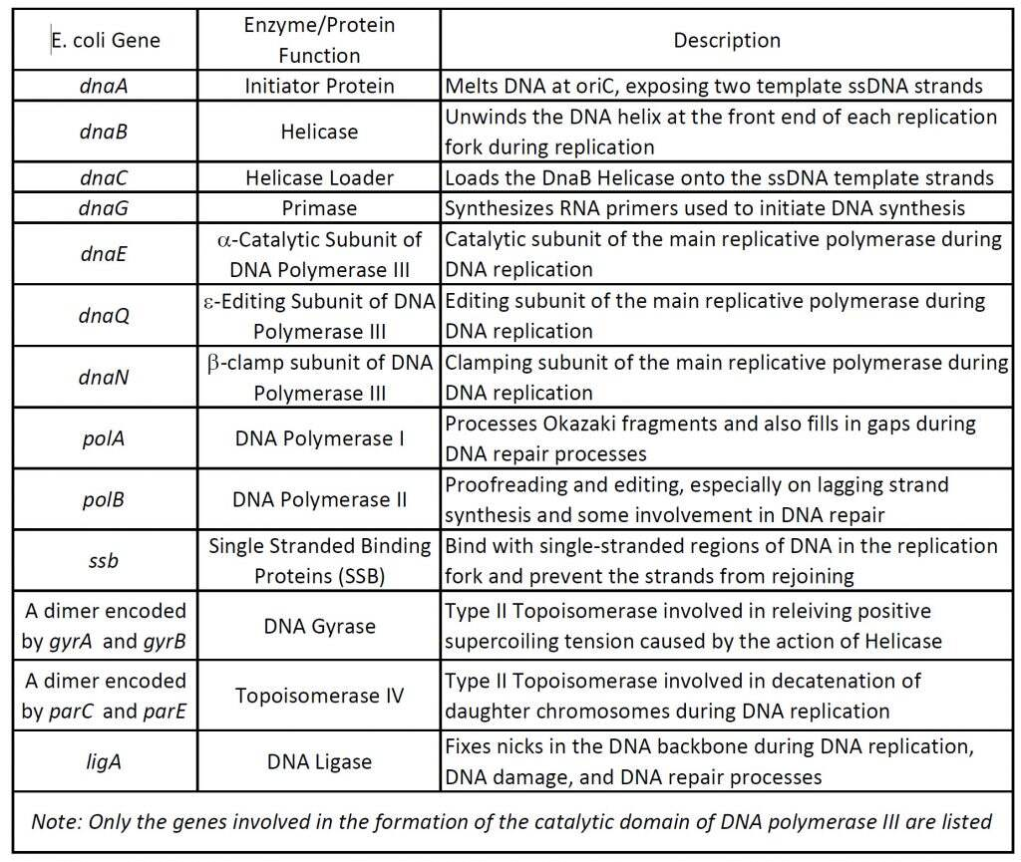
Notes:
This next table is a nice summary of the major enzymes that are required for prokaryotic DNA replication. We will work our way through the major players. Note that this table has a column where the enzymes are listed, as well as the genes in E. coli, that encode for them. Some of the diagrams that we look at may refer to the genes that are listed here. So use this table as a guide when you need some clarification.

Slide 7
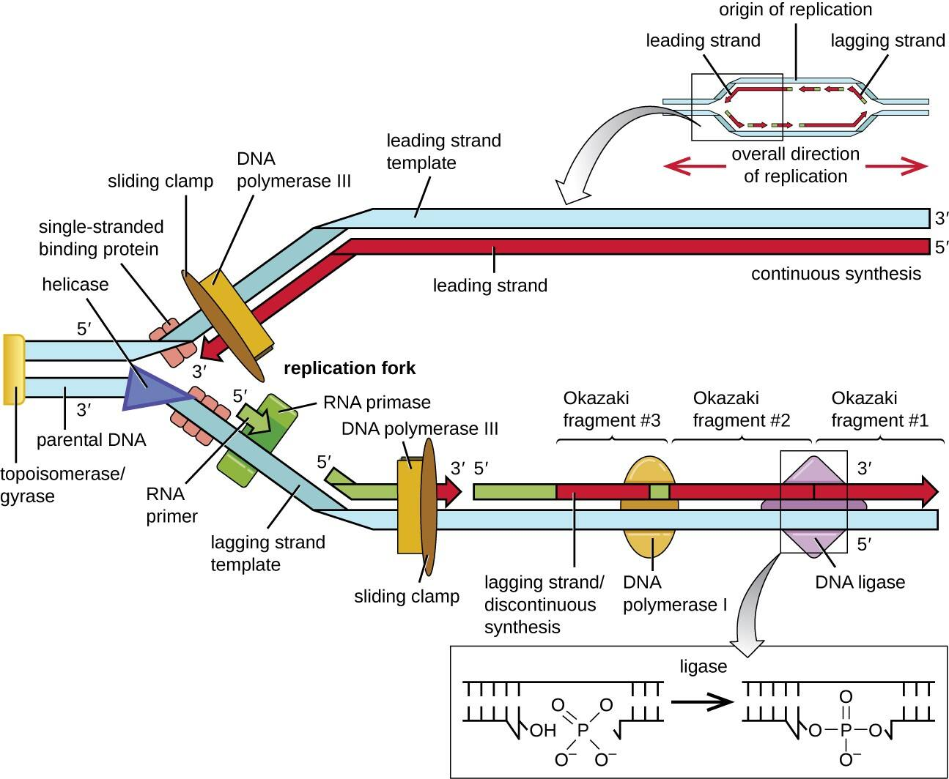
Prokaryotic Replication
Overview
Notes:
This diagram gives a nice overview of the major enzymes and proteins involved with DNA replication. Once the Ori has been opened, exposing single stranded DNA a DNA replication fork can form. Leading this way is the DNA helicase enzyme that is involved in unwinding the double stranded DNA to create the single stranded bubble. When the helicase unwinds the DNA, this introduces more tension into the double stranded DNA ahead of the replication fork. The DNA topoisomerase enzymes are used to relieve this supercoiled tension during the replication process. ssDNA binding proteins will bind to the DNA and keep it from reforming the double helix. Note that each strand of DNA is lying in the opposite orientation, one in the 5’ to 3’ direction and the other in the 3’ to 5’ direction. Recall that DNA synthesis only occurs in the 5’ to 3’ direction with the insertion of the new nucleotide at the 3’-OH of the previous base. Thus, for bidirectional synthesis to occur one strand can move easily in the same direction that the replication fork is going. This is the leading strand. This is where the new strand can be built in the 5’ to 3’ direction. The lagging strand has to be built in short bursts in the opposite direction of the replication fork as the lagging strand template must wind itself backwards through the DNA polymerase enzyme to link in bases in the 5’ to 3’ direction. After a short region is completed, the DNA is released and rewound again upstream. This creates multiple smaller DNA fragments on the lagging strand, known as Okazaki fragments, during the replication process. The DNA polymerase enzyme requires a few key components to mediate DNA replication. It must have a template strand to know which base to incorporate into the growing strand, and it must also have a primer to be able to incorporate the next base onto. DNA replication cannot just happen on its own. Thus, small RNA segments will serve as a primer that will enable the start of DNA replication. The RNA primase enzyme mediates this function. Only one primer is needed for the leading strand to start, but multiple small primers will be needed on the lagging strand, each time the sequence is released. Another DNA polymerase enzyme will end up removing the RNA primer sequences and filling them in with the appropriate DNA and the sugar/phosphate backbone will be resealed by the DNA ligase enzyme. Within the next few slides we will take a look at this process in more detail.

Slide 8
The Primosome
Notes:
The initiation of replication at the Ori location requires the assembly of a protein complex known as the primosome.

Slide 9
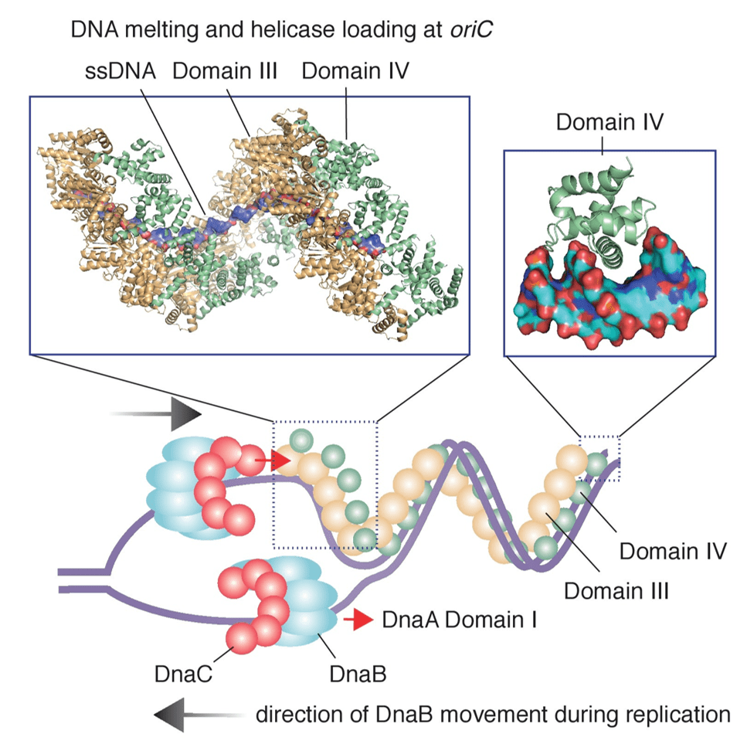
Primosome
Notes:
This diagram shows the assembly of the DNA primosome. This involves the binding of an initiator protein to the Ori sequence. In E. coli, this initiator is encoded for by the DnaA gene. The DnaA initiator protein binds to ATP and specific sequences at the Ori. DnaA is a long snake-like protein with multiple subunits. Domains III and IV are the most visible. Binding of DnaA + ATP causes torsional strain at the Ori and initiates the unwinding process. DnaC (the helicase loader) Interacts with DnaA that is bound at the Ori, and also traps the DnaB helicase protein in an open lock washer conformation so that it can load onto the ssDNA. Domain I of DnaA helps to capture another DnaB-DnaC complex to load on the opposite strand. Once this is assembled, DnaC (the helicase loader) dissociates from the complex and DnaB shifts conformation to a closed ring structure. This forms the functional primosome. The DnaB helicase then begins to unwind the DNA at the new replication fork, and the DnaG primase enzyme adds an RNA primer.

Slide 10
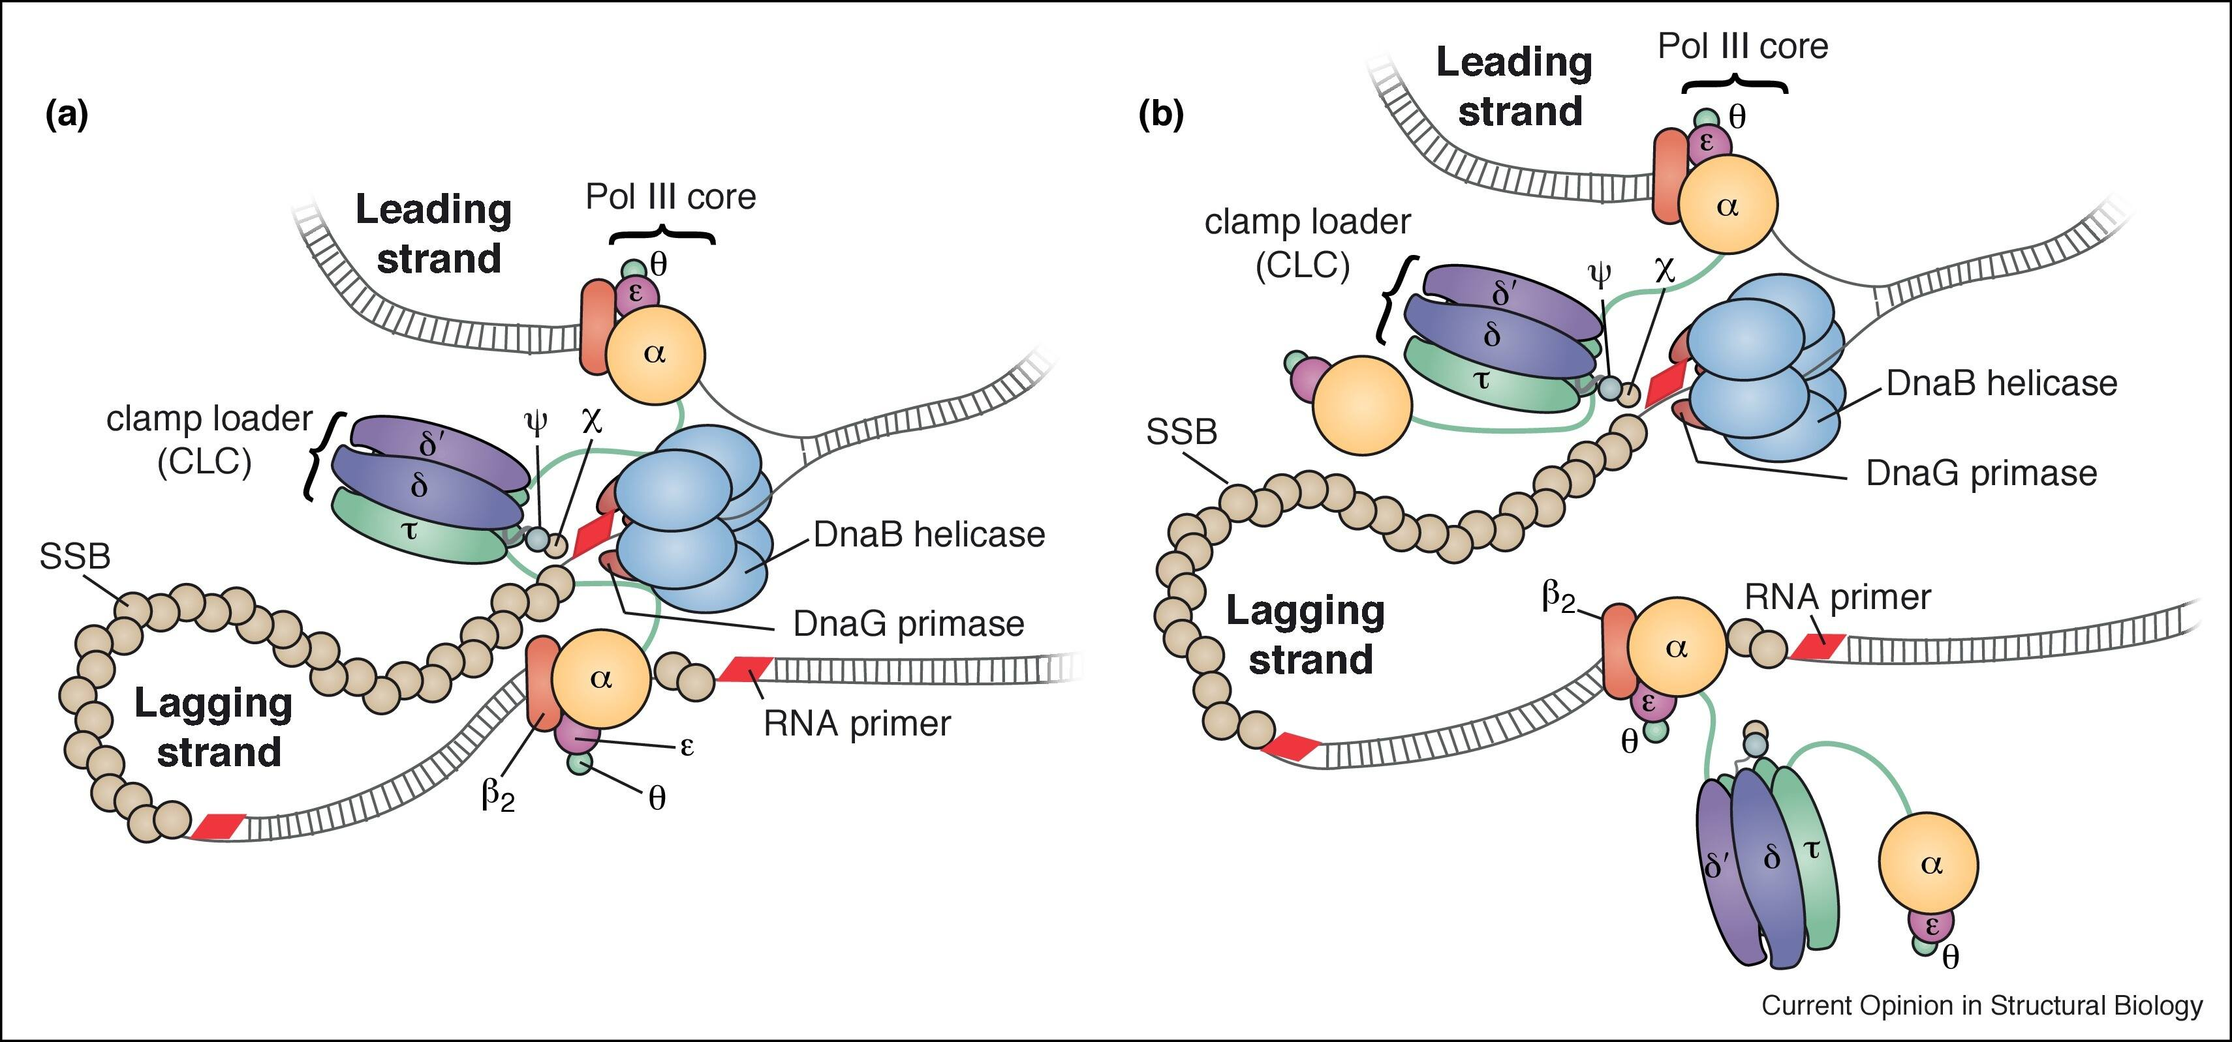
DNA Polymerase Enzymes
Notes:
E. coli has a total of 5 DNA Polymerase enzymes, 3 of which are involved in DNA replication (I, II, and III). DNA polymerase III is the main polymerase involved in both leading strand biosynthesis and the synthesis of the Okazaki Fragments during DNA replication. The DNA polymerase III holoenzyme is comprised of 10 different proteins organized into three functionally distinct, but physically interconnected assemblies: (1) the αεθ core, (2) the β₂ sliding clamp, and (3) the δτ_{n}γ_{3-n}δ’ΨX clamp loader complex. Figure a, shows the standard textbook model of a DNA Replisome with the coupled and highly coordinated processes of leading strand and lagging strand synthesis. DNA polymerase III is connected to the DnaB helicase through the τ subunit of the clamp-loader comples and two or three polymerase cores replicate DNA from both leading strand and lagging strand DNA templates concurrently. The ssDNA in the lagging strand loop is bound by ssDNA binding proteins (SSB). However, as shown in Figure b, recent studies have shown that E. coli DNA polymerase III is readily exchangeable at the fork and that leading strand and lagging strand synthesis may not be tightly coupled, or may even be accomplished by different DNA polymerase III holoenzymes. The DnaB helicase can also be decoupled from the DNA polymerase complex and translocate ahead of the apex of the fork.

Slide 11
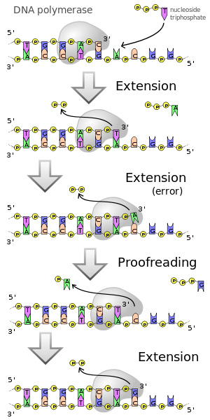
DNA Pol III
Polymerase
Proofreading
Notes:
DNA Pol III has both DNA Polymerase and Proofreading capabilities which give it really high fidelity. Typically it has an error rate of 1 in 1 million bases.

Slide 12
DNA Pol III
Polymerase
Proofreading
Notes:
DNA Pol III polymerase activity is shown here with the incorporation of the deoxythymidine triphosphate into the growing chain.

Slide 13
DNA Pol III
Polymerase
Proofreading
Notes:
Occasionally there is an extension error, where the wrong nucleotide is incorporated into the growing chain. Here you can see that an ‘A’ has been incorporated opposite a ‘C’, rather than the correct ‘G’ base.

Slide 14
DNA Pol III
Polymerase
Proofreading
Notes:
In this case, the proofreading capabilities of the polymerase utilize 3’ to 5’ exonuclease activity to remove the misincorporated base. Then normal polymerase activity and extension of the new DNA strand can continue. So overall, DNA polymerase III have 5’ to 3’ polymerase activity and 3’ to 5’ proofreading exonuclease activity.

Slide 15
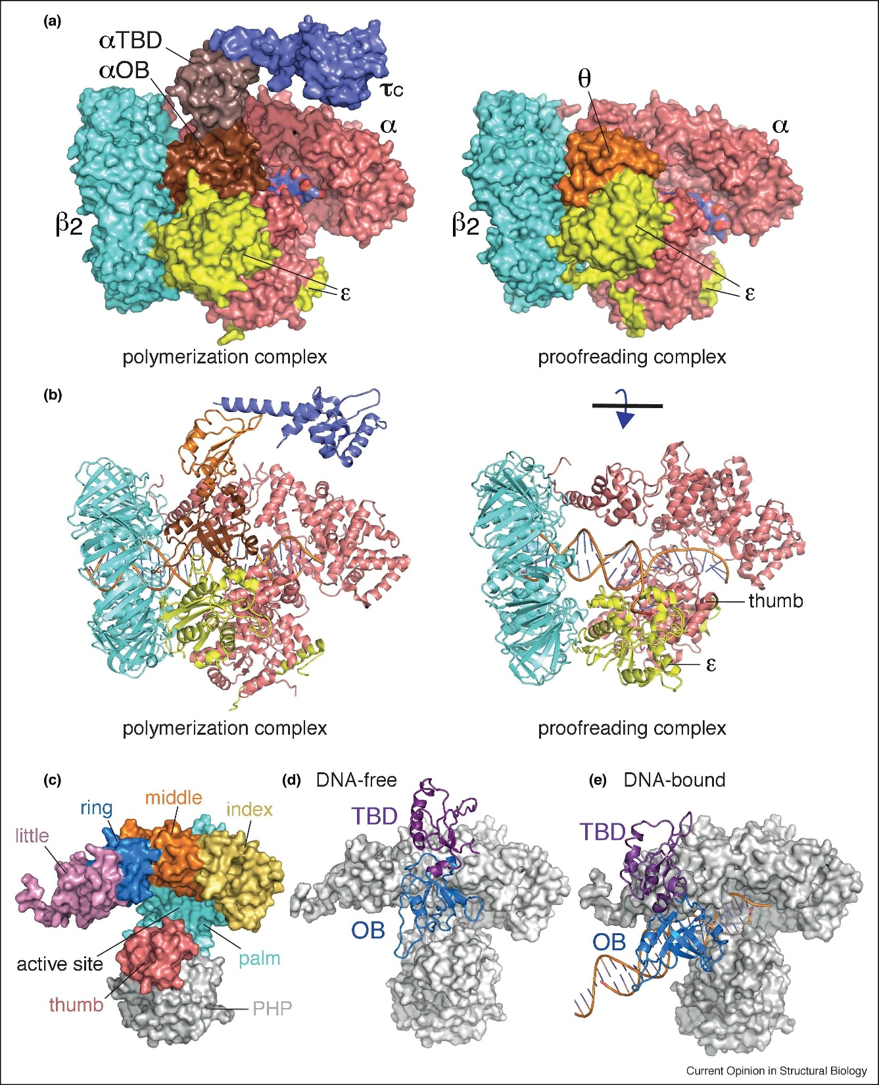
DNA Pol III
Core
Notes:
Cryo-EM structures of the DNA Pol III Core, clamp and the tao clamp loader are shown here, with the DNA polymerase in both the polymerization and proofreading modes. This shows that there is a lot of flexibility in the DNA polymerase, especially in the thumb region, such that the polymerase is essentially adding a base, and then shifting to check the added base, before it moves forward to add the next base.

Slide 16
DNA Polymerase III
Notes:
This diagram is showing a side view of the DNA polymerase III protein, with special detail shown for the flexible movement of the tao binding domain (TBD) and the oligonucleotide binding domain (OB) when the polymerase is free or with the DNA bound to the structure.

Slide 17
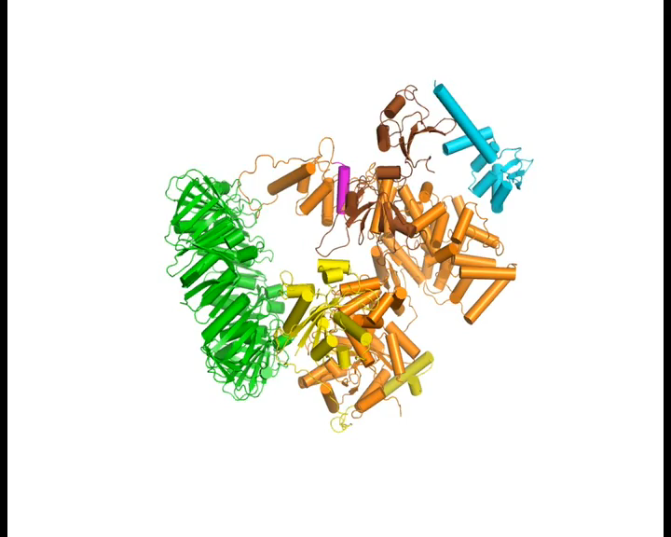
Notes:
This video shows the flexibilitiy of the DNA polymerase III, especially the tao binding domain and the oligonucleotide binding domains.

Slide 18
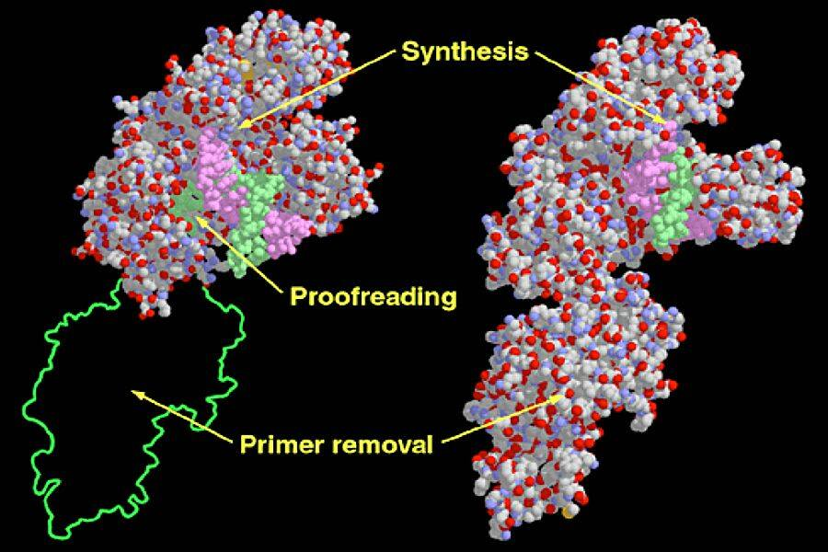
DNA Polymerase I
Notes:
DNA Polymerase I is mainly involved with primer removal and replacement during DNA replication, as well as with DNA Proofreading. In addition to the 5’ to 3’ polymerase active and the 3’ to 5’ exonuclease proofreading abilities, the DNA pol I enzyme also has 5’ to 3’ exonuclease activity. This means that the DNA Polymerase I can remove the RNA primer sequences that are laid down along the lagging strand during DNA replication, and replace that sequence with DNA. The E. coli DNA Pol I is shown on the left and was crystalized without the 5’ to 3’ exonuclease domain. The green outline shows where this portion of the protein normally would be. The structure of the right is the full DNA pol I enzyme from Thermus aquaticus. Note that DNA Pol II is predominantly utilized in the repair of mismatch bases following DNA replication, and has some overlapping function with DNA Pol I.

Slide 19
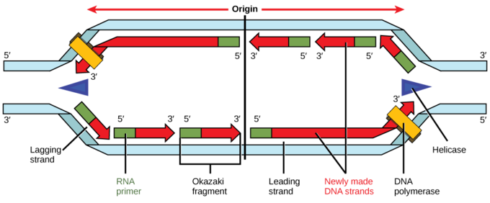
DNA Polymerase I
Figure from: Biology. Libretexts
Notes:
Once the DNA Polymerase III has finished synthesizing the bulk of the DNA, you will notice that the lagging strand of each replication fork, has many RNA primers throughout the DNA. These cannot be removed by DNA polymerase III, as it does not have 5’ – 3’ exonuclease activity. Thus, when DNA polymerase III runs into the downstream primer, it falls off of the DNA and is finished with its synthesis ability. The DNA Polymerase I will link on to the DNA and scan along the sequence checking the 5’ to 3’ strands. It has 5’ to 3’ exonuclease activity and can remove and replace the RNA primers in the Okazaki fragments. The one thing that it cannot do, it cannot seal the breaks in the backbone between the separate Okazaki fragments. The DNA Ligase enzyme will be required for this purpose, and we’ll take a look at that over the next few slides.

Slide 20
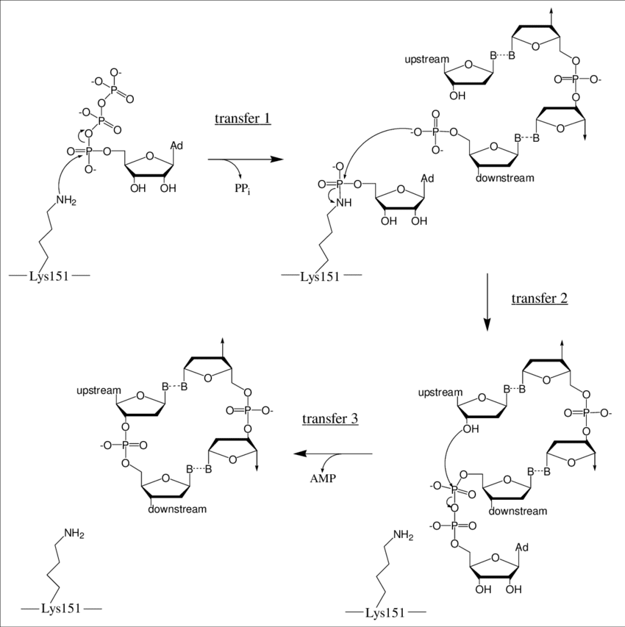
DNA Ligase
Notes:
The DNA Ligase enzyme uses ATP to seals breaks in the sugar-phosphate backbone.

Slide 21
DNA Ligase
Notes:
The DNA Ligase enzyme uses an active site lysine residue to mediate the reaction. Before it can actually seal the break. The ATP molecule used in the reaction is first attached as an adenylate to the lysine active site residue. The amine nitrogen mediates nucleophilic attack at the alpha phosphorous atom. This creates an oxyanion intermediate that will rebound and cause the release of the diphosphate. Further hydrolysis of the diphosphate releases energy that will drive the reaction forward.

Slide 22
DNA Ligase
Notes:
So here is the double stranded DNA helix, with the break in the sugar phosphate backbone that needs to be sealed. And here is the activated lysine residue that has been covalently linked with the AMP molecule. As the DNA ligase is scanning the DNA, when it finds a break in the backbone, the active site is aligned so that the free 5’ phosphate group from the DNA backbone is in proximity with the AMP-Lys residue. The phosphorous from the free phosphate group mediates nucleophilic attack at the phosphorous of the AMP-Lys residue. The lysine amine group serves as the leaving group for the reaction. (And yes, what is the intermediate? You guessed it…the oxyanion intermediate.). At this point, the AMP has now been transferred to the downstream phosphate group in the DNA backbone.

Slide 23
DNA Ligase
Notes:
Now the downstream phosphate group is activated, and the 3’-OH group from the upstream nucleotide, can mediate nucleophilic attack onto the downstream 5’ phosphate group. This again creates an oxyanion intermediate that will then rebound and cause the AMP to be a good leaving group. This restores both the enzyme in the process and seals the break in the backbone of the DNA.

Slide 24
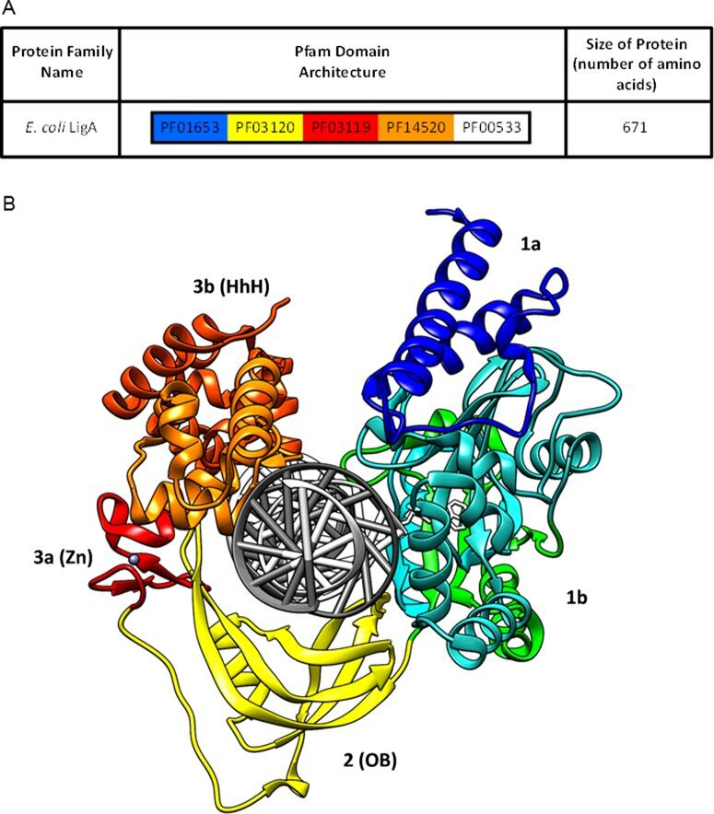
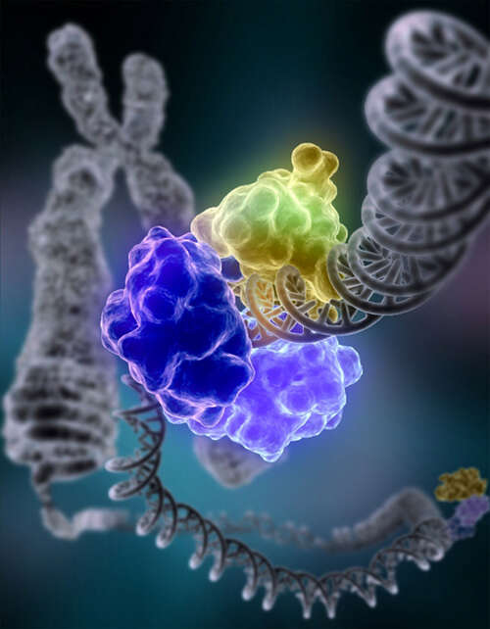
DNA Ligase
Notes:
This is the crystal structure of the DNA Ligase enzyme bound to DNA. You can see that it forms a clamp-like structure around the DNA. This enables the enzyme to attach to the DNA and then slide along it to check for nicks in the backbone of the DNA.

Slide 25
Prokaryotic Replication
Overview
Notes:
So that takes care of most of the major elements of DNA replication. However, we need to consider one more aspect of the process. As the helicase and the front of the replication fork unwinds the double helix so that the replication bubble can form and single stranded DNA regions are made available to use as a template, this creates added strain upstream of the replication fork. This strain is caused by increasing the supercoiling of the DNA ahead of the fork to relieve supercoiling and allow helix unwinding at the replication fork. DNA replication would come to a halt, if the continued increasing strain could not be dissipated. Thus, the topoisomerase enzyme system is required to alleviate this increased strain.

Slide 26
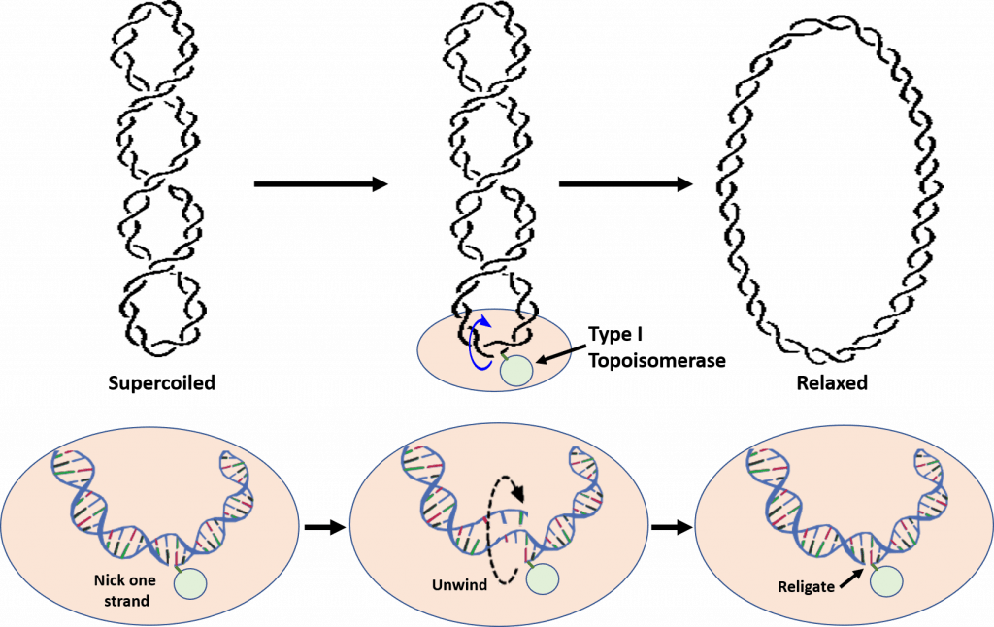
Type I Topoisomerases
Notes:
Topoisomerase enzymes come in two flavors: Type I and Type II. Let’s talk about Type I, first. Type I Topoisomerases relieve tension caused during the winding and unwinding of DNA. One way that they can do this is by making a cut or nick in one strand of the DNA double helix as shown in the figure here. The 5′-phosphoryl side of the nicked DNA strand remains covalently bound to the enzyme at a tyrosine residue, while the 3′-end is held noncovalently by the enzyme. The Type I topoisomerases rotate or spin the 3′-end of the DNA around the intact DNA strand. This releases overwinding in the DNA and effectively releases tension. The enzyme completes the reaction by resealing the phosphodiester backbone or ligating the broken strand back together. So the 3’ end is never released by the enzyme and isn’t just flopping around in the wind. It is a very controlled unwinding and resealing, that is never out of contact with the enzyme.
Overall, only one strand of the DNA is broken during the reaction mechanism and there is NO requirement of ATP during the reaction. The E. coli Topo I enzyme can only remove negative DNA supercoils, but not positive ones. Thus, this enzyme is not involved in relieving the positive supercoiling caused by the DNA helicase during replication. This is in contrast to eukaryotic Topo I that can relieve both positive and negative supercoiling. Although E. coli Topoisomerase I is not directly involved in relieving the tension caused by DNA replication, it is essential for E. coli viability. It is thought to help balance the actions of the Type II topoisomerases and help maintain optimal supercoiling density within the chromosomal DNA. Note that the enzyme naming is independent of which family they belong to…they are two separate things. The E. coli Topo I enzyme happens to fall into the Type I class, but so does the E. coli Topo III enzyme. Topo III is also a Type I Topoisomerase. The naming is a little bit unfortunate and can be confusing.

Slide 27
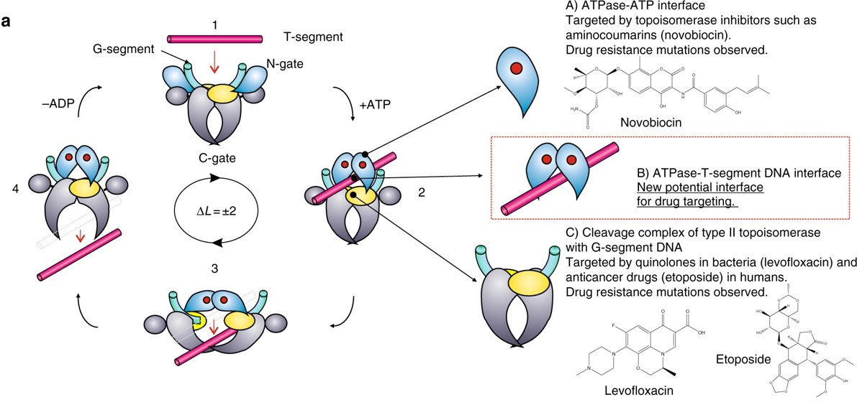
Type II Topoisomerase Enzymes
Notes:
Type II Topoisomerases have multiple functions within the cell. They can increase or decrease winding tension within the DNA or they can unknot or decatanate DNA that has become tangled with another strand. It does so by a more dangerous method than their Type I counterparts, by breaking both strands of the DNA during their reaction mechanism. The enzyme is covalently attached to both broken sides while the other DNA helix is passed through the break. The double strand break is then resealed. DNA gyrase, is the type II topoisomerase enzyme that is primarily involved in relieving positive supercoiling tension that results due to the helicase unwinding at the replication fork. Type II Topoisomerases, especially Topo IV, also address a key mechanistic challenge that faces the bacterial replisome during termination of DNA replication. The circular nature of the bacterial chromosome dictates that a pair of replisomes that initiate from a single origin of replication will eventually converge on each other in a head-to-head orientation.Positive supercoiling accumulates between the two replisomes as they converge, but the activity of DNA gyrase, which normally removes positive supercoils, becomes limited by the decreasing amount of template DNA available.Instead, supercoils may diffuse behind the replisomes, forming precatenanes between newlyr eplicated DNA; in E.coli these must be resolved byTopo IV for chromosome segregation to occur.

Slide 28
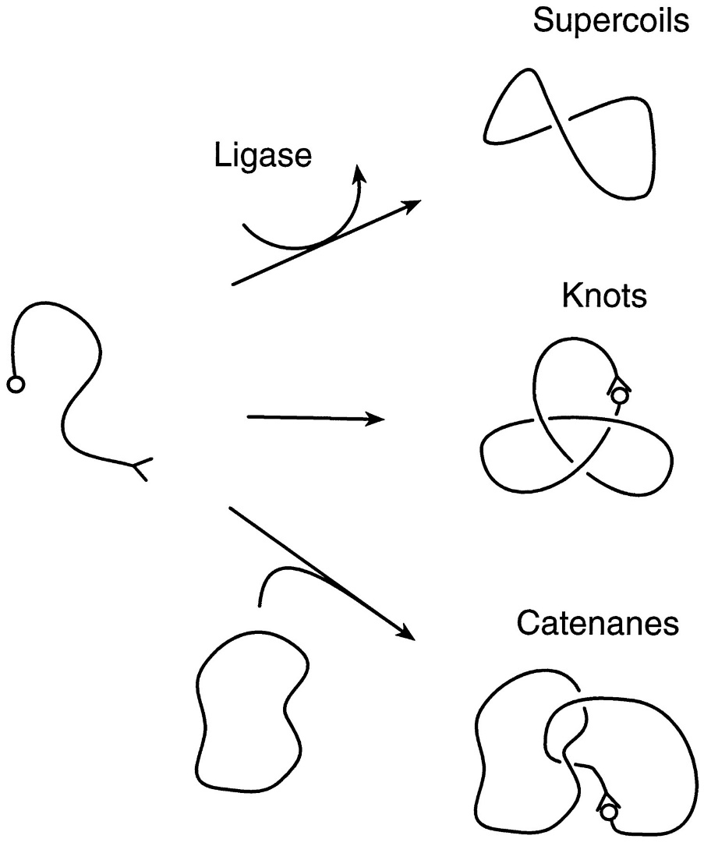
Catenated and Knotted DNA
Notes:
As discussed in the previous slide, sometimes knots can develop in the DNA structure, or two newly synthesized bacterial chromosomes can linked together like a chain. This is called catenation. Type II topoisomerases are able to unknot DNA and to free catenated DNA so that they can be segregated properly into the two new daughter cells following replication.

Slide 29
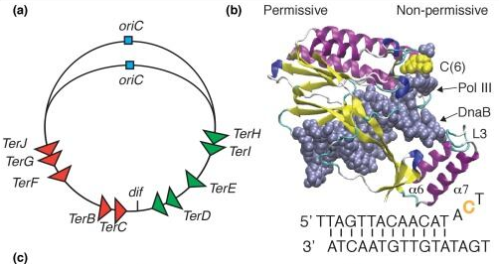
Replication Termination
Notes:
Tus proteins are involved with the termination of DNA replication in prokaryotes. Proper termination of DNA replication is important for genome stability. E. coli replication terminates in the region opposite oriC. There are ten 23-bp termination (Ter) sites in the region with some sequence variations that determine their binding affinities for the monomeric termination protein Tus. Tus binds to Ter with high affinity in 1:1 ratio, and Tus–Ter can further form a very stable ‘lock’ complex if cytosine-6 of the strictly conserved G–C(6) base pair of Ter is flipped out of the DNA duplex and bound in a preformed cytosine-binding pocket of Tus. The Tus–Ter lock complex is polar with a permissive face that allows the replisome to pass unhindered and a non-permissive face that can block the replisome. The ten Ter sites are organized as two oppositely orientated groups of five, allowing the replisome to pass the first group and be blocked at the second. This ensures that the two replication forks converge in the terminus region for proper chromosome segregation. In the next section, we will talk about the replication of extrachromosomal elements within prokaryotic systems.

