Slide 1
Chapter 8: Protein Regulation and Degradation
8.5 Intracellular Protein Degradation
Notes:
In this section, we will discuss the primary methods of targeted protein degradation within cells.

Slide 2
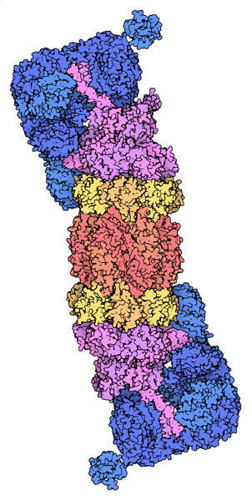
The Proteosome
26S Eukaryotic Proteosome
required for the degradation of protein factors in multiple cellular pathways and it plays a fundamental role in cell stability.
Figure from: Goodsell, D. (2012) Molecule of the Month, Protein Database
Notes:
Proteasomes are distributed throughout the cell, detected in the cytoplasm and in the nucleus, and they can localize to hotspots in distinct intracellular regions or specific sites with high protein metabolism or with specific protein degradation requirements.The core particle of the 26S proteosome is shown here in yellow and red. Within the core, three types of proteases, shown in different shades of red, are present and each have specific affinity for specific peptide sequences. This ensures maximal breakdown of proteins that are targeted for degradation. ATP binds within the magenta portions of the proteosomes and provides the needed energy to unfold proteins targeted for degradation and prepares them for cleavage in the peptidase-containing core. The regulatory subunits, shown in blue are responsible for the proteosome selectivity, ensuring that only proteins targeted for degradation are processed.

Slide 3
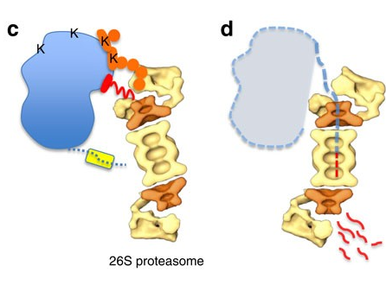
Polyubiquitination is a
Degradation Signal
Figure from: Guharoy, M., et al. (2016) Nat Commun 7:10239
Notes:
In section 8.2, you learned about the ubiquitin post-translational modification, where the small peptide known as ubiquitin, can be added to protein targets, altering their function. When proteins are polyubiquitinated (or many ubiquitin peptides are covalently added to the protein, this can serve as a signal for degradation at the 26S proteosome. In this diagram, the protein that is being targeted for degradation is shown in blue. On the upper surface of the protein are several Lysine residues shown as K. The two marked in orange are the ones that are covalently modified with ubiquitin. Additional ubiquitin peptides are then added forming a polyubiquitin structure shown in orange. The polyubiquitin structure is recognized by the proteosome regulatory domain shown in yellow, and protein unfolding and degradation ensues, beginning with the degradation initiation site on the protein, shown in red. The ubiquitin peptides are released and recycled in the process, rather than degraded.

Slide 4
How are Proteins Ubiquitinated?
E1
Ubiquitin Activating Enzyme
E2
Ubiquitin Conjugating Enzyme
E3
Ubiquitin Ligase
(Binds the Target Protein)
Notes:
So how are ubiquitin peptides added to proteins? Is this a selective process or are all intracellular proteins targeted equally? The process of protein ubiquitination requires the activity of three enzymes, the E1 (ubiquitin activating enzyme), the E2 (ubiquitin conjugating enzyme, and the E3 (uqibuitin ligase enzyme). The E3 ligase enzyme is actually a family of enzymes (~600 different E3 ligases exist in mammalian systems). E3 ligases recognize specific sequences in their target proteins and will only modify specific substrates with the ubiquitin tag. Thus, intracellular protein degradation is a highly complex and regulated system, similar to DNA transcriptional activation. Thus, it provides an elegant way for protein levels (and hence activity) to be post-translationally regulated.

Slide 5
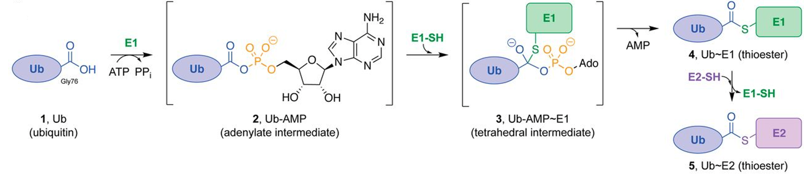
Ubiquitin Attachment
N
K
H
Notes:
So it turns out that Ub is added onto target proteins using the C-terminal carboxylic acid group, which happens to be a glycine residue. The peptide is linked with the R-group amine from a lysine residue on the target protein forming an amide bond. So this looks strikingly similar to peptide bond formation that we’ve been studying all term! Except that the amide is formed with an R-group amine rather that with a main chain amine functional group. So it turns out, that amide formation in vivo is not as simple as the dehydration synthesis reaction that we have become familiar with. It is actually quite a bit more complicated. We will see this with true peptide bond formation as well when we dive into the structure and function of the ribosome in a few chapters down the road. Within this reaction, the hydroxyl group of the carboxylic acid is not a good leaving group and amide bond formation is usually energetically unfavorable. Thus, the carboxylic acid functional group needs to be coupled with another reaction and activated first,

Slide 6
E1 Activating Enzyme
Notes:
The E1 Activating enzyme is required to activate the carboxylic acid of ubiquitin. It uses a molecule of ATP in this process.

Slide 7
E1 Activating Enzyme
Notes:
In the first part of the reaction, the E1 Activating Enzyme uses a molecule of ATP to form a ubiquitin-adenylate intermediate. Anytime an adenosine monophosphate molecule is added onto another molecule, it is called an adenylate, and it is linked through a phosphoester bond. Note that the diphosphate that is cleaved off of the ATP molecule here, will be hydrolyzed to release the inorganic phosphate molecules and this hydrolysis reaction releases a lot of energy. This hydrolysis reaction provides the energy to make this reaction energetically favorable in vivo.

Slide 8
E1 Activating Enzyme
Notes:
Once the adenylate has formed, a cysteine residue on the E1 enzyme can mediate nucleophilic attack on the carbonyl carbon of the Ub glycine residue and form an oxyanion intermediate. Notice that you are seeing a lot of oxyanion intermediates within enzyme reaction mechanisms…these are common! The AMP can then serve as a good leaving group, when the electrons rebound into the molecule and reform the carbonyl group.

Slide 9
E1 Activating Enzyme
Notes:
So the AMP leaves and the E1 enzyme is left covalently linked to ubiquitin through the formation of the thioester linkage with the active site Cys residue. The E2 Conjugating Enzyme, will then recognize the loaded E1 enzyme, and mediate attack at the carbonyl carbon, essentially transferring the ubiquitin protein to a Cys residue on the E2 enzyme. This goes through an oxyanion intermediate as well, and results in the E1 enzyme serving as the leaving group. This restores the E1 Activating Enzyme so that it can activate another molecule of ubiquitin for protein conjugation.

Slide 10
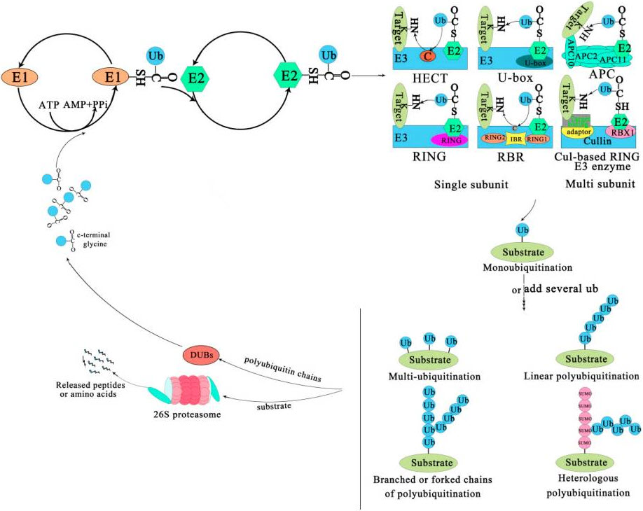
E1 and E2 Enzyme Reactions
Notes:
This diagram is just showing the E1 and E2 reactions a little bit more dynamically. Here is the pool of ubiquitin proteins shown in blue. Together with a molecule of ATP, the ubiquitin is able to be covalently linked to E1 through a thioester intermediate. This is transferred to the E2 conjugating enzyme.

Slide 11
The E3 Ligase Enzyme Family
Notes:
Once the E2 enzyme is covalently modified to carry the ubiquitin peptide, it can bind with an appropriate E3 Ligase enzyme and its target protein substrate. Recall that the family of E3 Ligases is quite large, over 600 have been identified in mammalian genomes. Thus, different subfamilies of E3 Ligases have different methodologies for binding with the loaded E2 conjugating enzyme and the protein target. For example, some E3 Ligases have multiple subunits that are required for substrate binding. Furthermore, the most simplistic E3 ligases will mediate the direct transfer of the ubiquitin peptide from the E2 conjugating enzyme to the target protein. This is mediated by nucleophilic attack of the lysine amine group from the target protein on the carbonyl carbon of ubiquitin. The Cys residue from the E2 conjugating enzyme then serves as the leaving group and the ubiquitin is now covalently linked to the lysine residue of the target protein through an amide linkage. Some E3 Ligases are a little more complicated and form a covalent link with ubiquitin (through a Cys thioester), prior to facilitating the amide bond formation with the target protein.

Slide 12
Protein Ubiquitination
Notes:
There are many different ways target proteins can be ubiquitinated. They can have a single Ub added creating a monoubiquitinated substrate. This will usually not be enough of a signal to cause degradation at the proteosome. However, it may have other regulatory effects, such as we already have seen for histone modification. Polyubiquitinated proteins can have multiple single Ubs attached to the molecule, or they can be added in a linear string or contain branching. They can also form a heterologous structure with the addition of SUMO peptides as well, that are shown here in pink.

Slide 13
Notes:
These polyubiquitinated products are then often targeted for degradation at the 26S proteosome, shown here. Deubiquitinating Enzymes (DUBs) recycle the ubiquitin peptides, so that they can be reused by the E1 Activating Enzymes, while the target protein is cleaved into small peptide fragments and free amino acids. In the next chapter, we will switch gears from learning about how enzymes work and how their regulated, to learning more about the biosynthesis of DNA through the process of replication.

