Slide 1
Foundations of Biochemistry
Chapter 6: Enzyme Principles and Biotechnical Applications
Notes:
Overall, in Chapter 6 we will be learning some basic enzyme principles to get us started on our journey of Enzyme activity and regulation.

Slide 2
Major Topics
6.1 The Nature and Classification of Enzymes
6.2 Enzyme Names and Classification
6.3 Enzyme Structure and Substrate Binding
6.4 Enzymes and Reaction Equilibrium
6.5 Properties and Mechanisms of Enzyme Action
6.6 Enzymes are Affected by pH and Temperature
6.7 Enzymes are Sensitive to Inhibitors
6.8 Allosteric Regulators and the Control of Enzyme Activity
6.9 Origin, Purification, and Uses of Enzymes
6.10 Industrial Enzymology
Notes:
There are quite a few sections in this chapter, but as you will see, many are quite short!

Slide 3
Foundations of Biochemistry
Chapter 6.5 Properties and Mechanisms of Enzyme Action
Notes:
In this section, we will discuss some of the nuts and bolts of enzyme kinetics.

Slide 4
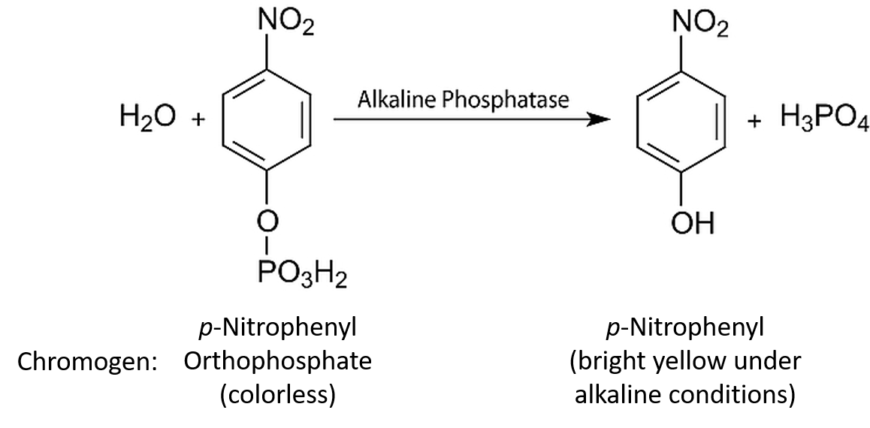
Enzyme Assays
Notes:
To measure the activity of an enzyme, you first need to have an assay that allows you to detect the activity. Colorimetric assays are often very useful ways to detect the activity of an enzyme as a simple UV spectrophotometer can be used to measure changes over time.

Slide 5
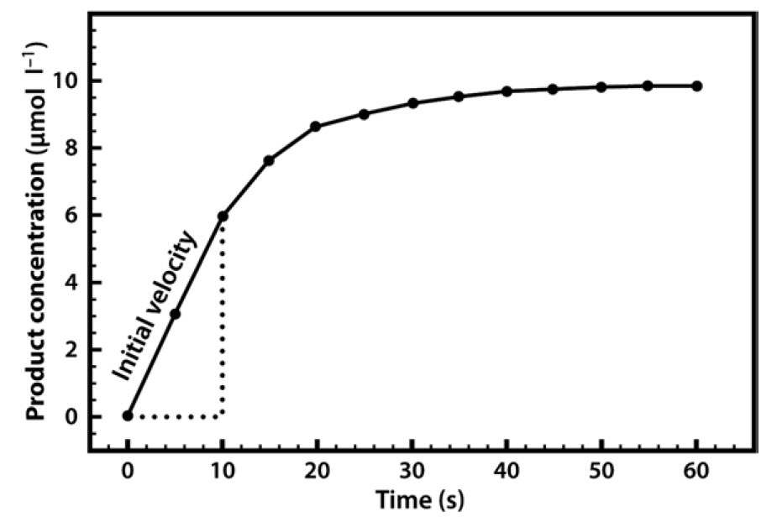
Enzyme Assays
Notes:
In this type of system, a reaction can be started by the addition of the enzyme to a cuvette containing substrate that will reveal a colorimetric product that can then be measured. It is easy to create a colorimetric standard, such that the total amounts of product can be calculated. This is what a typical enzyme assay would look like. Notice at the beginning of the reaction, that the curve is in the linear phase. We refer to this initial rapid rate as the initial velocity (v₀). This is when there is little to no product and all substrate present. Over time the reaction slows as the substrate in the mixture is used up or the enzyme denatures during the course of the reaction. Thus, when taking measurements of enzymes, only the initial velocity is used (note that the initial velocity is the slope of the linear portion of the line and has the units of product concentration over time).

Slide 6
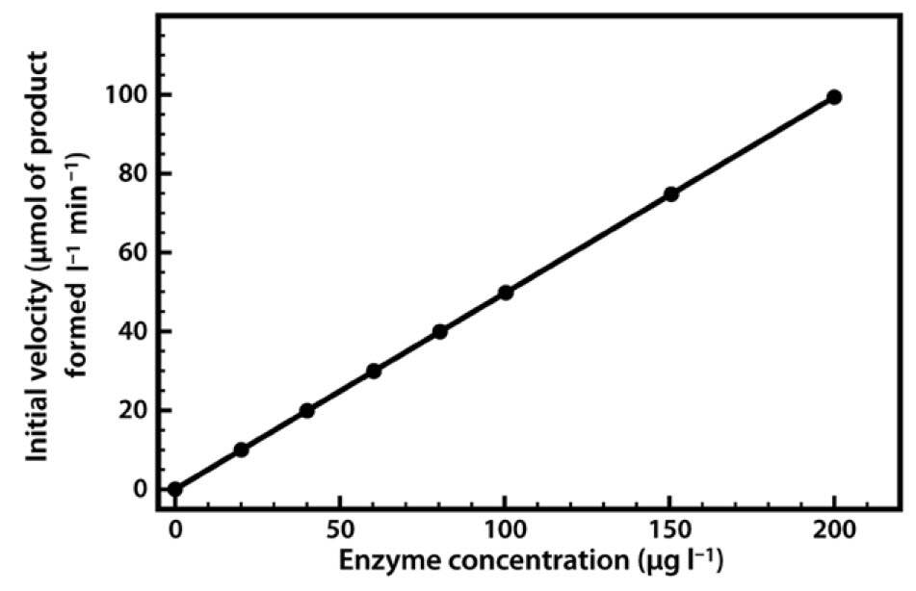
Enzyme Concentrations
Notes:
If you run many different reactions with unlimited substrate and different concentrations of enzyme, you can make a cumulative graph of Enzyme concentration vs the initial velocity of the reaction. You can see that if substrate is unlimited, that adding additional enzyme will cause an increase in the initial velocity that is linear.

Slide 7
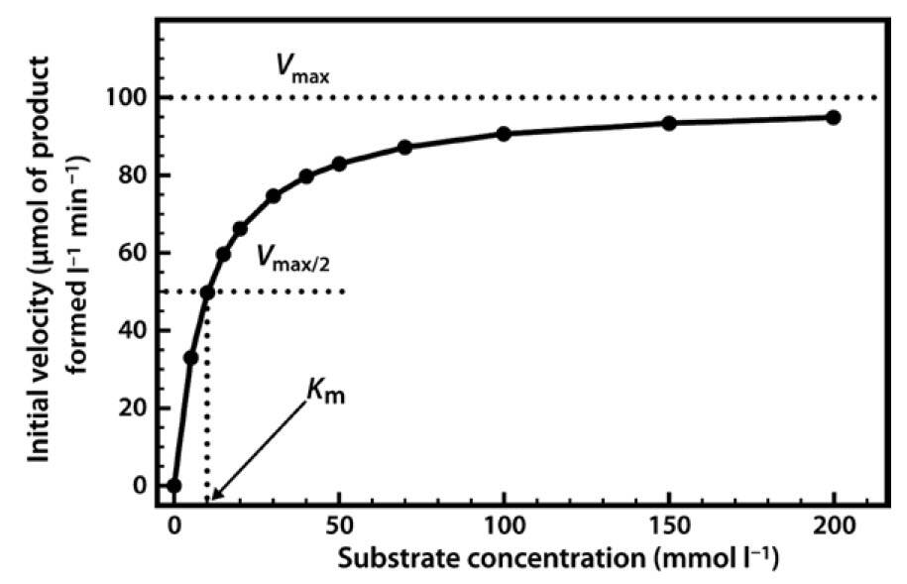
Michaelis-Menton Kinetics
Notes:
You can also analyze enzyme reactions using a set amount of enzyme and then use different concentrations of substrate. If you do these types of reactions and then plot the substrate concentration against the initial velocity of the reactions, you will often get an exponential curve, like the one shown here. Initially, when the substrate concentration is increased, the rate of reaction increases considerably. However, as the substrate concentration is increased further the effects on the reaction rate start to decline, until a stage is reached where increasing the substrate concentration has little further effect on the reaction rate. At this point the enzyme is considered to be coming close to saturation with substrate, and demonstrating its maximal velocity (V_{max}). Note that this maximal velocity is, in fact, a theoretical limit that will not be truly achieved in any experiment, although we might come very close to it.

Slide 8
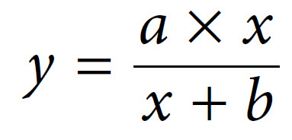
Michaelis-Menten Kinetics
Notes:
The relationship described here is a fairly common one, which a mathematician would immediately identify as a rectangular hyperbola. The equation that describes such a relationship is shown in the graph. The two constants, ‘a’ and ‘b’ can be defined. In fact, the first one, ‘a’, we have already defined. It is Vmax. The ‘b’ constant is the value on the x-axis that gives half of the maximal value of ‘y’. This value (the substrate concentration at ½ Vmax), is called the Michaelis-Menten constant (Km).

Slide 9
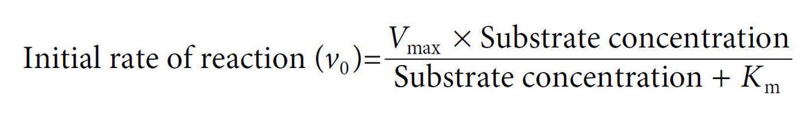
Michaelis-Menten Kinetics
Notes:
If we substitute these values into our equation, we can see that:

Slide 10
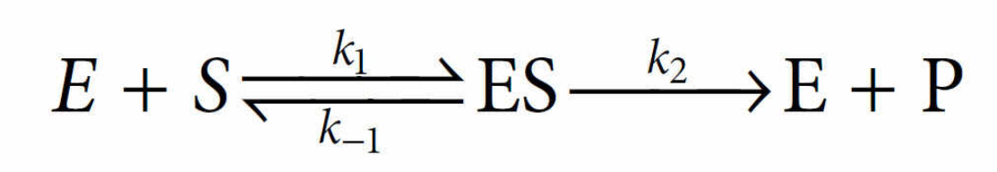
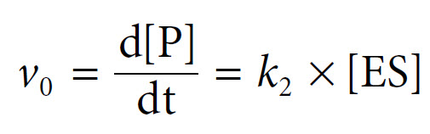
Deriving the Equation
Notes:
The Michaelis–Menten derivation requires two important assumptions. The first assumption is that we are considering the initial velocity of the reaction (v₀), when the product concentration will be negligibly small (i.e. [S] ≫ [P]), such that we can ignore the possibility of any product reverting to substrate. The second assumption is that the concentration of substrate greatly exceeds the concentration of enzyme (i.e. [S] ≫ [E]). The derivation begins with an equation for the expression of the initial rate, the rate of formation of product, as the rate at which the ES complex dissociates to form product. This is based upon the rate constant k₂ and the concentration of the ES complex, as follows:
Since ES is an intermediate, its concentration is unknown, but we can express it in terms of known values.

Slide 11
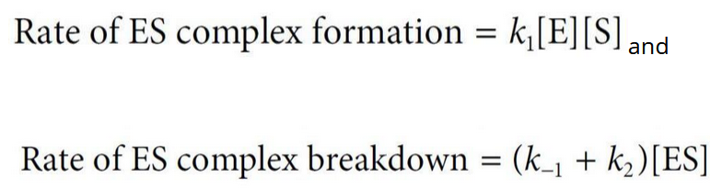
At Steady State
Rate of formation of [ES] = Rate of [ES] Breakdown
Notes:
To do this, we need to think about the reaction at steady state. For an entire system to be at steady state, i.e. for all state variables of a system to be constant, there must be a flow through the system, such that nothing has a net change. A simple example of such a system is the case of a bathtub with the tap running but with the drain unplugged: after a certain time, the water flows in and out at the same rate, so the water level (the state variable Volume) stabilizes and the system is in a steady state. In a steady-state approximation we can assume that although the concentration of substrate and product changes, the concentration of the ES complex itself remains constant. The rate of formation of the ES complex and the rate of its breakdown must therefore balance at the steady state. So we can think about other mathematical ways of representing the formation of [ES] as the rate of the forward reaction dependent on k1 and the concentrations of [E] and [S] and the rate of breakdown being dependent on the [ES] and k-1 going back to the substrate and the enzyme or k2 going forward to the enzyme and the product.

Slide 12

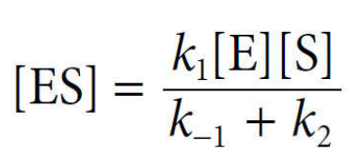
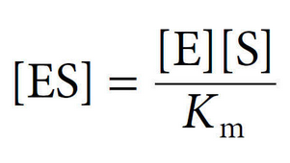
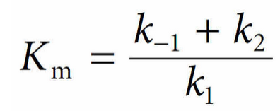
At Steady State
(1)
( )
(2)
(3)
(4)
Notes:
Thus, we can then set these equal to eachother at steady state, shown in equation (1), and then rearrange the equation to that shown in (2), which solves for [ES]. Previously, we graphically defined the Micaelis-Menten constant as the [S] at ½ Vmax. It is also defined mathematically by the reaction constants such that it equals the sum of the [ES] breakdown constants (k-1 and k2) divided by the [ES] formation constant, k1. This is shown in equation (3). Equation (4) substitutes in the Km value.

Slide 13
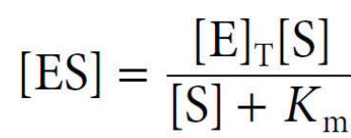
[E] = [E]_{T} – [ES]
(4)
(5)
(6)
Notes:
Since the concentration of substrate greatly exceeds the concentration of enzyme (i.e. [S] ≫ [E]), the concentration of uncombined substrate [S] is almost equal to the total concentration of substrate. The concentration of uncombined enzyme [E] is equal to the total enzyme concentration [E]_{T} minus that combined with substrate [ES]. Introducing these terms to into the equation above and solving for ES gives us equation (5). Recall from the beginning of our conversations about Vo…that we we determined that we could define the initial reaction rate as equation (6). Now we have derived a mathematical equation for [ES] that we can substitute into equation (6)

Slide 14
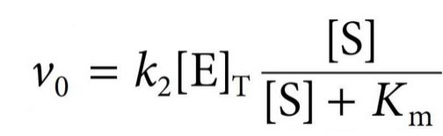
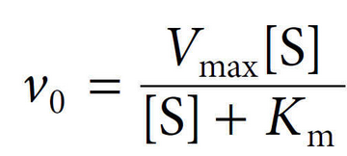
(7)
(8)
Notes:
When we do this, we get equation (7). And in fact, the term k2[E]T = Vmax. Thus we can substitute Vmax in equation (7) to get equation (8). And equation (8) is really the important part of our conversation about standard enzyme kinetics.

Slide 15
Notes:
So let’s think about what happens to the initial velocity under different conditions. Well, if Vmax is large, the enzyme will have a faster catalytic turnover rate (more products will be made in a shorter amount of time). This is obvious from our equation as Vmax is directly proportional to Vo. However, let’s look at Km…what does it tell us about a reaction? A low K_{m} value indicates that the enzyme requires only a small amount of substrate in order to become saturated. Therefore the maximum velocity is reached at relatively low substrate concentrations. Essentially the Km term goes to zero and the the [S] will cancel out…thus, Vo is going to approach Vmax. And you can see that this is true graphically as well. However, if Km is large, this will be inversely proportional to Vo, making the system take longer to reach the Vmax, or in essence require higher levels of substrate to approach Vmax.

Slide 16
K_{m} Measures Enzyme Affinity!
It is an INVERSE correlation
A low Km = high affinity
A high Km = low affinity
Notes:
Overall, the Km value is a measure of the enzyme’s affinity or ability to bind with the substrate, and this is an inverse correlation. A low Km indicates high enzyme affinity for the substrate and an enzyme with a high Km will have low substrate affinity or binding. This can lead us to several conclusions. An enzyme with a low K_{m} value relative to the physiological concentration of substrate will probably always be saturated with substrate, and will therefore act at a constant rate, regardless of variations in the concentration of substrate within the physiological range. An enzyme with a high K_{m} value relative to the physiological concentration of substrate will not be saturated with substrate, and its activity will therefore vary according to the concentration of substrate, so the rate of formation of product will depend on the availability of substrate. If an enzyme acts on several substrates, the substrate with the lowest K_{m} value is frequently assumed to be that enzyme’s ‘natural’ substrate, although this may not be true in all cases. If two enzymes (with similar V_{max}) in different metabolic pathways compete for the same substrate, then if we know the K_{m} values for the two enzymes we can predict the relative activity of the two pathways. Essentially the pathway that has the enzyme with the lower K_{m} value is likely to be the ‘preferred pathway’, and more substrate will flow through that pathway under most conditions. This is really why enzyme kinetic analysis is really important…it gives us a window into what is going on at the cellular level and why.

Slide 17
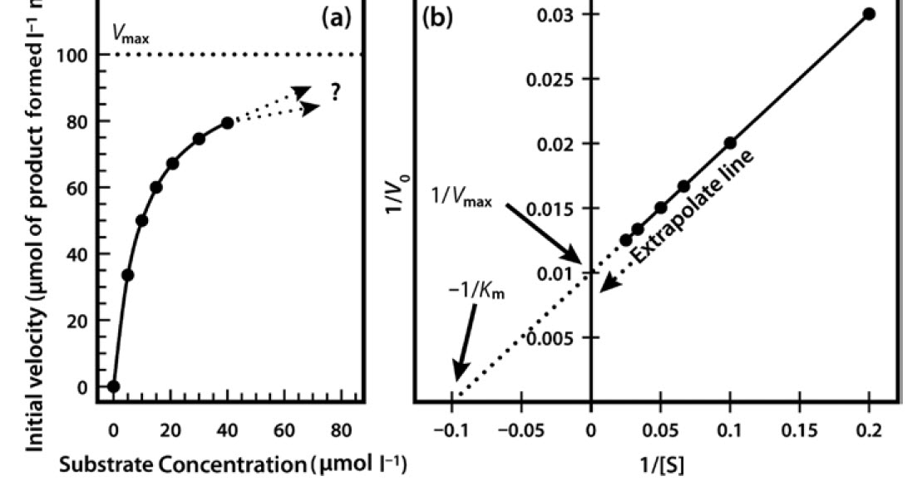
Calculating Vmax and Km
Notes:
Very often it is not possible to estimate K_{m} values from a direct plot of velocity against substrate concentration (as shown in Figure 6.6) because we have not used high enough substrate concentrations to come even close to estimating maximal velocity, and therefore we cannot evaluate half-maximal velocity and thus K_{m}. Fortunately, we can plot our experimental data in a slightly different way in order to obtain these values. The most commonly used alternative is the Lineweaver–Burk plot (often called the double-reciprocal plot). This plot linearizes the hyperbolic curved relationship, and the line produced is easy to extrapolate, allowing evaluation of V_{max} and K_{m}. We will see in our enzyme kinetics activity, that there are many different ways that the data can be plotted to convert the hyperbolic graph into a linear one. Each way this is done will help us estimate Vmax and Km, however, it also introduces error into the estimate. Even a small change at a single point, can change the values of Km and Vmax. You will take a look at that more closely in your assignment.

Slide 18
Foundations of Biochemistry
Chapter 6.6 Enzymes are Affected by pH and Temperature
Notes:
In this section, we will discuss how pH and Temperature affect enzyme activity.

Slide 19
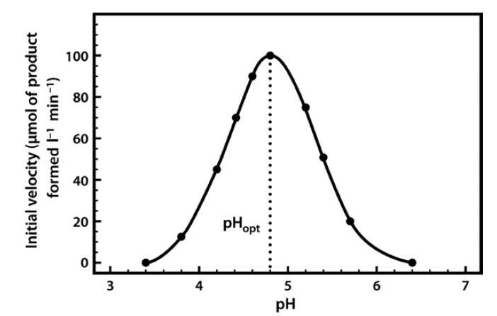
pH and Enzyme Activity
Notes:
The pH profile is dependent on a number of factors. As the pH changes, the ionization of groups both at the enzyme’s active site and on the substrate can alter, influencing the rate of binding of the substrate to the active site. These effects are often reversible. For example, if we take an enzyme with an optimal pH (pH_{opt}) of 5.0 and place it in an environment at pH 4.0 or 6.0, the charge properties of the enzyme and the substrate may be suboptimal, such that binding and hence the reaction rate are lowered. If we then readjust the pH to 5.0, the optimal charge properties and hence the maximal activity of the enzyme are often restored. However, if we place the enzyme in a more extreme acidic or alkaline environment (e.g. at pH 1 or 14), the enzyme may be completely denatured and unfolded. This might permanently alter the enzyme activity. Each enzyme will have it’s own pH optimum that must be established through experimentation. For example, proteases from the stomach, such as Papain, have optimal ranges close to pH 2.0, whereas Trypsin, which is found in the small intestine, prefers a pH closer to 8.0 and would be denatured in the stomach environment.

Slide 20
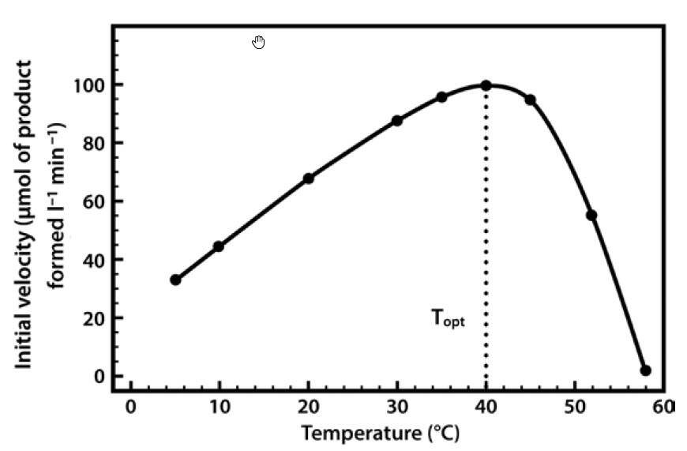
Temperature and Enzyme Activity
Notes:
Temperature also has an optimal range of activity. Generally, temperatures colder than optimal activity do not negatively impact the enzyme folding pattern or denature the enzyme. Instead, they simply reduce the kinetic energy of the solution and slow the movement of molecules, inhibiting the reaction. Freezing, however, can cause protein misfolding and denaturation causing a loss in activity when the protein is restored to optimal temperatures. This can often be inhibited by adding glycerol to the solution prior to freezing. Temperatures greater than the optimal temperature, however, usually cause the denaturation or melting of the enzyme, resulting in a loss of tertiary structure. This is usually a permanent alteration that causes a loss in protein activity. Each enzyme will have it’s own optimal pH and temperature ranges that must be established through biological assays. For example, the Taq Polymerase is optimal at 72C, whereas human DNA polymerase I is optimal at 37C, and is rapidly denatured at 72C.

Slide 21
Foundations of Biochemistry
Chapter 6.7 Enzyme Inhibition
Notes:
In this section, we will look at different mechanisms of enzyme inhibition.

Slide 22
Types of Inhibition
Reversible
  Competitive
  Noncompetitive
  Uncompetitive
Irreversible

Slide 23
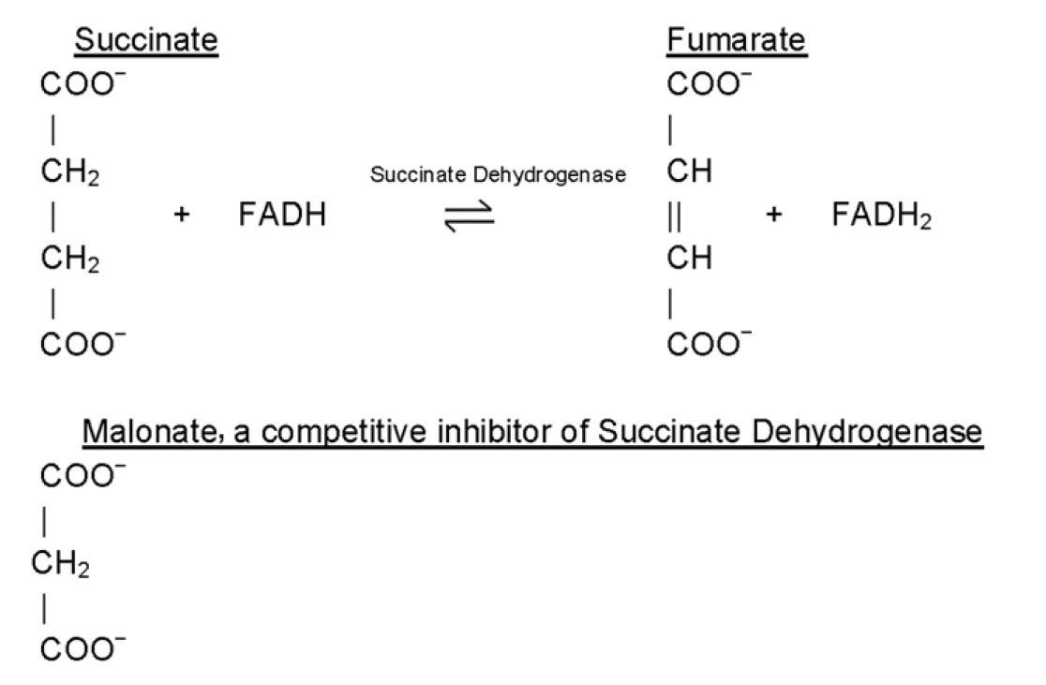
Competitive
Notes:
In competitive inhibition, a small molecule that mimics the native substrate of the enzyme will reversibly bind in the active site and block the access of the natural substrate. For example, malonate is a competitive inhibitor of Succinate Dehydrogenase, that normally converts succinate to fumarate in the Kreb Cycle.

Slide 24
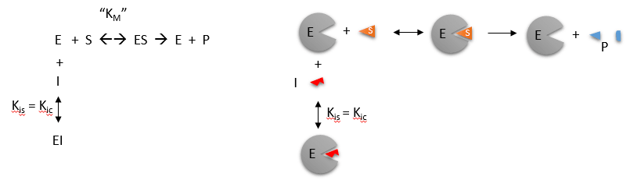
Competitive Inhibition
Notes:
Competitive inhibition occurs when substrate (S) and inhibitor (I) both bind to the same site on the enzyme. In effect, they compete for the active site and bind in a mutually exclusive fashion. The rate constant for Inhibitor binding to form the [EI] complex is called Ki or Kic, in this case, for competitive inhibition.

Slide 25
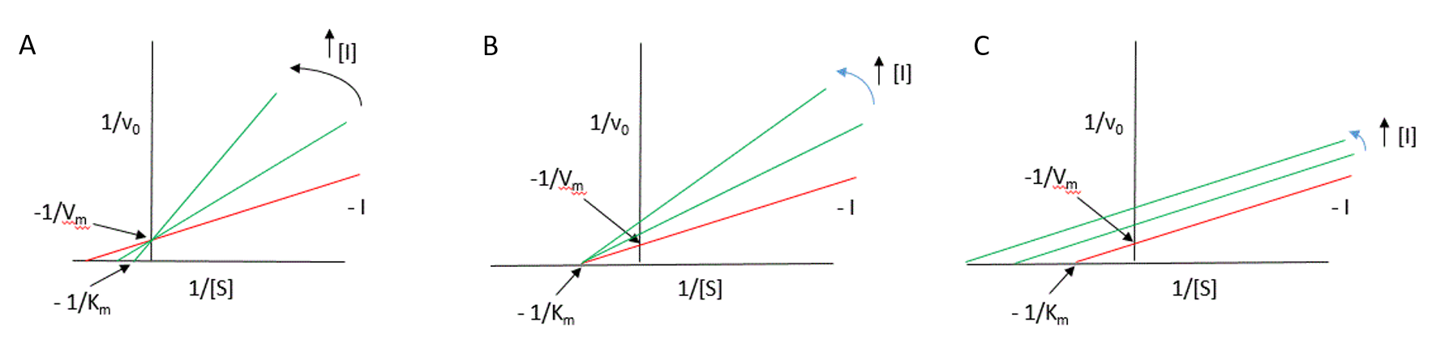
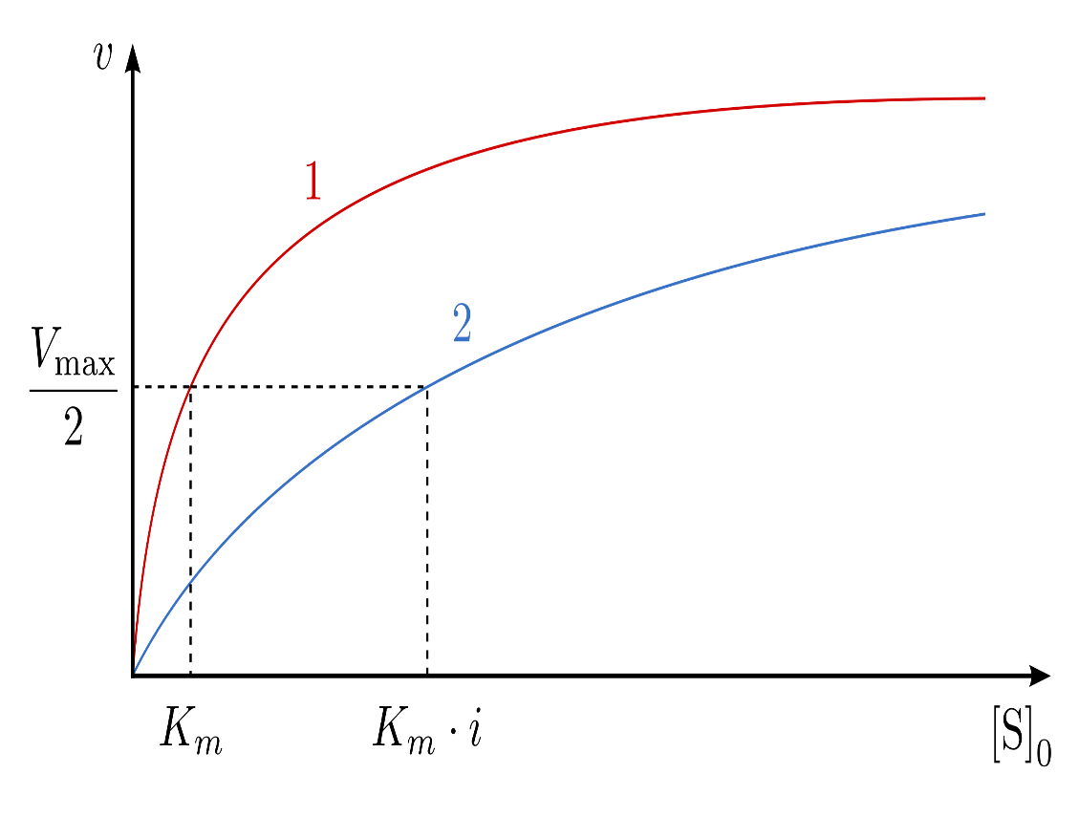
Competitive Inhibition
Notes:
One of the characteristics of competitive inhibitors is that they can be displaced from the active site if high concentrations of substrate are used, thereby restoring enzyme activity. Thus competitive inhibitors increase the K_{m} of a reaction because they increase the concentration of substrate required to saturate the enzyme. However, they do not change V_{max} itself. This is easy to see on a Lineweaver-Burk plot where Vmax remains unchanged and only the Km value shifts closer to zero with higher levels of inhibitor as this is calculated as -1/Km.

Slide 26
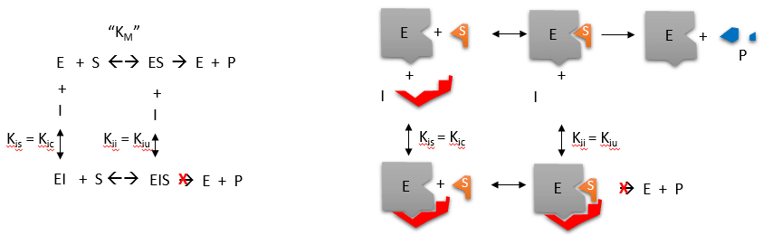
Noncompetitive Inhibitor
Notes:
Non-competitive inhibitors react with the enzyme at a site distinct from the active site. Therefore the binding of the inhibitor does not physically block the substrate binding site, but it does prevent subsequent reaction. Most noncompetitive inhibitors are chemically unrelated to the substrate, and their inhibition cannot be overcome by increasing the substrate concentration. Such inhibitors in effect reduce the concentration of the active enzyme in solution, thereby reducing the V_{max} of the reaction. However, they do not change the value of K_{m}.

Slide 27
Noncompetitive Inhibitor
Notes:
But you can see that you have some different situations that can occur. You can have the enzyme bind with the substrate, forming [ES] and converting it to product, like normal. The enzyme can bind to the inhibitor by itself forming [EI], or the inhibitor can bind to the enzyme when the substrate is also bound forming the [ESI] complex. Both of these situations inhibit the enzyme from converting substrate into product.

Slide 28
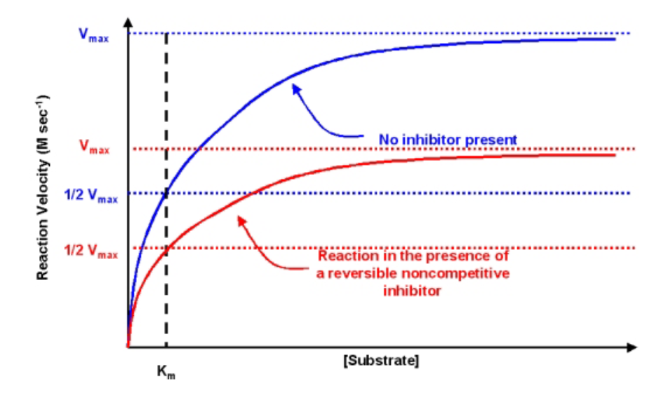
Noncompetitive Inhibitor
Notes:
So in the noncompetitive inhibitor the Km stays the same (ie binding affinity for the enzyme with its substrate is unchanged). However, the turnover rate or Vmax is decreased. Essentially, a pool of the enzyme is bound to the inhibitor or the inhibitor + substrate, and is unable to convert substrate to product. This type of inhibition cannot be overcome by adding more substrate. You can also see on the Lineweaver-Burk plot that Km stays the same and the Vmax decreases causing the slope of the line to increase.

Slide 29
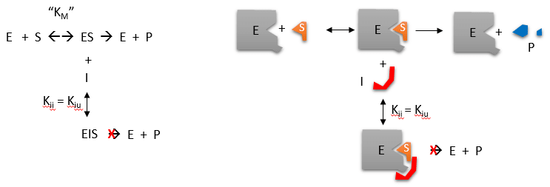
Uncompetitive Inhibition
Notes:
The last case of reversible inhibition is Uncompetitive Inhibition. In uncompetitive inhibition the inhibitor can only bind with the enzyme after it has formed the [ES] complex. In this case, the [ESI] complex forms and prevents the formation of product from happening. You can see that this rate constant is termed Kiu for uncompetitive. Note in the section on the noncompetitive inhibitor, that it has both inhibitor rate constants, as both complexes can form.

Slide 30
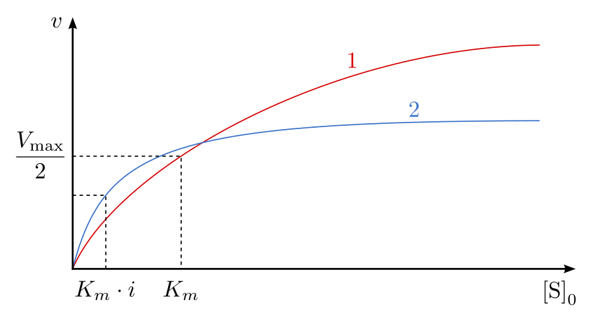
Uncompetitive Inhibition
Notes:
In uncompetitive inhibition both the Km and Vmax change. The Km actually decreases, as substrate is bound with higher affinity to the enzyme when the inhibitor is present. However, the overall catalytic rate, Vmax is reduced, as the inhibitor prevents the formation of product when it is present. Thus, both Km and Vmax values will change and be visible in the Lineweaver-Burk plot.

Slide 31
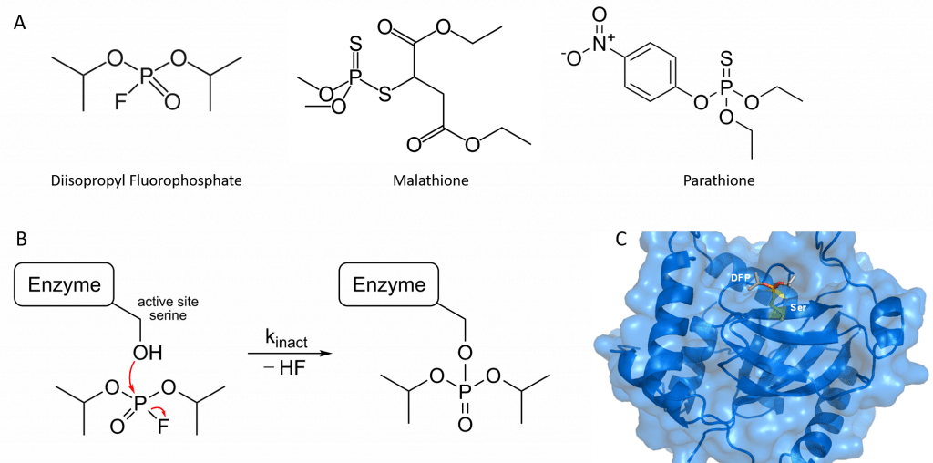
Irreversible Inhibitors
Notes:
Irreversible inhibitors tend to bind to the enzyme covalently causing the permanent inactivation of the enzyme. An example of this is with the acetylcholine esterase enzyme. This enzyme normally breaks down neurotransmitters that will induce muscle contraction when they are released. Organophosphates, that are typically used as insecticides or even as chemical nerve agents that have been used in war, covalently bind with and block the activity of this enzyme. This causes painful muscle convulsions and death. DFP shown here is an inhibitor of the Herpes Simplex Virus Protease enzyme and works in a similar fashion. It covalently links to an active site serine residue and blocks the activity of the enzyme, shown here in (B) and (C).

Slide 32
Foundations of Biochemistry
Chapter 6.8 Allosteric Regulators and the Control of Enzyme Activity
Notes:
In this section, we will take a look at allosteric protein regulators.

Slide 33
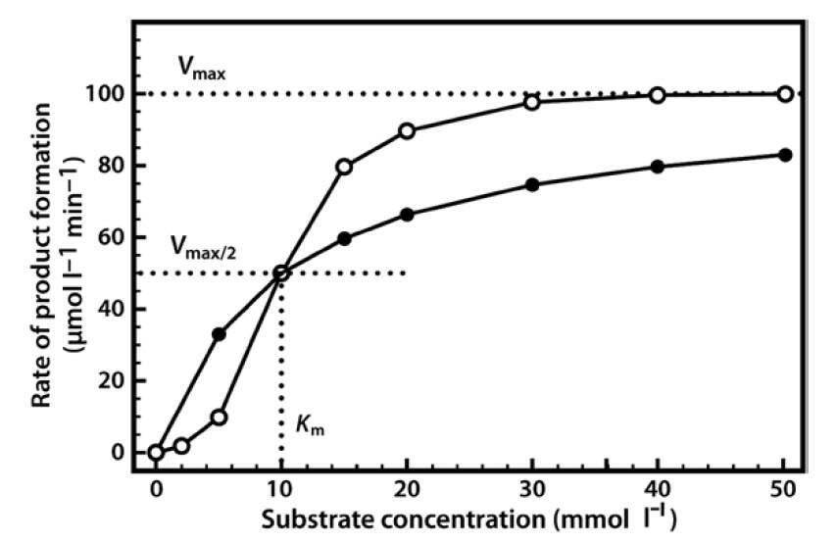
Many Enzymes Do Not Display Michaelis-Menten Kinetics
Notes:
So, after we just get done going through the rigors of Michaelis-Menten Kinetics, I have to tell you that life is often not that simple, and that many enzymes do not display Michaelis-Menten Kinetics. They are further regulated through allosteric protein interactions. They will tend to have S-shaped enzyme curves, rather than the standard hyperbolic graph that we are used to seeing.

Slide 34
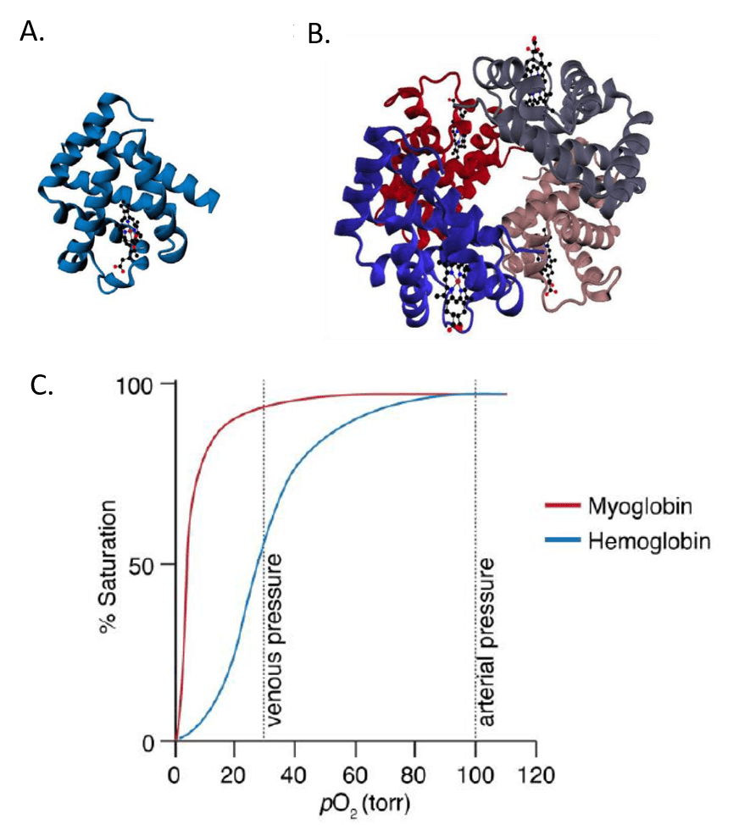
Hemoglobin and Myoglobin
Notes:
A good example to look at for comparisons are the hemoglobin and myoglobin proteins. These proteins are not technically enzymes, but they carry and transport oxygen. So we can look at oxygen binding using standard enzymatic curves. Myoglobin is a homolog of hemoglobin, however, it only contains a single polypeptide chain, where hemoglobin is a tetramer that contains two alpha and to beta subunits in the adult hemoglobin form. You can see that their ability to bind oxygen varies. Myoglobin shows standard Michaelis-Menten kinetics, whereas Hemoglobin is showing an S-curve instead.

Slide 35
Myoglobin and Hemoglobin
Notes:
If we look more closely at these two proteins, we can see that myoglobin is a holoenzyme that requires a heme prosthetic group. This prosthetic group contains one oxygen binding site, whereas each subunit of hemoglobin contains one of these prosthetic groups for a total of four oxygen binding sites.

Slide 36
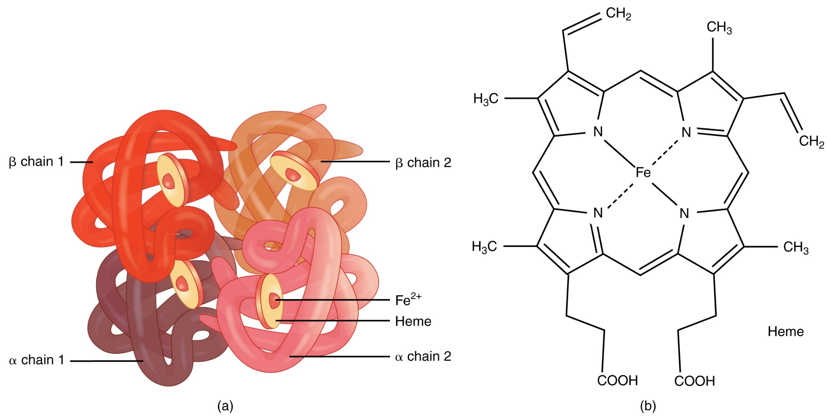
Hemoglobin and the Heme Cofactor
Notes:
Here is a closer look at the Heme Prosthetic group used in both hemoglobin and myoglobin. Notice that an iron metal is coordinated at the center of the molecule. This iron helps to coordinate the binding of the oxygen molecule when it docks onto the hemoglobin.

Slide 37
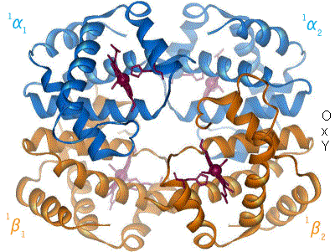
Oxygen Binding Causes Shift in Structure
Image by: BerserkerBen
Notes:
A schematic visual model of oxygen-binding process, showing all four monomers and hemes, and protein chains only as diagrammatic coils, to facilitate visualization into the molecule. Oxygen is not shown in this model, but, for each of the iron atoms, it binds to the iron (red sphere) in the flat heme. For example, in the upper-left of the four hemes shown, oxygen binds at the left of the iron atom shown in the upper-left of diagram. This causes the iron atom to move backward into the heme that holds it (the iron moves upward as it binds oxygen, in this illustration), tugging the histidine residue (modeled as a red pentagon on the right of the iron) closer, as it does. This, in turn, pulls on the protein chain holding the histidine.

Slide 38
Many Enzymes Do Not Display Michaelis-Menten Kinetics
Notes:
It is this shift in the protein structure that causes the S-shaped curve during Hemoglobin oxygen-binding. As oxygen binds to the first subunit, it has lower affinity for the oxygen. When it binds, it causes a conformational change in the subunit. This conformational changes also tugs at the neighboring subunit, causing it to shift conformation into one that is more favorable for oxygen binding. Thus, the curve ticks upward more sharply for the binding of the second, third, and fourth molecules of oxygen, until all of the enzymes in the mixture become saturated at Vmax. This causes the S-shape of the curve and is known as Cooperative Binding.

Slide 39
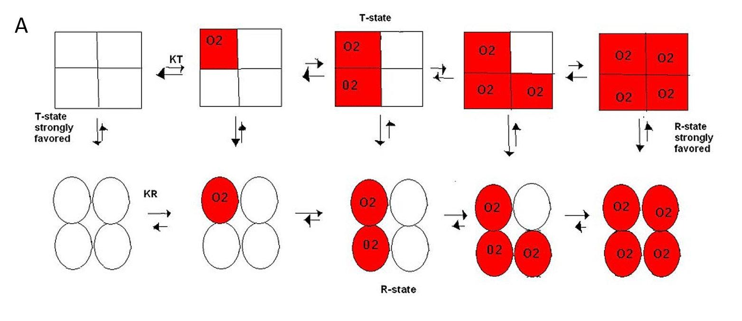
Tense vs Relaxed
Notes:
So the Hemoglobin protein can exist in in different conformations that have different binding affinity for oxygen. To distinguish these binding states, researchers call them the Tense or the Relaxed state of the enzyme. We will see that this type of terminology for allosteric enzymes is used a lot. The Tense state favors inactivity or reduced oxygen binding in this case and is denoted by the squares, whereas the Relaxed state favors oxygen binding and is shown by the circles. This model shows oxygen bound subunits as red. With no oxygen bound, the protein will strongly favor the fully Tense state. As oxygen begins to bind, this shifts the protein through intermediary structures that will convert the protein to strongly favoring the Relaxed State.

Slide 40
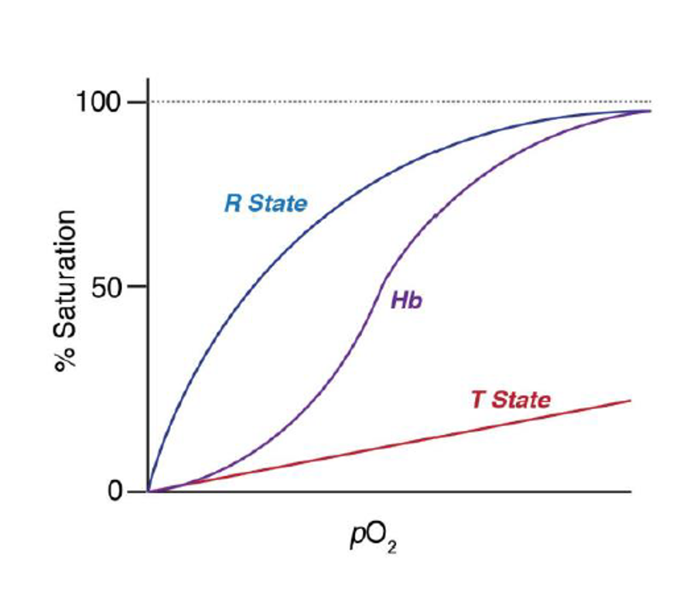
Tense vs Relaxed
Notes:
This can then be visualized graphically as the sigmoidal curve or S-shaped curve, which mimics the Tense state at the beginning of the reaction and transforms to the Relaxed state at the top. In between, it is in flux between the two states.

Slide 41
Hemoglobin and Myoglobin
Notes:
Note that the graph here denotes the partial pressure of oxygen within the system (indicating increased overall amount of oxygen within the system). In the arterial system, the pressure is higher and keeps hemoglobin saturated, whereas, in the venous system, the pressure is lower and oxygen affinity is reduced. This is important, as we will see that hemoglobin is also responsible for the transport of carbon dioxide back out of the system. Blood in the arteries needs to carry oxygen to the body tissues, whereas venous blood is returning to the heart (and lungs) with the carbon dioxide waste products to be released from our body. Without the cooperative nature of hemoglobin, this dynamic would be much harder to do with a single protein (ie. It wouldn’t be possible with myoglobin, which is an oxygen sequestering protein found in muscle tissue.)

Slide 42
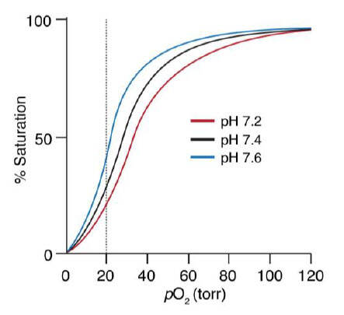
The Bohr Effect
Notes:
pH is another important factor in Hemoglobin oxygen binding dynamics. This effect was described by Christian Bohr (yes, Niel’s Bohr’s Father). He won the Nobel Prize in Medicine for this discovery. Essentially, what he demonstrated is that oxygen binds more strongly to Hemoglobin when the pH is more basic (close to 7.6 rather than 7.2). Note that these minor fluctuations in pH can be sustained in vivo and play an important role in Hemoglobin dynamics.

Slide 43
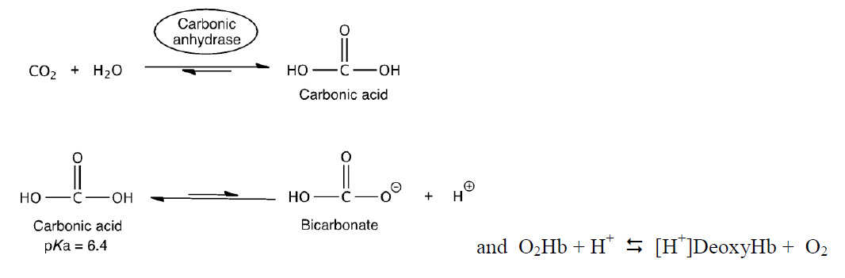
Physiological Conditions
Notes:
To think about the basis of this pH effect, recall three important factors: (1) CO₂/HCO₃– exist in equilibrium within biological systems and can effect the overall pH, (2) deoxyHb is a stronger base than O₂•Hb, and (3) in red blood cells (RBCs), there is an enzyme called carbonic anhydrase, which catalyzes the hydration of CO₂ by water to form HCO₃– . The equations above can be used to describe how hemoglobin maximizes unloading of O₂ in the tissues and unloading of CO₂ in the lungs.
First example: In muscle during exercise, glucose is converted to CO₂. The CO₂ then diffuses to the capillaries and RBCs and equilibrates to H⁺ and HCO₃–. Some of the side chains of Hb act as a buffer. The H⁺s bind to deoxyHb and thus shift the equilibrium to the right, releasing more O₂.
Second example: The deoxyHb is transported through the circulatory system back to the lungs where it picks up O₂. O₂ shifts the equilibrium to the left generating H⁺. The protons then react with HCO₃– to generate CO₂ and H₂O. The CO₂ is exhaled.
Overall, analysis of the biological activity of hemoglobin shows that regulation of a single protein’s activity is complex and can differ at different locations within the body or when exposed to allosteric effectors.

Slide 44

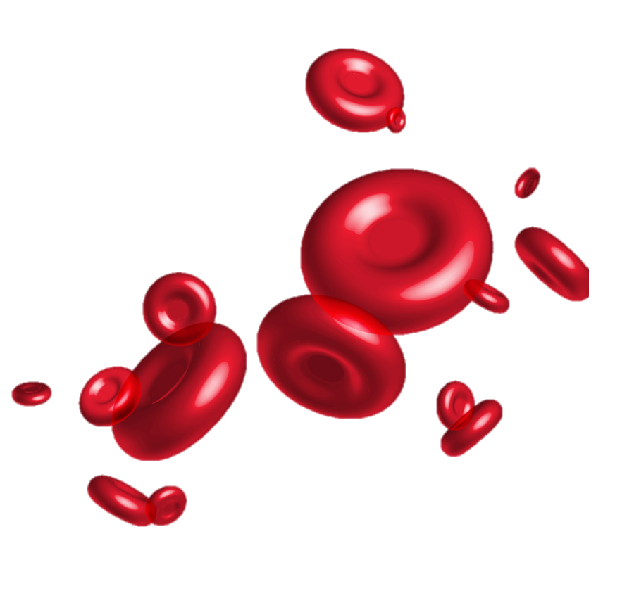
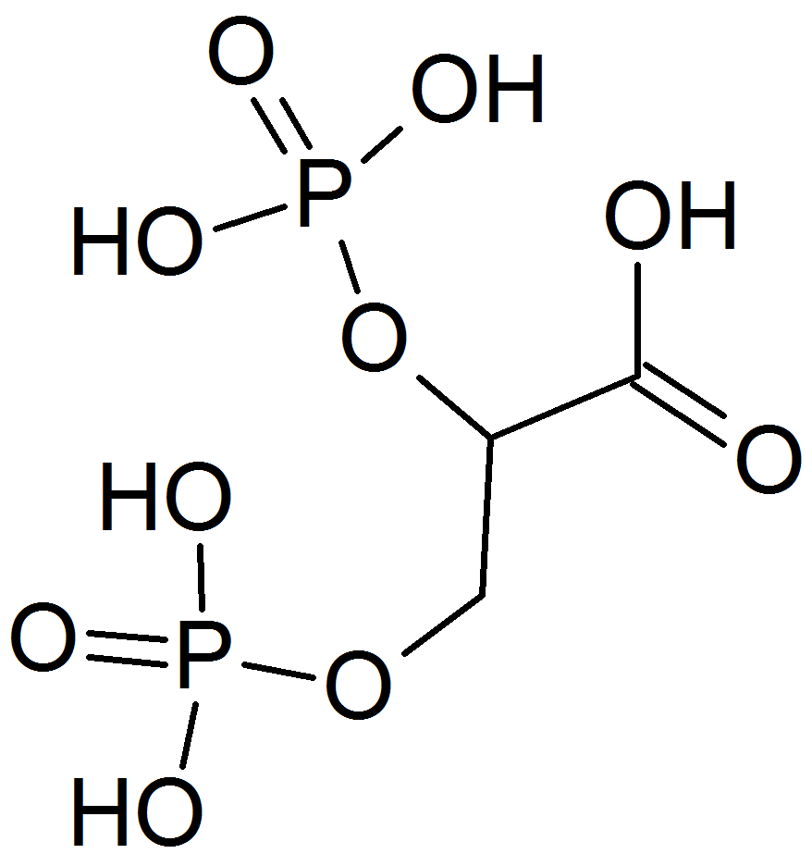
2,3-BPG
Notes:
At high altitude the body struggles to get enough oxygen to all of the tissues of the body. This is due to decreased oxygen availability at higher altitudes and reduced overall air pressure. For example, At 14,000 ft, the air has 43% less oxygen than at sea level, and at the top of Mt. Everest, it is only at 21%! This are is known as the death zone. An extended stay above 8,000 metres (26,247 ft) without supplementary oxygen will result in deterioration of bodily functions and death.
One of the ways that our bodies adapt to help combat this issue is to increase an allosteric effector of the Hemoglobin (Hb) protein known at 2,3-BPG. This can occur in as little as 24 hr after being at a higher altitude. The body will also begin high production levels of red blood cells to carry more oxygen, but this process takes a couple of weeks to increase RBC count.

Slide 45
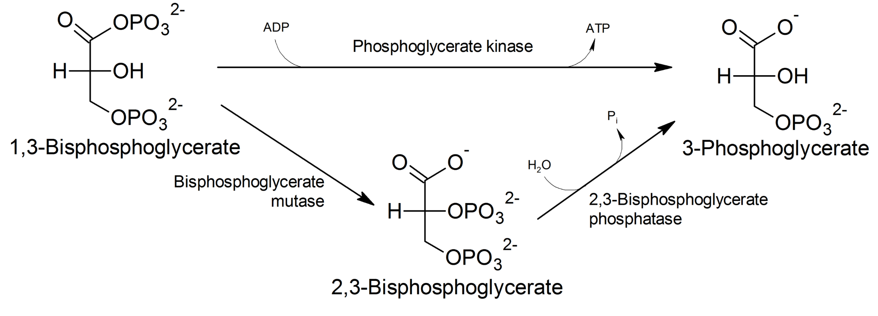
2,3-Bisphosphoglycerate and Hb
Notes:
2,3-BPG is made as a side product from normal sugar metabolism during glycolysis. You will become much more familiar with glycolysis next term, and the production of ATP.

Slide 46
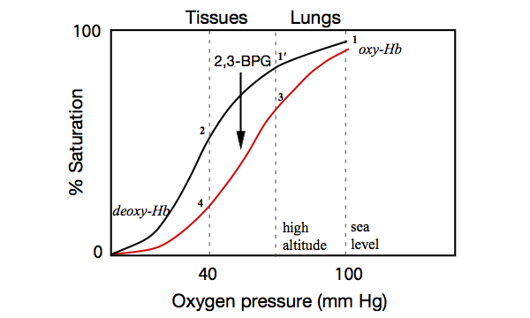
2,3-BPG Reduces Hemoglobin
Affinity for Oxygen
Notes:
This may seem counterproductive at first, but 2,3-BPG reduces the affinity of Hemoglobin for oxygen. However, you can see that the pressure in the lungs is high enough that the Hb protein will still be close to saturated with oxygen, even in the presence of the 2,3-BPG. Where it really makes a difference is in the tissues. The Hb protein is more likely to release oxygen more readily into the tissues of the body that are experiencing a higher demand for oxygen.

Slide 47
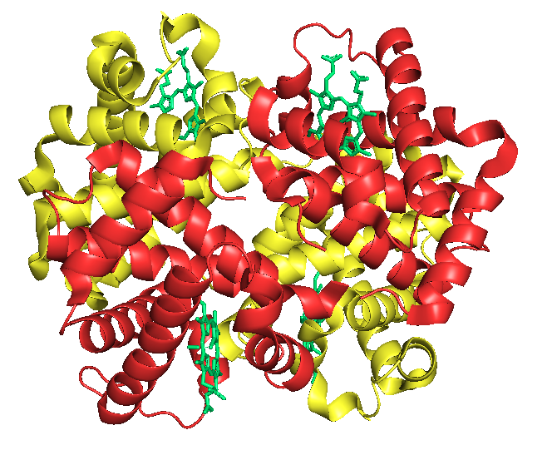
Fetal vs. Adult Hemoglobin
Notes:
Another interesting story, is that there are different alleles of the Hb protein that can be incorporated into the tetramer. In the human fetus, the make up of Hemoglobin is different than shortly occurs after birth. The predominant form in the fetus contains 2 alpha chains and 2 gamma chains (rather than the two beta chains). This alters the oxygen affinity of fetal Hb when compared with the adult form.

Slide 48
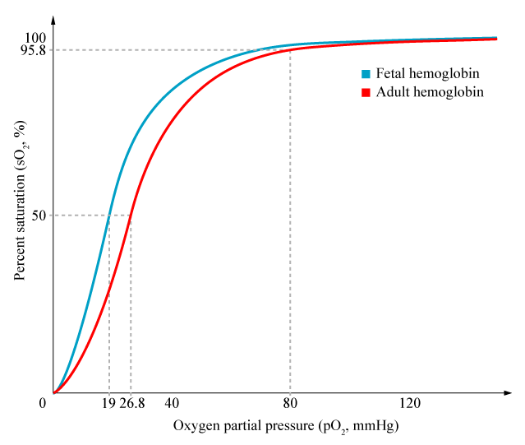
Fetal Hemoglobin
Notes:
In this case, the fetal Hb has higher affinity for oxygen, which makes sense, as the fetus will need to sequester oxygen from the mother’s blood to help the fetus grow.

Slide 49
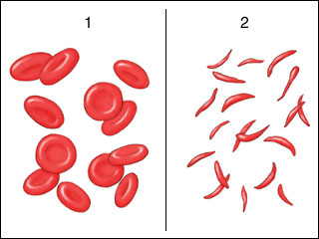
Sickle Cell Anemia
Notes:
One last area, that I would like to visit, with regards to hemoglobin, is the condition of sickle cell anemia.

Slide 50
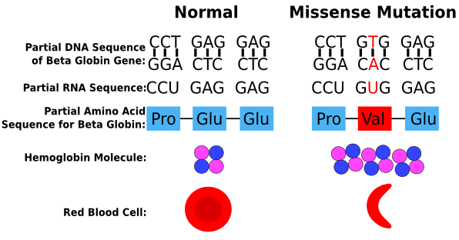
Sickle Cell Mutation
Notes:
The most common form of sickle cell anemia is caused by a single point mutation in the beta globin gene causing a replacement of glutamate with valine. This shift in a highly polar amino acid for a hydrophobic one causes a sticky patch to occur on the Hb protein that wants to be shielded from the water environment. This causes multiple Hb proteins to stick together in a long clumpy chain within the red blood cell. This clumpy protein chain deforms the nice doughnut shape of the red blood cell into a sickle shape. The clumping is worse when low oxygen levels are present, such as when a person is working out hard or running. The disease is the worst in patients that have two mutant alleles. People that are heterozygous and carry one wild type allele and one mutant allele do not have as many symptoms and are typically thought of as carriers for the disease, although they can suffer from some milder symptoms.

Slide 51
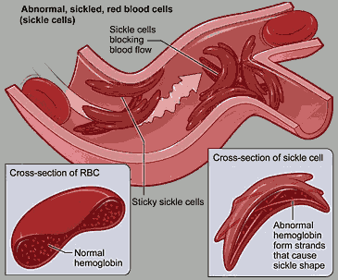
Notes:
The sickled red blood cells get clumped together and cannot pass easily through small capillary beds. This can lead to multiple pleiotropic problems for a sickle cell patient. If this happens in the heart it can cause a heart attack, or in the brain, it can cause a stroke. It can negatively impact the function of other organs, such as the liver, kidney and lungs, as well as cause joint pain and muscle cramping. It is a devastating disease that can seriously reduce life expectancy.

Slide 52
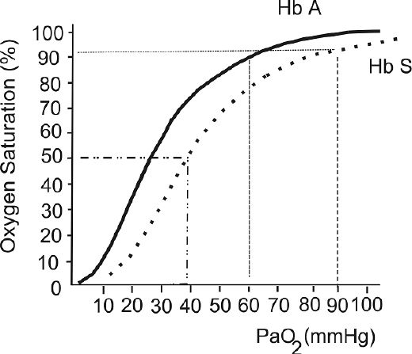
Sickle Cell Mutation has lower oxygen binding affinity
Notes:
The wildtype hemoglobin protein (indicated as HbA) shows higher oxygen binding affinity that the sickle cell hemoglobin (indicated as HbS) that contains the Glu → Val substitution in the beta globin gene. Next week, you will work on an assignment that analyzes other hemoglobin mutations.

Slide 53
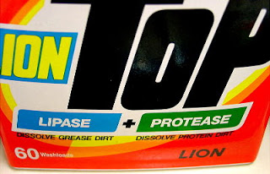
Industrial Enzyme Use
Notes:
Overall, this chapter has provided an overview about enzyme activity and the various factors that can cause changes to biological activity. This is very helpful for understanding health, medicine and disease states. It is also useful for synthetic and industrial purposes, as well, such as lipases and proteases in laundry detergent, glucose isomerase enzymes used to make high fructose syrups, and the use of lactase enzymes to breakdown the lactose in milk products for lactose intolerant people, to name a few. In the next chapter, we will look at the active site strategies that enzymes use to mediate their catalytic activities.

