Slide 1
Chapter 11: Translation
11.1 Overview of Translation
Notes:
In chapter 11, we will investigate the process of protein translation. In this first section, we will review the major features of translation before we get into the details.

Slide 2
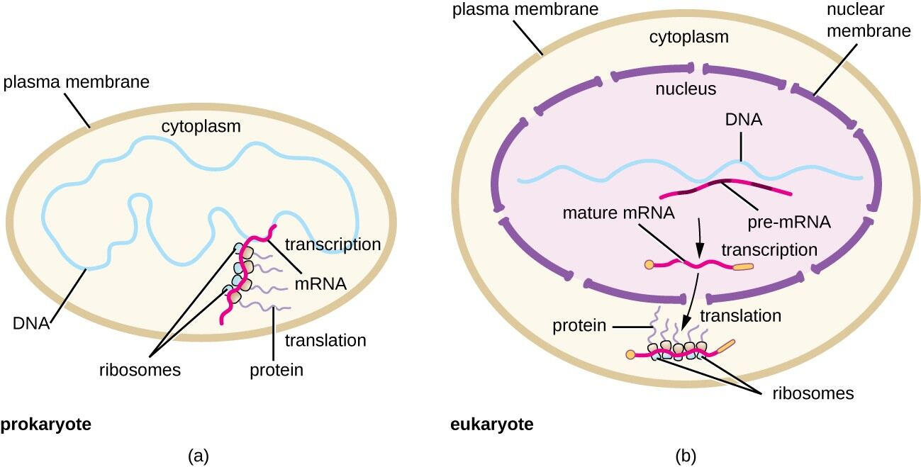
Prokaryotic vs Eukaryotic Translation
Notes:
First, prokaryotic and eukaryotic translation differ in their timing and location. In prokaryotic systems, we learned in Chapter 10 that transcription and translation are coupled, as there is no spatial separation between the genomic DNA and the ribosomal machinery. There is also very little to no post-transcriptional modification of the mRNA in prokaryotes. Whereas in eukaryotes, the mRNA is extensively modified following transcription. It then has to be translocated into the cytoplasm prior to translation at the ribosomes.

Slide 3
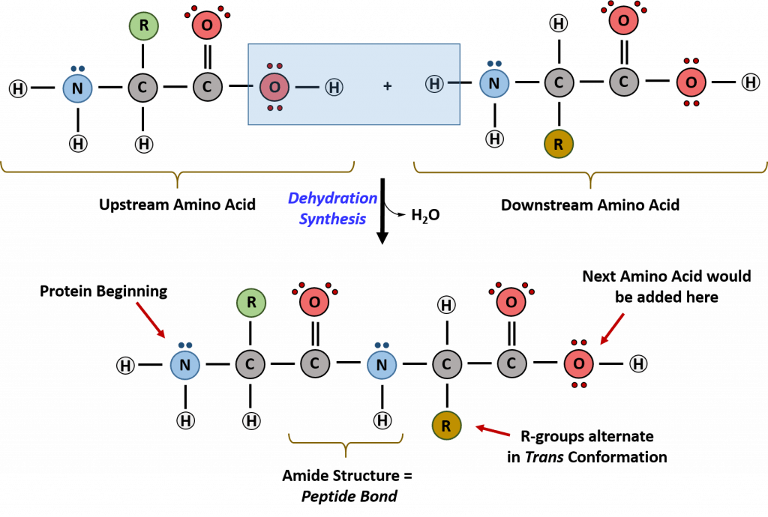
Peptide Bond Formation
Notes:
Recall that you have also learned that the peptide bond is formed by dehydration synthesis, with the loss of the hydroxyl group from the carboxylic acid functional group and a hydrogen from the amine functional group. This leads to the formation of the amide bond. In vivo, we will see that to get this reaction to go in the forward direction, requires activation of the amino acid and quite a bit of energy in the form of ATP.

Slide 4
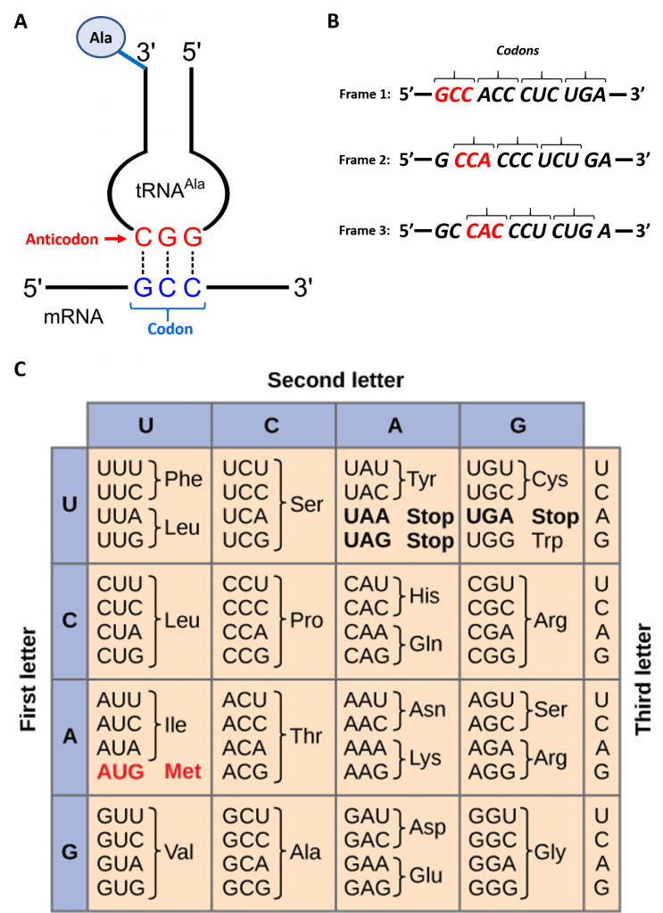
Transfer RNA and the Genetic Code
Notes:
Mechanically, the reaction is facilitated by the transfer RNA and the ribosomal RNA. The messenger RNA holds the code that determines the sequence of the resulting protein. The transfer RNA is responsible for bringing in the correct amino acids that will need to be assembled. The ribosome, which is an assembly of proteins and the ribosomal RNA, is the machinery that brings the mRNA and the correct tRNAs together, so that peptide bond formation can occur, and the nascent peptide can be created. Recall the each tRNA molecule has a 3 base pair segment called the anticodon, that will recognize and hydrogen bond with the codons found in the mRNA. Each tRNA is attached with a specific amino acid at the 3’ end of the molecule. The ribosome enables the mRNA to be read within a specific, non-overlapping reading frame. Each message has a potential for 3 different open reading frames. One will be chosen as the correct reading frame by the placement of the mRNA in the ribosome.

Slide 5
Codon Chart
Notes:
Each of the 64 possible codons (triplets of RNA bases) encodes for a specific amino acid. All except for three. Three of the codons encode for stop codons and will signify the end of the protein sequence. Note also that there is one typical codon, AUG that is used as the starting position for translation. Since there are only 20 amino acids incorporated into protein sequences, but 64 possible codons, there is redundancy within the code. Each specific codon is specific for one amino acid. However, there can be multiple codons that encode for the same amino acid. This is redundancy. For example, ACU, ACC, ACA and ACG all encode for the amino acid, threonine. Redundancy helps to minimize the effects of mutations in the DNA, as mutations can happen that will not change the amino acid being encoded. . Redundancy is caused by degeneracy within the code. We will explore this concept further in the next lecture.

Slide 6
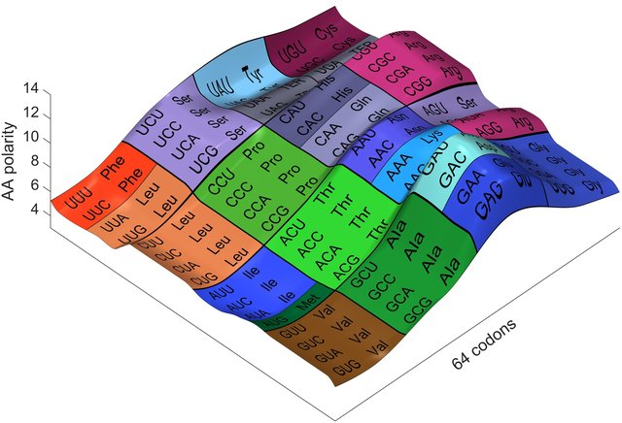
Codons and Polarity
Notes:
Interestingly, if you look at the redundancy within the code, it becomes apparent that the polarity of amino acids encoded by the different codons has evolved such that neighboring codons typically encode for amino acids of similar polarity. This likely arose during evolutionary history as mutations will be minimized more often by replacement with similarly charged amino acids.

Slide 7
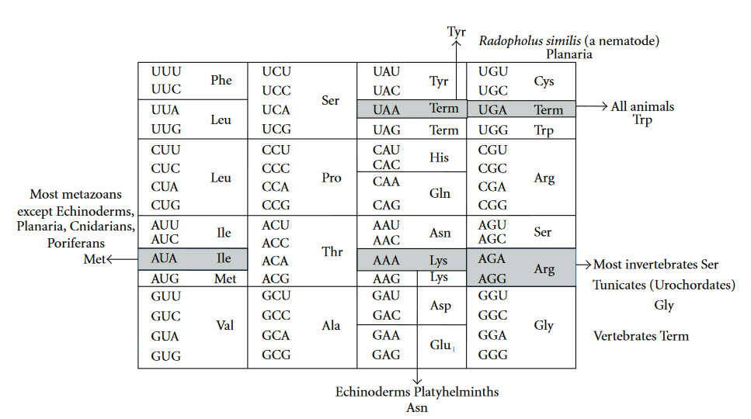
Variations in the Genetic Code
Notes:
The genetic code is also highly conserved between different species on the planet. There are very few changes or variations between all of the differently life forms. The highest diversity is found within the mitochondria of animals, as indicated here. This is a strong indicator that the process of evolution has driven the generation of diversity on the planet over millions of years. In the next section, we will explore the structure of transfer RNA in more detail.

Slide 8
Chapter 11: Translation
11.2 Transfer RNA
Notes:
In this section, we will focus on the key structural elements of transfer RNA.

Slide 9
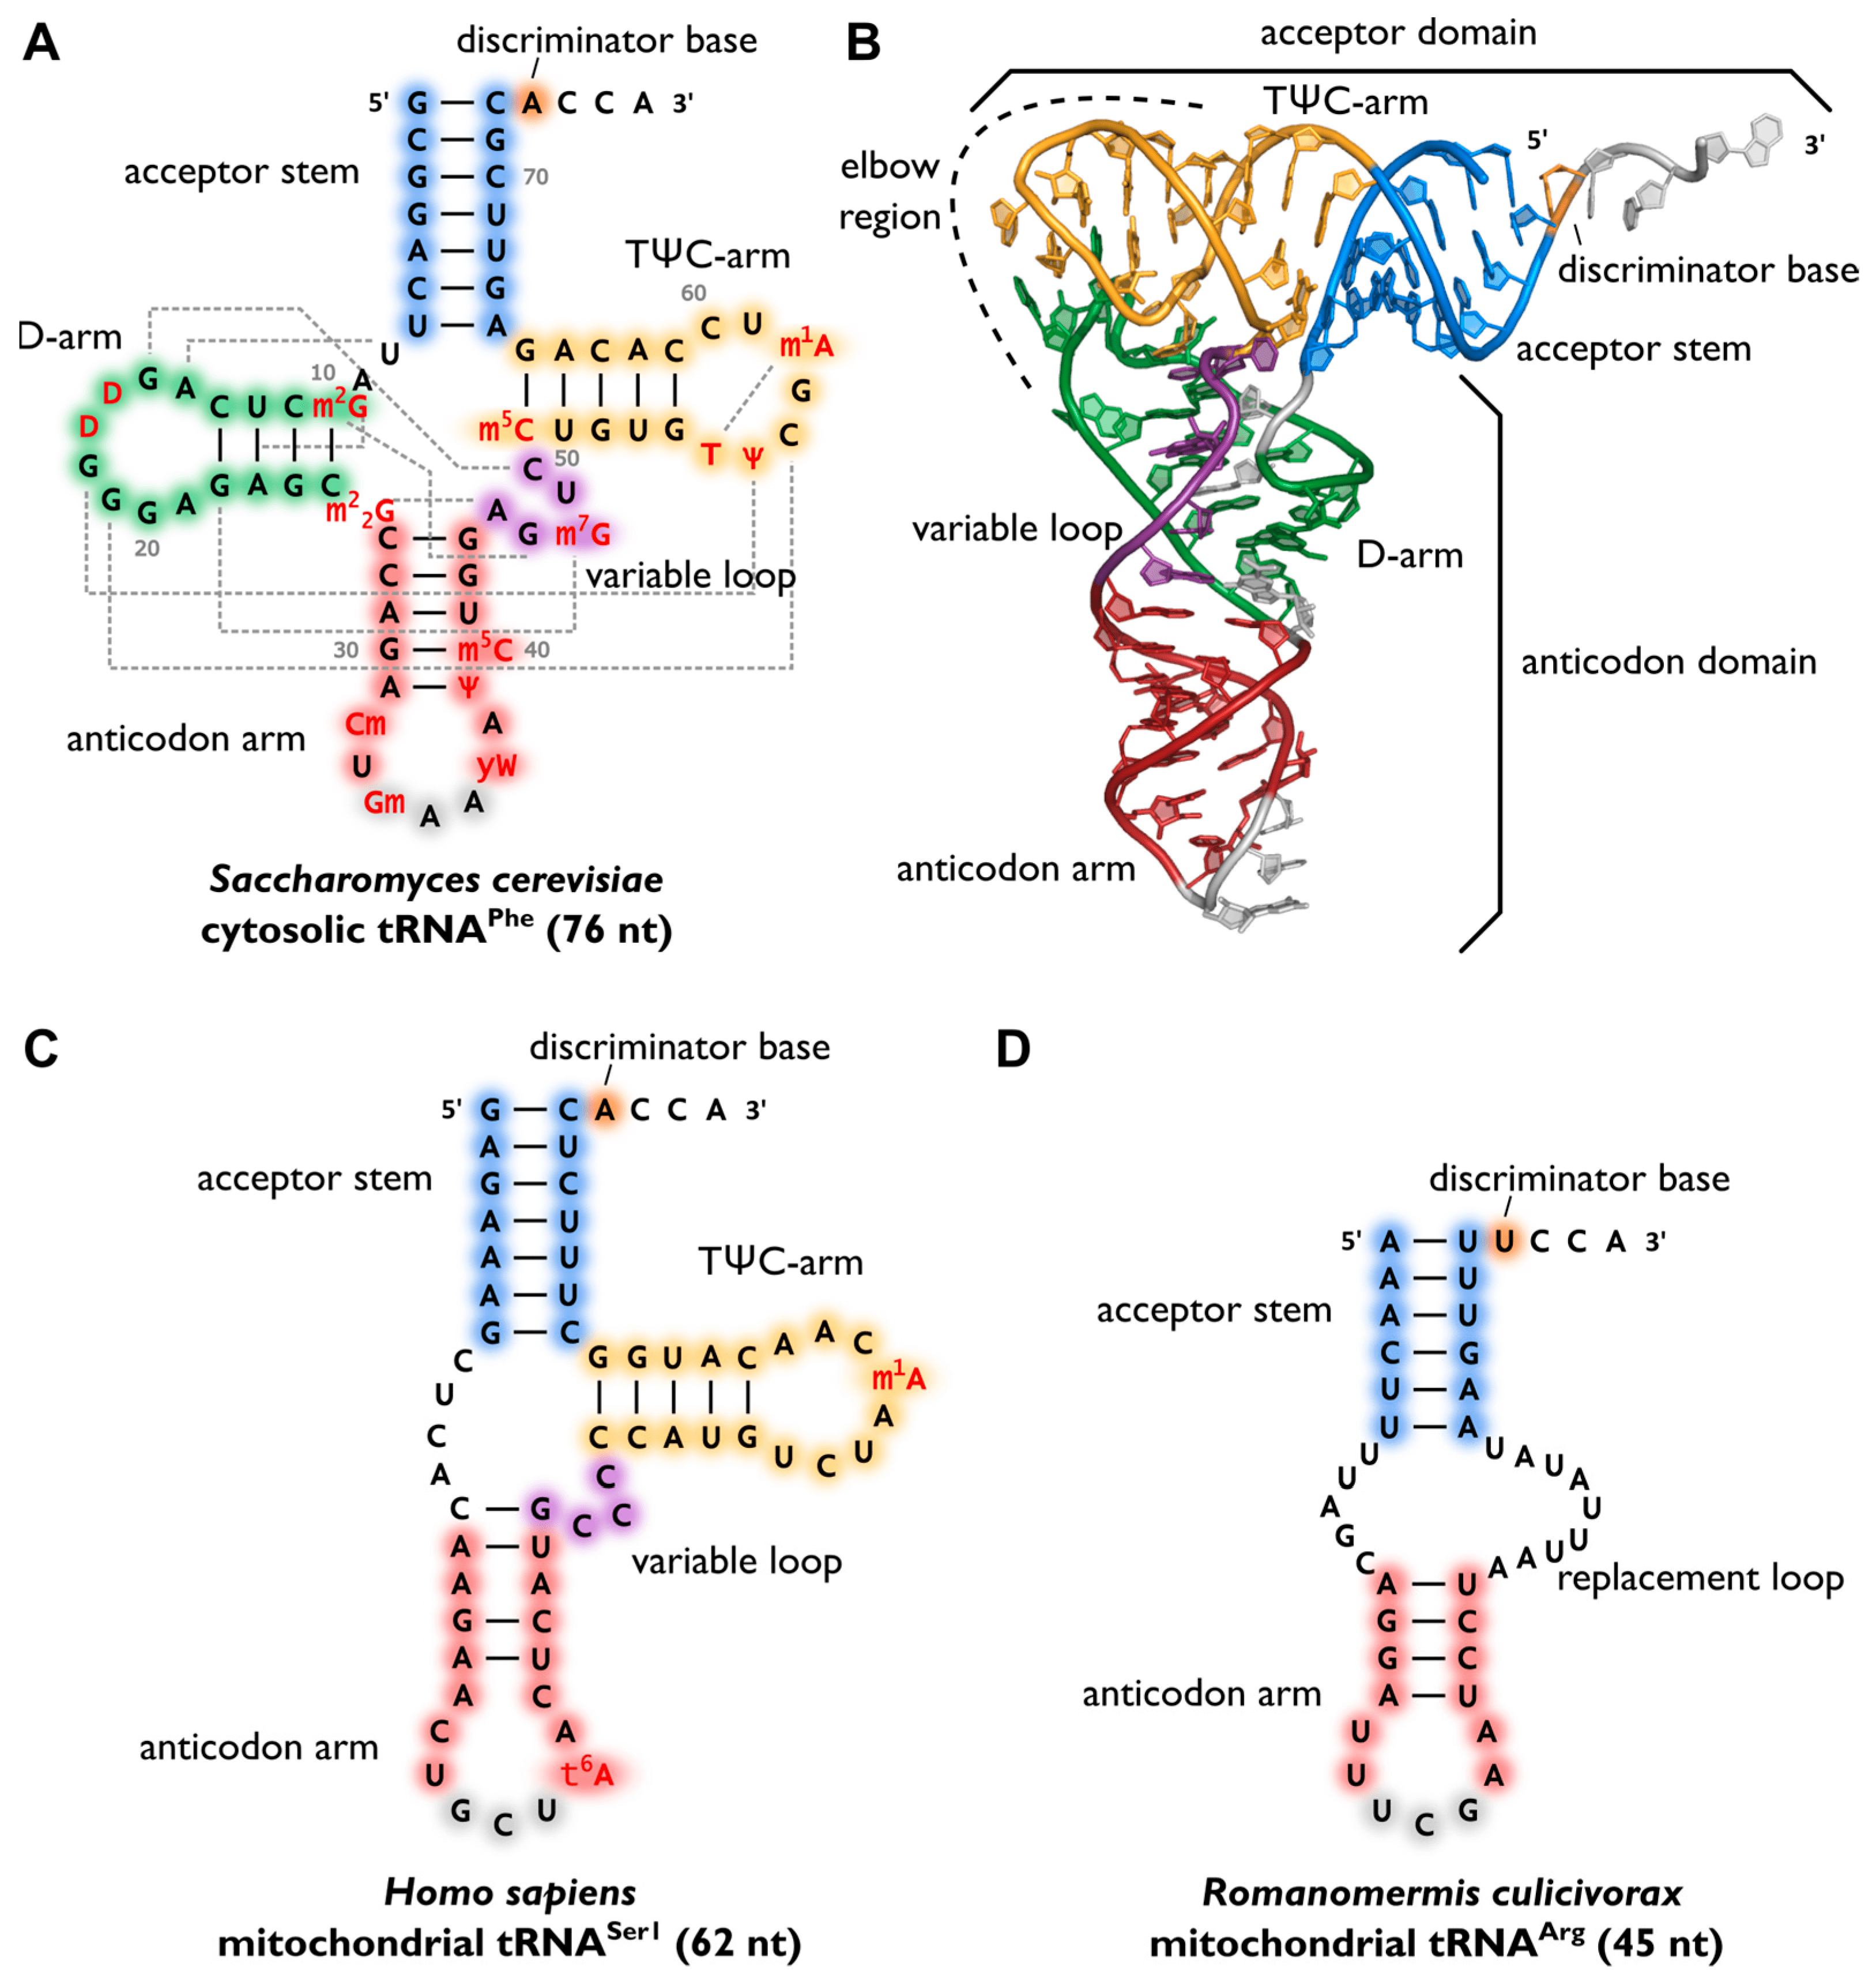
Transfer RNA Structure
Notes:
There are 20 key tRNA molecules within the body. One for each of the amino acids that are encoded into protein synthesis. Most transfer RNA molecules share a highly similar 3-D structure as it needs to fit into the active site of the ribosome and dock on the mRNA. tRNA molecules also have unique elements that help the ribosome and the tRNA synthetase enzymes to distinguish between them. This ensures that they are loaded with the correct amino acid. The 2-D structure of tRNA is characterized by this cloverleaf pattern. At opposing points is the acceptor stem, where the amino acid will be appended onto the molecule, and the anticodon region that will recognize and hydrogen bond with the mRNA. The two side arms have many uniquely modified nucleotides and fold over one another to generate the 3-D L-structure shown on the right. This places the anticodon down here, and the amino acid up here.

Slide 10
Mitochondrial tRNA
Notes:
Major tRNA structural variations occur most often in mitochondrial specific tRNA molecules.

Slide 11
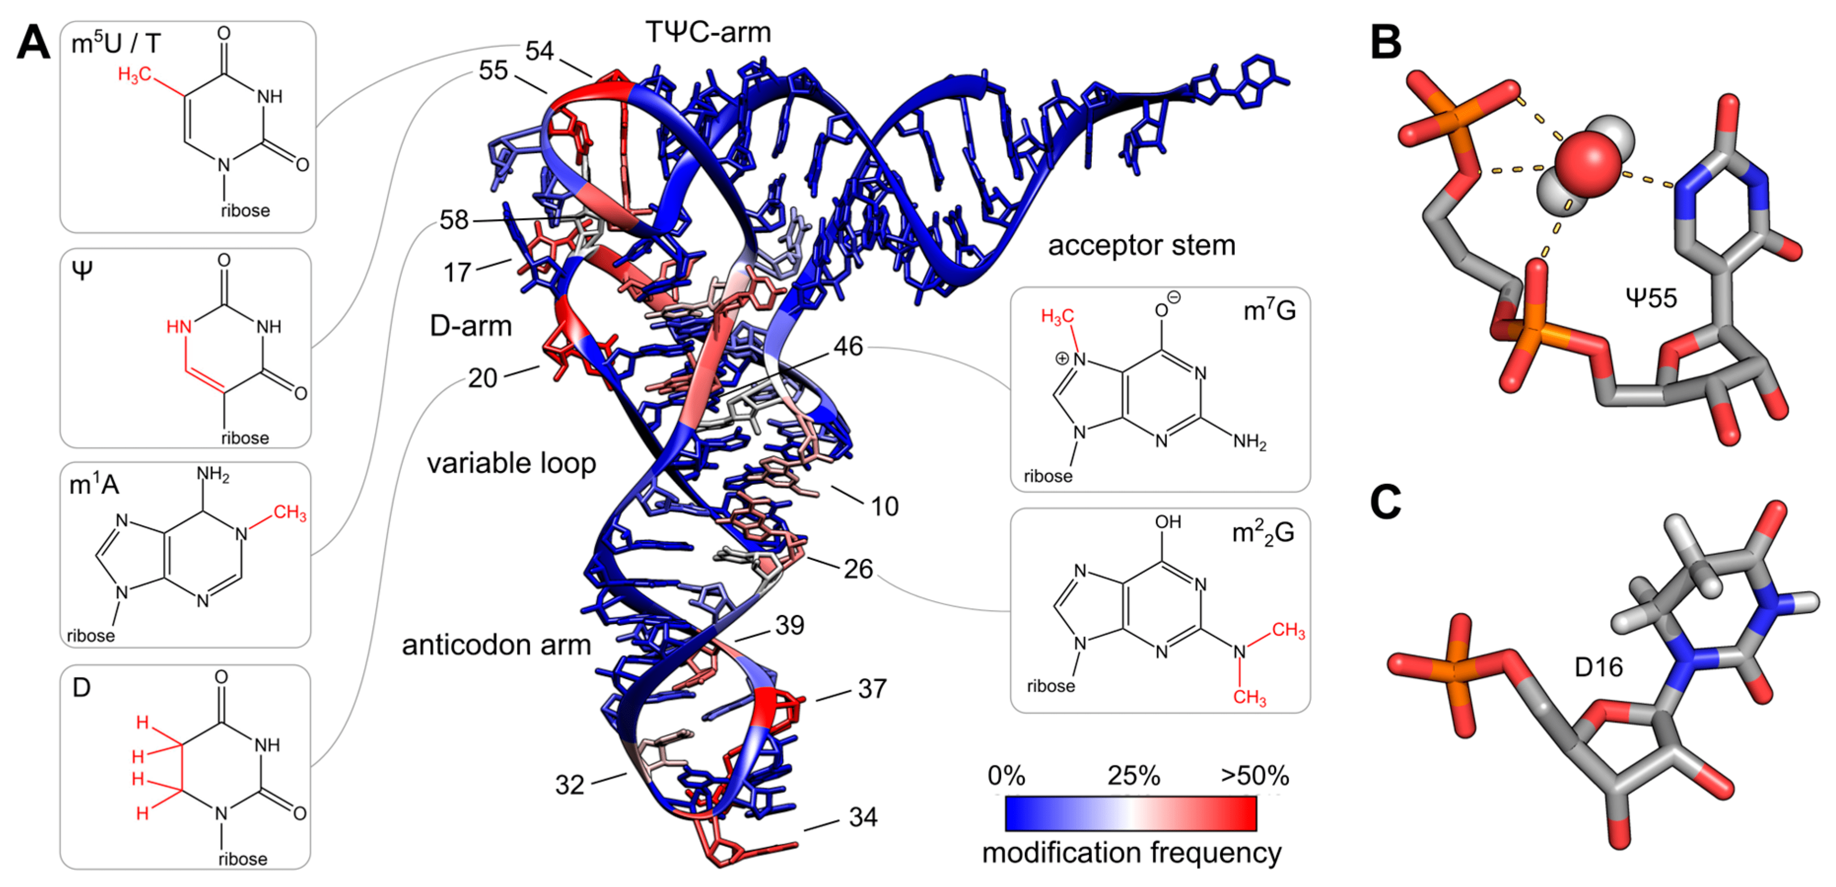
Modified Nucleotides
Notes:
Modified nucleotides in the tRNA help to aid in the unique folding pattern of the tRNA structure. These modifications make additional hydrogen bonding and other electrostatic interactions possible. The red regions indicate areas that have higher frequencies of modifications, while the blue areas are more conserved, and tend to form more helical types of structures. You will notice that the anticodon area is one region that has high modification frequency. This helps to give rise to the redundancy observed in the genetic code.

Slide 12
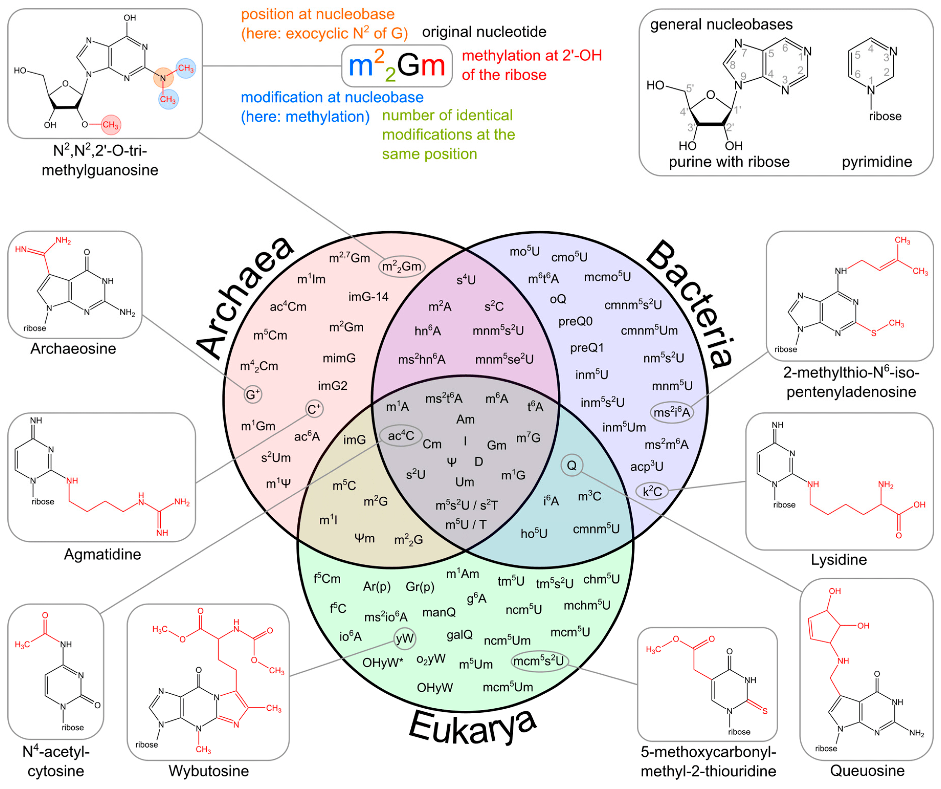
Notes:
Here you can get a feel for how common these different types of tRNA modifications are within the different domains of life. There are modifications that occur commonly in all domains of life and others that are quite specific to a single domain. These can range from methylation, amination, and acetylation, among other more elaborate decorations. One of the major commonalities found in all three domains is the inosine base, and one that you should be sure to become familiar with….

Slide 13
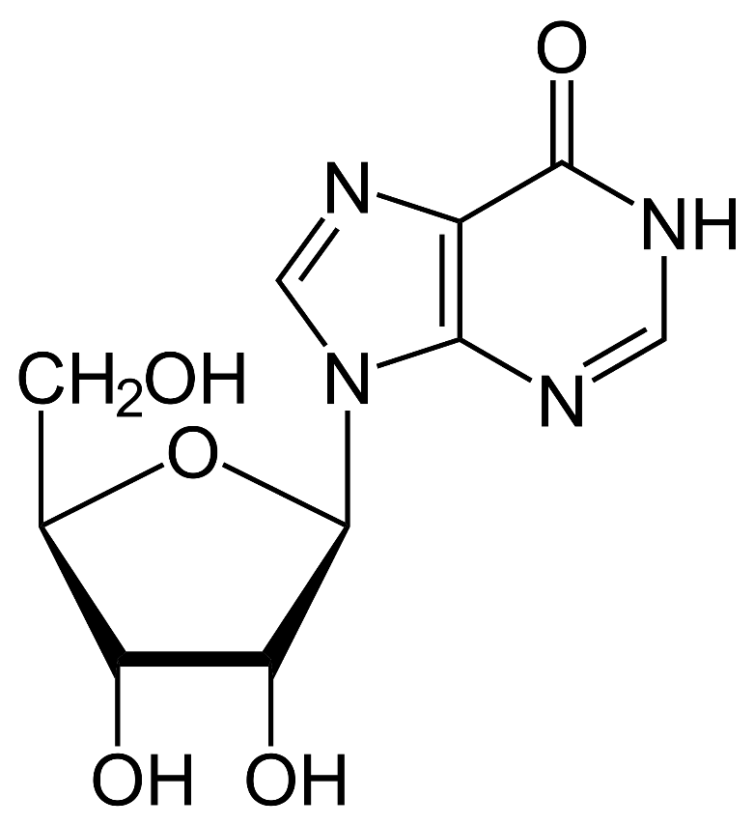
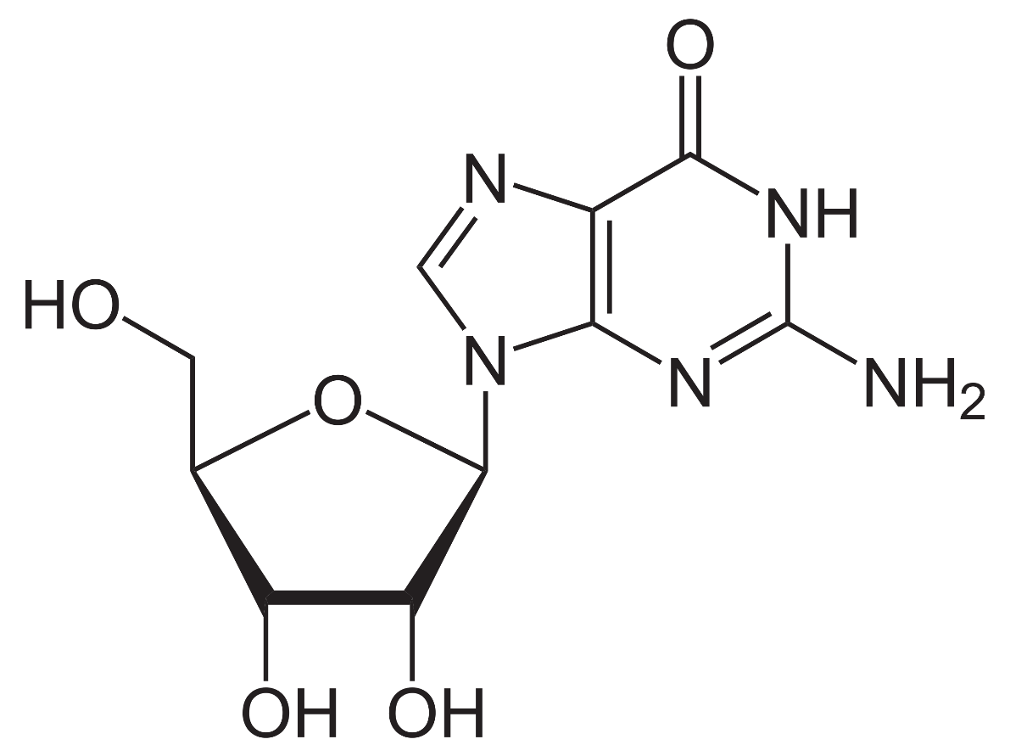
The Inosine Base
Inosine
Guanosine
Notes:
The inosine base is the most common modification located in the anticodon region. It is located at the wobble base position, aligning to the 1st position of the anticodon and the 3rd base position of the mRNA codon. This is usually modified with the inosine base, which is similar to the guanosine base, without the amine functional group, located here. The inosine base has flexibility in movement and hydroden bonding with the 3rd position of the mRNA codon, which is why it is often called the wobble base or wobble position.

Slide 14
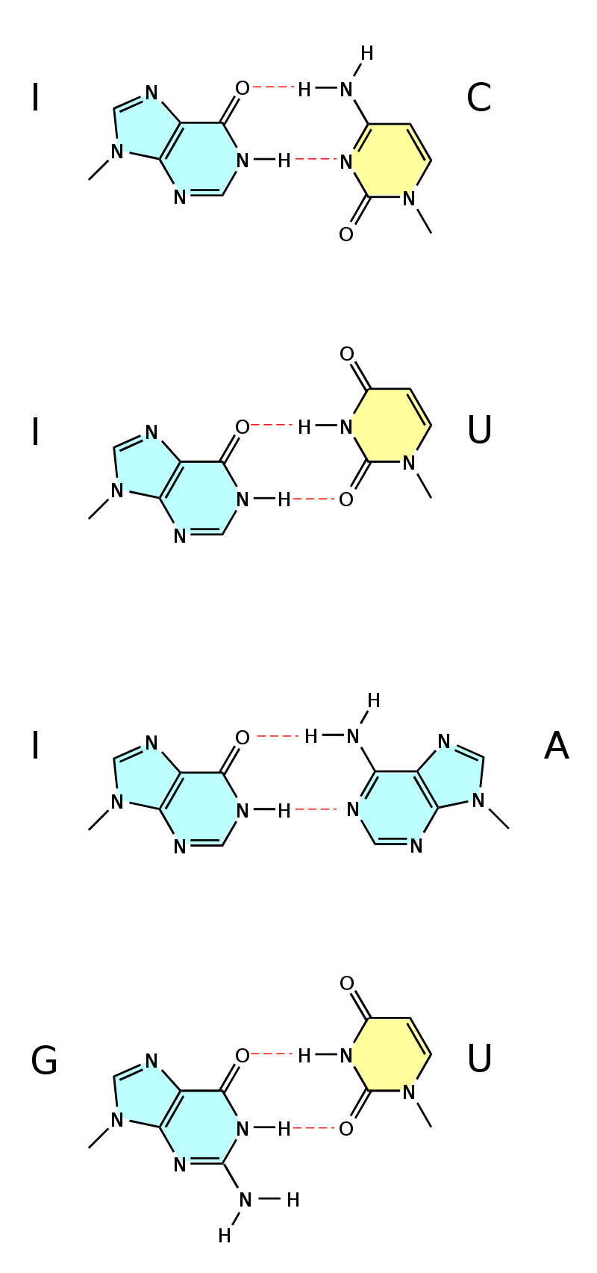
Inosine and Wobble Bases
Notes:
Here you can see that the inosine base can effectively hydrogen bond with C, A, and U bases. Also when Guanosine is located at the wobble position, it can bind with the cytosine base or with uracil. In addition to these unique base pairings, Adenosine and Uracil can when placed at the 1st position of the anticodon can bind with any of the four nucleotide bases (A, C, G, and U) further expanding the wobble base/degeneracy capacity of the tRNA molecules.

Slide 15
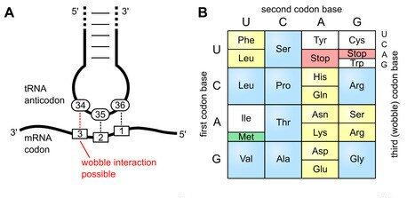
Wobble Position and Degeneracy
Notes:
This allows for the flexibility of the tRNA to recognize multiple codons and provides the key explanation for the redundancy found in the genetic code. In the next section, we will learn how the tRNA’s are loaded to carry their amino acid cargo.

Slide 16
Chapter 11: Translation
11.3 Aminoacyl tRNA Synthetases
Notes:
In this section, we will learn about the Synthetase enzymes required to attach amino acids to their cognate tRNA molecules.

Slide 17
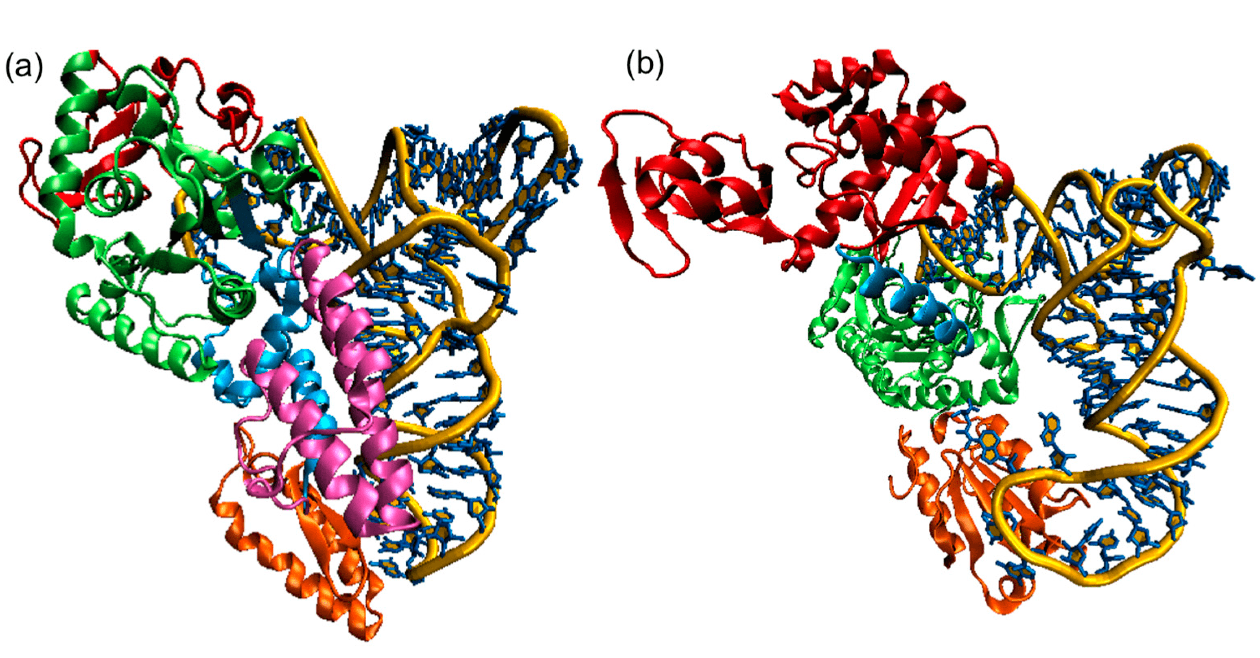
Aminoacyl tRNA Synthetases
Notes:
Aminoacyl-tRNA synthetase enzymes can be divided into two major classes, Class I and Class II. Within the cytoplasm of animals there are a total of 20 standard aminoacyl tRNA-synthetase enzymes, one for each of the specific tRNA molecules. We will discuss the details of these two classes, after we take a look at their mechanism of action.

Slide 18
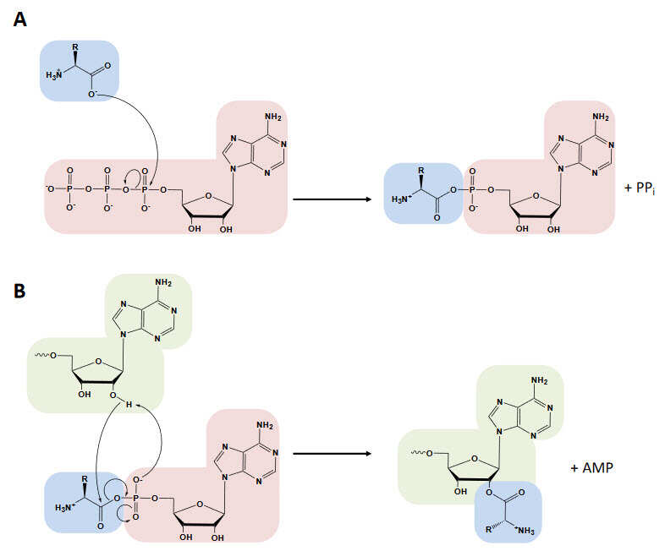
2-Step Reaction
Notes:
Aminoacyl-tRNA Synthetase Enzymes all share a two step reaction mechanism.

Slide 19
2-Step Reaction
Notes:
In the first part of the reaction mechanism, the carboxylic acid function group of the amino acid that will be attached to the tRNA molecule needs to be activated. The hydroxyl group is not reactive enough to serve as a good leaving group in vivo. This is very similar to what we saw with the E1 ubiquitin activating enzyme in Chapter 9. In this step, the synthetase enzyme binds with the amino acid and and ATP molecule. The enzyme positions the amino acid in close proximity with the ATP substrate. The hydroxyl of the amino acid mediates nucleophilic attack on the alpha phosphate of ATP. This forms an oxyanion intermediate. When the electrons rebound into the phosphorous bond, the diphosphate of ATP serves as the leaving group. The hydrolysis of the diphosphate, as we have seen in other reactions, will release enough energy to drive the reaction in the forward direction. At the same time, the amino acid is now bound with the AMP molecule. This is known as an amino acyl adenylate. The amino acid becomes the prefix in the naming (amino acyl), and the AMP is adenylate.

Slide 20
2-Step Reaction
Notes:
In the second part of the reaction, the amino acid is transferred from the AMP to the tRNA. The tRNA molecule is shown in green here. The 3’-terminal base of the tRNA molecule is an adenosine base. This is where the amino acid will be attached on the tRNA molecule. Attachment can occur at either the 2’-OH or the 3’-OH position of the tRNA. Class I Aminoacyl-tRNA Synthetase enzymes mediate attachment at the 2’-OH position, whereas Class II Aminoacyl-tRNA Synthetase enzymes mediate attachment at the 3’-OH position. In this diagram, you can see that attachment is occurring at the 2’-OH position. Essentially, the hydroxyl group of the tRNA mediates nucleophilic attack at the carbonyl carbon of the amino acid. This forms our familiar oxyanion intermediate, which rebounds and then causes the AMP component to serve as the leaving group. The tRNA is then attached to the amino acid.

Slide 21
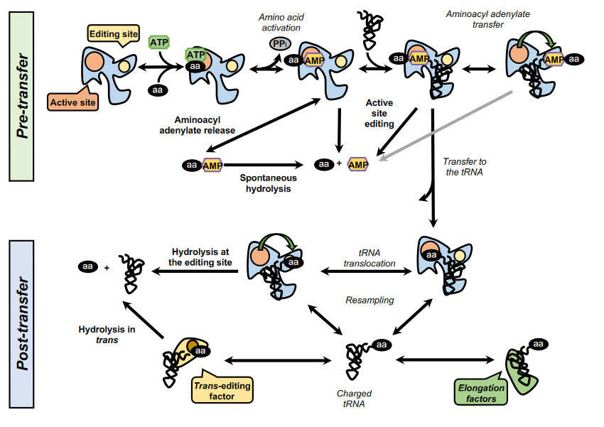
Aminoacyl tRNA Synthetases
Notes:
Here is a diagram of this process with the enzyme present in the reaction.

Slide 22
Aminoacyl tRNA Synthetases
Notes:
Aminoacyl-tRNA Synthetase enzymes have two binding sites. The active site and an editing site. In the first part of the reaction the amino acid is activated to the amino acyl-adenylate. The diphosphate is cleaved to inorganic phosphate and leaves the active site. The tRNA then binds with the enzyme and the substrates are flipped into the editing site to check and make sure the correct amino acid and correct tRNA molecules are docked. All of these steps confer the pre-transfer portion of the reaction.

Slide 23
Aminoacyl tRNA Synthetases
Notes:
Once the amino acyl-adenylate and the tRNA have been checked, they are flipped back into the active site of the enzyme where the amino acid is covalently linked with the tRNA. The amino acyl-tRNA is then checked one more time in the editing site and released from the enzyme if correct. If it is incorrect, the amino acid will be hydrolyzed from the tRNA and both will be released. The resulting amino acyl-tRNA can be further checked by other trans-editing protein factors, or it may bind with elongation factors that will transport it to the ribosome for protein assembly. Ultimately, it is a process that has multiple checkpoints to ensure that the tRNAs are assembled with their cognate amino acids correctly. It is also energy intensive. 1 ATP is used for every amino acid that is linked to a tRNA. Thus, a protein that has 300 amino acids would require 300 molecules of ATP, just to make the tRNAs required for the process…we will see that utilization of the aa-tRNAs at the ribosome is also energy intensive. It takes a lot of energy to make proteins.

Slide 24
Aminoacyl tRNA Synthetases
Notes:
Getting back to the two classes of Aminoacyl-tRNA Synthetases, both use ATP to activate amino acid prior to attachment onto the cognate tRNA. Both have active sites, and both have editing sites. Class I attaches the amino acid at the 2’OH of the 3’-adenosine residue, whereas Class II attaches at the 3’-OH position. Class I and Class II enzymes are not homologs. They are products of convergent evolution and have arisen independently of each other. Of the 20 proteogenic amino acids, 10 use the Class I system and 10 use the Class II system. In the next section, we will focus on the structure of the ribosome.

