Slide 1
Chapter 10: Transcription and RNA Processing
10.1 Types of RNA
Notes:
In Chapter 10, we will learn more about the different types of RNA and how RNA is transcribed from the DNA sequence. We will start with section 10.1 covering the types of RNA.

Slide 2
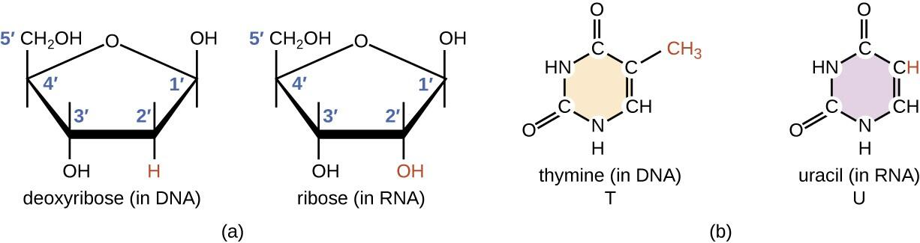
DNA vs RNA
Notes:
Recall that RNA has two key chemical differences from the DNA molecule. RNA uses the ribose sugar that contains the 2’-OH and it also uses the uracil base in place of thymine in DNA.

Slide 3
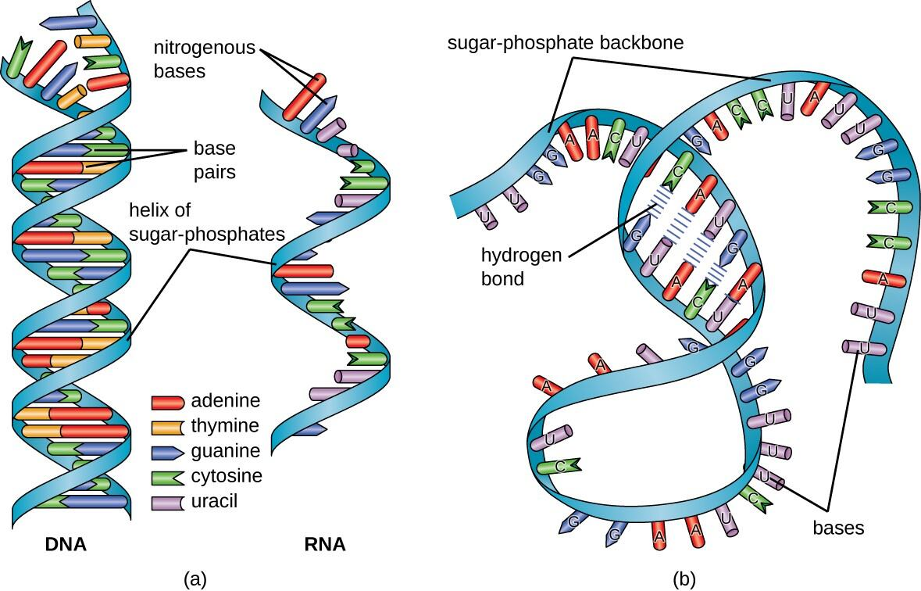
DNA vs RNA
Notes:
These minor chemical differences result in major structural differences between the molecules. While DNA is held in the rigid structure of the alpha helix, RNA is usually single stranded and therefore has much more variation in the shapes that it can adopt. RNA can largely be divided into two types, one that carries the code for making proteins or coding RNA, which is also called messenger RNA (mRNA), and non-coding RNA (ncRNA). The ncRNA can be subdivided into several different types, depending either on the length of the RNA or on the function. Size classification begins with the short ncRNAs (~20–30 nt), which include microRNAs (miRs), and small interfering (siRNAs); the small ncRNAs up to 200 nt, which include transfer RNA (tRNA), small nuclear RNA (snRNA), and small nucleolar RNA (snoRNA); and long ncRNAs ( > 200 nt), which include ribosomal RNA (rRNA), enhancer RNA (eRNA) and long intergeneic ncRNAs (lincRNAs), among others.

Slide 4
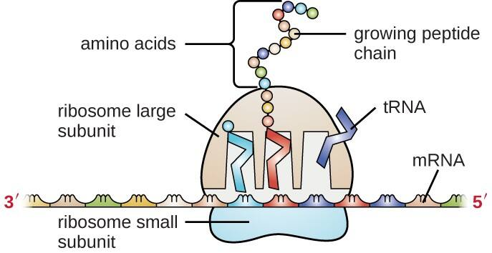
Translation
Notes:
Cells access the information stored in DNA by creating RNA, through the process of transcription, which then directs the synthesis of proteins through the process of translation. The three main types of RNA directly involved in protein synthesis are messenger RNA (mRNA), ribosomal RNA (rRNA), and transfer RNA (tRNA). The mRNA carries the message from the DNA, which controls all of the cellular activities in a cell. If a cell requires a certain protein to be synthesized, the gene for this product is “turned on” and the mRNA is synthesized through the process of transcription. The mRNA then interacts with ribosomes and other cellular machinery to direct the synthesis of the protein it encodes during the process of translation. mRNA is relatively unstable and short-lived in the cell, especially in prokaryotic cells, ensuring that proteins are only made when needed.

Slide 5
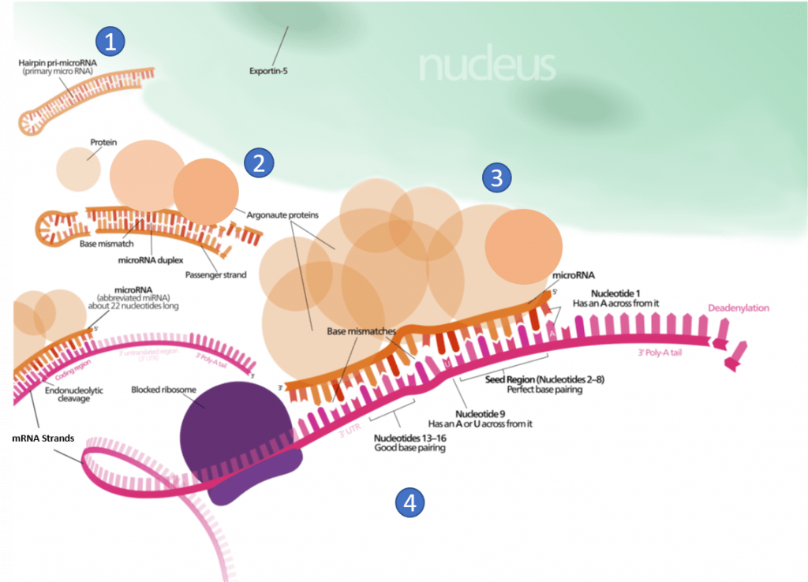
Micro RNA (miRNA)
Notes:
the post-transcriptional expression levels of many genes can be controlled by RNA interference, in which miRNAs, specific short RNA molecules, pair with mRNA regions and target them for degradation (Figure 10.4). This process is aided by protein chaperones called argonautes. This antisense-based process involves steps that first process the miRNA so that it can base-pair with a region of its target mRNAs. Once the base pairing occurs, other proteins direct the mRNA to be destroyed by nucleases. Fire and Mello were awarded the 2006 Nobel Prize in Physiology or Medicine for this discovery.

Slide 6
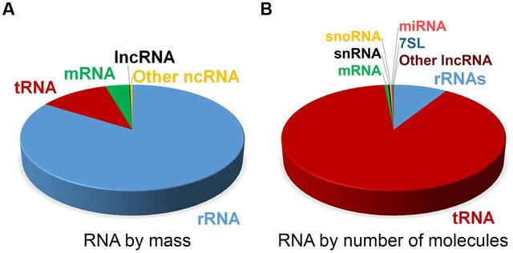
Types of RNA Molecules
Notes:
At steady state, the vast majority of human cellular RNA consists of rRNA (∼90% of total RNA for most cells Figure 10.5). Although there is less tRNA by mass, their small size results in their molar level being higher than rRNA (Figure 10.5). Other abundant RNAs, such as mRNA, snRNA, and snoRNAs are present in aggregate at levels that are about 1–2 orders of magnitude lower than rRNA and tRNA (Figure 10.5). Certain small RNAs, such as miRNA and piRNAs can be present at very high levels; however, this appears to be cell type dependent. lncRNAs are present at levels that are two orders of magnitude less than total mRNA. Although the estimated number of different types of human lncRNAs may have a very restricted expression pattern and thus, accumulate to higher levels within specific cell types. For example, sequencing of mammalian transcriptomes has revealed more than 100,000 different lncRNA molecules can be produced, compared with the approximate 20,000 protein-coding genes. The diversity and functions of the transcriptome within biological processes are currently a highly active area of research.

Slide 7
Chapter 10: Transcription and RNA Processing
10.2 RNA Polymerase Enzymes
Notes:
RNA Polymerase Enzymes (RNAPs) are required to carry out the process of transcription and are found in all cells ranging from bacteria to humans. All RNAPs are multi-subunit assemblies, with bacteria having five core subunits that have homologs in archaeal and eukaryotic RNAPs. In this section, we will learn more details about this enzyme class.

Slide 8
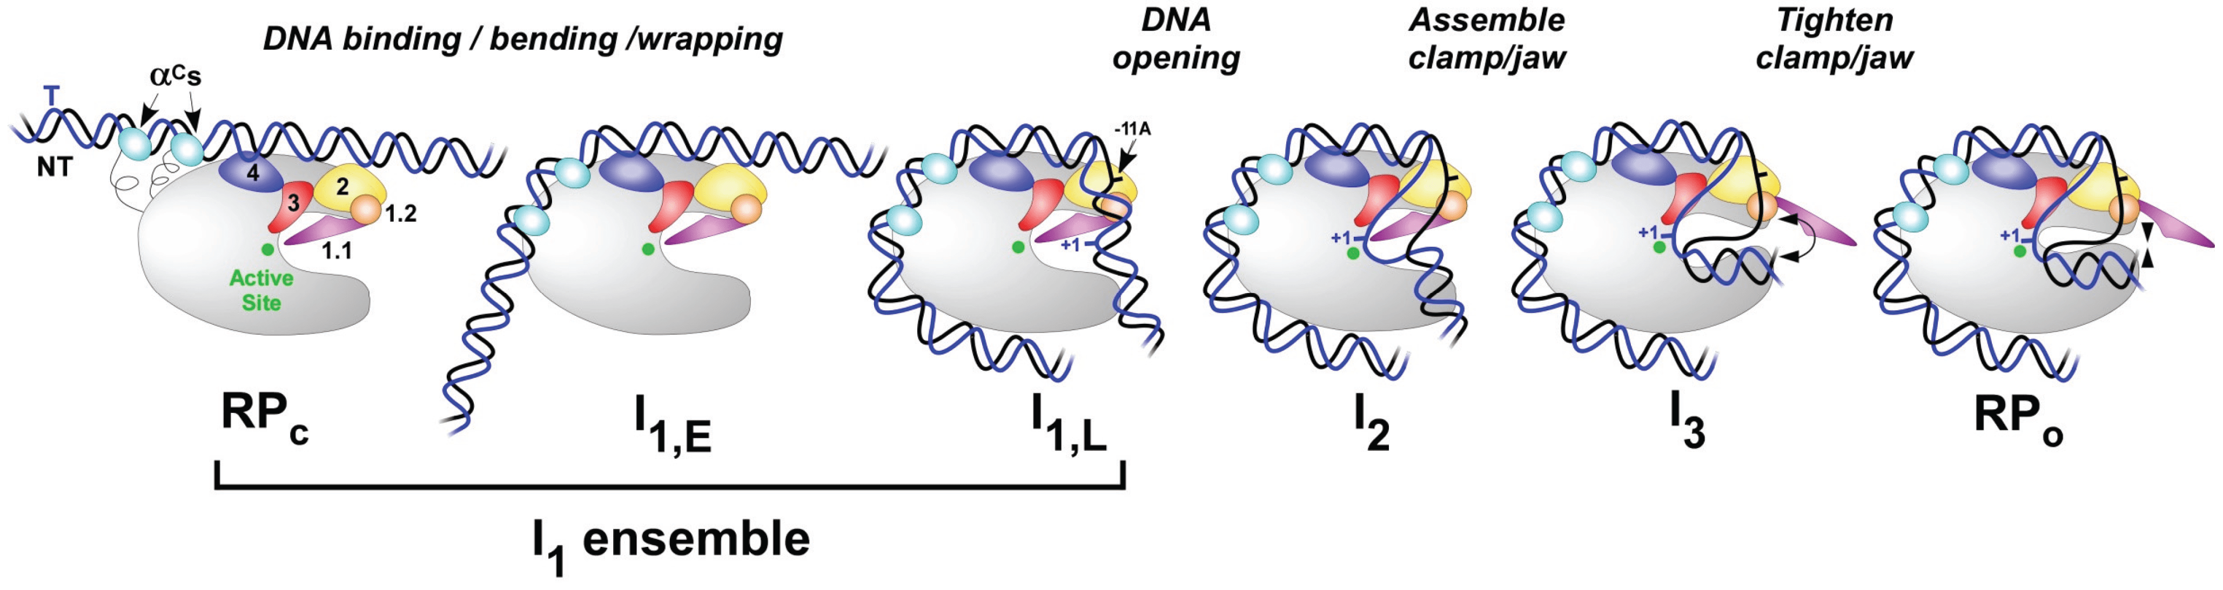
Transcription Initiation
Notes:
Transcription takes place in several stages. To start with, the RNA polymerase holoenzyme locates and binds to promoter DNA. At this stage the RNAP holoenzyme is it the closed conformation (RP_{c}). Initial specific binding to the promoter by sigma factors of the holoenzyme, sets in motion conformational changes in which the RNAP molecular machine bends and wraps the DNA with mobile regions of RNAP playing key roles. Next, RNAP separates the two strands of DNA and exposes a portion of the template strand. At this point, the DNA and the holoenzyme are said to be in an ‘open promoter complex’ (RP_{o}), and the section of promoter DNA that is within it is known as a ‘transcription bubble’.

Slide 9
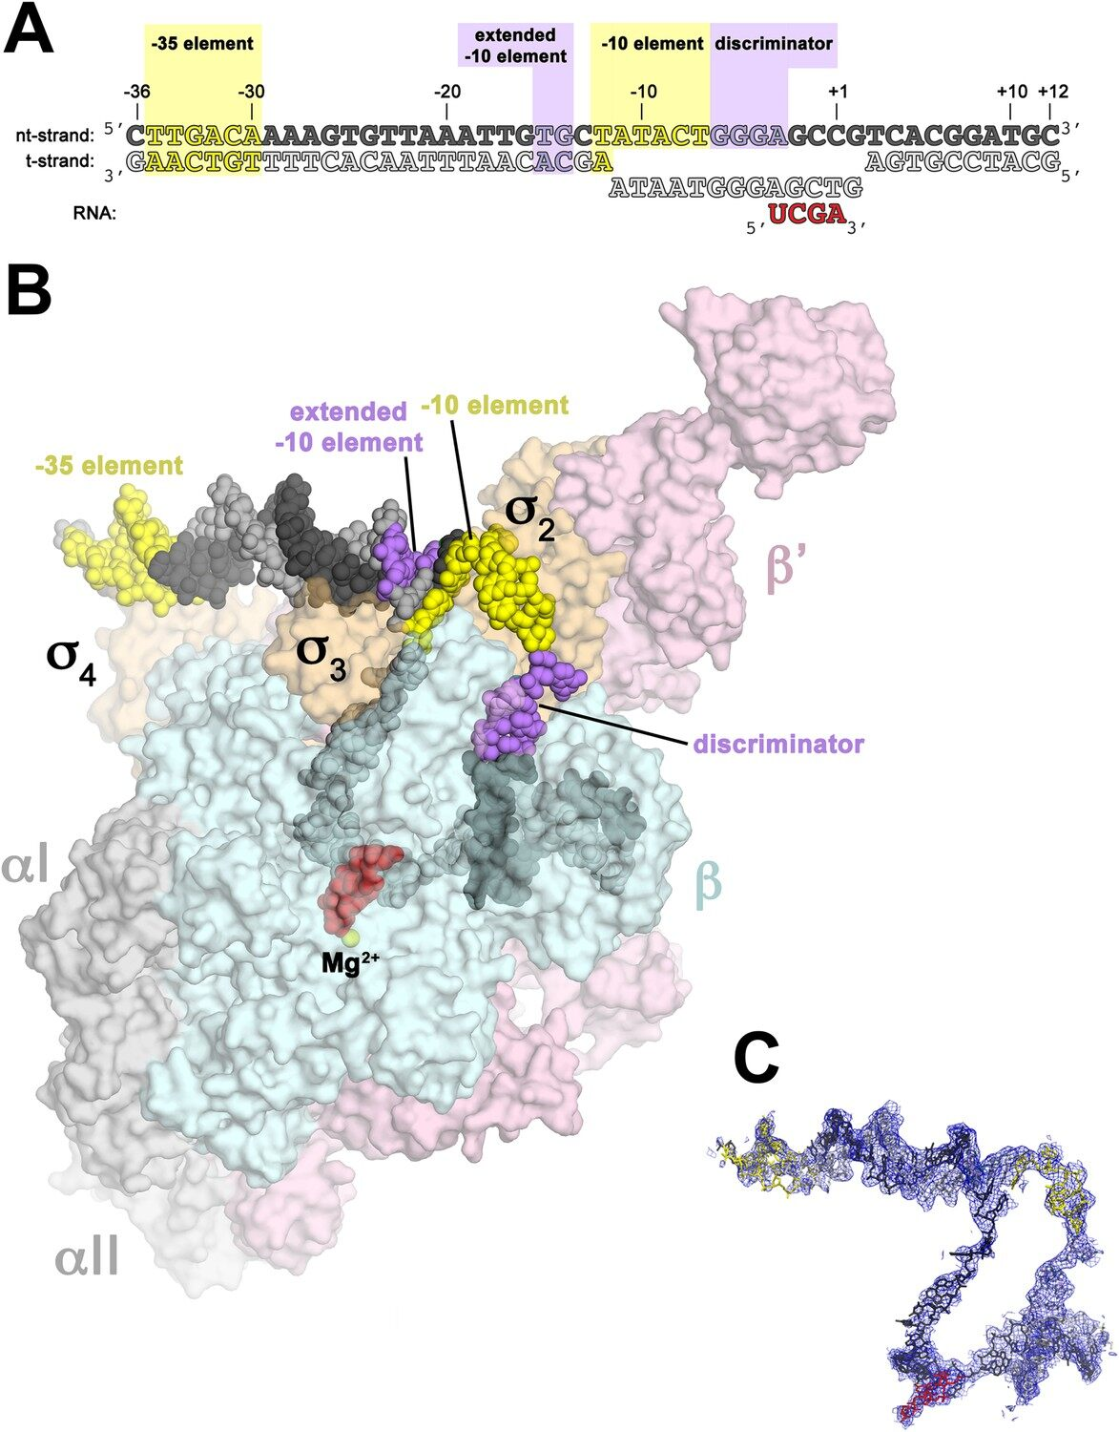
RNAP
Notes:
The RNAP catalytic core within bacteria contains five major subunits (α₂ββ’ω). To position this catalytic core onto the correct promoter requires the association of a sixth subunit called the sigma factor (σ). Within bacteria there are multiple different sigma factors that can associate with the catalytic core of RNAP that help to direct the catalytic core to the correct DNA locations where RNAP can then initiate transcription. For example, within E. coli σ⁷⁰ is the housekeeping sigma factor that is responsible for transcribing most genes in growing cells. It keeps essential genes and pathways operating. Other sigma factors are activated during certain environmental situations, such as σ³⁸ which is activated during starvation or when cells reach the stationary phase. When the sigma subunit associates with the RNAP catalytic core, the RNAP has then formed the holoenzyme. When bound to DNA, the holoenzyme conformation of RNAP can initiate transcription. Once the transcription bubble has formed and transcription initiates, the sigma subunits dissociate from the complex and the RNAP catalytic subunit continues elongation on its own.

Slide 10
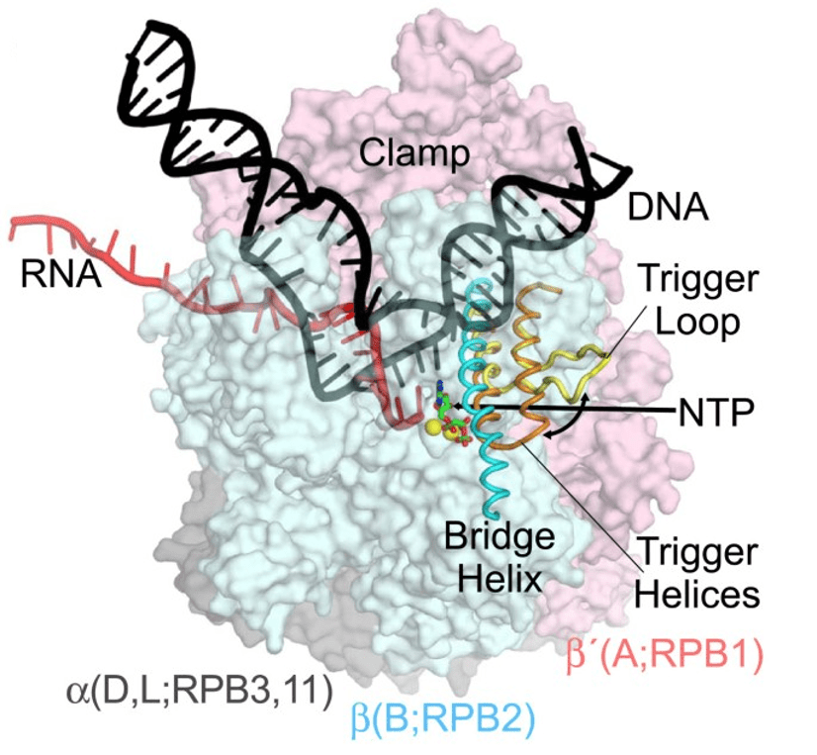
Eukaryotic RNA Polymerase Enzyme
Notes:
In eukaryotic cells, three RNAPs share the task of transcription, the first step in gene expression. RNA Polymerase I (Pol I) is responsible for the synthesis of the majority of rRNA transcripts, whereas RNA Polymerase III (Pol III) produces short, structured RNAs such as tRNAs and 5S rRNA. RNA Polymerase II (Pol II) produces all mRNAs and most regulatory and untranslated RNAs.
The three eukaryotic RNA polymerases contain homologs to the the five core subunits found in prokaryotic RNAPs. In addition, the eukaryotic Pol I, Pol II and Pol III have five additional subunits forming a catalytic core that contains 10-subunits. The core has a characteristic crab-claw shape which encloses a central cleft that harbors the DNA, and has two channels, one for the substrate NTPs and the other for the RNA product. Two ‘pinchers’, called the ‘clamp’ and ‘jaw’ stabilize the DNA at the downstream end and allow opening and closing of the cleft. For transcription to occur, the enzyme has to maintain a transcription bubble with separated DNA strands, facilitate the addition of nucleotides, translocate along the template, stabilize the DNA:RNA hybrid and finally allow the DNA strands to reanneal. This is achieved by a number of conserved elements in the active site, which include the fork loop(s), rudder, wall, trigger loop and bridge helix.

Slide 11
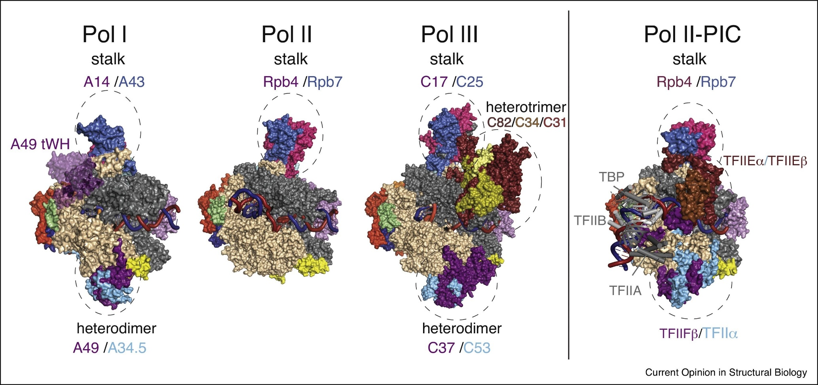
Notes:
Here you can see a comparison of all three RNA polymerases from eukaryotes. They all are homologs and share a similar core complex shown in the gray and tan regions. The stalk region is also a related structure in all the polymerases. The Pol I and III enzymes have more subunits than Pol II. They have more limited arrays of transcripts that they create and tend to permanently incorporate transcription factors into their core structures. Pol II, however, has a much more diverse array of targets, and therefore, has a wider array of transcription factors that it needs to bind with, therefore they are not permanently incorporated giving a smaller polymerase structure. In the next section, we will focus on the activity of RNA polymerase II

Slide 12
Chapter 10: Transcription and RNA Processing
10.3 Transcription Factors and the Preinitiation Complex
Notes:
RNA transcription consists of three phases: Initiation, Elongation, and Termination. In this section, we will focus on the Initiation phase of transcription where the RNA Polymerase II is recruited and activated by a host of transcription factors.

Slide 13
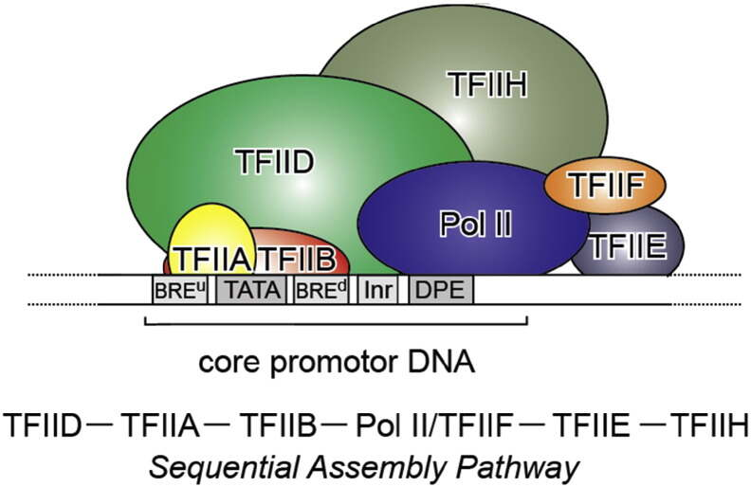
General Transcription Factors
Notes:
Transcription factors that are critical for the recruitment of RNA Polymerase II are typically referred to as the TFII class of transcription factors. They are further identified by a letter A, B, C, and so on. Class II gene transcription is regulated at various levels: while assembling on chromatin, before and during transcription initiation, throughout elongation and mRNA processing, and termination. A host of activators and repressors has been reported to regulate transcription, including a central multisubunit complex called the Mediator that helps in the recruitment of general transcription factors (GTFs) and the activation of RNA Pol II. Here we will focus on the formation of the GTFs that make up the core preinitiation complex (PIC) during transcriptional activation.

Slide 14
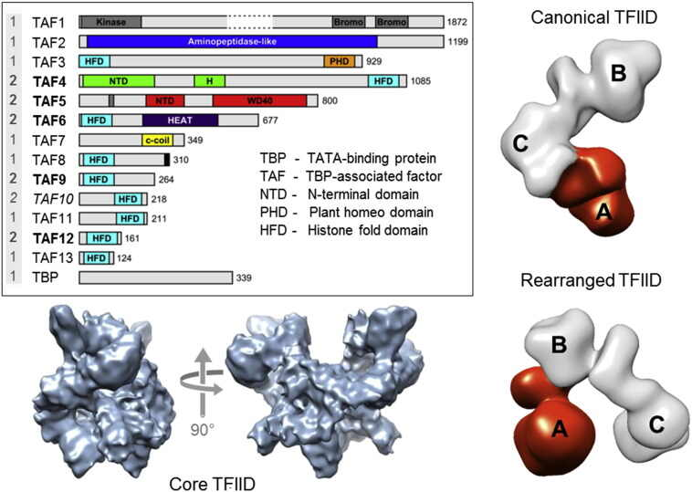
Preinitiation Complex (PIC)
Notes:
Transcription of RNA pol II-dependent genes is triggered by the regulated assembly of the Preinitiation Complex (PIC). PIC formation commences with the binding of TFIID to the core promoter. TFIID is a large megadalton-sized multiprotein complex with around 20 subunits made up of 14 different polypeptides: the TATA-box binding protein (TBP) and the TBP-associated factors (TAFs) (numbered 1–13) TFIID was shown to adopt an asymmetric, horse-shoe shape with three almost equal-sized lobes (A, B, and C), exhibiting a considerable degree of conformational flexibility with at least two distinct conformations (open and closed)

Slide 15
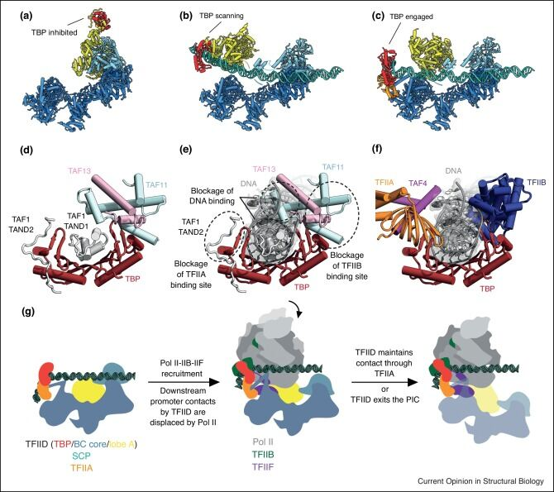
TBP – TATA Box Binding Protein
Notes:
The TBP component of TFIID binds with a specific DNA sequenced called the TATA box. This DNA sequence is found about 30 base pairs upstream of the transcription start site in many eukaryotic gene promoters.

Slide 16
TBP – TATA Box Binding Protein
Notes:
If inhibitors bind with TBP, it will be unable to interact with the DNA and start the formation of the preinitiation complex.

Slide 17
TBP – TATA Box Binding Protein
Notes:
In the absence of inhibitors, TFIID will bind with the DNA and the TATA Box Binding protein will scan the DNA for the TATA box sequence.

Slide 18
TBP – TATA Box Binding Protein
Notes:
In the absence of inhibitors, TFIID will bind with the DNA and the TATA Box Binding protein will scan the DNA for the TATA box sequence. When TBP binds to a TATA box within the DNA, it distorts the DNA by inserting amino acid side-chains between base pairs, partially unwinding the helix, and doubly kinking it. Note that TBP is released from TFIID during this process.

Slide 19
TBP – TATA Box Binding Protein
Notes:
The diagram on the right shows the TFIID complex in scanning mode. Notice that several transcription factor binding sites are blocked during this time, so that the preinitiation complex won’t form inappropriately. When TBP binds with a TATA box and dissociates from TFIID, this opens up a binding site for TFIIB which will in turn bind with RNA Polymerase II, and initiate the formation of the preinitiation complex.

Slide 20
Preinitiation Complex
Notes:
This slide just shows that assembly a little more clearly. TFIID binds to the DNA, when the TBP finds a TATA box, it releases from TFIID and can recruit TFIIB and the RNA polymerase II enzyme, in addition to other TFII factors. TFIID may dissociate completely or stay loosely associated with TFIIA. TFIIB is critical for the transition of RNA Pol II from the closed to the open conformation when transcription can begin. In most eukaryotes, after synthesizing about 20–100 bases, RNA pol II can pause (Promoter proximal pause) and then disconnect from promoter elements and other components of the transcription machinery, giving rise to a fully functional elongation complex in a process called promoter escape. The promoter-bound components of the PIC, in contrast, remain in place, and thus only TFIIB, TFIIF, and RNA pol II need to be recruited for re-initiation, significantly increasing the transcription rate in subsequent rounds of transcription.

Slide 21
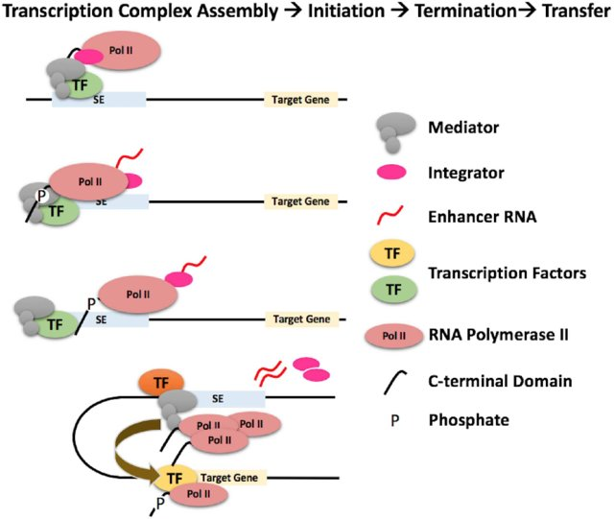
Enhancer Elements
Notes:
enhancer elements are also important for the initiation of transcription. Promoters are defined as DNA elements that recruit transcription complexes for the synthesis of coding and non-coding RNA. Enhancers are defined as DNA elements that positively regulate transcription at promoters over long distances in a position- and orientation-independent manner. Most of the time, enhancers will bring the RNA polymerase II complex to the target gene area to mediate transcription. The mediator complex, shown in grey helps the looping process occur. However, sometimes enhancers may also lead to the short transcription of noncoding RNA from the enhancer region as well. The function of these very short noncoding RNAs is not known.

Slide 22
Chapter 10: Transcription and RNA Processing
10.4 Transcription Elongation and Termination
Notes:
In this section, we will focus on the elongation and termination phases of transcription. For the elongation material, we will only focus on prokaryotic mechanisms as these are better understood. For termination processes, we will first focus on prokaryotic systems and then take a brief look at the complexity of eukaryotic termination processes.

Slide 23
Prokaryotic Transcription Elongation
Notes:
Once transcription has been initiated, the elongation phase is where the RNA polymerase enzyme will use the template strand of the DNA to create the nascent RNA. This diagram shows the catalytically active RNA Polymerase. You can see that within the enzyme catalytic center, a small transcription bubble forms where the DNA helix is unwound. The template DNA strand is shown in blue. The Mg2+ cofactor is shown in red positioned at the catalytic active site.

Slide 24
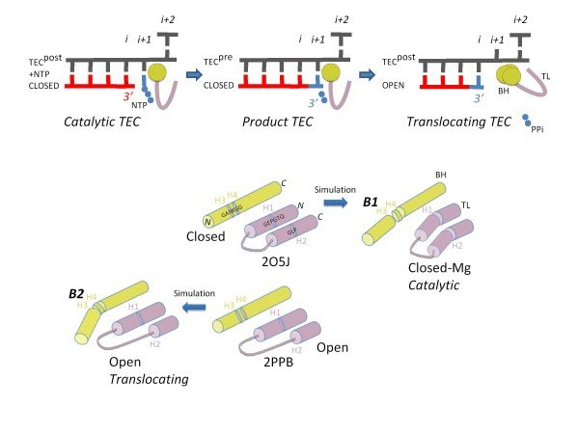
Prokaryotic Transcription Elongation
Notes:
This diagram shows that catalytic activity of the polymerase in a little more detail. The DNA template is shown in grey and the nascent RNA strand shown in red. The polymerase has two major conformations during the process of elongation. A closed catalytic conformation, that is used when the polymerase is adding nucleotides to the nascent chain. Notice here that the diphosphate is cleaved from the incoming nucleotide. Further hydrolysis of the diphosphate will release energy that helps to drive this reaction forward. Once the incoming nucleotide has been added, the polymerase has to then translocate down the DNA template to open up the position for the next nucleotide to enter. It does this by switching to an open conformation that is more flexible. This allows the polymerase to essentially pull itself along the DNA template, one nucleotide at a time.

Slide 25
Prokaryotic Transcription Elongation
Notes:
Within the catalytic center, a bridge region, shown in yellow, and a hinge loop shown in pink, are required for catalysis and translocation. In the closed conformation, the polymerase is modestly flexible, which enables the positioning of the Mg2+ cofactor to facilitate nucleotide addition. Following nucleotide addition, the bridge assumes an open conformation that is much more flexible. Movement of the hinge-loop causes bending of the bridge and the polymerase can shift down on the DNA template.

Slide 26
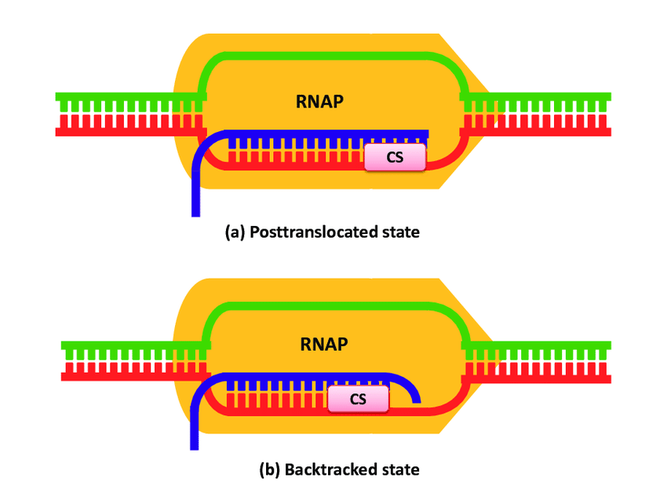
Transcriptional Backtracking
Figure from: Sharma, A.K. and Chowdhury, D. (2012) Biophys Rev & Let 07:03n04
Notes:
Sometimes the elongation phase does not move smoothly in the forward direction. The elongation complex can sometimes regress in a process called backtracking. This can sometimes be caused by a misincorporation event or by brief pauses of the RNA polymerase complex. The backtracking process, however, stalls the elongation process, and it must now be rescued by additional protein helpers.

Slide 27
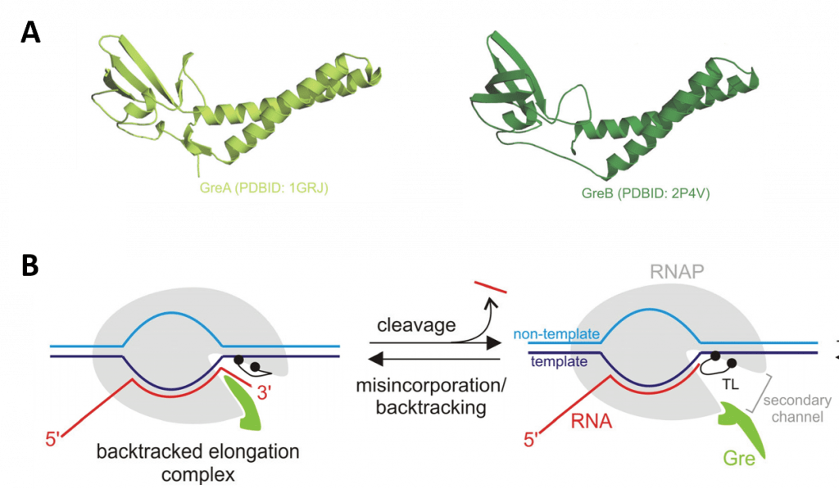
Gre Factors to the Rescue!
Notes:
Gre factors are involved in rescuing a stalled transcriptional elongation complex. During normal elongation, the Gre protein is bound to the active elongation complex, but does not exert any activity on the complex. It essentially stays out of the way, like a tool in a tool belt. However, upon backtracking or nucleotide misincorporation, The Gre factor produces its own trigger loop domain, which supplants the normal catalytic trigger loop of the RNA polymerase enzyme that we saw in more detail in a previous slide. The Gre factor will then cleave off any overhanging mRNA from the backtracked complex. The elongation complex is then rescued and the normal trigger loop domain from the RNA polymerase will again be functional and can resume the elongation process.

Slide 28
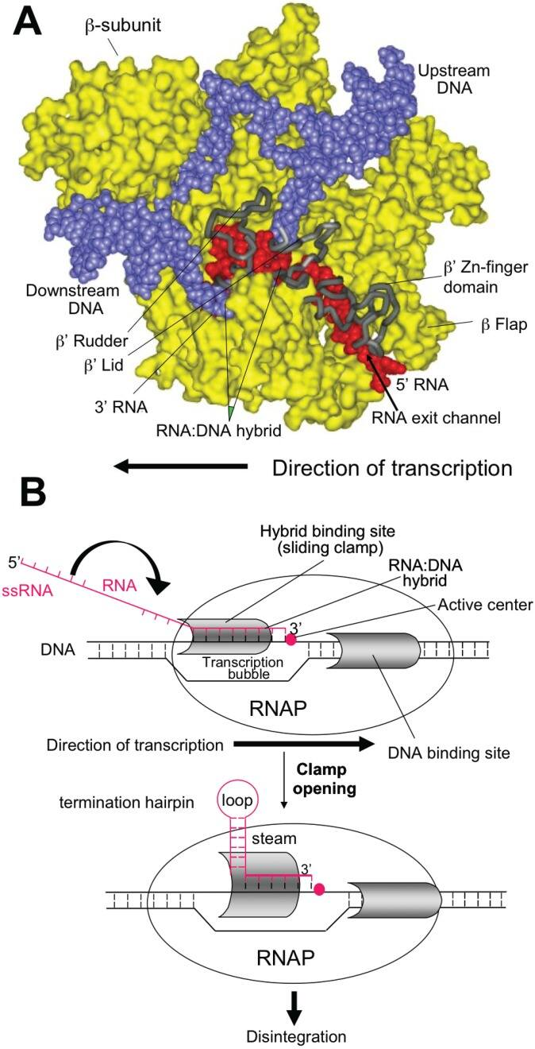
Prokaryotic Transcription Termination
Notes:
Termination of transcription in prokaryotes can occur using an intrinsic model. The diagram on the left shows the polymerase in yellow, in the open conformation with the DNA in blue and the nascent RNA in red. Intrinsic termination occurs at specific template sequences – an inverted repeat followed by a run of A residues. This sequence causes the formation of a short stem-loop structure in the nascent RNA chain which in essence will derail the polymerase from continuing.

Slide 29
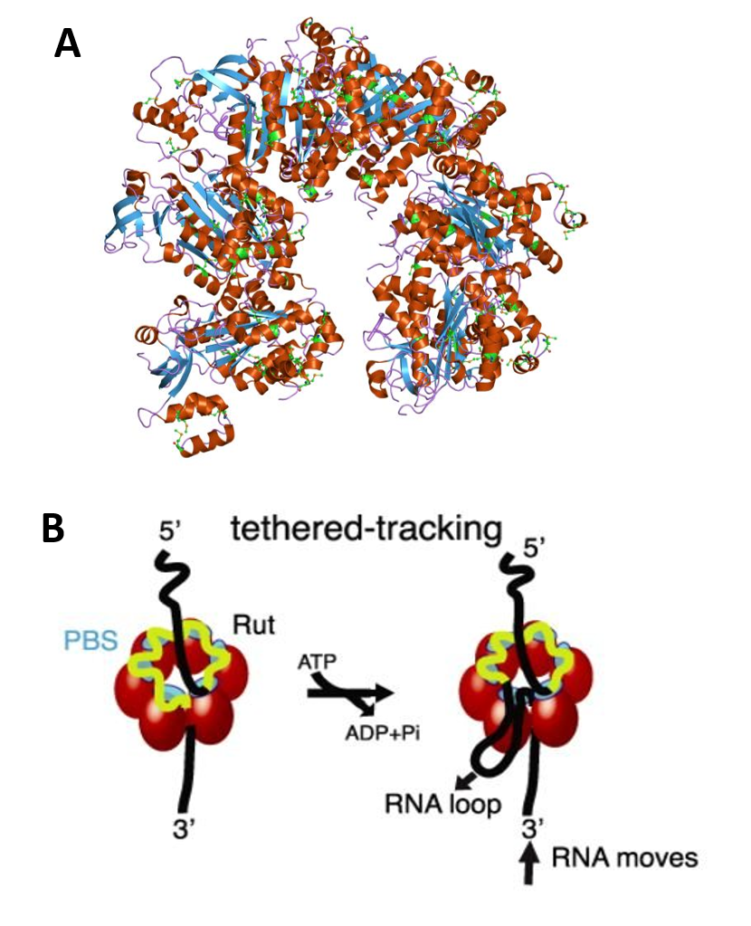
Prokaryotic Transcription Termination
The Rho Protein
Notes:
Extrinsic factors can also be involved in the termination process. This can be most aptly seen by the functioning of the Rho protein. As the nascent mRNA extends outward from the RNA polymerase machinery, the Rho protein is a small, horseshoe-shaped protein that can clamp onto the extending nucleic acid. Biochemical and structural data suggest that Rho initially binds to RNA in an open, ‘lock-washer’ conformation that closes into a planar ring as RNA transfers to the central cavity. There, the ssRNA contacts an asymmetric secondary binding site (SBS). Upon hydrolysis of ATP, the ssRNA is pulled upon conformational changes of the conserved Q and R loops of the SBS, leading to Rho translocation, and ultimately promoting RNA polymerase (RNAP) dissociation.

Slide 30
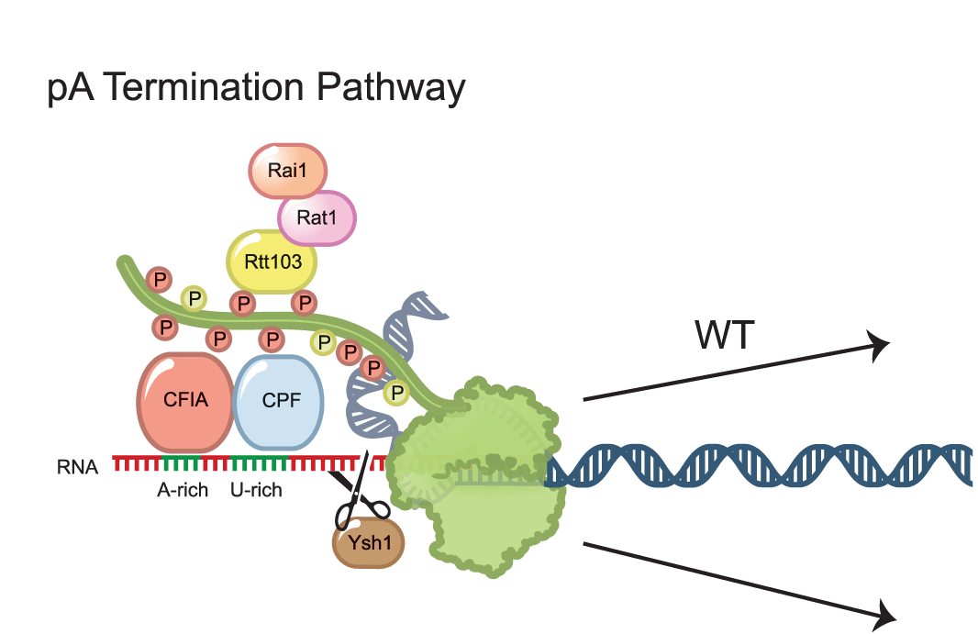
Eukaryotic Termination
Notes:
In eukaryotes, termination of protein-coding gene transcription by RNA polymerase II (Pol II) usually requires a functional polyadenylation (pA) signal, typically a variation of the AAUAAA hexamer. Nascent pre-mRNA is cleaved by the Ysh1 protein and then polyadenylated by the CPF proteins. Currently, the details of this mechanism have not been fully elucidated and multiple models have been postulated. You can read more about these models in Chapter 10. In the next section, we will discuss eukaryotic mRNA post-translational processing in more detail.

Slide 31
Chapter 10: Transcription and RNA Processing
10.5 Processing of RNA
Notes:
In this section, we will focus on the major post transcriptional modifications completed in the processing of prokaryotic and eukaryotic messenger RNA.

Slide 32
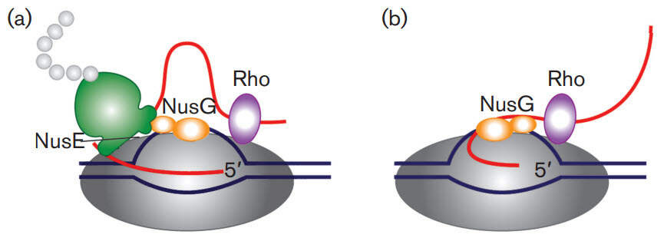
Prokaryotic mRNA Processing
Notes:
Bacterial cells do not have extensive post-transcriptional modification of mRNA primarily because transcription and translation are coupled processes. Bacterial cells lack the physical barrier of a nucleus, which allows transcription and translation machineries to function at the same time, enabling the concurrent translation of an mRNA while it is being transcribed. Within this system the NusG protein plays a critical role. NusG has three separate domains and the functions of two of them are known. The NusG N-terminal domain (NusG-NTD) has the capacity to bind to RNAP, whereas the C-terminal domain (NusG-CTD) can combine with the NusE (RpsJ) component of ribosomes. These two functions of NusG enable transcription to be coupled with translation. NusG CTD can also bind to Rho to terminate transcription

Slide 33
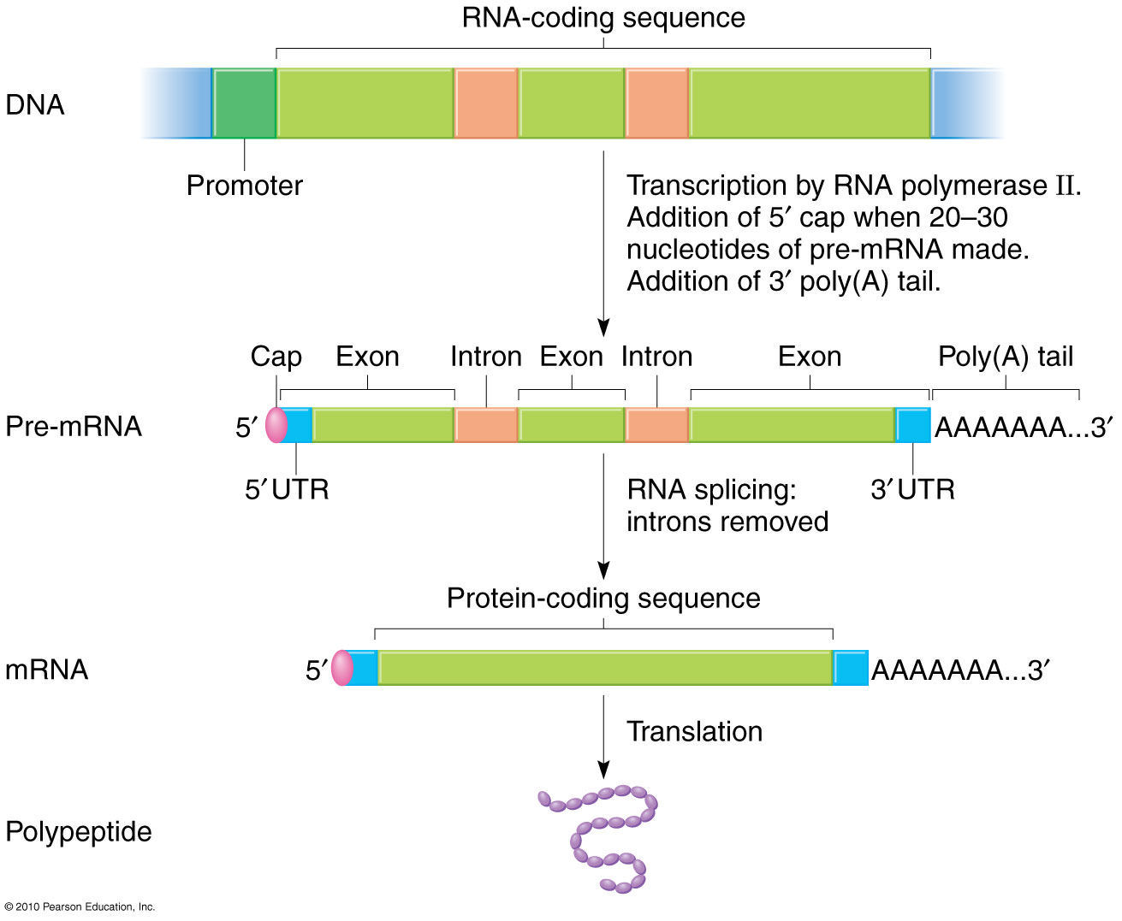
Eukaryotic RNA Processing
Notes:
In multicellular organisms almost every cell contains the same genome, yet complex spatial and temporal diversity is observed in gene transcripts. This is achieved through multiple levels of processing leading from gene to protein, of which RNA processing is an essential stage. Following transcription of a gene by RNA polymerases to produce a primary mRNA transcript, further processing is required to produce a stable and functional mature RNA product. This involves various processing steps including RNA cleavage at specific sites, intron removal, called splicing, which substantially increase the transcript repertoire, and the addition of a 5’CAP. Another crucial feature of the RNA processing of most genes is the generation of 3′ ends through an initial endonucleolytic cleavage, followed in most cases by the addition of a poly(A) tail, a process termed 3′ end cleavage and polyadenylation

Slide 34
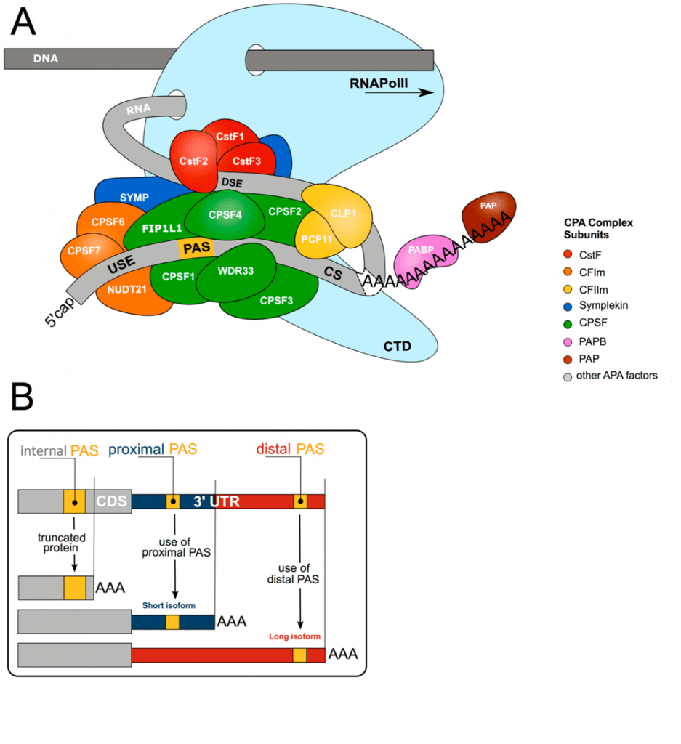
3’- Polyadenylation
Notes:
Polyadenylation is a required step for the correct termination of nearly all mRNA transcripts. In addition to deterimining the correct transcript length at transcription termination, the poly(A) tail helps to ensure the translocation of the nascent RNA molecule from the nucleus to the cytoplasm, enhances translation efficiency, and acts as a signal feature for RNA degradation. RNA cleavage and polyadenylation is carried out by a multi-subunit 3′ end processing complex, which involves over 80 trans-acting proteins, comprised of four core protein subcomplexes. Polyadenylation signal sequences in the nascent mRNA initiate the cleavage and polyadenylation process, where approximately 50 – 100 adenosine residues are added to the mRNA.

Slide 35
The Location of Polyadenylation
Notes:
More than 70% of all genes harbour more than one polyadenylation signal (PAS). This gives rise to transcript isoforms differing at the mRNA 3′ end. While alternative polyadenylation (APA) in 3′UTR changes the properties of the mRNA (stability, localisation, translation), internal PAS usage (in introns or the coding sequence (CDS)) changes the C-termini of the encoded protein, resulting in different functional or regulatory properties.

Slide 36
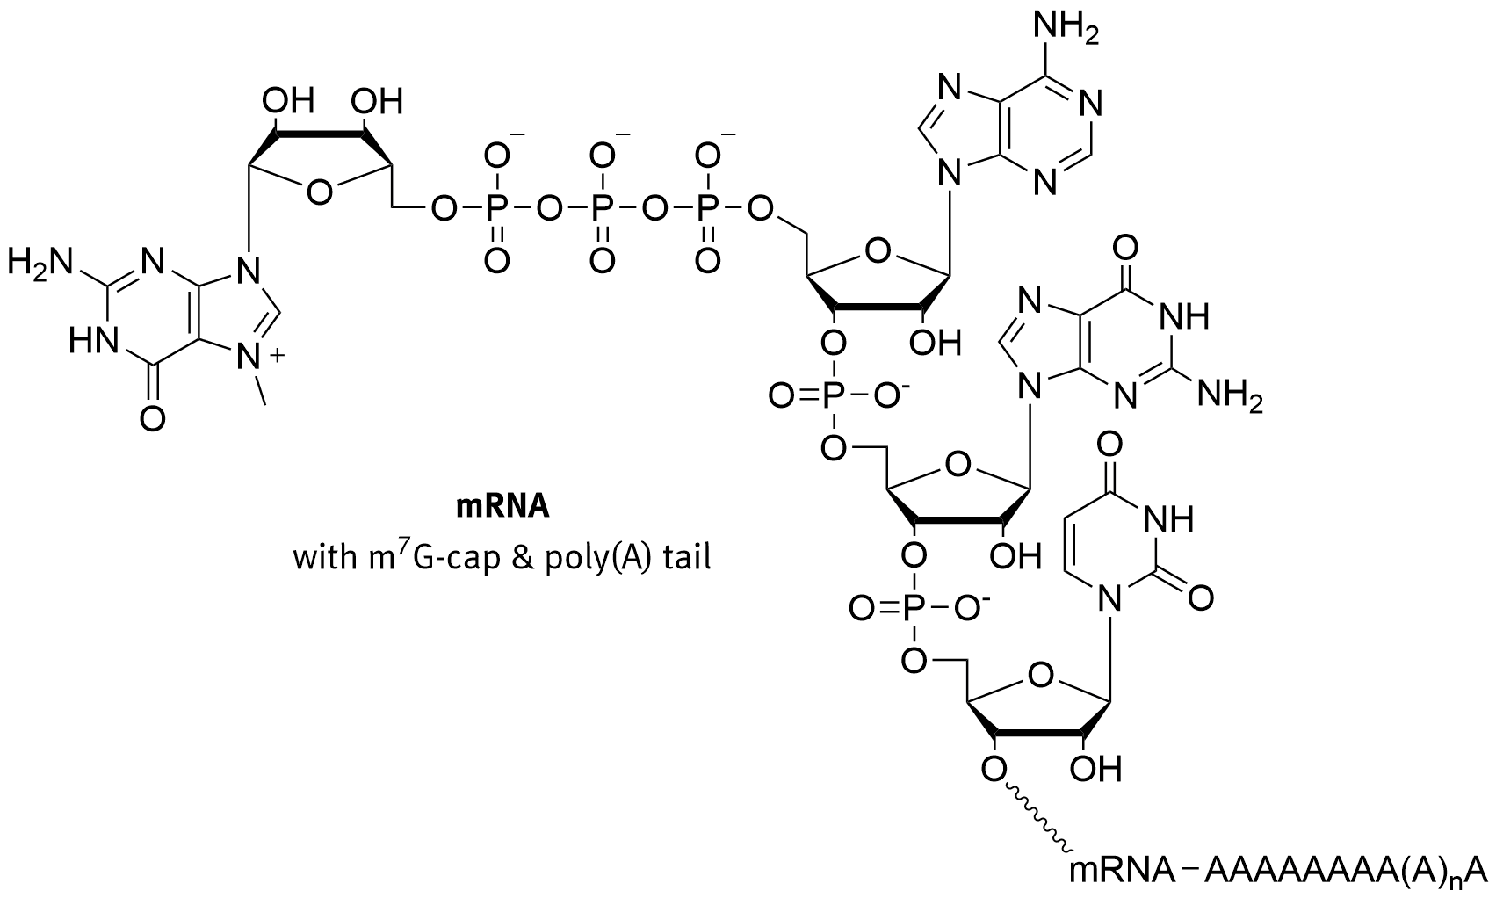
5’- CAP Formation
Notes:
In eukaryotes, the 5′ cap, found on the 5′ end of an mRNA molecule, consists of a guanine nucleotide connected to mRNA via an unusual 5′ to 5′ triphosphate linkage. This guanosine is methylated on the 7 position directly after capping in vivo by a methyltransferase. It is referred to as a 7-methylguanylate cap, abbreviated m⁷G. There are some other unusual 5’-CAPs but the 7-methylguanate cap is the most common. For capping with 7-methylguanylate, the capping enzyme complex (CEC) binds to RNA polymerase II before transcription starts. As soon as the 5′ end of the new transcript emerges from RNA polymerase II, the CEC carries out the capping process. The enzymes for capping can only bind to RNA polymerase II that is engaging in mRNA transcription, ensuring specificity of the m⁷G cap almost entirely to mRNA.
The 5′ cap has four main functions:
Regulation of nuclear export
Prevention of degradation by exonucleases
Promotion of translation (see ribosome and translation)
Promotion of 5′ proximal intron excision

Slide 37
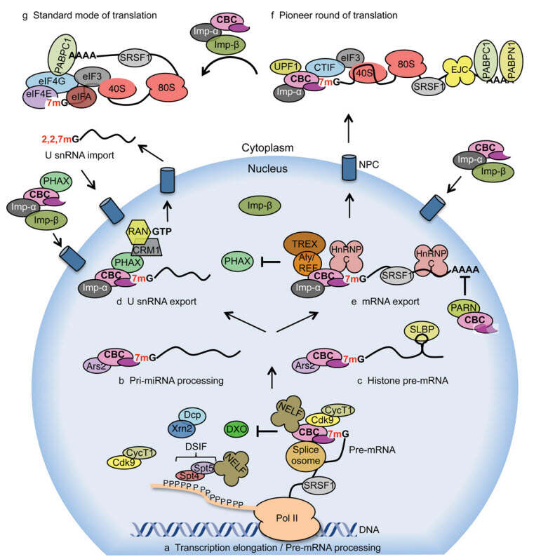
Notes:
In addition to the polyA tail, nuclear export of RNA is regulated by the cap binding complex (CBC), which binds to 7-methylguanylate-capped RNA.

Slide 38
Notes:
The CBC is then recognized by the nuclear pore complex and the mRNA exported. Once in the cytoplasm after the pioneer round of translation, the CBC is replaced by the translation factors eIF4E and eIF4G of the eIF4F complex. This complex is then recognized by other translation initiation machinery including the ribosome, aiding in translation efficiency. In addition, the 5’ CAP prevents degradation by functionally looking like the 3’ end of the RNA and evading the 5’ degradation exonucleases. Secondly, when the 5’CAP is bound by translation machinery it hides the CAP from the decapping enzyme and increases the lifespan of the message.

Slide 39
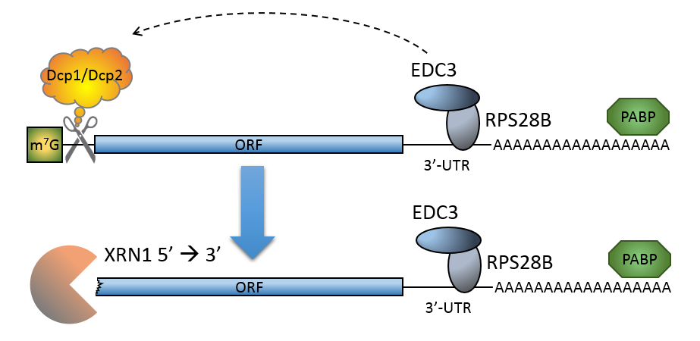
Decapping Enzymes and Degradation
Figure from: DanyilGrybchuk
Notes:
Decapping of a 7-methylguanylate-capped mRNA is catalyzed by the decapping complex made up of at least Dcp1 and Dcp2, which must compete with eIF4E to bind the cap. The decapping enzymes are aided by enhancer proteins such as EDC3 that can bind with mRNA in a sequence specific manner and help recruit the decapping enzymes. Thus the 7-methylguanylate cap is a marker of an actively translating mRNA and is used by cells to regulate mRNA half-lives in response to new stimuli. During the decay process, mRNAs may be sent to P-bodies. P-bodies are granular foci within the cytoplasm that contain high levels of exonuclease activity.

Slide 40
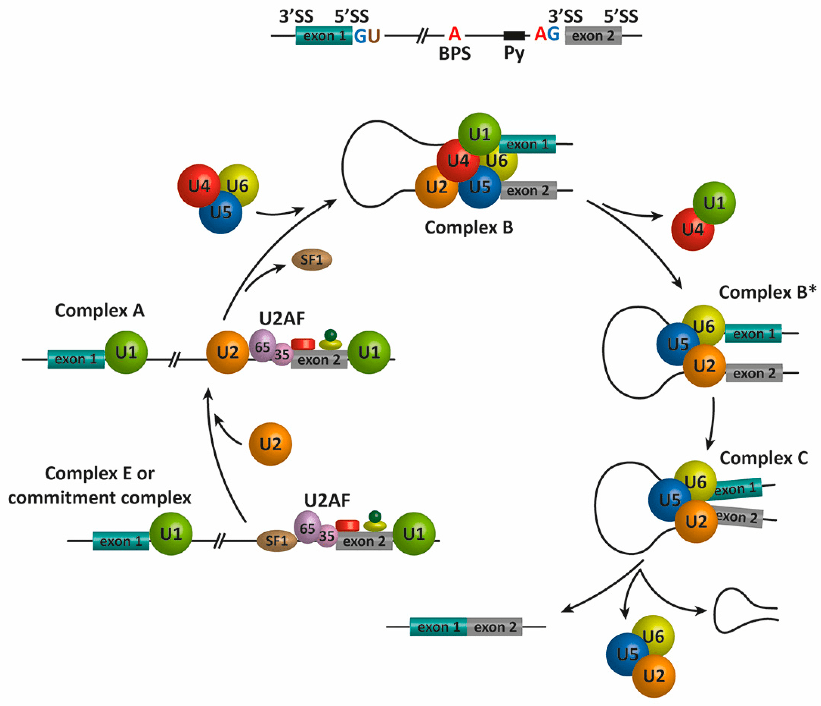
Intron Splicing
Notes:
Eukaryotic organisms also have large tracks of non-coding regions interspersed throughout gene sequences, known as intron sequences. These introns must be removed from the pre-messenger RNA before it translocates into the cytoplasm to undergo the translation process. Intron removal is mediated by the spliceosome, which is a macromolecular complex formed by five small nuclear ribonucleoproteins (snRNPs), termed U1, U2, U4, U5, and U6, and approximately 200 proteins. Only the snRNP molecules are shown in the diagram above

Slide 41
Intron Splicing
Notes:
If we take a closer look at the pre-mRNP that needs to be spliced, we can see that there are some key sequence elements within the intron sequence that enable the snRNA molecules to recognize the intron and choose the correct excision sites for the splicing. Exon 1 is shown here in blue and Exon 2 in grey. There is a key GU sequence on the 5’ side of the splice site and a key AG sequence on the 3’ site that identify the borders of the intron. There is also a polypyrimidine sequence (Py) that is a key recognition sequence for the snRNP binding. There is also a branch point sequence that contains the critical adenine base that will be involved in the splicing reaction.

Slide 42
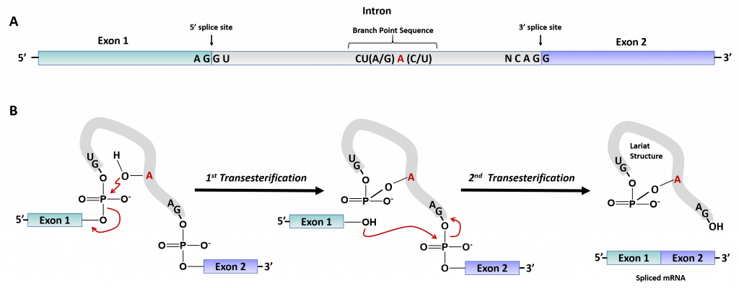
Two Transesterification Reactions
Notes:
The splicing reaction itself is a series of two transesterification reactions.

Slide 43
Two Transesterification Reactions
Notes:
So again, for the chemistry that will be occurring during the reaction, the key elements are the identification of the correct cleavage sites at the 5’ and 3’ ends of the intron, and the key Adenine base that is found within the branch point sequence.

Slide 44
Two Transesterification Reactions
Notes:
The first transesterification occurs by the positioning of the 2’-OH residue of the branchpoint Adenine near the 5’-phosphate of the Guanine residue at the 5’-edge of the intron. The 2’-OH will mediate nucleophilic attack on the 5’-phosphate group of the guanine residue in the intron. You guessed it! This forms an oxyanion intermediate, and when the electrons rebound in to reform the P-O double bond, the 3’-OH of the last guanine residue in Exon 1, will serve as the leaving group.

Slide 45
Two Transesterification Reactions
Notes:
This forms the first intermediate product. The branchpoint Adenine residue is now covalently linked to the 5’ guanine residue of the intron at the 2’-OH position of the adenine. This has released the 3’-OH of Exon 1. This 3’-OH is positioned at the 5’ side of Exon 2, where it mediates nucleophilic attack at the 5’-phosphate group of the first residue of Exon 2. This begins the second transesterification with the formation of the oxyanion intermediate. In this esterification reaction, the intron will serve as the leaving group, with the reforming of the P – O double bond, and the two exons will now be perfectly joined together.

Slide 46
Two Transesterification Reactions
Notes:
The final products are shown here. Exon 1 and Exon 2 are joined, and the intron has been successfully spliced out. The branchpoint adenine residue remains covalently linked to the 5’-phosphate of the intron. This resulting looped structure is known as a lariat structure. A lariat is a rope used by cowboys to lasso or tether animals. The intron loop resembles this type of rope structure and why it has this name.

Slide 47
Intron Splicing
Notes:
So now let’s go back to our original diagram and see how the small nuclear RNP molecules are involved in this process.

Slide 48
Intron Splicing
Notes:
In the first step, you can see that there are a number of small proteins involved in the recognition of the 3’ intron border sequence, and that the U1 small nuclear RNP molecule recognizes and binds with the 5’ edge of the intron sequences. This will happen simultaneously for all of the 5’ edges of all the introns within the pre-mRNP molecule. This is known as the commitment complex. Next the U2 snRNP will bind to the branch point sequence. This is known as complex A.

Slide 49
Intron Splicing
Notes:
Complex A is converted to Complex B with the binding of three additional snRNA molecules and the loss of the SF1 protein. U4, U5, and U6 join the complex and cause the folding of the mRNP so that Exon 1 will be in close proximity of Exon 2. Sorry, there is no U3 snRNP involved within this process. Researchers likely identified the snRNP molecules before they new their complete functions.

Slide 50
Intron Splicing
Notes:
U1 and U4 dissociate from the complex and U2, U5 and U6 rearrange forming Complex B*

Slide 51
Intron Splicing
Notes:
Complex B* quickly shifts conformation to form Complex C, which is catalytically active and mediates the two transesterification reactions.

Slide 52
Intron Splicing
Notes:
Once the transesterification reactions are complete, the U2, U5, U6 complex is releases the Lariate product and the mRNA with the exons correctly joined together. U2, U5, and U6 will then be recycled for another round of splicing.

Slide 53
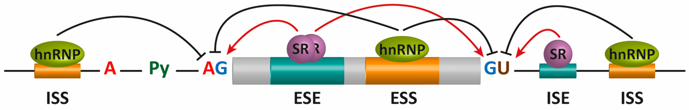
Alternative Splicing
Notes:
Alternative Splicing (AS) offers an additional mechanism for regulating protein production and function. AS options are determined by the expression of or exposure to in trans elements present within unique cellular locations and environments. Additional sequence elements within the mRNA, known as exonic and intronic splicing silencers or enhancers (ESS, ISS, ESE, and ISE, respectively), participate in the regulation of AS. Specific RNA-binding proteins, including heterogeneous nuclear ribonucleoproteins (hnRNPs) and serine/arginine-rich (SR) proteins, recognize these sequences to positively or negatively regulate AS. These regulators, together with an ever-increasing number of additional auxiliary factors, provide the basis for the specificity of this pre-mRNA processing event in different cellular locations within the body.

Slide 54
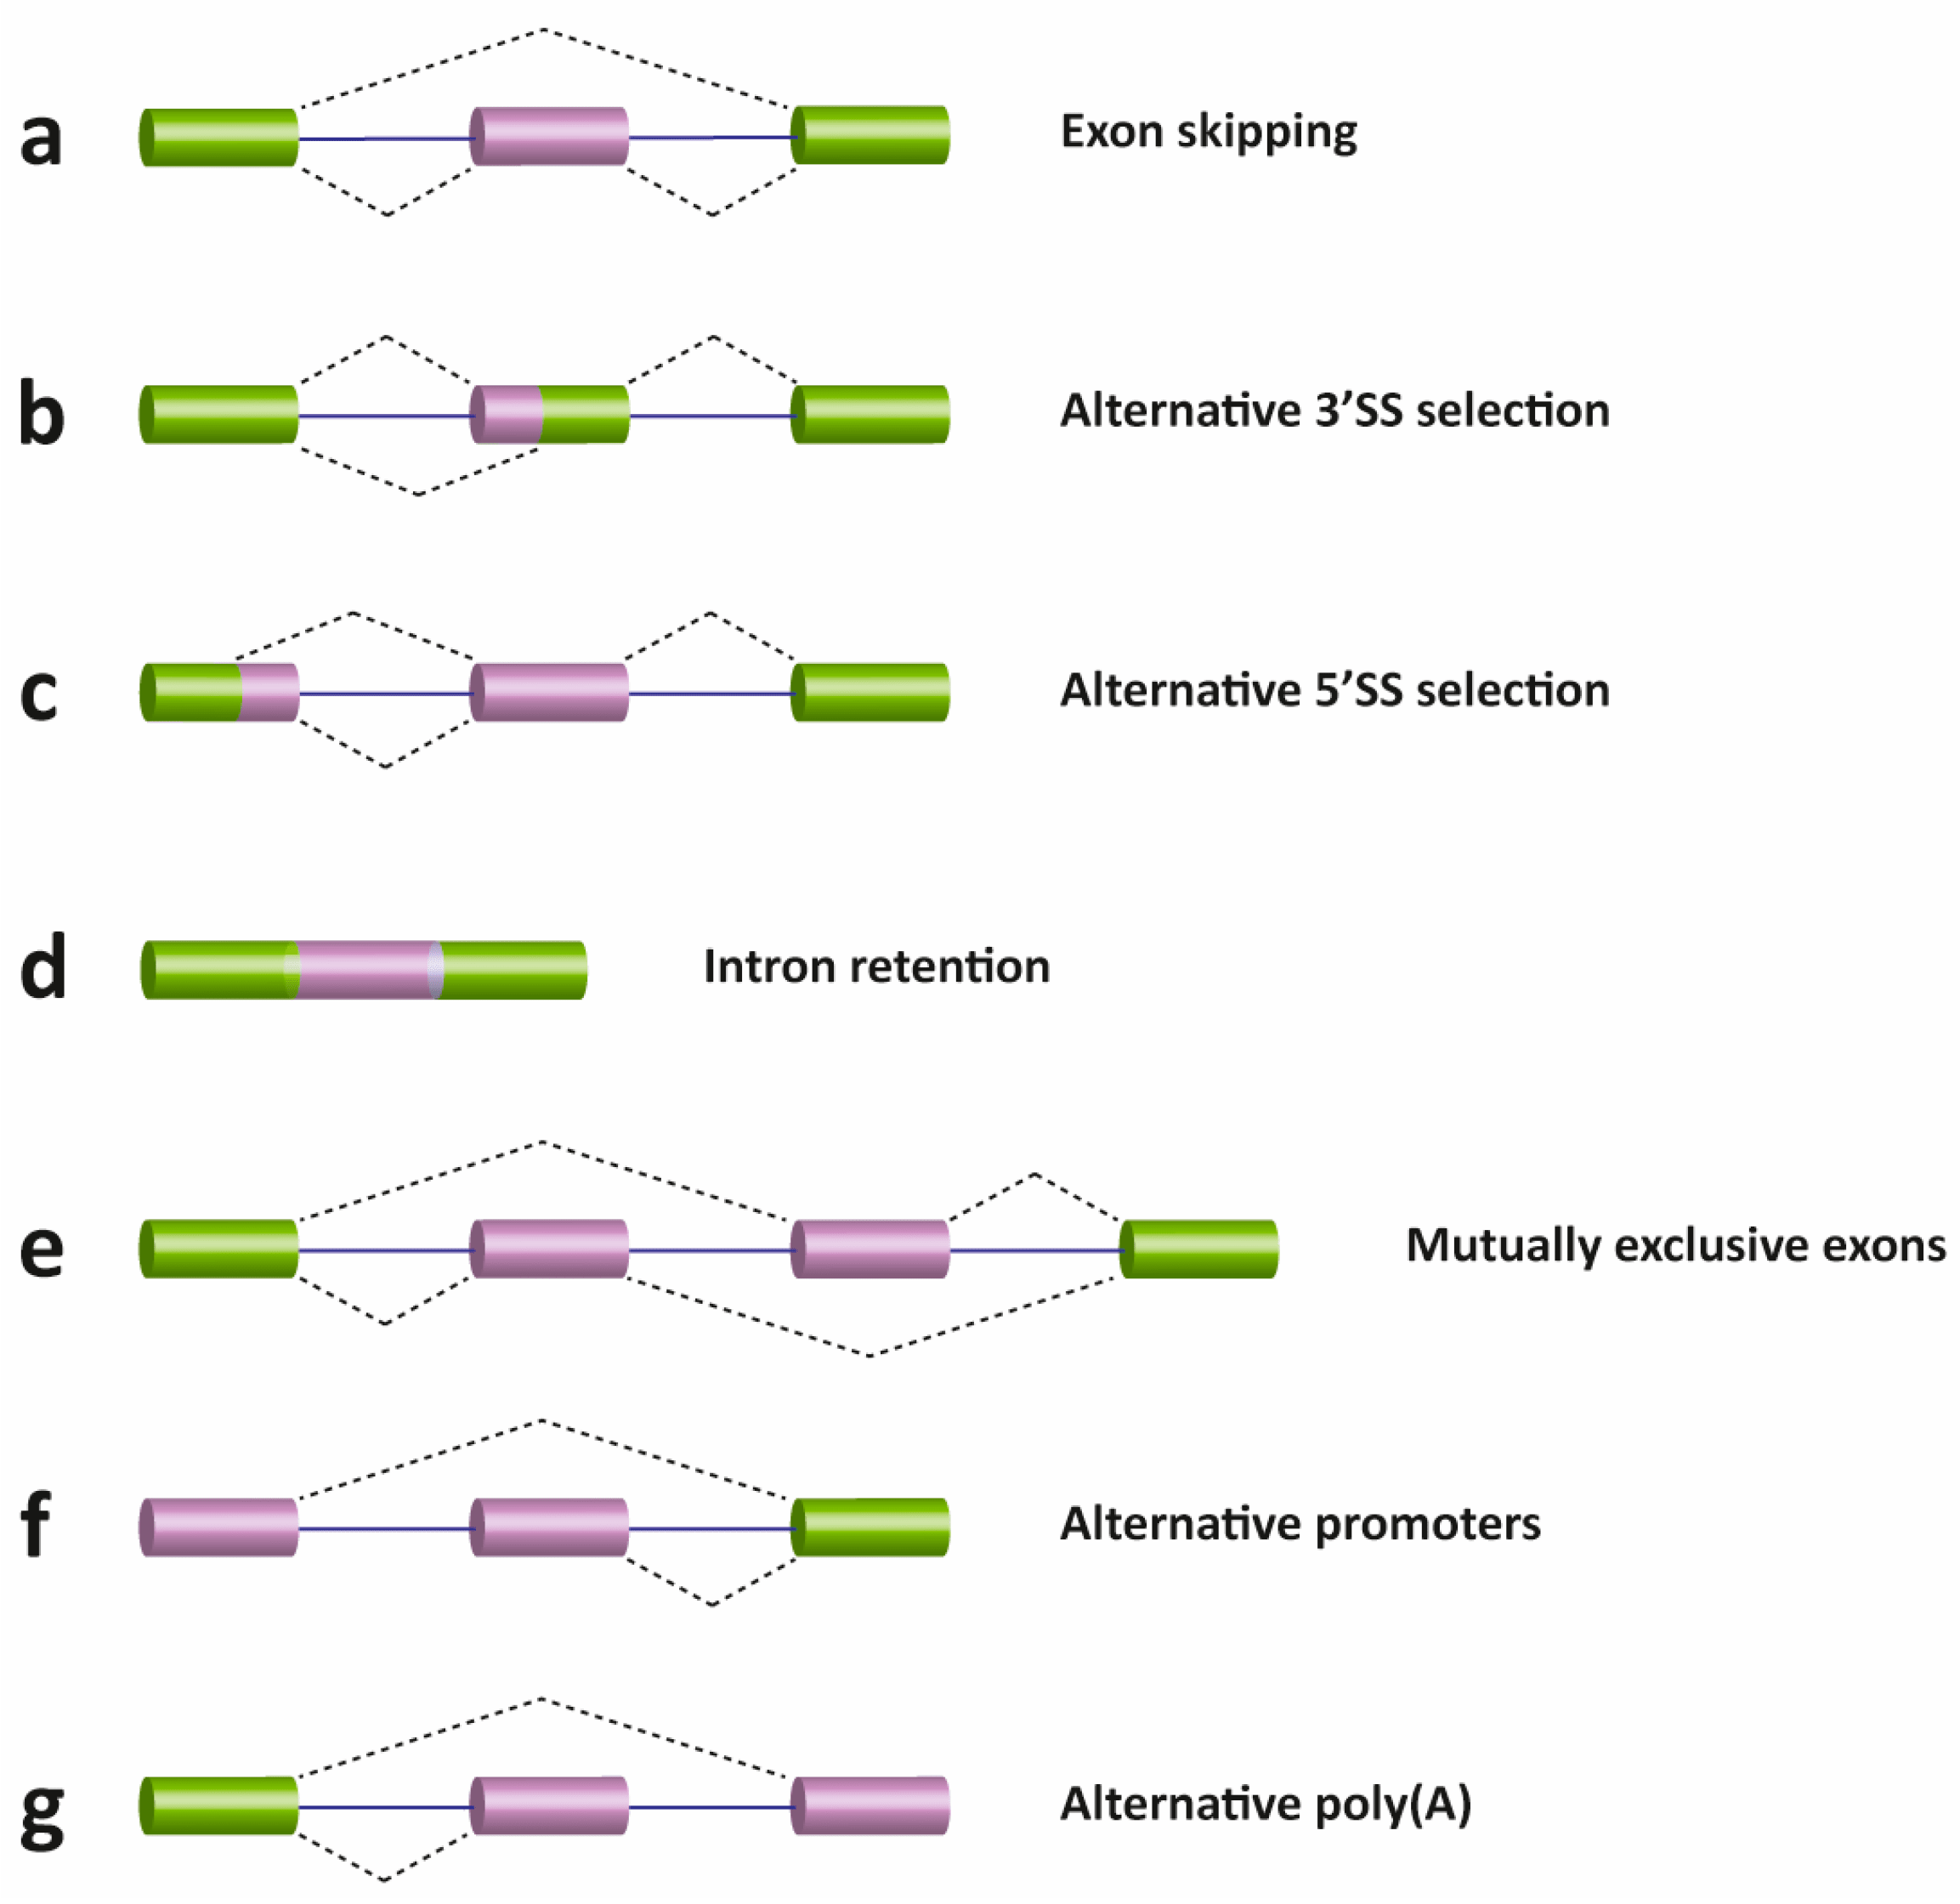
Alternative Splicing
Notes:
There are several different types of AS events, which can be classified into four main subgroups. The first type is exon skipping, which is the major AS event in higher eukaryotes. In this type of event, a cassette exon is removed from the pre-mRNA. The second and third types are alternative 3′ and 5′ SS selection. These types of AS events occur when the spliceosome recognizes two or more splice sites at one end of an exon. The fourth type is intron retention, in which an intron remains in the mature mRNA transcript. This AS event is much more common in plants, fungi and protozoa than in vertebrates.

Slide 55
Alternative Splicing
Notes:
Other events that affect the transcript isoform outcome include mutually exclusive exons, alternative promoter usage, and alternative polyadenylation. Overall, there are many layers of RNA modifications that help to regulate the lifespan and translation efficiency of messenger RNA and help to control protein levels within a cell. In the next chapter, we will look in more depth at the translation process.

