Slide 1
Lipids
Waxes and Related Compounds
Notes:
Welcome to part 4 of our lecture series on Lipids. Here we will learn about the basic structure and properties of waxes.

Slide 2
What are Waxes
Stearic Acid
Oleic Alcohol
Notes:
Waxes are formed when a fatty acid combines with a long chain alcohol forming an ester bond.

Slide 3
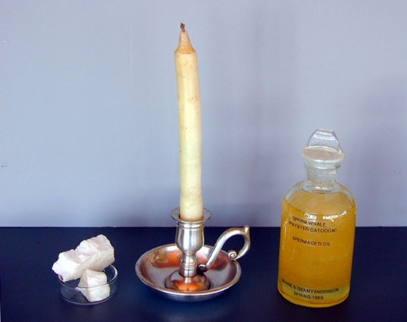
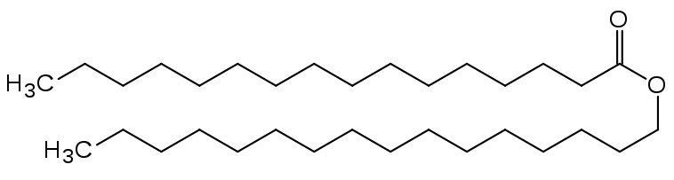
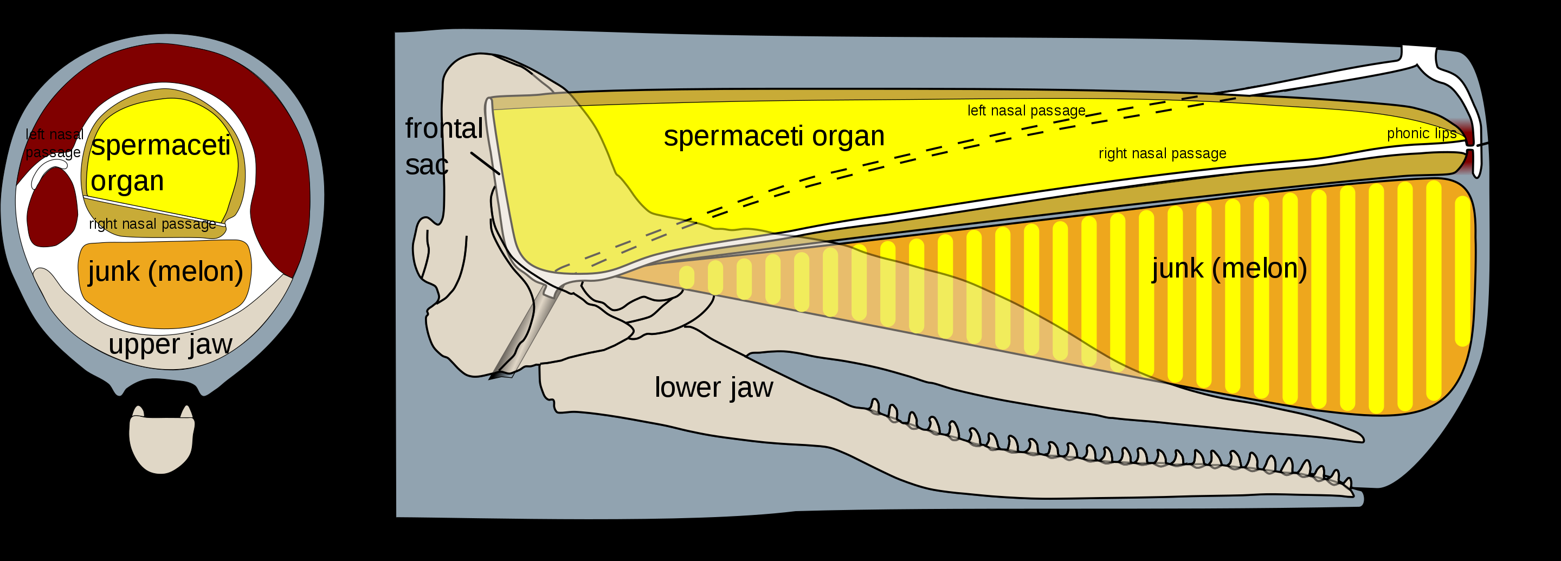
Spermaceti and Sperm Oil
Spermaceti = Cetyl Palmitate
Figure by: Dschanz
Picture by: Genevieve Anderson
Figure by: Kurzon
Notes:
Spermaceti is a waxy substance found in the head cavities of the sperm whale (and, in smaller quantities, in the oils of other whales). Spermaceti is created in the spermaceti organ inside the whale's head. This organ may contain as much as 1,900 litres (500 US gal) of spermaceti. The spermaceti is thought to play a biological role in echolocation for the whales. Whaling fleets in the 1800s, hunted the sperm whale to near extinction. At the height of whaling, nearly 5,000 animals were killed each year. Spermaceti was harvested from the head of the animal and the rest was discarded. It was sold largely as lamp fuel.
Text modified from: Wikipedia contributors. (2019, September 27). Spermaceti. In Wikipedia, The Free Encyclopedia. Retrieved 00:33, March 3, 2020, from https://en.wikipedia.org/w/index.php?title=Spermaceti&oldid=918238270

Slide 4
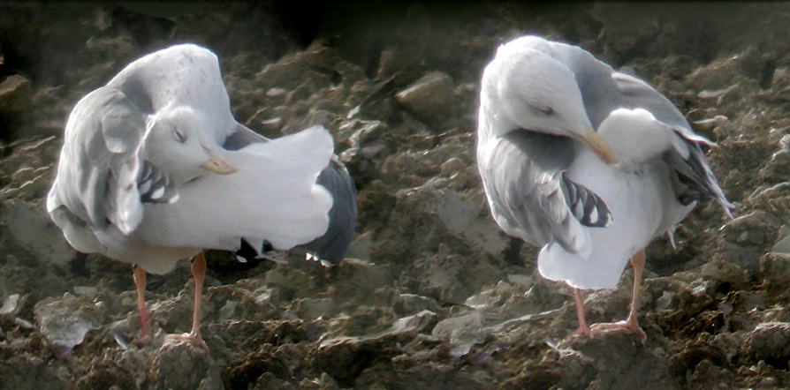
Waterproofing Bird Waxes
Photo By Lamiot – Own work, CC BY 2.5, https://commons.wikimedia.org/w/index.php?curid=1383465
Notes:
Waxes can be found throughout the biological world, in all kingdoms of life. In the example here, water birds, such as Larus argentatus shown here, maintain and waterproof their feathers by smoothing waxes produced by the uropygial gland located near the anus. These are called preen waxes.

Slide 5
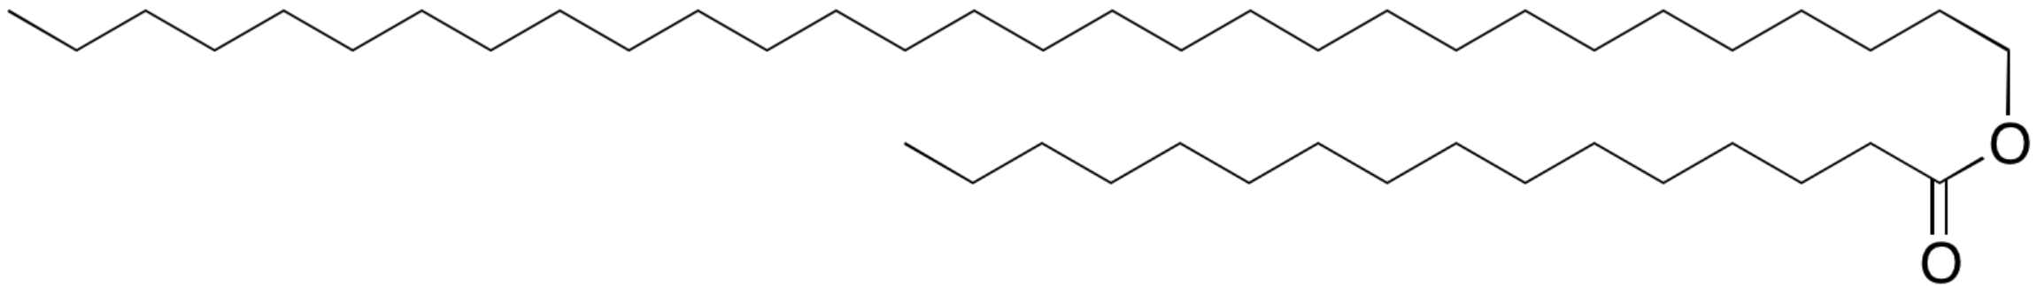
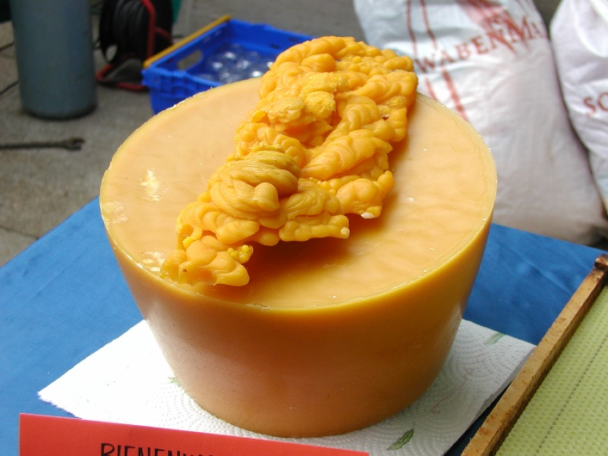
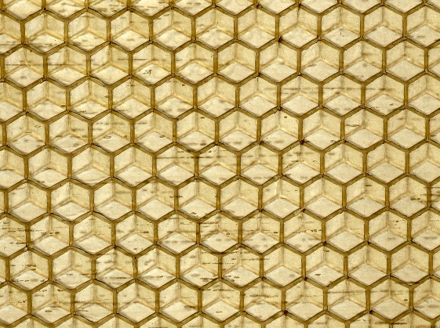
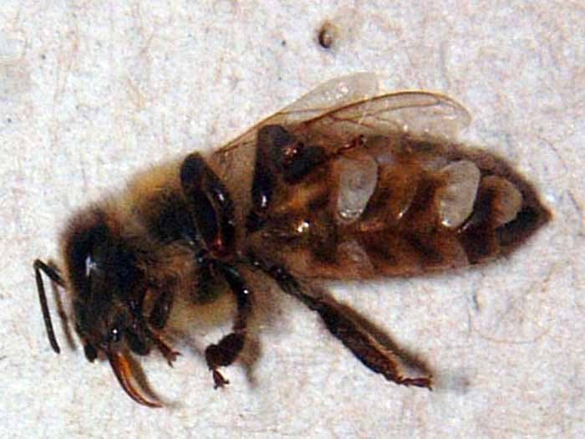
Beeswax
Triacontanyl Palmitate
Image From: Beeswax at Wikiwand
Picture by: Plantsurfer
Picture by: Frank Milkey
Picture by: G.S. Reuter, University of Minnesota
Notes:
Beeswax (cera alba) is a natural wax produced by honey bees of the genus Apis. The wax is formed into scales by eight wax-producing glands in the abdominal segments of worker bees, which discard it in or at the hive. The hive workers collect and use it to form cells for honey storage and larval and pupal protection within the beehive. Chemically, beeswax is a mixture that consists mainly of esters of fatty acids and various long-chain alcohols. The wax ester, triacontanyl palmitate is a major component of beeswax
Text modified from: Wikipedia contributors. (2020, January 6). Beeswax. In Wikipedia, The Free Encyclopedia. Retrieved 19:43, March 2, 2020, from https://en.wikipedia.org/w/index.php?title=Beeswax&oldid=934441673

Slide 6
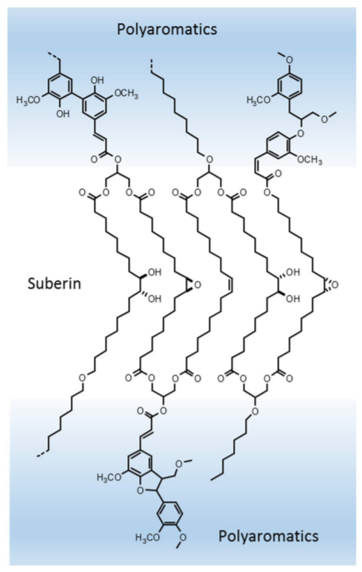
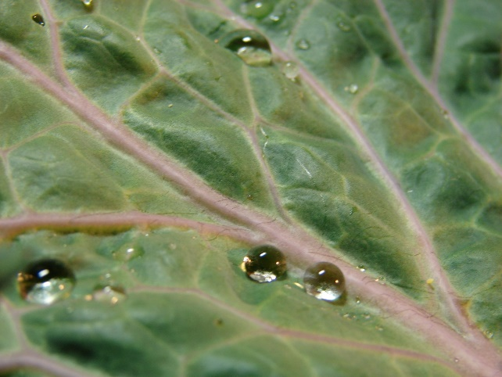
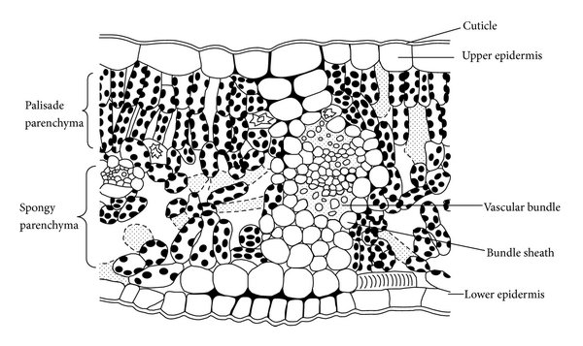
Waxes on the Plant Cuticle
Picture by: Rei
Figure by: Diah, S.Z.M., et al (2014) Article ID: 878409
Figure by: Graca, J. (2015) Frontiers in Chemistry 3:62
Notes:
The picture at the top shows water beads on the waxy cuticle of kale leaves. The cuticle is composed of an insoluble cuticular membrane impregnated by and covered with soluble waxes. The epidermis consists of a layer of cells covering, both upper and lower surfaces of the leaf and located directly below the cuticle. These cells have lost their protoplasmic contents and the outer wall has become very much thickened and infiltrated with a waxy substance, which makes the leaf water-proof. Suberin, shown here, is created by fatty acid lipids being attached to glycerol backbones in a randomized, disordered net of lipids forming what is called the dark lamellae. The outer wall is called the cuticle and is composed of cutin, a waxy substance similar to suberin, cross-linked with plant cell wall carbohydrates to form a protective, waterproof layer.
Text modified from: Diah, S.Z.M., et al (2014) Article ID: 878409

Slide 7
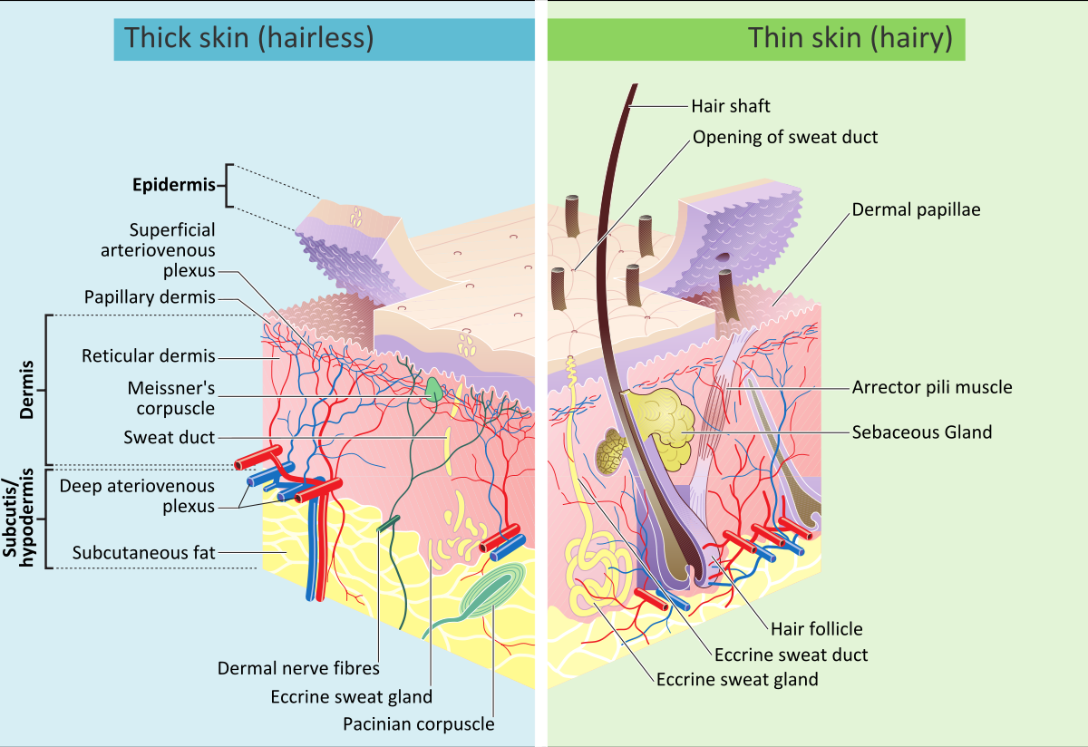
Human Skin
Figure by: Madhero88 and M. Komorniczak
Notes:
A sebaceous gland is a microscopic exocrine gland in the skin that opens into a hair follicle to secrete an oily or waxy matter, called sebum, which lubricates the hair and skin of mammals. Sebum is made up of triglycerides, free fatty acids, wax esters, squalene, cholesterol esters, and cholesterol. In humans, sebaceous glands occur in the greatest number on the face and scalp, but also on all parts of the skin except the palms of the hands and soles of the feet. In the eyelids, meibomian glands, also called tarsal glands, are a type of sebaceous gland that secrete a special type of sebum into tears.
Text modified from: Wikipedia contributors. (2020, February 27). Sebaceous gland. In Wikipedia, The Free Encyclopedia. Retrieved 17:58, March 2, 2020, from https://en.wikipedia.org/w/index.php?title=Sebaceous_gland&oldid=942825703

Slide 8
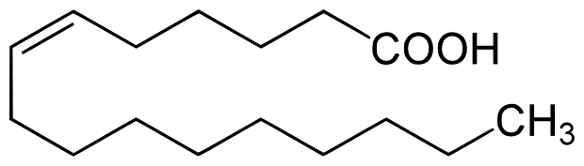
Skin Barrier and Immune System
Skin Ceramide
Cer (EOS)/Cer 1
Sapienic Acid (16:1Δ⁶)
Figure from: Yikrazuul
Notes:
The sebaceous glands within skin are responsible for the secretion of oily compounds that form the primary skin barrier. The secretion of ceramide lipids from sebaceous glands play a major role in forming the barrier function of the skin. Cer 1 listed above is only 1 of 11 known ceramides found on the skin surface. Intermolecular hydrophobic forces that form between the ceramide molecules create a highly impermeable barrier with robust integrity. In addition, compounds, such as sapienic acid are also secreted onto the skin surface. These small acids have potent antibacterial activity and provides natural defenses against the types of bacteria that cause acne and other opportunist pathogens such as Staphylococcus aureus. Overall, this section has introduced you to some of the diverse waxy compounds found in nature. In the next section, you will learn more about the steroid class of lipids.

