Slide 1
The Kreb Cycle
Part 1: Overview and the Pyruvate Dehydrogenase Complex
Notes:
Welcome to part one of our lecture series on the Kreb Cycle. This tutorial will give you an overview of the Kreb Cycle process and focus on the Pyruvate Dehydrogenase reaction that generates the Acetyl-CoA required for entry into the Kreb Cycle.

Slide 2
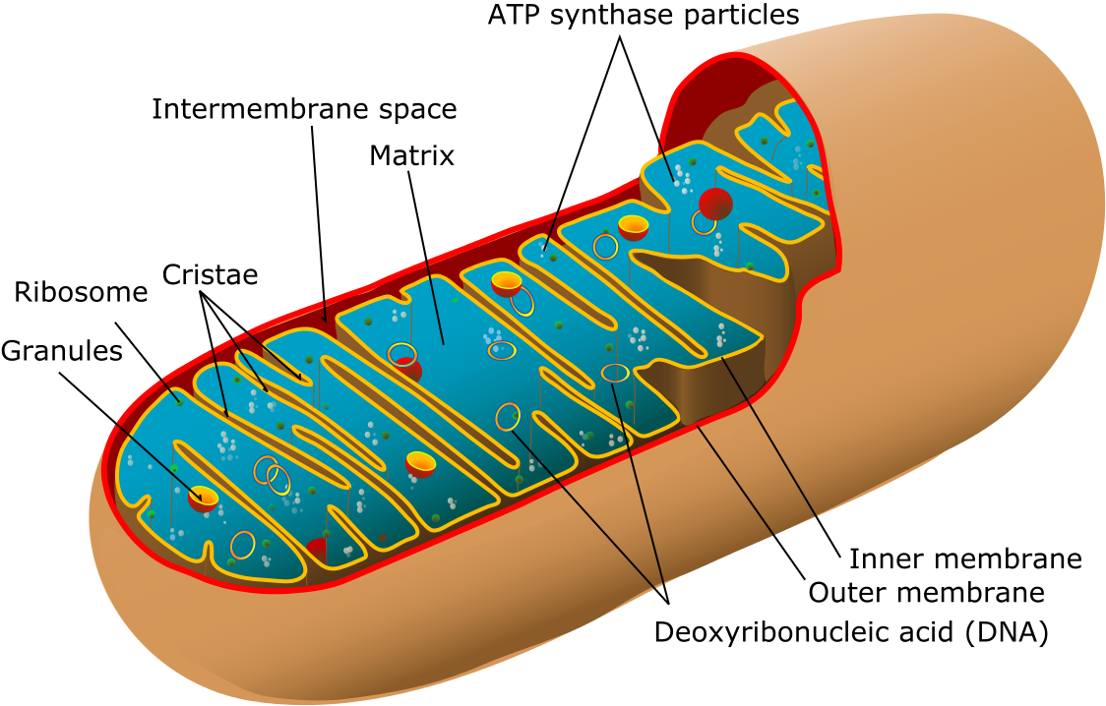
The Amazing Mitochondria
Image from Villareal, M.R.
Notes:
Following the completion of glycolysis, pyruvate will move into the matrix of the mitochondria during aerobic respiration. It will then be converted to Acetyl-CoA which can then enter into the reactions of the Kreb Cycle (which is also called the Citric Acid Cycle or Tricarboxylic Acid Cycle)

Slide 3
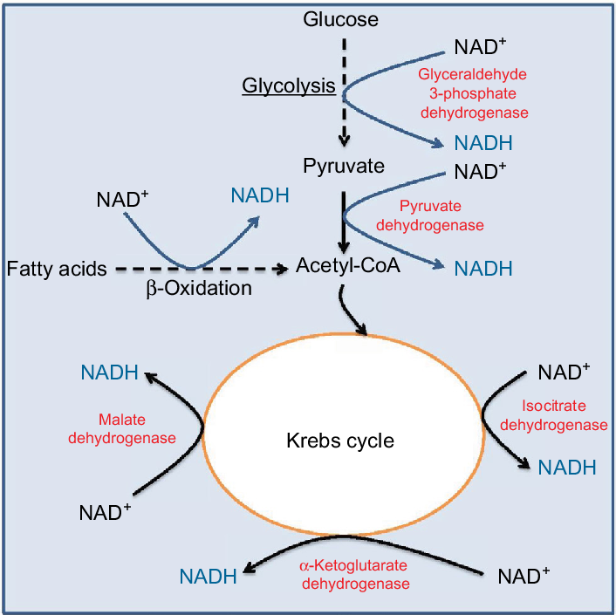
Overview of Kreb Cycle
Sugars and Lipids are the primary energy sources used in the Kreb Cycle to harvest electrons
Figure from: Wu, J., Jin, Z., Zheng, H., and Yan, L-J. (2016) Diabetes, Metabolic
Syndrome and Obesity: Targets and Therapy 9:145-153.
Notes:
A broad overview of those reactions is shown here. In this overview the production of NADH electron carriers is emphasized. As the carbohydrate metabolites move through glycolysis and pass through the Kreb Cycle, electrons are harvested from the metabolites until they are fully oxidized to carbon dioxide. Recall that glycolysis will produce two molecules of NADH for each glucose and that these reactions occur in the cytosol. Pyruvate is then transported to the mitochondrial matrix where it will be converted to Acetyl-CoA and enter into the Kreb Cycle. Conversion of Pyruvate to Acetyl-CoA produces one molecule of CO₂ and NADH. Two more molecules of CO₂ are released during the Kreb Cycle and three more molecules of NADH are produced. For each molecule of glucose metabolized, two pyruvate molecules are formed, thus a total of 8 NADH are formed in the mitochondria during the aerobic oxidation of pyruvate (2 in the conversion of Pyruvate to Acetyl-CoA and 6 more in the Kreb Cycle). Note also that fatty acids from stored lipids can also be metabolized to Acetyl-CoA and enter into the Kreb Cycle to produce energy.

Slide 4
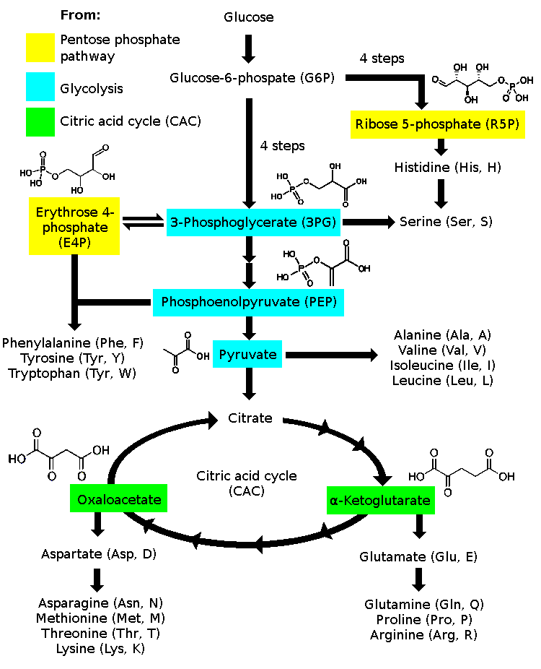
Amino Acid Metabolism
Amino acid synthesis is tied with the processes of carbohydrate metabolism
Image from : Keministi
Notes:
It is interesting to note that while the glycolytic pathway and the Kreb cycle are known for their abilities to produce electron carriers that will generate large amounts of ATP (producing energy for the cell), the intermediates within the pathway can also be converted to amino acids that will be utilized during protein synthesis. For example, you have already seen in the process of gluconeogenesis, that oxaloacetate can be converted into aspartate, and alpha-ketoglutarate into glutamate. These can be further modified to form other amino acids such as Asparagine and Methionine, or Proline and Arginine. Many branched chain amino acids can also be produced from pyruvate, including alanine.

Slide 5
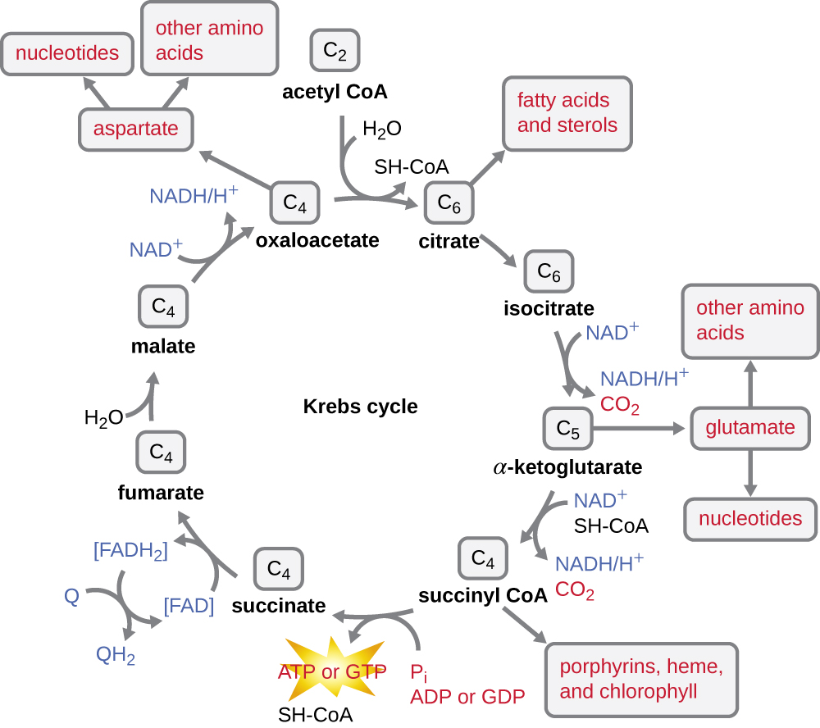
Nucleotide Biosynthesis
Image from : Keenleyside W. Microbiology: Canadian Edition
Notes:
Further branching off from these metabolite pools are the production of the nucleotide monomers used in DNA and RNA biosynthesis. Other important cofactors such as the heme in hemoglobin are also produced from intermediates in the Kreb Cycle. Thus, this metabolic pathway sets the stage for providing both the resources and energy for building the major macromolecules within the body. They are all connected here, which is why we spend so much time studying this system.

Slide 6
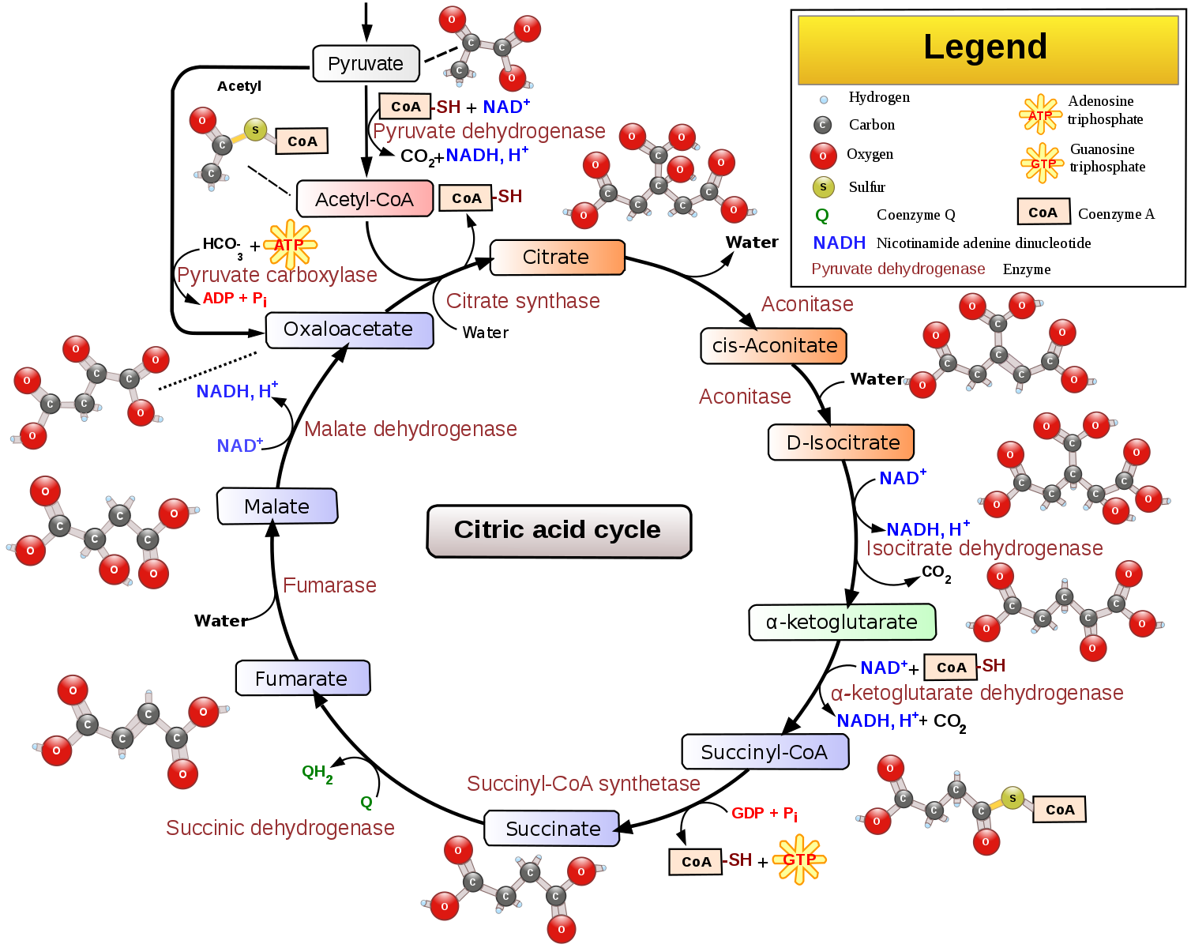
Kreb Cycle
Overview
Image from
Narayanese, WikiUserPedia,
YassineMrabet, TotoBaggins
Notes:
In the next few lectures, we will explore the reactions of the Kreb Cycle in more depth.

Slide 7
Conversion of Pyruvate to Acetyl-CoA
By the Pyruvate Dehydrogenase (PDH) Complex
-CoA
Image from
Narayanese, WikiUserPedia,
YassineMrabet, TotoBaggins
Notes:
But before we can get into the reactions that are within the Kreb Cycle, pyruvate must first be converted into Acetyl-CoA. This is mediated by a major enzyme complex (perhaps one of the largest complexes known!) that is called the Pyruvate Dehydrogenase Complex. It is common for this complex to have more than 60 subunits and it is visible by electron microscopy. Within this reaction Pyruvate and Coenzyme-A(SH) are substrates that end in producing a molecule of CO₂ and Acetyl-CoA. A molecule of NADH is also produced during this process.

Slide 8
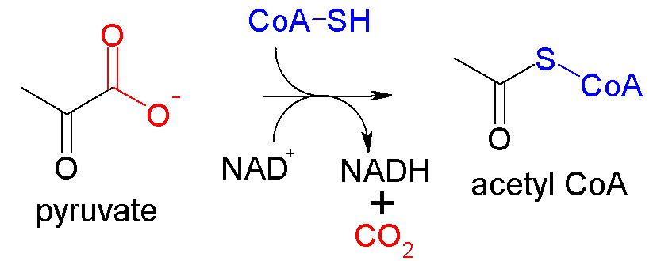
Pyruvate Dehydrogenase Complex
Multiple Reactions:
Decarboxylation Reaction
Transacetylase Reaction
Dehydrogenase Reaction
Image from : Akane700
Notes:
This protein complex mediates the conversion of pyruvate to acetyl-CoA. To complete this conversion, three enzymatic process have to occur. First, there is a decarboxylation of the pyruvate molecule to release carbon dioxide. There is a transacetylase reaction that moves the acetate functional group of pyruvate to the Coenzyme A carrier to produce Acetyl-CoA. During this process, electrons are harvested from the substrates and transferred to the NAD+ carrier to form NADH. This redox/energy-harvesting step is a dehydrogenase reaction. The enzyme complex is named for this important step in the reaction.

Slide 9
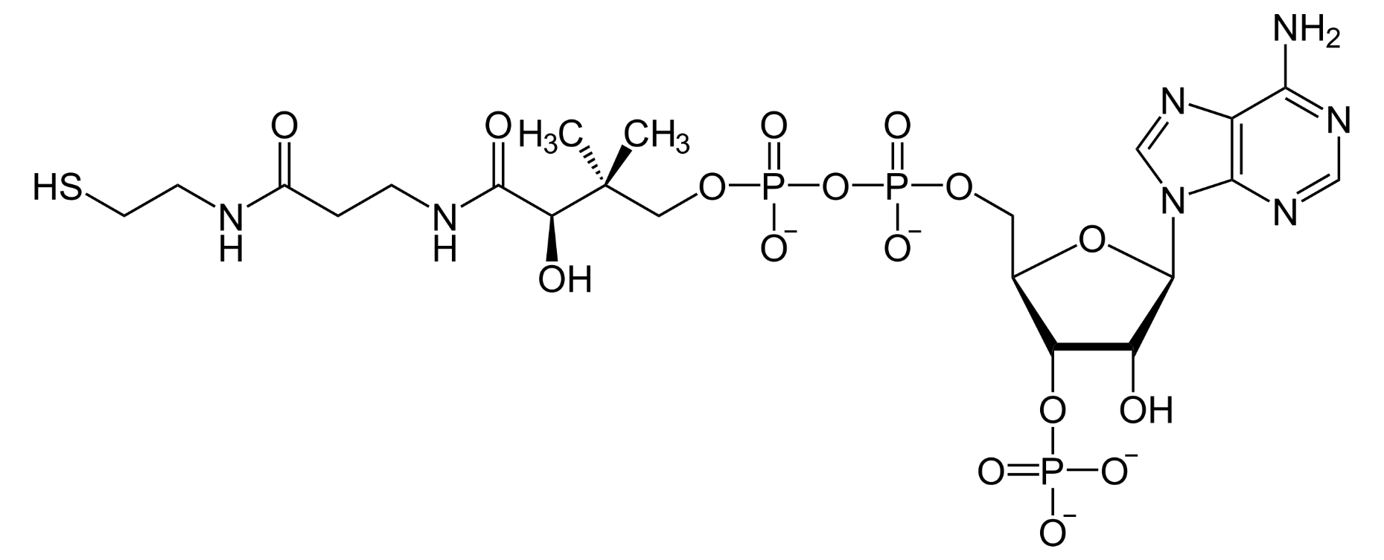
Coenzyme A is a Substrate
Coenzyme A is also commonly used as a substrate/intermediate in reactions
CoASH
Using the thiol functional group, commonly forms thioesters with carboxylic acid functional groups
Notes:
The reduced form of Coenzyme A serves as a substrate for the PDH reaction and is oxidized in the reaction process to a thioester carrier.

Slide 10
Pyruvate Dehydrogenase (PDH) Complex
Is a Multienzyme Complex
Image from : Goodsell, D. (2012) Molecule of the Month, Protein Database
Notes:
This massive protein complex contains many copies of three catalytically active subunits known as the E1 (green), E2 (Blue), and E3 (Orange) subunits. The subunits are tethered together by long flexible protein arms that are able to shuttle the reaction intermediates from one location to another. Since the overall complex is so flexible, it has been difficult to study. Structural biologists have taken a divide-and-conquer approach, and broken the complex into small pieces that are amenable for study. Pictures of parts of the complex from electron microscopy, X-ray crystallography and NMR spectroscopy are then used to figure out how to reassemble all the pieces.

Slide 11
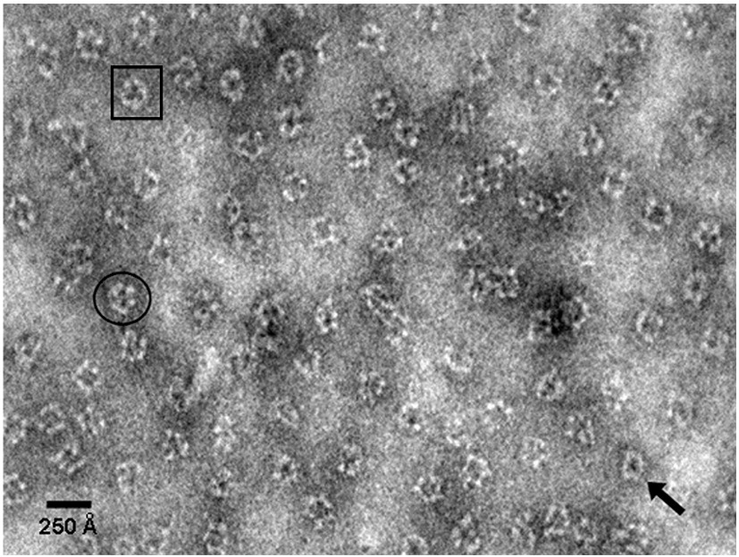
Electron Microscopy of PDH Complex
Image from : Vijayakrishnan, S., et al (2010) J Mol Bio 399(1):71-93
Notes:
This is a partial recombinant structure of the Pyruvate Dehydrogenase (PDH) Protein Complex analyzed by negative-stain electron microscopy. I love the technologies that allow us to visualize the realtime structure of biological molecules. It makes me stop and reflect on the wonders of life and how complex we all really are.

Slide 12
Pyruvate Dehydrogenase Complex
Uses several cofactors
Thiamine Pyrophosphate
Lipoamide
FAD
NAD+
Image from : Goodsell, D. (2012) Molecule of the Month, Protein Database
Notes:
The reactions performed in the PDH complex are tricky, so several specialized chemical cofactors are used by the enzyme subunits. This included thiamine pyrophosphate, lipoamide, FAD, and NAD+. The E1 enzyme subunit (shown here) that performs the first step uses thiamine pyrophosphate to extract carbon dioxide from pyruvate.

Slide 13
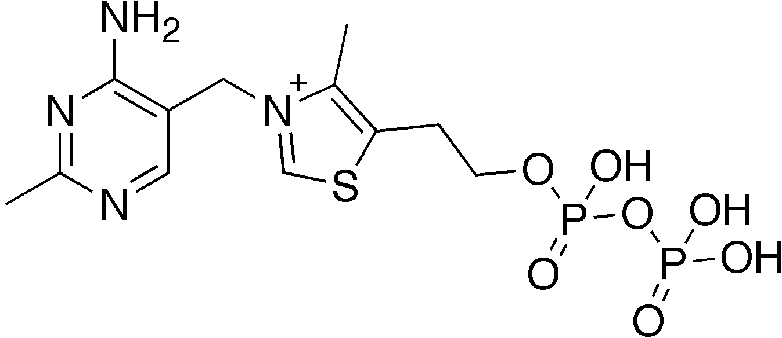
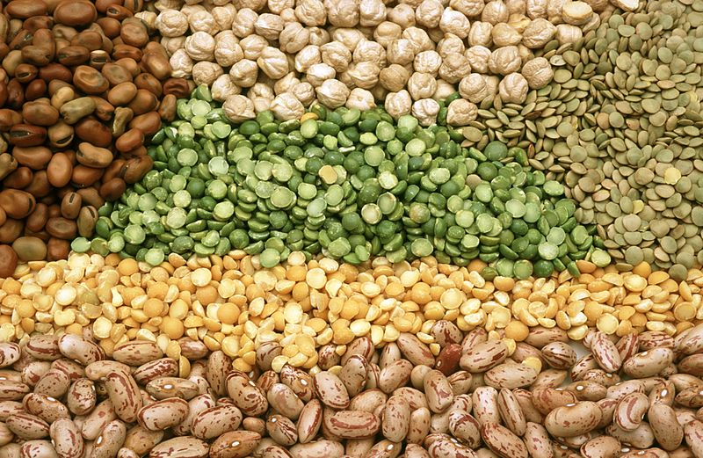
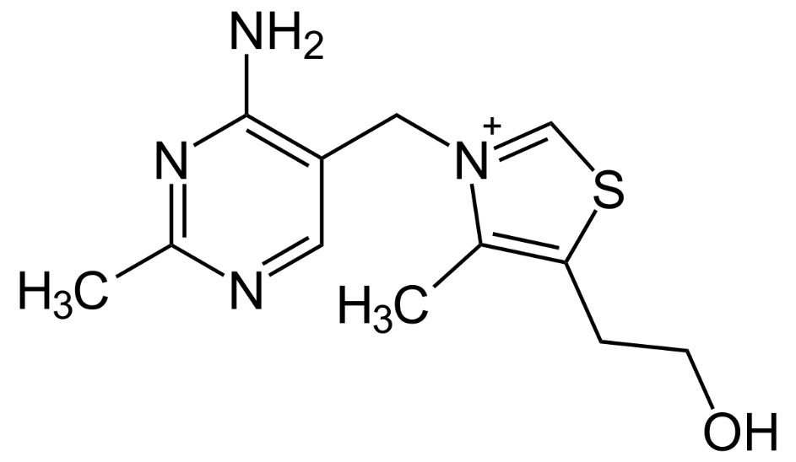
Thiamine Pyrophosphate (TPP)
Derivative of Vitamin B1
Image from : CSIRO
Notes:
Thiamine Pyrophosphate is derived from vitamin B1. Good sources of Thiamine (vitamin B1) from the diet, include legumes, nuts, oats, eggs, milk, beef, and liver. Other food sources are often fortified with vitamin B1 such as rice, pasta, breads, cereal and flour.

Slide 14
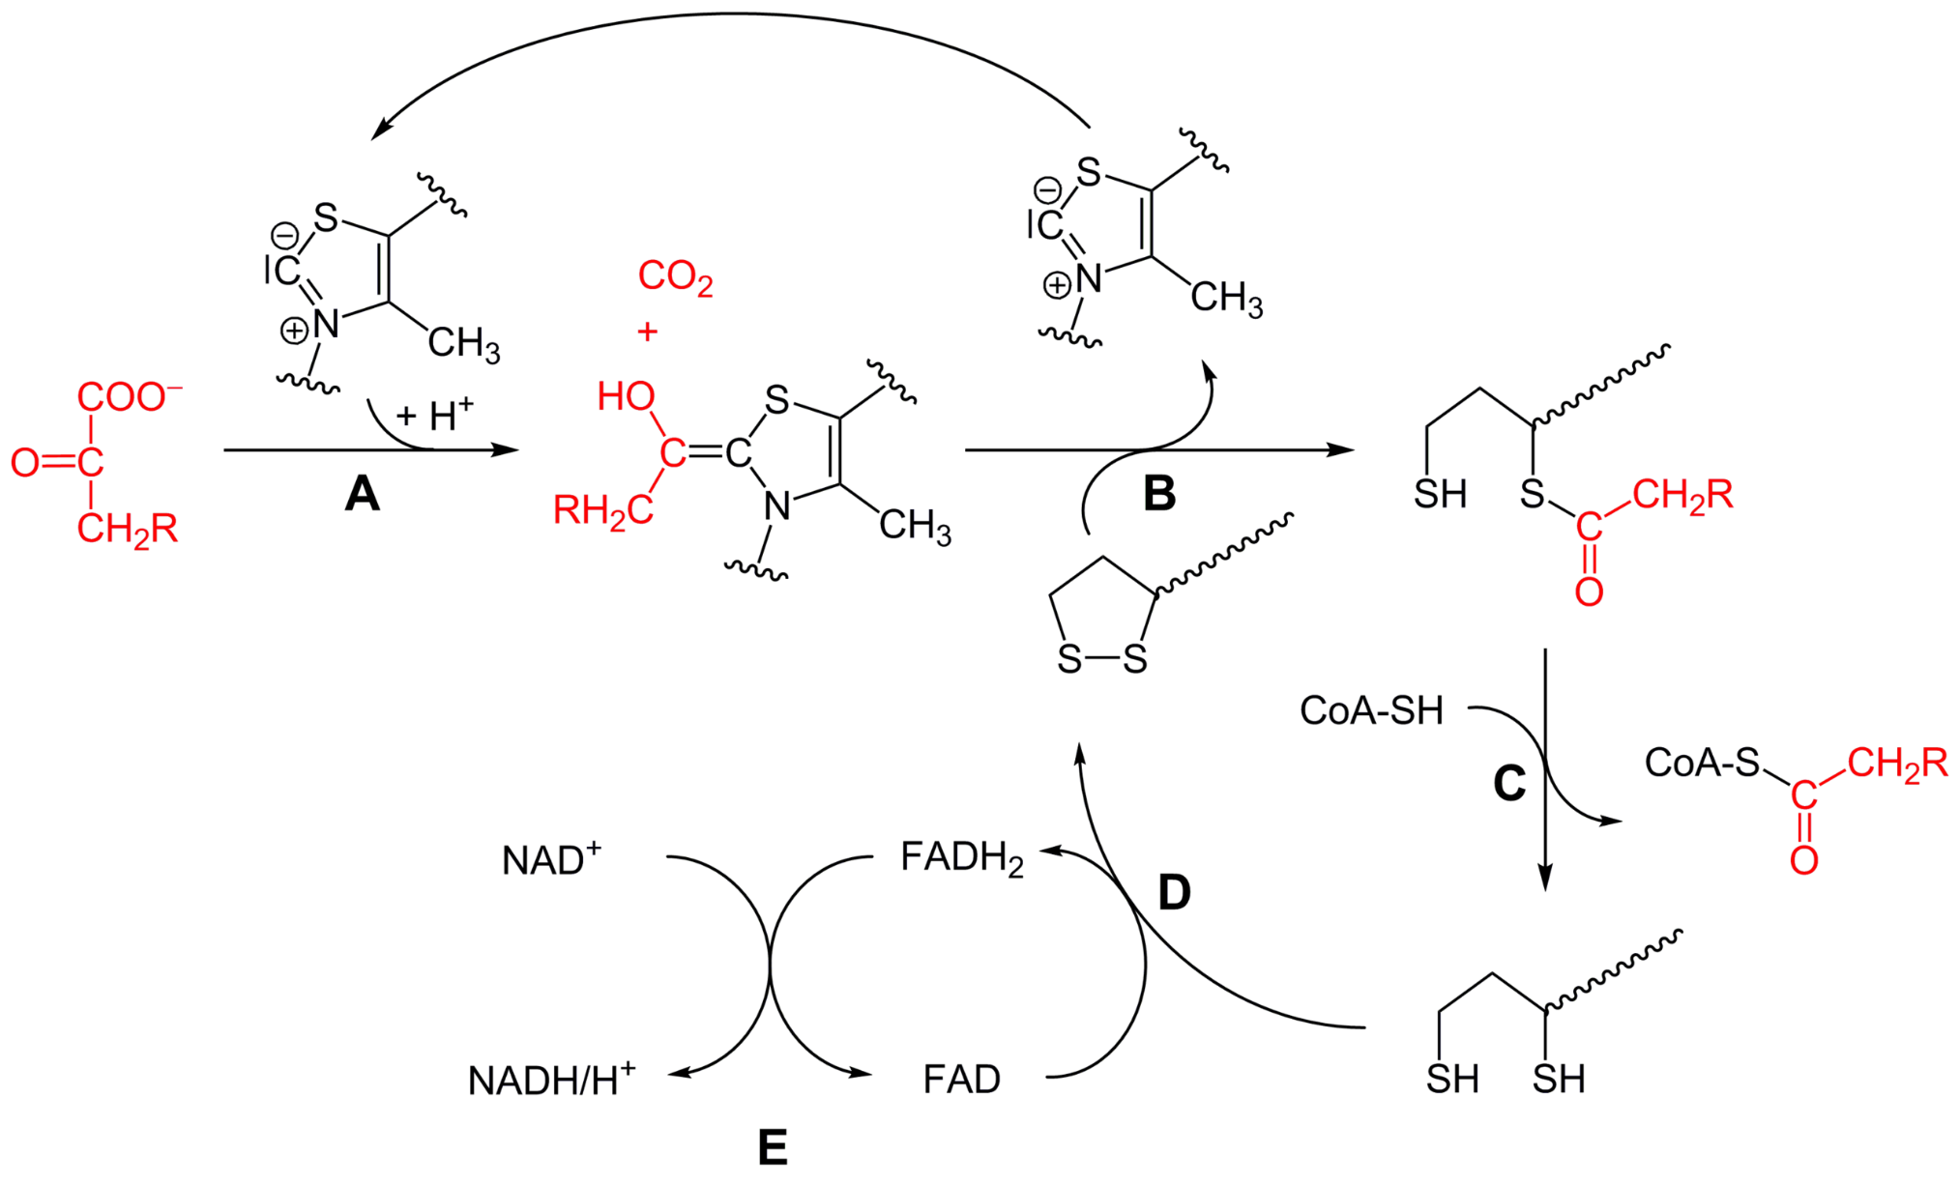
Decarboxylation Occurs at E1
E1 Subunit
₃H
H₃
H₃
E1 Subunit =
Pyruvate Decarboxylase Activity
H₃
Image modified from : Yikrazuul
Notes:
During the reaction mechanism of PDH, pyruvate and thiamine pyrophosphate (TPP) are bound by the E1 subunint of PDH. The thiazolium ring of TPP is in a zwitterionic form, and the anionic C2 carbon performs a nucleophilic attack on the C2 (ketone) carbonyl of pyruvate. The resulting intermediate undergoes decarboxylation leaving a 2 carbon intermediate attached to TPP.

Slide 15
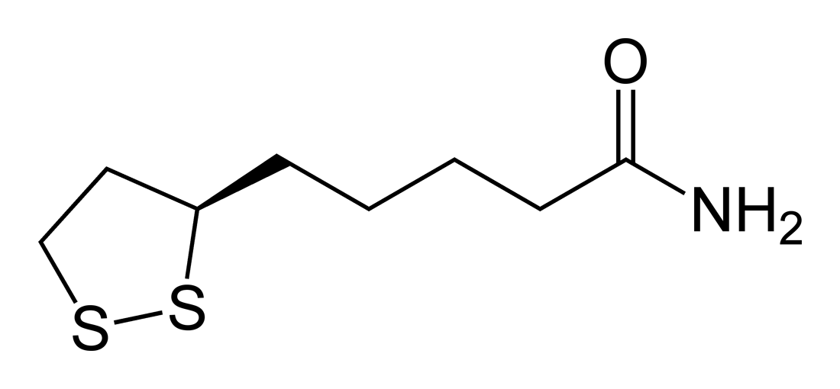
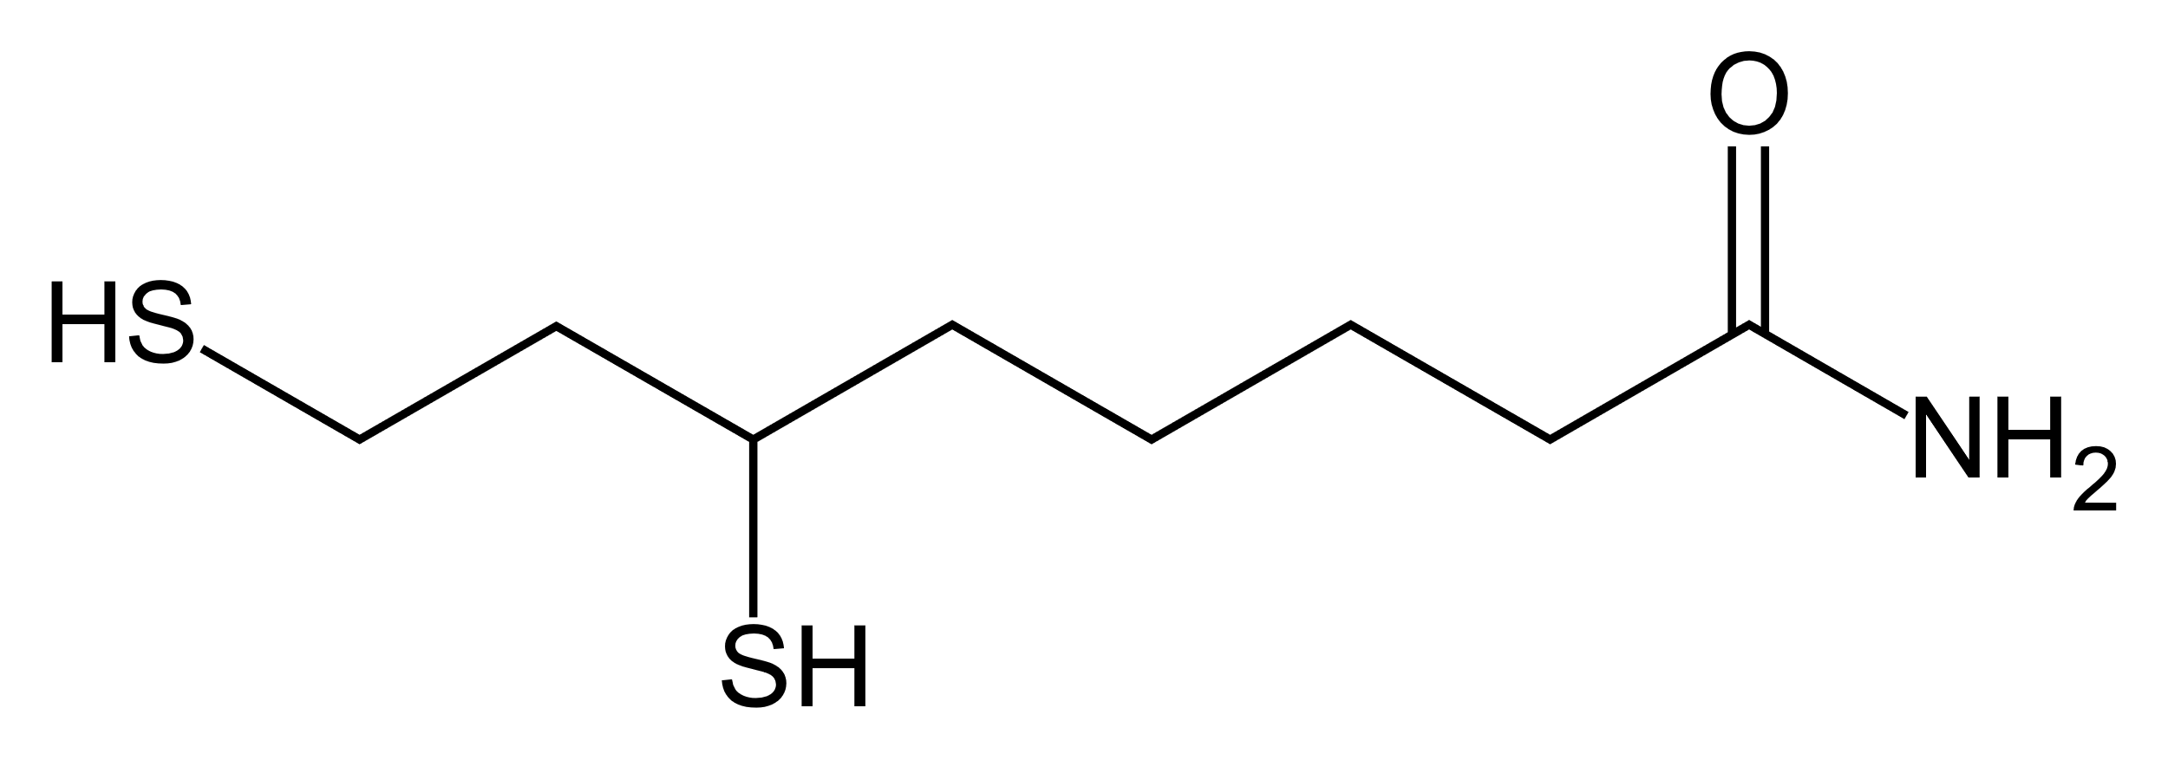
Lipoamide and Dihydrolipoamide
Lipoamide (Oxidized)
Dihydrolipoamide (Reduced)
Notes:
At this point, the second cofactor, lipoamide becomes involved in the reaction mechanism. Lipoamide is a tightly bound prosthetic group that is attached to the enzyme through a covalent linkage with a lysine residue. This cofactor can exist in and oxidized and reduced form through the formation and breakdown of a disulfide linkage (similar to that seen between cysteine residues). It is used to harvest electrons from the Pyruvate and CoASH substrates during the reaction.

Slide 16
Pyruvate Dehydrogenase Complex
Is a Multienzyme Complex
Image from : Goodsell, D. (2012) Molecule of the Month, Protein Database
Notes:
The lipoamide cofactor is shown in pink on this diagram and is attached on the long, flexible arms of the PDH complex. This allows the lipoamide cofactor to be dipped in and out of the different protein subunits and serve as an electron carrier molecule.

Slide 17
Decarboxylation Occurs at E1
E1 Subunit
₃H
H₃
H₃
E1 Subunit =
Pyruvate Decarboxylase Activity
H₃
Image modified from : Yikrazuul
Notes:
Once the acetyl group has been attached to the TPP in the E1 subunit, the oxidized form of the lipoamide cofactor enters the subunit. The ene-ol carbon in the TPP-intermediate structure has anionic character, enabling it to attack the disulfide bond of the oxidized lipoamide cofactor. This releases and restores the TPP cofactor in the E1 subunit and opens the ring structure of lipoamide to create one reduced thiol functional group and the other sulfur loaded with the acetyl group from pyruvate. The E1-catalyzed process is the rate-limiting step of the whole pyruvate dehydrogenase complex.

Slide 18
Decarboxylation Occurs at E1
E1 Subunit
₃H
H₃
H₃
E1 Subunit =
Partial reduction of lipoamide
H₃
Image modified from : Yikrazuul
Notes:
Here you can see the partially reduced lipoamide cofactor forming a thioester intermediate with the acetyl group from pyruvate.

Slide 19
Pyruvate Dehydrogenase Complex
E1
E1
E2
Is a Multienzyme Complex
E1
Image from : Goodsell, D. (2012) Molecule of the Month, Protein Database
Notes:
The acetyl-hydrolipoamide intermediate will then shift from the E1 subunit and move to the E2 subunit. The E1 subunit is shown in green above and the E2 subunit in blue.

Slide 20
Reduction and Transacetylation at E2
E2 Subunit
₃H
H₃
H₃
E2 Subunit = Lipoamide Reductase Activity
H₃
Image modified from : Yikrazuul
Notes:
At this point, the hydrolipoate-thioester functionality is positioned into the dihydrolipoyl transacetylase (E2) active site, where a transacylation reaction transfers the acetyl from the "swinging arm" of lipoamide to the thiol of coenzyme A. This produces acetyl-CoA, which is released from the enzyme complex and subsequently enters the citric acid cycle. It also fully reduced the lipoamide cofactor to dihydrolipoamide. Thus, the E2 subunit can also be called lipoamide reductase-transacetylase.

Slide 21
Pyruvate Dehydrogenase Complex
E3
E2
Is a Multienzyme Complex
E3
E3
Image from : Goodsell, D. (2012) Molecule of the Month, Protein Database
Notes:
Once the lipoamide has been fully reduced to dihyrolipoamide, the flexible arm will swing away from the E2 subunit and move to the E3 subunit, shown in orange here. This is where the final dehydrogenase activity of the enzyme will occur.

Slide 22
Dihydrolipoyl Dehydrogenase (E3)
₃H
H₃
H₃
E3 Subunit = Reduces NAD+
Through FAD
E3 Subunit
H₃
Image modified from : Yikrazuul
Notes:
Once the dihydrolipoyl has migrated to the dihydrolipoyl dehydrogenase (E3) active site, it undergoes a flavin-mediated oxidation. First, FAD oxidizes dihydrolipoate back to the oxidized lipoate state, producing the reduced FADH₂. Recall that FAD is a tight binding cofactor that cannot be released from the enzyme. To make the electrons available for use in the electron transport chain, the electrons are transported to the mobile NAD⁺ cofactor. NAD⁺ oxidizes FADH₂ back to its FAD resting state, producing NADH and H+. NADH/H+ can then leave the PDH enzyme system and shuttle the electrons to the electron transport chain. At this point, the enzyme is reset and has completed one round of catalytic activity, producing one molecule of Acetyl-CoA, one molecule of CO₂ and one molecule of NADH/H+. Note that this reaction will happen twice for each glucose molecule processed in glycolysis.

Slide 23
Pyruvate Dehydrogenase Complex
Multiple Reactions:
Decarboxylation Reaction
Transacetylase Reaction
Dehydrogenase Reaction
Image from : Akane700
Notes:
The acetyl-CoA produced in this reaction is then poised to enter into the Kreb cycle. Note that the conversion of pyruvate to acetyl-CoA is an irreversible step. Typically decarboxylation reactions cannot be easily reversed. The PDH complex is also a key regulatory element in the pathway linking glycolysis to the Kreb cycle.

Slide 24
Pyruvate Dehydrogenase Regulation
Is Allosterically Regulated
  Negative feedback inhibition by Acetyl-CoA
Is inhibited by a high ratio of NADH/NAD+.
Is Regulated by reversible Phosphorylation of the E1 subunit
  PDKs = pyruvate dehydrogenase kinases - INACTIVATED
  PDPs = pyruvate dehydrogenase phosphatases - ACTIVATED
Notes:
Acetyl-CoA will inhibit the enzyme reaction by negative feedback inhibition. Similarly, a high ratio of NADH/NAD+ will indicate that there is not enough NAD+ to serve as a cofactor for the enzyme to receive the electrons housed on FAD. Without being able to off-load the electrons from the system, the system will get backed up and shut down until electron carrier molecules are oxidized and available to accept electons from the E3 subunit. The PDH complex is also regulated through phosphorylation by a family of PDKs and PDPs that are differentially expressed/activated within different tissue types throughout the body.

Slide 25
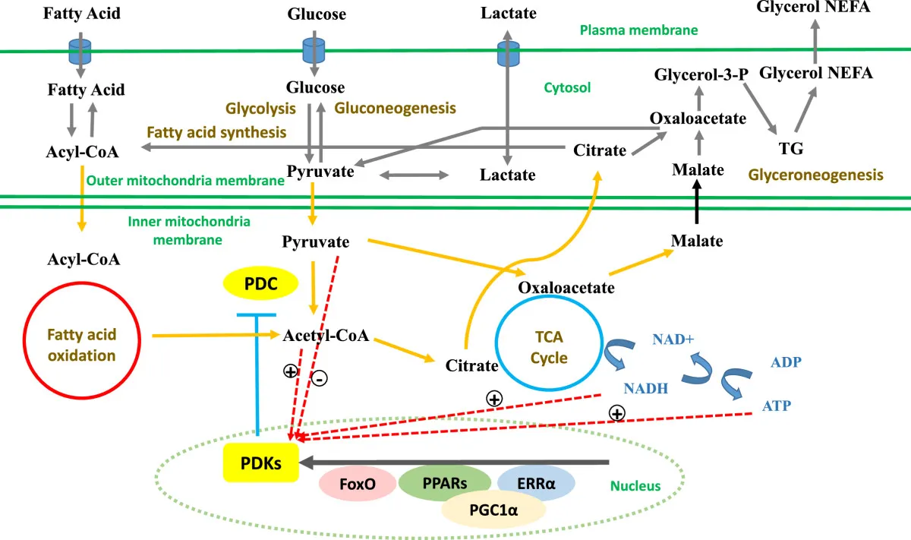
Figure from : Zhang, et al (2014) Nutrition & Metabolism 11:10
Notes:
Regulation of the PDH Complex by phosphorylation allows for cells to adapt to changing metabolic environments and differing, tissue-specific energy demands. PDC can be phosphorylated by PDKs, which can be regulated by mitochondrial acetyl-CoA, NADH, pyruvate, ATP and nuclear transcription factors. PDC is more active in the healthy and well-fed state. However, suppression of PDC is crucial for glucose synthesis when glucose is scarce, especially in liver tissue where the process of gluconeogenesis is the most active. In the next section, we will explore the 8 major metabolic reactions of the Kreb Cycle.

