Slide 1
The Electron Transport Chain
Part 4: Complex IV – the End of the Line
Notes:
Welcome to part 4 of our lectures on the Electron Transport Chain.

Slide 2
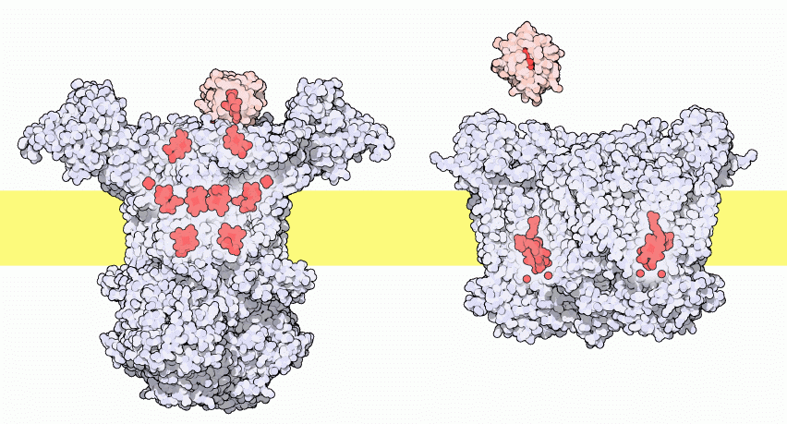
Tranfer of Electrons from III to IV
Image modified from : Goodsell, D. (2012) Molecule of the Month, Protein Database
Notes:
This diagram shows the transfer of electrons via Cytochrome C from Complex III to Complex IV in the electron transport chain.

Slide 3
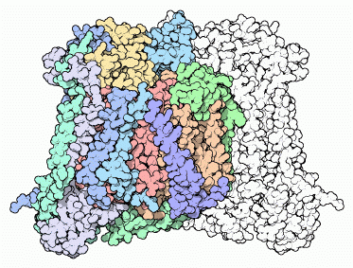
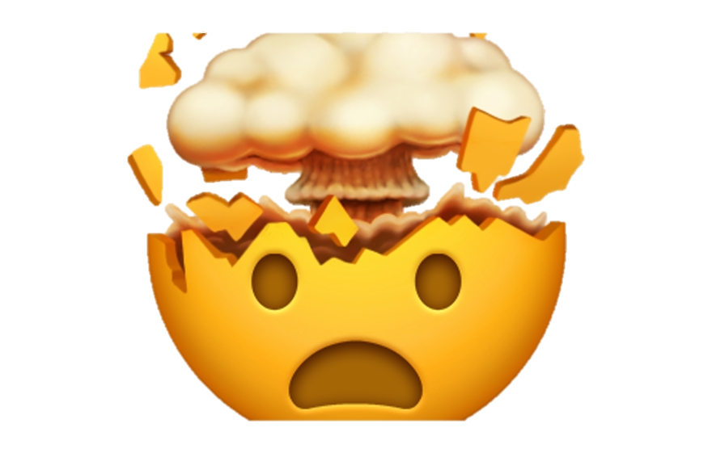
Complex IV: Cytochrome C Oxidase
Evolution is a wonder!
Cytochrome C-oxidase (and other mitochon. Proteins) are made from both nuclear and mitochondrial genes!
Image from : Goodsell, D. (2012) Molecule of the Month, Protein Database
Notes:
The evolution of Complex IV in our mitochondria is fascinating! Our mitochondria actually contain all of the machinery needed to build their own proteins--they have DNA, ribosomes, and everything. In our cells, the three core subunits of cytochrome c oxidase are built inside our mitochondria, but the remaining ten small chains are built outside in the cytoplasm using our nuclear DNA and then added to the mitochondria later. So, our mitochondria build a bacteria-like enzyme, which our cells then decorate with other proteins to customize its function. I don’t know about you, but my mind is blown!

Slide 4
Complex IV: Cytochrome C Oxidase
The Final ETC Protein
Oxidizes Cytochrome C
Reduces O₂ to H₂O
Pumps 2 protons per NADH or FADH2
Image from : Goodsell, D. (2012) Molecule of the Month, Protein Database
Notes:
Overall, complex IV is involved in the oxidation of cytochrome c, the reduction of molecular oxygen to form water, and the continued pumping of protons into the intermembrane space of the mitochondria.

Slide 5
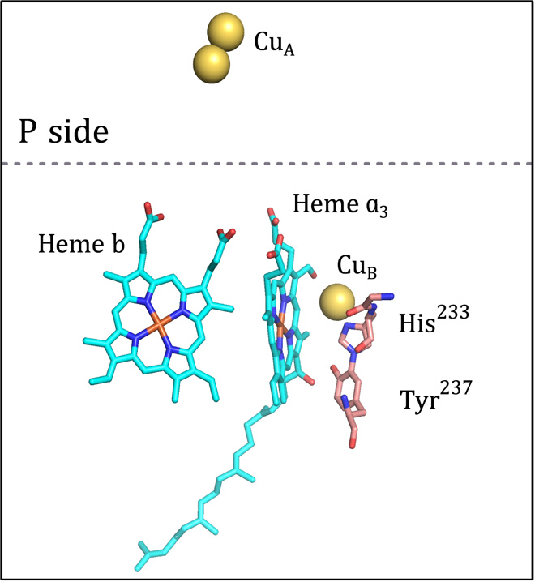
Cytochrome C - Oxidase
Cofactors
  Cu_{A}
  Cu_{B}
  Heme a₃
  Heme b
Active Site residues
  Histidine
  Tyrosine
Figure from :Poaiana, F., et al (2017) Scientific Advances 3(6):e1700279
Notes:
Complex IV or Cytochrome C Oxidase houses several different cofactors involved in the reaction mechanism including two heme groups (heme b and heme a3) and two Copper cofactors (CuA and CuB). Active site tyrosines and histidines are also important in the reaction mechanism.

Slide 6
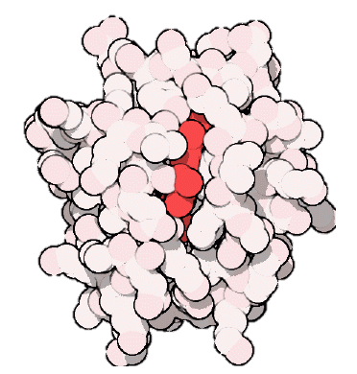
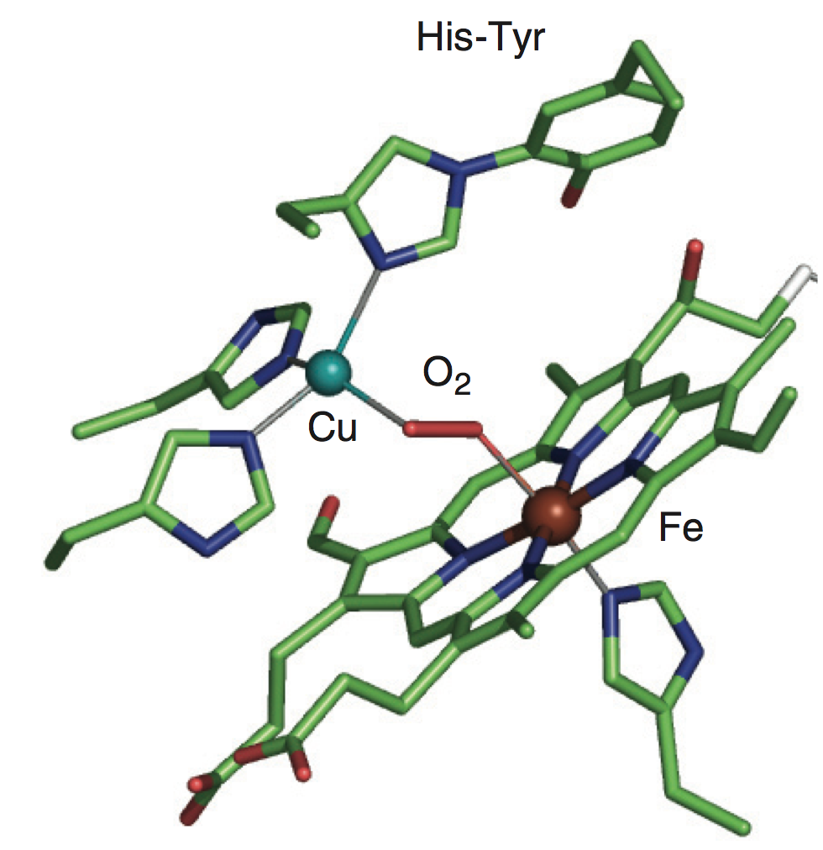
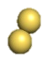
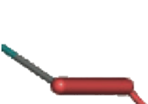
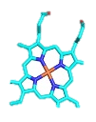
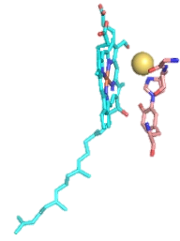




The First Half Reaction:
2 Reduced
Cytochrome C
2 Oxidized
Cytochrome C
2 H⁺
Intermembrane
Space
O₂
Matrix
2 H⁺
Image from: ChemTube3D – The University of Liverpool
Notes:
The reduction of oxygen to water is achieved through a two part reaction. In the first part, 2 electrons are dropped off at the complex by 2 molecules of Cytochrome C. This reoxidizes the molecules of Cytochrome C so that they can pick up more electrons from Complex III. The two electrons move through the CuA cofactor, the heme b cofactor and land in the heme a3 and CuB cofactors. This energy release causes the pumping of 2 protons into the intermembrane space. The CuB and heme a3 cofactors make up the active site of the enzyme. When in the reduced state the Cu and Fe from these cofactors can coordinate with molecular oxygen to form a peroxide intermediate. One electron from the pi bond between the oxygen residues will coordinate with the electron housed on the CuB cofactor and the other electron from the pi bond will coordinate with the electron housed on the Fe within the heme a3 cofactor.

Slide 7


The Second Half Reaction:
2 Reduced
Cytochrome C
2 Oxidized
Cytochrome C
2 H⁺
Intermembrane
Space
Matrix
2 H⁺
Image from: ChemTube3D – The University of Liverpool
Notes:
In the second half of the reaction, 2 more Cytochrome C molecules drop off 2 more electrons to the catalytic center. This causes the pumping of two more protons into the intermembrane space. It also allows the breaking of the peroxide bond and formation of the hydroxyl-Cu and hydroxyl-Fe intermediates.

Slide 8
The Second Half Reaction:
2 Reduced
Cytochrome C
2 Oxidized
Cytochrome C
Intermembrane
Space
Matrix
Image from: ChemTube3D – The University of Liverpool
Notes:
The metal-oxygen linkages are unstable, and the electrons will pick up 2 more protons from the matrix of the mitochondria to complete the formation of 2 water molecules. This completes one round of enzymatic activity by Complex IV.

Slide 9
Complex IV: End Result for 1 NADH or 1 FADH₂
2 e- from 2 Cytochrome C molecules
Achieves ½ of the Reduction of O₂
2 Protons (H+) pumped into Intermembrane Space
No water made at this step
Complex IV: End Result for 2 NADH or 2 FADH₂
Repeat the reaction (second half)
  Use 2 more e- from 2 Cytochrome C molecules
  Pump 2 more H+
  Make 2 water molecules (complete reduction of 1 O₂)
  Remove 4 H+ from matrix to make water
Notes:
With the energy from only 1 NADH or 1 FADH, it is only possible to finish half of the reaction at Complex IV. This would harvest 2 electrons from Complex III, partially reduce molecular oxygen and pump 2 protons (H+) across the membrane into the intermembrane space. With the completion of the full reaction, you would need 2 molecules of NADH or FADH2 to make 2 molecules of water, pump a total of 4 protons across the membrane and reoxidize a total of 4 molecules of Cytochrome C.

Slide 10
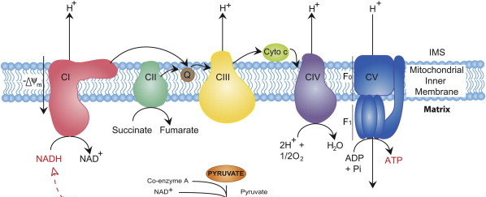
Summary of the Electron Transport Chain
4 H⁺
4 H⁺
2 H⁺
10 H⁺
3 ADP
+Pi
3 ATP
From Kreb Cycle
Notes:
This is a cartoon summary of the entire electron transport chain. Complex I harvesting electrons derived from NADH of the Kreb Cycle to produce 1 molecule of Coenzyme Q and pump 4 protons across the membrane. Complex II harvests the electrons from the succinate dehydrogenase reaction of the Kreb cycle and feeds them through FADH2 and other iron-sulfur clusters to generate 1 molecule of Coenzyme Q. The molecules of Coenzyme Q are used to reduce Cytochrome C at Complex III through the Q-Cycle. Complex III also pumps 4 protons per NADH or FADH2. Cytochrome C then transfers electrons to Complex IV that reduces molecular oxygen to water and pumps 2 more protons to the intermembrane space fore each NADH or FADH2 molecules consumed.

Slide 11
Proton Load for NADH and FADH₂
Electrons from 1 NADH = 10 protons (H+) pumped
  10 protons = 3 ATP (inside the matrix of mitochondria)
Electrons from 1 FADH₂ = 6 protons (H+) pumped
  6 protons = ~1.8 ATP (inside the matrix of mitochondria)
Notes:
Overall for 1 NADH molecule, 10 protons are pumped across the membrane resulting in one turn of the ATP Synthase protein and the generation of 3 ATP molecules (that are located in the matrix of the mitochondria) We will see there is an energy costs to move the ATP to the cytoplasm where it can be used more efficiently to do work, such as muscle contraction. FADH2, on the other hand, bypasses Complex I and does not itself pump protons. Thus, it is worth less currency when it comes to the production of ATP. 1 FADH2 is not capable on its own to generate one turn of the ATP Synthase enzyme. Thus, in estimation, each FADH2 is worth approximately 1.8 ATP molecules (although you have to make them 3 at a time!). In the next lecture, we will explore the structure and activity of the ATP Synthase enzyme and see how ATP is transported into the cytosol.

