Slide 1
The Electron Transport Chain
Part 2: Complex II
Notes:
Welcome to part 2 of our lecture on the Electron Transport Chain.

Slide 2
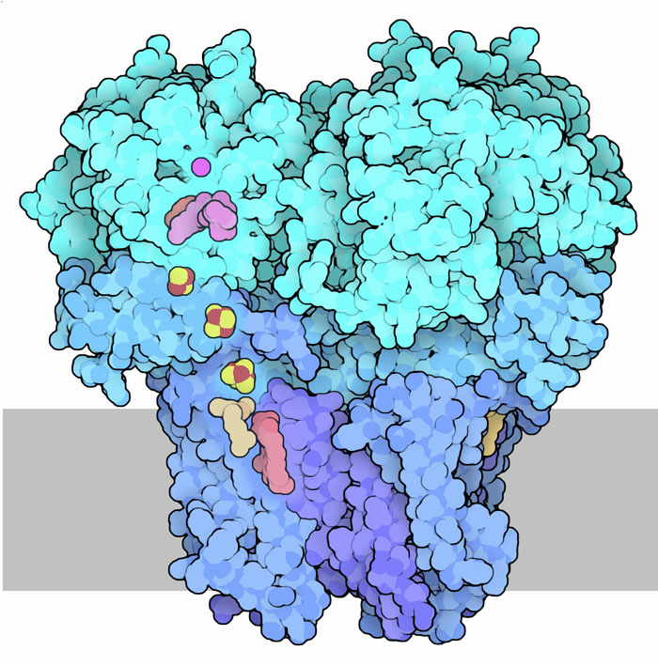
Complex II
Intermembrane
Space
Succinate dehydrogenase
Succinate/Q Reductase
Is NOT a proton (H+) pump
Matrix
Succinate
Fumarate
Image modified from : Goodsell, D. (2012) Molecule of the Month, Protein Database
Notes:
Complex II in the electron transport chain is also an enzyme involved in the Kreb Cycle. The Succinate Dehydrogenase enzyme is also directly involved with the transfer of electrons to Coenzyme Q.

Slide 3
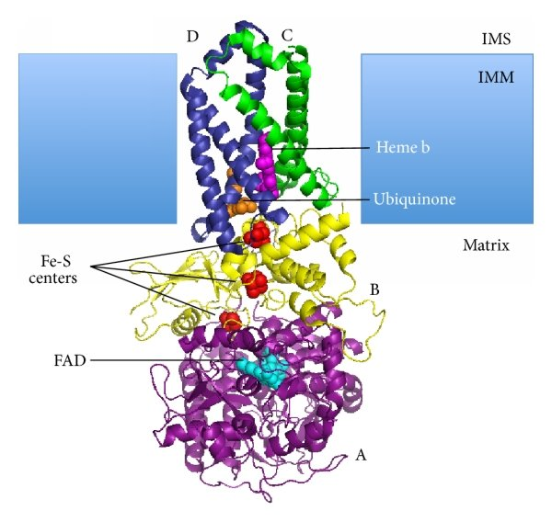
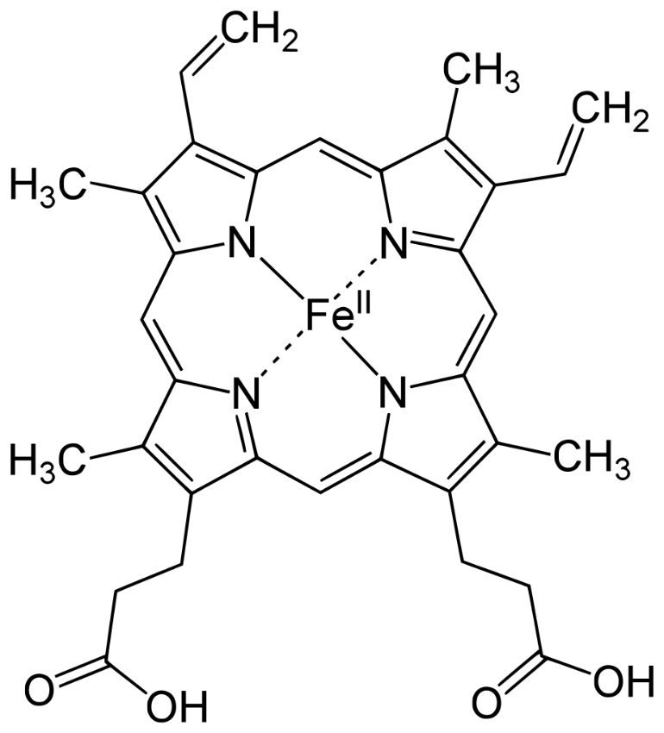
Cofactors in Complex II
Figure from Her, Y.F. and Maher, L.J. (2015) Int. J. of Endocrin. 11:296167
Notes:
This diagram shows the positions of the major cofactors in Complex II. The FAD (shown in blue) is reduced during the oxidation of succinate within the Kreb cycle. FADH2 subsequently passes the electrons through three iron-sulfur complexes (shown in red) to reach the Coenzyme Q (Ubiquinone – shown in orange). Heme b (shown in purple and on the lefthand diagram) prevents reactive oxygen species formation and does not participate in electron transfer.

Slide 4
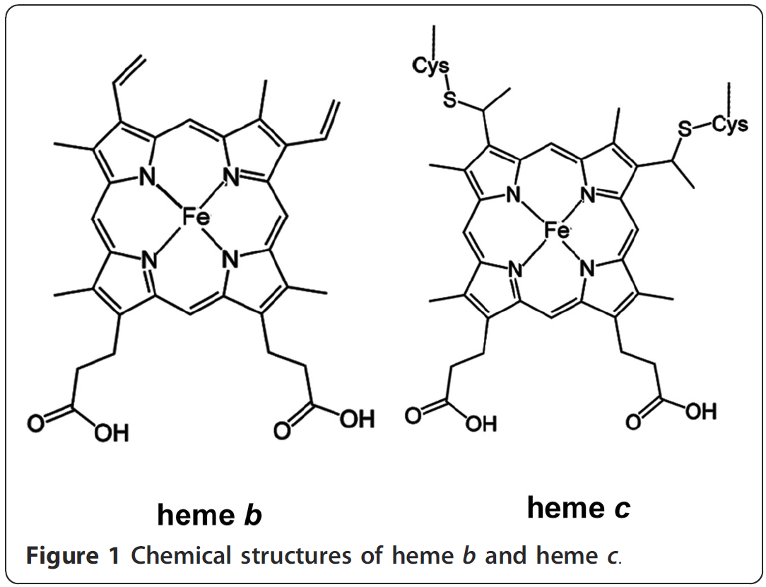
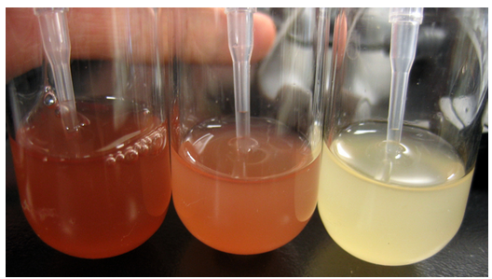
Heme Cofactors
Can exist in many forms
A
B
C
Figure from: BerkiGEM2007
Figure from: Li, T., Bonkovsky, H.L., and Guo, J-T., (2011) BMC Struct. Bio 11(1):13
Notes:
Let’s talk a little more about the heme cofactors as they will be important players at later points in the Electron Transport Chain. Among the known forms of heme cofactors, heme b and heme c represent the most common types of heme groups associated with proteins. Heme b binds to proteins noncovalently while heme c forms covalent bonds between the heme vinyl groups and two cysteine residues of proteins. The Heme in Complex II is in the b conformation. Note that proteins bound to heme cofactors are often referred to as cytochromes (or cellular pigments that have a distinctive energy absorption band in their reduced and oxidized states.) Cytochromes are classified according to the type of heme that they bind. Four major classes are recognized [cytochromes a (absorbing at 605 nm), b (at 565 nm), c (at 550 nm) and d (at ~636 nm)]. The figure on the left shows (A) a recombinant mutant hemoglobin protein in the reduced state with a mixture of heme a/b/c/d (B) only heme a/b/c/d and (C) negative control. You can see the characteristic red coloration of the heme cofactors.
(PDF) Structural analysis of heme proteins: Implication for design and prediction. Available from: https://www.researchgate.net/publication/50270061_Structural_analysis_of_heme_proteins_Implication_for_design_and_prediction [accessed Feb 09 2020].

Slide 5
Complex II: End Result for 1 FADH₂
Intermembrane
Space
2 electrons and 2 protons transferred from FADH₂ to Coenzyme Q (= 1 QH₂)
1 FADH₂ recycled to FAD for use in Kreb cycle
Succinate → Fumarate
NO PROTONS PUMPED
QH₂
Q
Matrix
Succinate
Fumarate
Figure modified from Mailloux, R.J. (2015) Redox Biology 4:381-389
Notes:
Now back to complex II. Succinate oxidation by complex II yields fumarate and the liberated electrons are passed through FAD and three Fe–S clusters reducing Q to QH2. Complex II is a Krebs cycle enzyme providing a direct link between Krebs cycle flux and electron transfer in the respiratory chain. Complex II is also embedded in the mitochondrial inner membrane but is not a protein pump. Unlike complexes I, III, and IV, complex II does not couple electron transfer to proton translocation into the intermembrane space. This is attributed to the low Gibbs free energy change for electron transfer in complex II to Q.
Teaching the fundamentals of electron transfer reactions in mitochondria and the production and detection of reactive oxygen species. Available from: https://www.researchgate.net/publication/272373768_Teaching_the_fundamentals_of_electron_transfer_reactions_in_mitochondria_and_the_production_and_detection_of_reactive_oxygen_species [accessed Feb 08 2020].

Slide 6
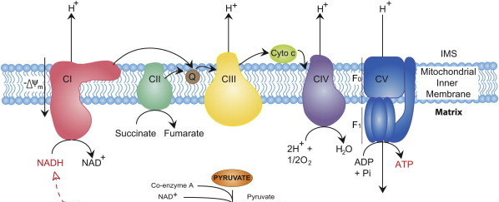
Summary of the Electron Transport Chain
4 H⁺
4 H⁺
2 H⁺
10 H⁺
3 ADP
+Pi
3 ATP
From Kreb Cycle
Notes:
This is a cartoon summary of the entire electron transport chain. Complex I harvesting electrons derived from NADH of the Kreb Cycle to produce 1 molecule of Coenzyme Q and pump 4 protons across the membrane. Complex II harvests the electrons from the succinate dehydrogenase reaction of the Kreb cycle and feeds them through FADH2 and other iron-sulfur clusters to generate 1 molecule of Coenzyme Q. The molecules of Coenzyme Q are used to reduce Cytochrome C at Complex III through the Q-Cycle. Complex III also pumps 4 protons per NADH or FADH2. Cytochrome C then transfers electrons to Complex IV that reduces molecular oxygen to water and pumps 2 more protons to the intermembrane space fore each NADH or FADH2 molecules consumed.

Slide 7
Proton Load for NADH and FADH₂
Electrons from 1 NADH = 10 protons (H+) pumped
  10 protons = 3 ATP (inside the matrix of mitochondria)
Electrons from 1 FADH₂ = 6 protons (H+) pumped
  6 protons = ~1.8 ATP (inside the matrix of mitochondria)
Notes:
Overall for 1 NADH molecule, 10 protons are pumped across the membrane resulting in one turn of the ATP Synthase protein and the generation of 3 ATP molecules (that are located in the matrix of the mitochondria) We will see there is an energy costs to move the ATP to the cytoplasm where it can be used more efficiently to do work, such as muscle contraction. FADH2, on the other hand, bypasses Complex I and does not itself pump protons. Thus, it is worth less currency when it comes to the production of ATP. 1 FADH2 is not capable on its own to generate one turn of the ATP Synthase enzyme. Thus, in estimation, each FADH2 is worth approximately 1.8 ATP molecules (although you have to make them 3 at a time!). In the next lecture, we will explore the structure and activity of the ATP Synthase enzyme and see how ATP is transported into the cytosol.

