Slide 1
The Electron Transport Chain
The Energy from Food
Notes:
Welcome to our lecture on the Electron Transport Chain.

Slide 2
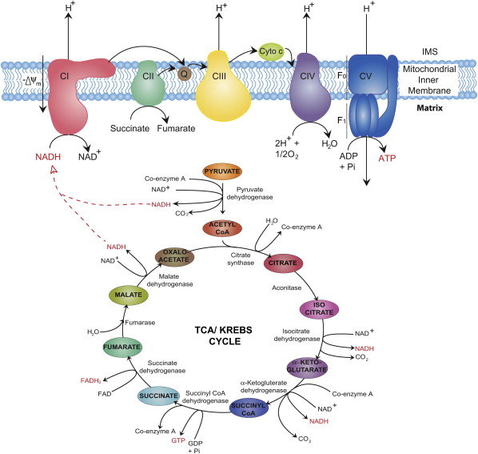
Figure from : Osellame, L, et al (2012) Best Pract. & Research Clin Endocrin. & Metab. 26:711-723
Notes:
The mitochondria house the major enzymatic systems used to complete the oxidation of sugars, fats and proteins to produce usable energy in the form of ATP. Each of these three substrates can be catabolised to acetyl-CoA, which then enters the first of these processes: the citric acid cycle, taking place in the mitochondrial matrix. Electrons harvested in the Kreb cycle are then transported to the electron transport chain, which consists of a series of multi subunit protein complexes embedded in the inner mitochondrial membrane. Here, the electrons removed from the citric acid cycle by NADH and FADH2 are used to power the pumping of protons from the matrix to the intermembrane space, generating a potential difference across the inner mitochondrial membrane. This potential difference is ultimately used to power the synthesis of ATP in the final step of oxidative phosphorylation. We will focus here on the details of the electron transport chain.
Cellular and molecular mechanisms of mitochondrial function. Available from: https://www.researchgate.net/publication/233737352_Cellular_and_molecular_mechanisms_of_mitochondrial_function [accessed Feb 08 2020].

Slide 3
Measuring Electron Reduction Potential
E₀’=standard reduction potential.
ΔGº' = -nF ΔE_{o}'
The relative tendency to accept e⁻s and become reduced.
Number of electrons transferred in the redox reaction
E_{o}'(acceptor) - E_{o}'(donor)
Faraday’s constant (96485 J/volt/mole)
If Δ E_{o}' is positive, an electron transfer reaction is spontaneous (ΔGº' <0)
Notes:
The electrons from our food molecules carry energy that drive the movement of protons across the inner mitochondrial membrane into the intermembrane space. This will form a gradient of protons that will be used to make ATP. The potential energy of the system can be calculated by the equation shown here where the free energy of the system is defined as negative nF delta E knot prime. n is the number of electrons transferred in the reaction, F is Faraday’s constant and the change in the standard reduction potential is made by subtracting the donor energy from the acceptor. If this difference is positive, then the free energy will be negative and the reaction will happen spontaneously (in this case, the protons will be pumped!)

Slide 4
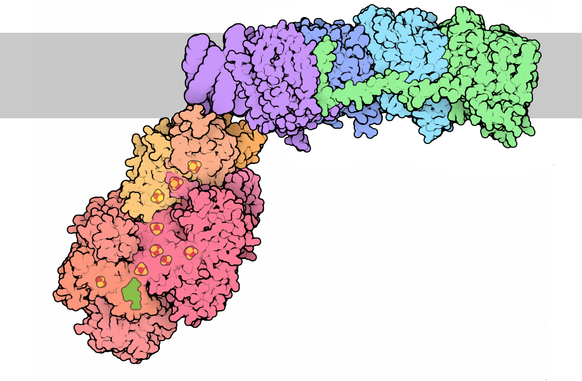
Complex I: NADH/Q Oxidoreductase
Intermembrane Space
Matrix
Image from : Goodsell, D. (2012) Molecule of the Month, Protein Database
Notes:
NADH brings free energy to the electron transport chain by binding to the largest of the respiratory complexes, the NADH-Q Oxidoreductase, or Complex I. This L-shaped enzyme contains a hydrophobic domain embedded in the inner mitochondrial membrane and a hydrophilic arm, protruding into the mitochondrial matrix, containing the NADH binding site. The whole complex consists of 45 subunits and is almost 1 MDa in mass.
The membrane-bound portion of complex I (shown here in green, blue and purple) pumps protons across a membrane. Each pair of electrons obtained from NADH will power the transport of 4 protons. Remarkably, the structure reveals that each of these protons is transported by a dedicated protein pump. Complex I has chain of transporters, all arranged in a row. The final transporter in the chain, colored green here, has a tail that reaches back and links all the transporters, and is thought to synchronize the electron transport reaction with the proton pumping cycle in all four transporters.
(PDF) Cellular and molecular mechanisms of mitochondrial function. Available from: https://www.researchgate.net/publication/233737352_Cellular_and_molecular_mechanisms_of_mitochondrial_function [accessed Feb 08 2020].

Slide 5
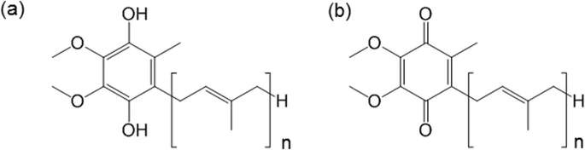
Coenzyme Q (Ubiquinone)
Coenzyme Q exists in a reduced and oxidized form
The hydrophobic chain (n) is usually 6 – 10 units in length
Notes:
Coenzyme Q (ubiquinones) are found in the cells of all aerobic organisms from the simplest bacteria to humans. They mediate important proton and electron transfer reactions in the mitochondria, chloroplasts, Golgi apparatus, endoplasmic reticulum and the plasma membrane of oxidative bacteria. Thus they are of key importance in producing energy during oxidative metabolism and photosynthesis. The electrons are ultimately used to reduce molecular oxygen to water releasing the energy necessary to sustain the life of the cell. Coenzyme Q exists in various reduced and oxidized forms that enable it to accept electrons from the NADH and FADH2 electron carriers generated in the Kreb Cycle. The most reduced and most oxidized forms are shown here. Notably, Coenzyme Q is predominantly a hydrophobic molecule and can travel inside the lipid portion of the inner mitochondrial membrane, enabling it to deliver electrons to the membrane protein pumps embedded there.

Slide 6
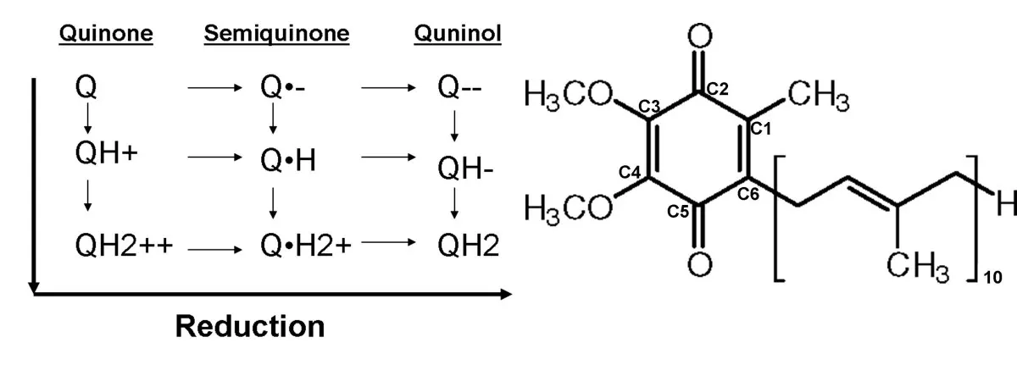
Coenzyme Q (Ubiquinone)
Can have 9 Redox States
Figure from Madeo, J., et al. (2013) Springer Plus 2: 139
Notes:
Quinones can accept a total of 2 protons and 2 electrons giving rise to 9 potential redox states. For example, you can have Coenzyme Q in the fully oxidized state, or it can pick up one proton or two protons, or one electron or two electrons, or one electron and one proton, etc. Due to this flexibility, this mechanism of electron transport has been highly exploited in biological systems.

Slide 7
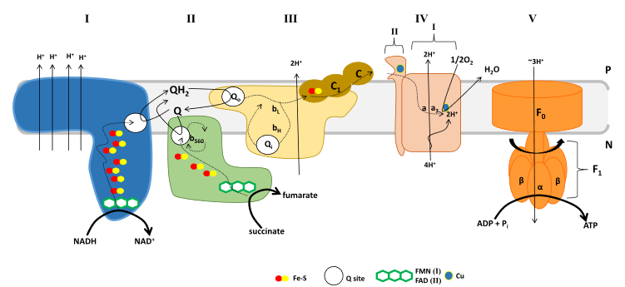







NADH/Q Oxidoreductase
Intermembrane Space
Large difference in E°′ between NADH and Q
Reduction of Q is spontaneous
energy used to pump protons across the innermembrane
Matrix
Figure modified from Mailloux, R.J. (2015) Redox Biology 4:381-389
Notes:
Oxidation of NADH by complex I yields NAD+ which returns to the Krebs cycle and two electrons which reduce FMN and are then systematically passed through 7–8 Fe-S clusters to the quinone binding site reducing Q to QH2. Due to the large difference in E°′ between NADH and Q, electron transfer induces changes in the membrane module of complex I resulting in the pumping of four protons into the intermembrane space.
Teaching the fundamentals of electron transfer reactions in mitochondria and the production and detection of reactive oxygen species. Available from: https://www.researchgate.net/publication/272373768_Teaching_the_fundamentals_of_electron_transfer_reactions_in_mitochondria_and_the_production_and_detection_of_reactive_oxygen_species [accessed Feb 08 2020].

Slide 8
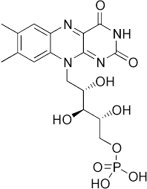
Flavin Mononucleotide (FMN)
Intermembrane Space
Matrix
Figure modified from Mailloux, R.J. (2015) Redox Biology 4:381-389
Notes:
As seen in the previous slide, proteins are amazingly large places for very small electrons and protons to be moved around. If you look at Complex I in the electron transport chain, the binding sites of NADH and Coenzyme Q are quite far apart. Thus, the electrons cannot be transferred directly between two molecules. Transfer of the electrons requires additional cofactors to pass the electrons through the protein to the correct location. FMN is related to FAD and can also serve as a prosthetic group that is able to transfer electrons and protons within a protein. Within Complex I, it is the first electron acceptor mediating the oxidation of NADH to NAD+.

Slide 9
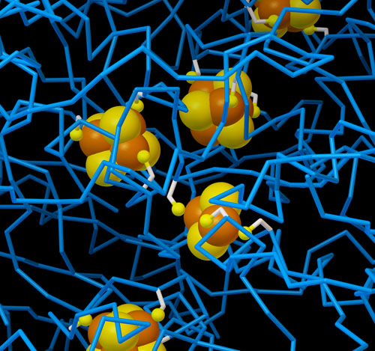
Iron-Sulfur Complexes
7 to 8 iron-sulfur complexes are present in Complex I
Image from : The Protein Data Bank. H.M. Berman, et al. (2000) Nucleic Acids Research, 28: 235-242 10.1093/nar/28.1.235
Notes:
Iron-sulfur clusters are also perfect for the task of transporting electrons and protons, since they form a unique delocalized system for storing electrons. Two types of clusters are particularly common: a square arrangement of two irons and two sulfurs, and a distorted cube composed of four irons and four sulfurs. Both are seen in the Complex I Protein, shown here

Slide 10
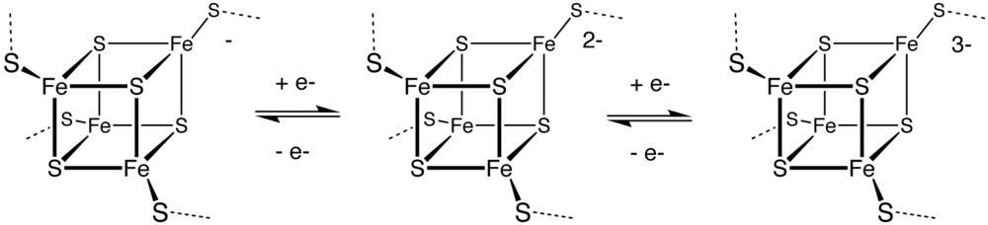
Distorted Cube form of Iron-Sulfur
Image from Wikiwand: Iron-Sulfur Potein
Notes:
Here is another diagram of the cube form of the iron-sulfur complex shown accepting either 1, 2, or 3 electrons.

Slide 11
Complex I: End Result for 1NADH
4 protons (H+) pumped into the intermembrane space
2 electrons and 2 protons transferred from NADH/H+ to Coenzyme Q (= 1 QH₂)
1 NADH recycled to NAD+ for use in Kreb cycle
Intermembrane Space
Matrix
Figure modified from Mailloux, R.J. (2015) Redox Biology 4:381-389
Notes:
In conclusion, the activity of Complex 1 elicited by 1 NADH molecule yields four protons pumped to the intermitochondrial space, the generation of 1 fully reduced Coenzyme Q molecule, and the recycling of reduced NADH to oxidized NAD+ for reuse in the Kreb Cycle.

Slide 12
Summary of the Electron Transport Chain
4 H⁺
4 H⁺
2 H⁺
10 H⁺
3 ADP
+Pi
3 ATP
From Kreb Cycle
Notes:
This is a cartoon summary of the entire electron transport chain. Complex I harvesting electrons derived from NADH of the Kreb Cycle to produce 1 molecule of Coenzyme Q and pump 4 protons across the membrane. Complex II harvests the electrons from the succinate dehydrogenase reaction of the Kreb cycle and feeds them through FADH2 and other iron-sulfur clusters to generate 1 molecule of Coenzyme Q. The molecules of Coenzyme Q are used to reduce Cytochrome C at Complex III through the Q-Cycle. Complex III also pumps 4 protons per NADH or FADH2. Cytochrome C then transfers electrons to Complex IV that reduces molecular oxygen to water and pumps 2 more protons to the intermembrane space fore each NADH or FADH2 molecules consumed.

Slide 13
Proton Load for NADH and FADH₂
Electrons from 1 NADH = 10 protons (H+) pumped
  10 protons = 3 ATP (inside the matrix of mitochondria)
Electrons from 1 FADH₂ = 6 protons (H+) pumped
  6 protons = ~1.8 ATP (inside the matrix of mitochondria)
Notes:
Overall for 1 NADH molecule, 10 protons are pumped across the membrane resulting in one turn of the ATP Synthase protein and the generation of 3 ATP molecules (that are located in the matrix of the mitochondria) We will see there is an energy costs to move the ATP to the cytoplasm where it can be used more efficiently to do work, such as muscle contraction. FADH2, on the other hand, bypasses Complex I and does not itself pump protons. Thus, it is worth less currency when it comes to the production of ATP. 1 FADH2 is not capable on its own to generate one turn of the ATP Synthase enzyme. Thus, in estimation, each FADH2 is worth approximately 1.8 ATP molecules (although you have to make them 3 at a time!). In the next lecture, we will explore the structure and activity of the ATP Synthase enzyme and see how ATP is transported into the cytosol.

