Slide 1
Reactive Oxygen Species
Production and Damage
Notes:
Welcome to lecture on Reactive Oxygen Species (ROS). Not to be confused with RUS’s…

Slide 2

Rodents of Unusual Size
Image from: Wikidot
Notes:
Rodents of unusual size

Slide 3
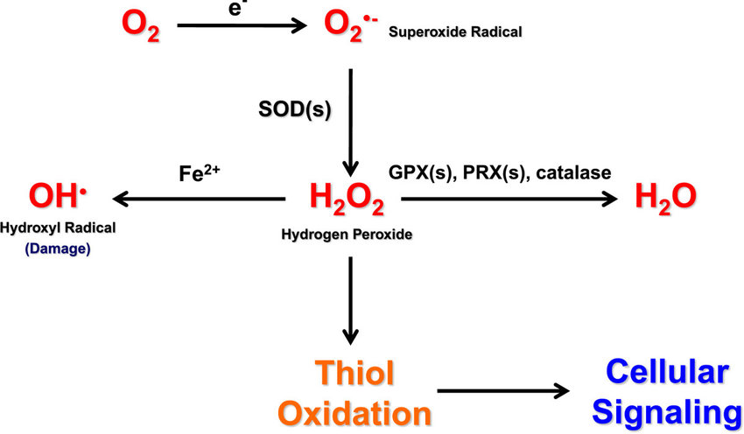
Figure from: Sullivan and Chandel (2014) Cancer and Metabolism 2:17
Notes:
In this lecture, we will look at the major sources for producing reactive oxygen species and the types of cellular damage that they can cause. ROS’s can be produced as one species and then interconverted by enzymatic reactions to other reactive products. One of the most damaging is the radical superoxide (O₂·⁻). Superoxide is formed from molecular O₂ by gaining a single electron from a NADPH oxidase (NOX) enzyme or from electron leak in the electron transport chain of the mitochondria. Superoxide dismutase (SOD) enzymes convert two superoxide molecules into a H₂O₂ and an oxygen (O₂) molecule. Hydrogen peroxide can undergo Fenton chemistry with Fe²⁺ to form a hydroxyl radical (HO·), which is extremely reactive and can cause cellular damage. Hydrogen peroxide can also modify redox-sensitive cysteine residues to change cellular signaling. Alternatively, hydrogen peroxide can be reduced to water by glutathione peroxidases (GPXs), peroxiredoxins (PRXs), or catalase.

Slide 4
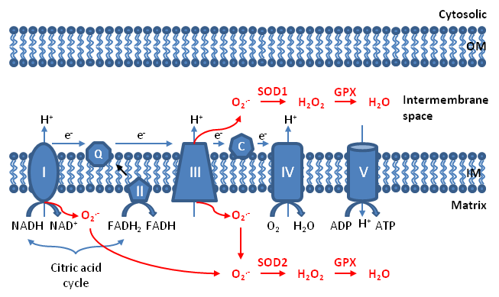
Generation of Superoxide during the ETC
Figure from Xinyuan Li
Notes:
Anytime proteins are transporting electrons through a system, especially with multiple transfers, there is some leakage from the system. Single electrons escaping from Complex I and Complex III of the Electron Transport Chain generate the superoxide radical.

Slide 5
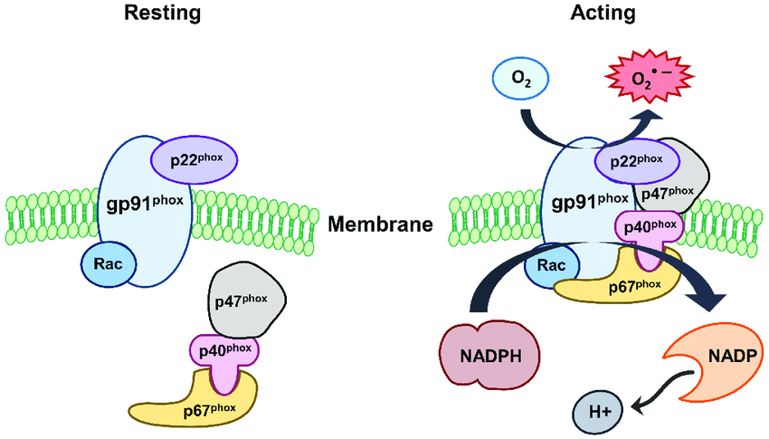
NADPH Oxidase (NOX)
Figure from Kim J.Y., et al, (2017) Experimental Neurobiology 26(4):195-205
Notes:
The NADPH Oxidase (NOX) comprises both cytosolic subunits (p47phox, p67 phox, and p40 phox) and membrane-bound subunits (gp91 phox, p22 phox and Rac). During activation of NOX, cytosolic subunits comprise a multi-component enzyme and migrate to the plasma membrane to dock with the membrane subunits. This multisubunit enzyme produces a superoxide anion (O₂ ●– ) the NOX-mediated release of reactive oxygen species (ROS), also called oxidative burst, leads to the elimination of invading microorganisms in macrophages and neutrophils and thereby serves as an inflammatory mediator.

Slide 6
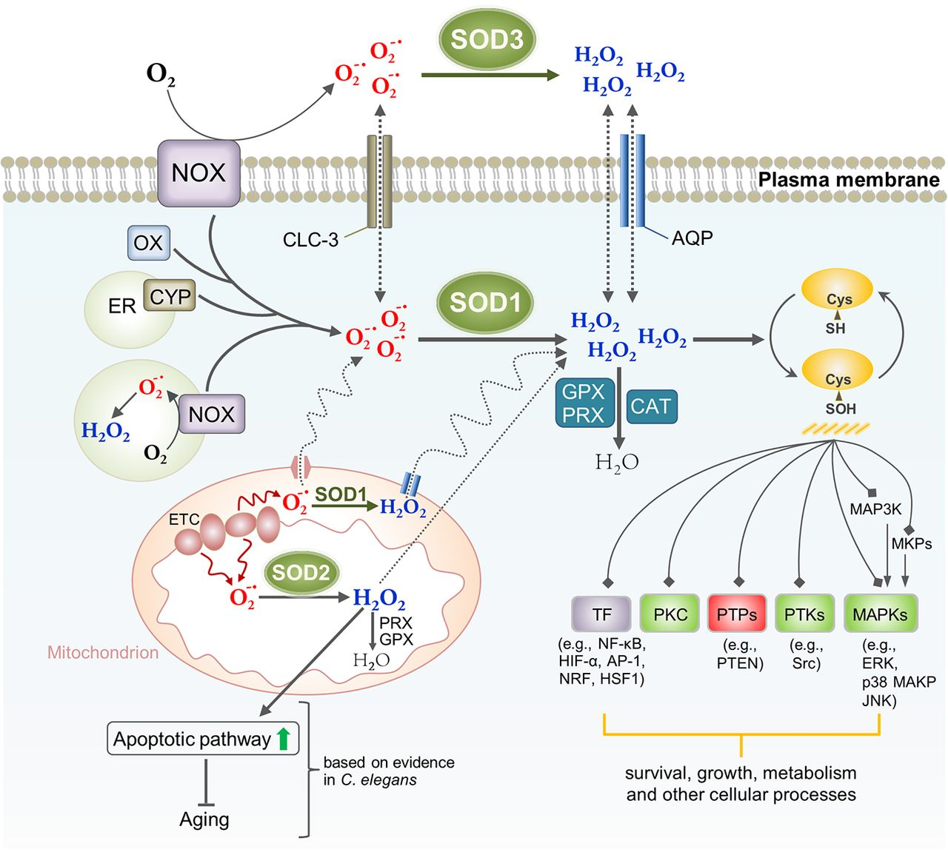
Super Oxide Dismutases
Figure from: Wang, Y., et al. (2018) J. Cell Biol 217(6):1915-1928
Notes:
Other enzymes also produce O₂^{•-}, including cytosolic xanthine oxidase (OX), the cytochrome P450-monooxygenases (CYP family proteins) in the ER, the mitochondrial ETC, and NADPH oxidase (NOX). The key enzyme class that is used to breakdown superoxide are the Superoxide Dismutase Enzymes (SOD). The SOD enzymes convert superoxide to hydrogen peroxide and a molecule of O₂. SOD1 is a cytosolic form of this enzyme, whereas SOD2 is mitochondrial, and SOD3 is extracellular. The peroxide produced in this process is also reactive and can cause damage to proteins, especially at Cysteine residues. Other enzymes such as catalase (CAT), peroxiredoxins (PRX), and glutathione peroxidase (GPX) can breakdown peroxide into water.

Slide 7
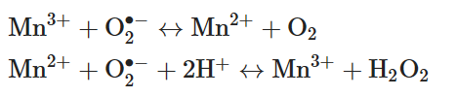
The Superoxide Dismutase Reaction
Cycle 1:
Cycle 2:
Notes:
Let’s take a closer look at the SOD enzyme reaction. Superoxide (O₂•⁻) is a potent oxidizing agent. Excessive amounts lead to a cascade of reactions causing damage to important biological macromolecules such as DNA, lipids, and proteins. Excess superoxide plays a role in the pathogenesis of many disease states including cancers, cardiovascular disorders, and neurodegenerative diseases. To protect cells from harmful amounts of superoxide, SODs convert two superoxide anions to oxygen and hydrogen peroxide using a cyclic reduction and oxidation reaction of the active site metal, which is often Mn. In the first half of the reaction Mn3+ is reduced to Mn2+ releasing a molecule of oxygen. The reduced Mn2+ is then utilized the second half of the cycle, where another superoxide molecule is reduced to hydrogen peroxide, restoring the Mn to the 3+ state. This redox shuffling of the active site metal to perform catalysis, is called dismutation, and is dependent on two protons per cycle.

Slide 8
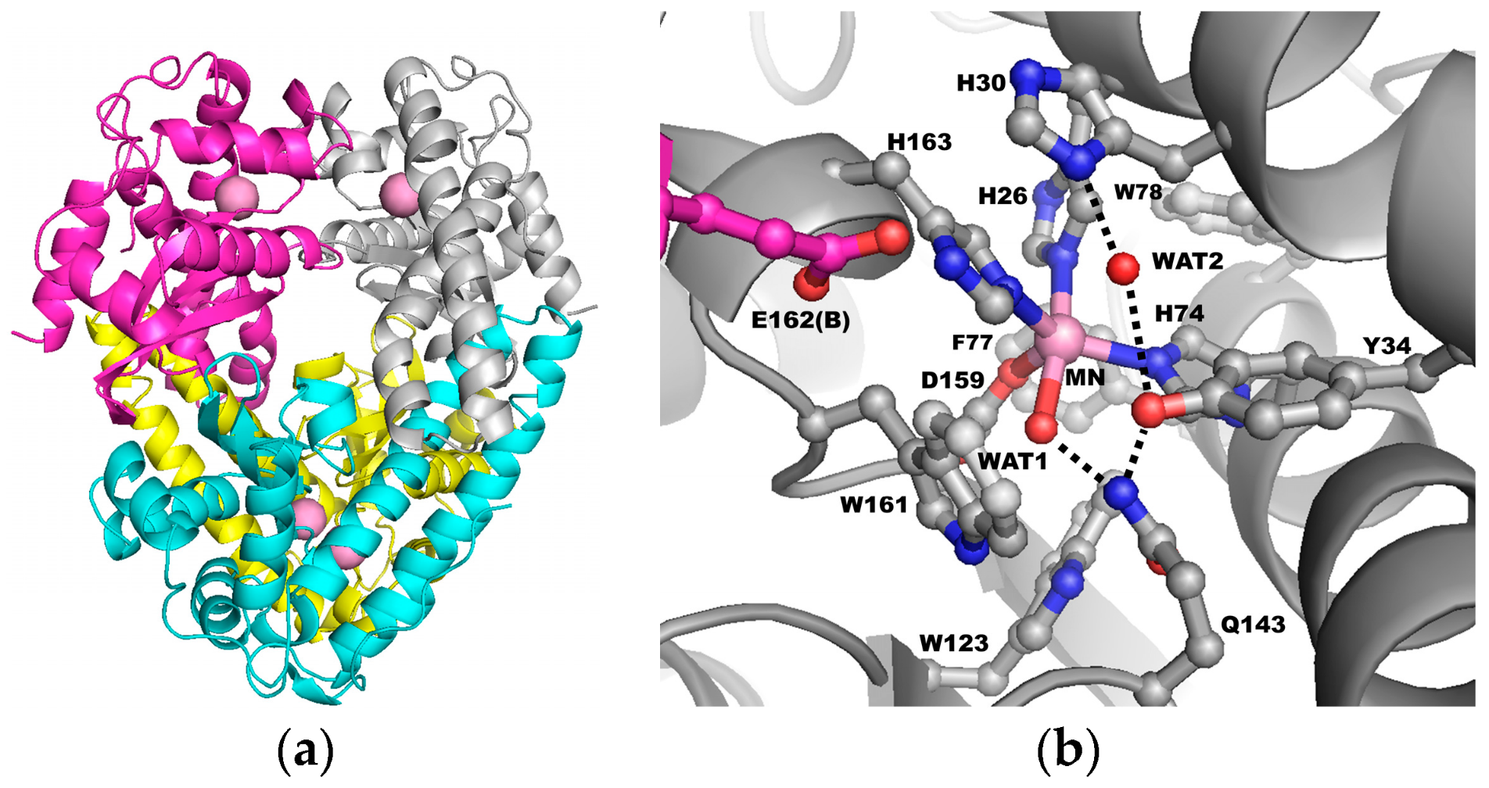
Superoxide Dismutase
Figure from:Azadmanesh, J. and Borgstahl, G.E.O. (2018) Antioxidants 7(2):10.3390/antiox7020025
Notes:
The human SOD enzyme is a tetramer where each subunit (a) contains a manganese ion at the catalytic center, indicated by pink spheres. In the active site (b) the red spheres denote oxygen atoms, blue denotes nitrogen atoms, grey denotes carbon atoms from one subunit of the tetramer, and magenta denotes carbon atoms from the adjacent subunit. The dashed lines represent the hydrogen bond network hypothesized to be the proton relay to the manganese ion used for catalysis.

Slide 9
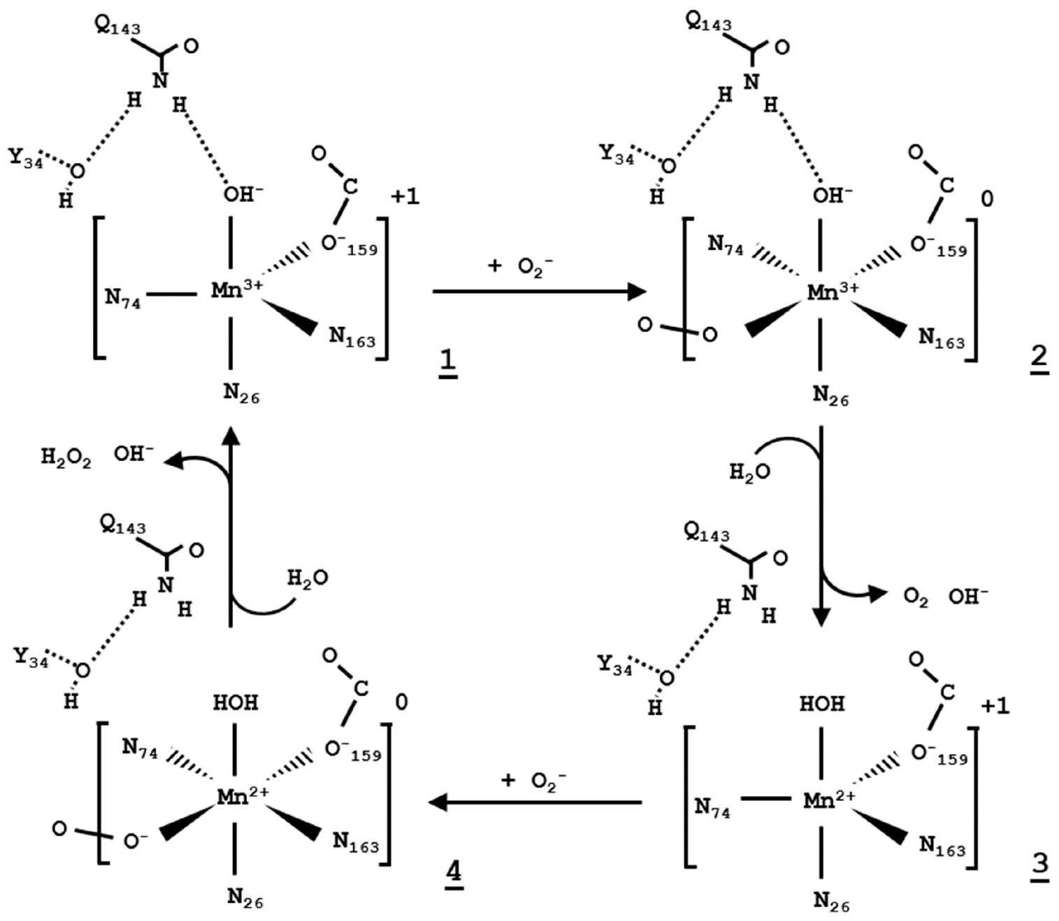
SOD reaction mechanism
Figure from:Azadmanesh, J. and Borgstahl, G.E.O. (2018) Antioxidants 7(2):10.3390/antiox7020025
Notes:
This schematic shows the cyclic Mn reduction and then oxidation to produce O2 and H2O2. In step 1, a superoxide molecule associates with the oxidized form of the SOD cofactor, Mn3+. The electron reduces the active site Mn from Mn3+ to Mn2+, and O2 is released from the enzyme. A second superoxide molecule associates with the active site Mn2+. The Mn2+ electron reduces the superoxide. This reaction is dependent on the incorporation of two protons derived from water to form the hydrogen peroxide molecule. The enzyme is then reset and ready to begin another round of dismutation.

