Slide 1
Lipids
Phospholipids and Sphingolipids
Notes:
Welcome to our lecture series on Lipids. Here we will learn about phospholipids and sphingolipids and their properties within the lipid bilayer.

Slide 2
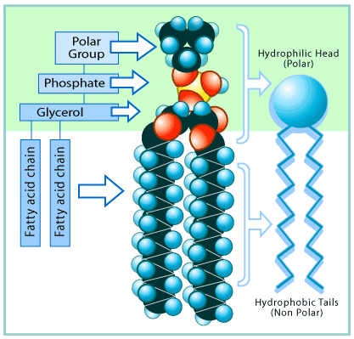
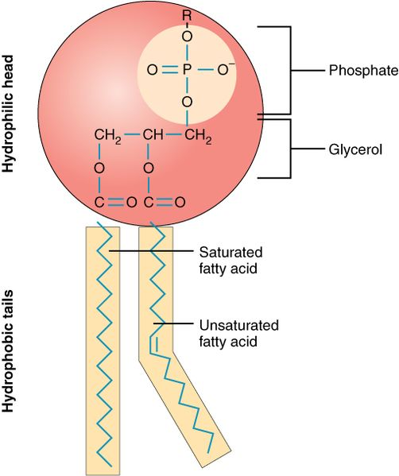
Phospholipid Structure
Figure from: OpenStax Anatomy and Physiology
Figure from: School of Biomedical Sciences Wiki
Notes:
The most common constituent of any lipid bilayer making up a cell membrane is the phospholipid. The base structure of a phospholipid is similar to that of a triacylglyceride, however, one of the glycerol positions is modified as a phosphoester, instead of an ester with a fatty acid component. Thus, there are only two fatty acids incorporated into the phospholipid structure. The phosphate functional group is then further modified by the addition of other functional groups that are shown in more detail on the next slide. All phospholipids are amphipathic. They have a polar head and two nonpolar hydrocarbon tails. Of the fatty acids incorporated into the phospholipid structure, one is usually saturated and the other unsaturated. Unsaturated fatty acids result in kinks in the hydrophobic tails. This moderates the melting temperature of the lipid bilayer and creates a structure that allows fluid movement of molecules laterally through the lipid bilayer.

Slide 3
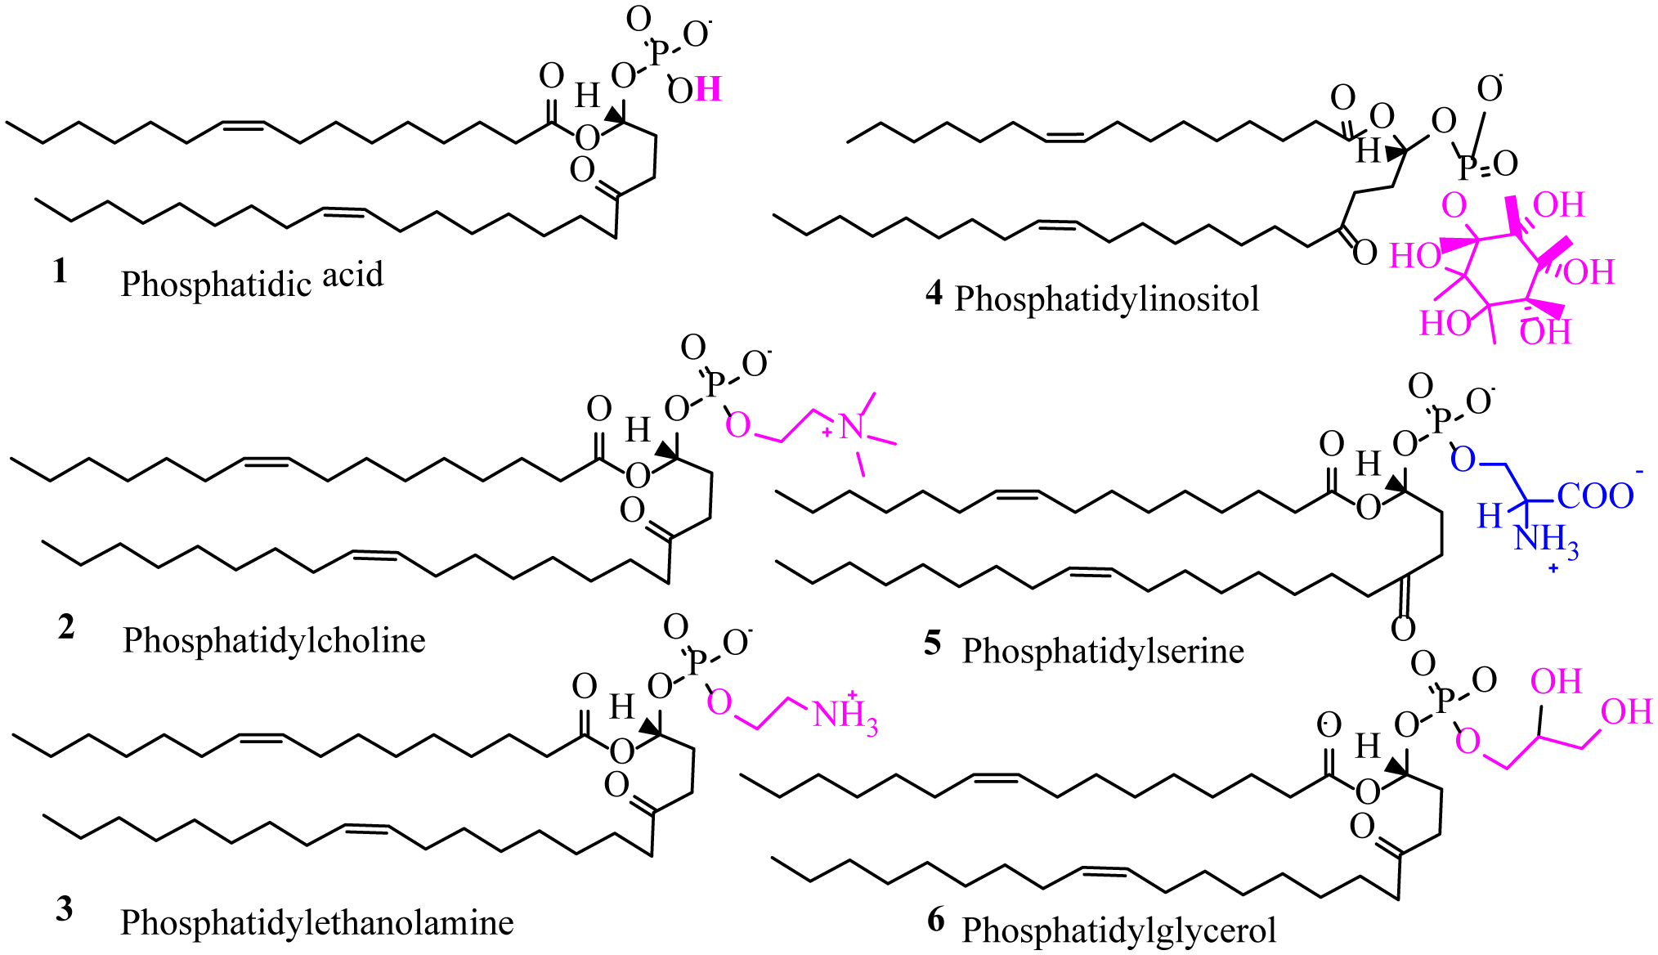
Typical Phospholipids in the PM
Figure from: Alagumuthu, M., et al (2019) AIMS Molecular Science 6(1):1-19
Notes:
Phospholipids have head groups connected to the backbone through phosphodiester bond. Phosphatidyl ethanolamine (PE), phosphatidylinositol (PI), phosphatidylcholine (PC), and phosphatidylserine (PS) are dominant phospholipids in the cell membrane. Notice that the polar head groups can have quite a variety and introduce unique structures and charges into the region of the plasma membrane in which they are found.

Slide 4
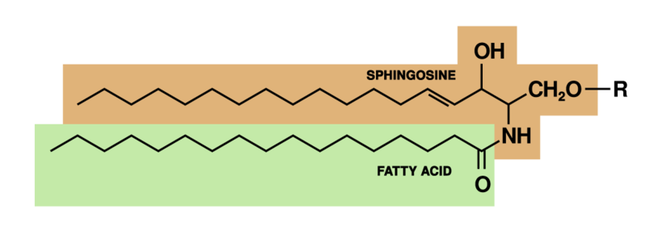
Sphingosine Based-Lipids
Figure from: OpenStax Anatomy and Physiology
Notes:
In addition to glycerol, sphingosine can also be used as a backbone to create amphipathic lipids that are incorporated into the lipid bilayer. Sphingosine has a polar head group and one long hydrocarbon chain that extends into the hydrophobic region of the plasma membrane, similar to the fatty acid hydrocarbon chains of phospholipids. A fatty acid is also incorporated into the structure through an amide linkage. Variations to the polar head group can be made at the indicated R-group with examples shown in the next two slides. Most sphingosine lipids are incorporated into the lipid bilayer, and are often conjugated to carbohydrates and are commonly found in localized regions of the plasma membrane known as lipid rafts. They can play a role in signal transduction cascades and have been shown to influence processes such as cell division, endocytosis/exocytosis, cell-cell interactions and adhesion. Sphingolipids are also required to maintain the barrier functions of the skin.

Slide 5
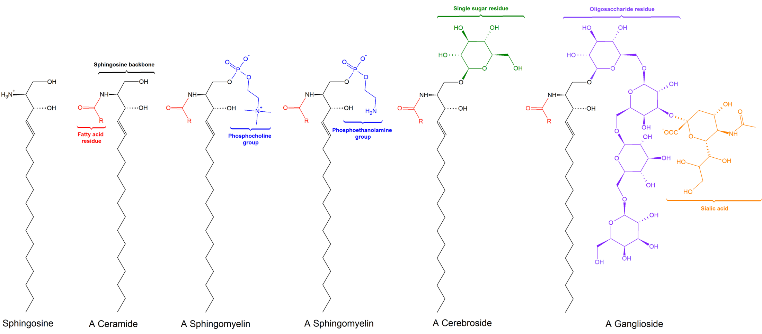
Sphingolipids
Figure modified from: LHcheM
Notes:
Sphingosine is converted to a ceramide by the addition of a fatty acid residue at the amine functional group. Note that the fatty acid tail is indicated as R here and not drawn out. Usually the fatty acids are 12 – 18 carbons in length. Sphingosine and ceramide are the simplest sphingosine-derived lipids that are incorporated into the plasma membrane. Sphingolipids can be further modified to phospholipids by the addition of phosphocholine and phosphoethanolamine groups. Phosphorylated sphingosine derivatives are called sphingomyelin. Sphingolipids are found in all cells of the body but are highly enriched in the nervous system and are required for proper brain development.

Slide 6
Sphingolipids
Figure modified from: LHcheM
Notes:
Sphingolipids are also commonly modified with polar carbohydrate headgroups forming cerebrosides and gangliosides. The grey matter and neurons within the central nervous system have high levels of gangliosides, whereas sphingomyelin and galactosylceramide are more common in oligodendrocytes (cells that support neuronal function and myelin formation).

Slide 7
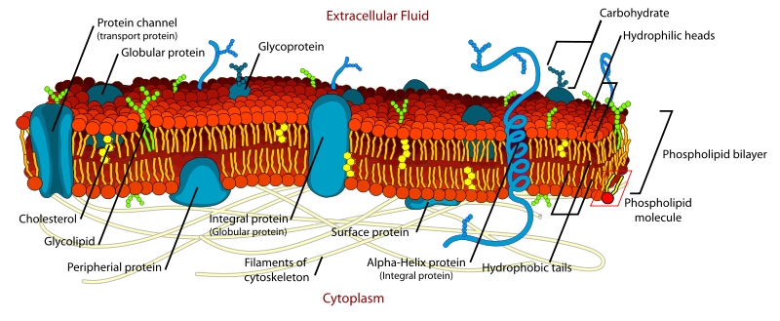
Phospholipid Bilayer
Figure from: Mariana Ruiz edited by Alokprasad84
Notes:
Within the lipid bilayer, the phospholipids are arranged such that their hydrocarbon fatty acid tails extend into the center creating a hydrophobic barrier. The polar phosphate-containing head groups are faced towards the outside, and the inside of the cell and interact with water-filled environments in these locations. Proteins associated with the plasma membrane can be integral and pass fully through the plasma membrane or they can be peripheral and only align on the cytoplasmic or extracellular sides of the membrane. Cholesterol is also part of the plasmsa membrane and we will talk about its role in a later lecture. Proteins and lipids contained within the membrane can move laterally through the bilayer, as if they are in a swimming pool of lipids. However, these molecules cannot readily flip transversely through the membrane, as the hydrophilic portions of the molecules would have to pass through the hydrophobic interior of the lipid bilayer. Proteins called flippases are required to flip molecules transversely within the membrane. Due to the enzymatic requirement of protein and lipid flipping, the plasma membrane is asymmetric in nature.

Slide 8
Peripheral Proteins
Mechanisms used to associate with the lipid bilayer
  Prenylation
  Palmitoylation
  Myristoylation
  Glycophosphatidylinositol Anchor
Notes:
Peripheral membrane proteins interact and attach to the plasma membrane through unique processes. Many of these involve the post-translational modification of the protein with hydrophobic, lipid components that will promote the formation of intermolecular forces within molecules in the plasma membrane. These include the processes of prenylation, Palmitoylation, and Myristoylation. In other processes, such as glycophosphatidylinositol anchor reactions, the protein of interest is covalently linked to the plasma membrane. We will take a look at these processes in a little more detail in the following slides.

Slide 9
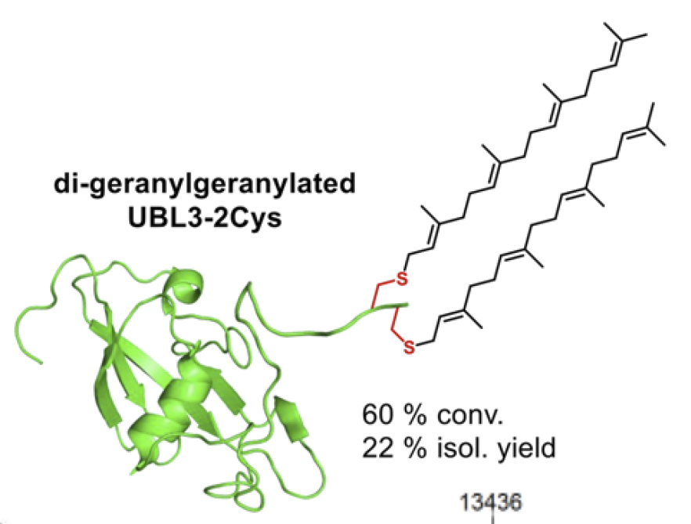
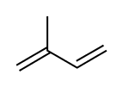
Prenylation
Ubiquitin Protein
Synthetically modified by prenylation
Isoprene Unit
Figure modified from: Schlatzer, T., et al. (2019) JACS 141:14931-14937
Notes:
Prenylated proteins are proteins with covalently attached hydrophobic isoprene polymers (i.e. branched five-carbon hydrocarbon) at cysteine residues of the protein. More specifically, these isoprenoid groups, usually farnesyl (15-carbon) and geranylgeranyl (20-carbon) are attached to the protein at cysteine residues near the C terminal of the protein. The prenylation of lipid chains to proteins facilitate their interaction with the cell membrane, as the lipid chains can be inserted into the hydrophobic core of the lipid bilayer. Note the isoprene building block that is used to create these hydrophobic polymers. We will revisit this structure again when we consider the synthesis of lipids from the steroid class.
Text from: Wikipedia contributors. (2019, December 14). Lipid-anchored protein. In Wikipedia, The Free Encyclopedia. Retrieved 06:04, February 28, 2020, from https://en.wikipedia.org/w/index.php?title=Lipid-anchored_protein&oldid=930735315

Slide 10
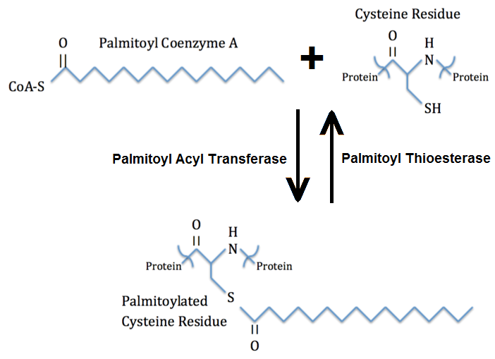
Palmitoylation
Figure from: Sivart13
Notes:
Fatty acids can also be incorporated into protein structures, either on Cys residues (as is the case in palmitoylation shown here) or using the N-terminal amine functional groups (as in the case of myristoylation shown on the next slide)

Slide 11
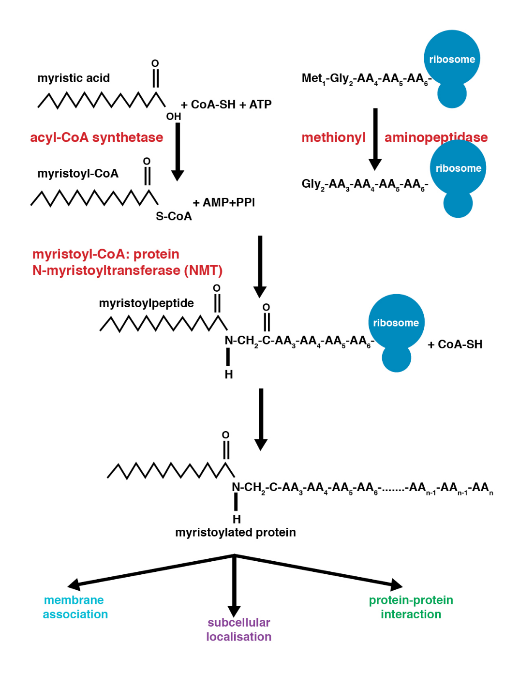
Myristoylation
Figure from: Lengkr
Notes:
The myristoylation pathway adds myristic acid to the N-terminal glycine amino group of nascently translated proteins. Since the start codon for protein translation is typically Met, this first residue must be removed by a methionyl aminopeptidase prior to myristoylation. The target protein is required to have a glycine in the second amino acid position as a target sequence for this process. Myristic acid is then first converted to Myristoyl-CoA as the thioester provides a better leaving group during the formation of the amide linkage.

Slide 12
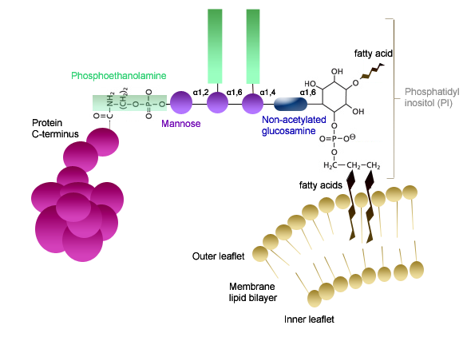
Glycophosphatidylinositol Anchor
Figure from: Nadia Skauli
Notes:
During this process, a glycophosphatidylinositol functional group is covalently linked with a protein as part of a post-translational modification to the c-terminal carboxylic acid through an amide linkage with the ethanolamine portion of the molecule. This is then used as a bridge to dock the protein covalently with a phosphatidyl inositol, phospholipid bound in the plasma membrane. This forms an anchor point for the protein docking it with the plasma membrane.

Slide 13
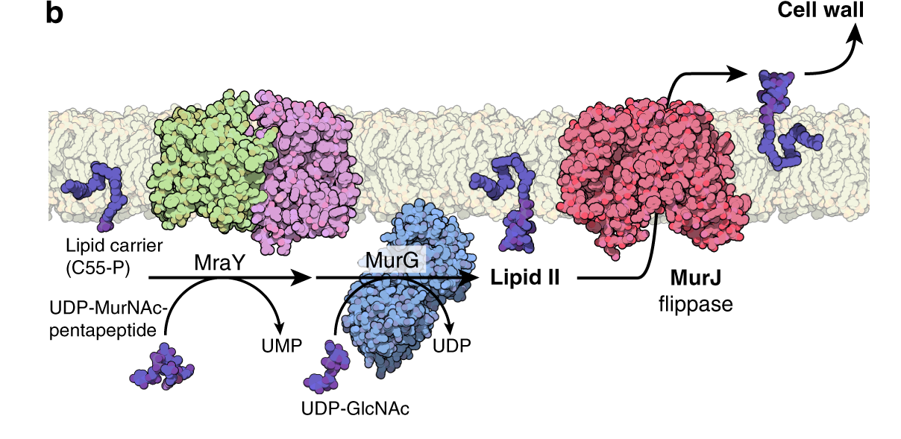
Bacterial Flippase MurJ
Figure from: Alvin, C., et al. (2019) Nature Communications 10: 1736
Notes:
In the previous slide, we mentioned that there is a lot of lateral movement that goes on within the plasma membrane, but that transverse movement or flipping is much more prohibitive due to the need to move the positively charged portions of the molecule through the hydrophobic core of the lipid bilayer during the process. Bacteria provide a useful model for lipid flipping. Bacteria produce a cell wall component outside of their lipid bilayer structure that is composed of small protein units linked with carbohydrate structures and is called the peptidoglycan layer. Flippase enzymes are required to transport the peptidoglycan components from the inside of the cell, across the lipid bilayer, where they can be polymerized into the peptidoglycan cell wall structure. The UDP-activated peptidoglycan moiety (MurNAc-pentapeptide) is covalently linked to a a lipid carrier molecule (C55-P) by the MraY and MurG enzymes to form Lipid II. The cytoplasmic-facing Lipid II is flipped to the periplasmic side of the membrane by a Lipid II flippase (MurJ), after which the GlcNAc-MurNAc-pentapeptide moiety is released and incorporated into the peptidoglycan layer. The lipid carrier is flipped back to the cytoplasmic side and recycled. In addition to mediating the transport of molecules from one side of the membrane to the other, flippase enzymes can introduce variations in the types of lipids that are found on the inside of the lipid bilayer vs. the lipids facing the extracellular matrix. This gives the plasma membrane an asymmetric character that is important for proper cellular functioning.

Slide 14
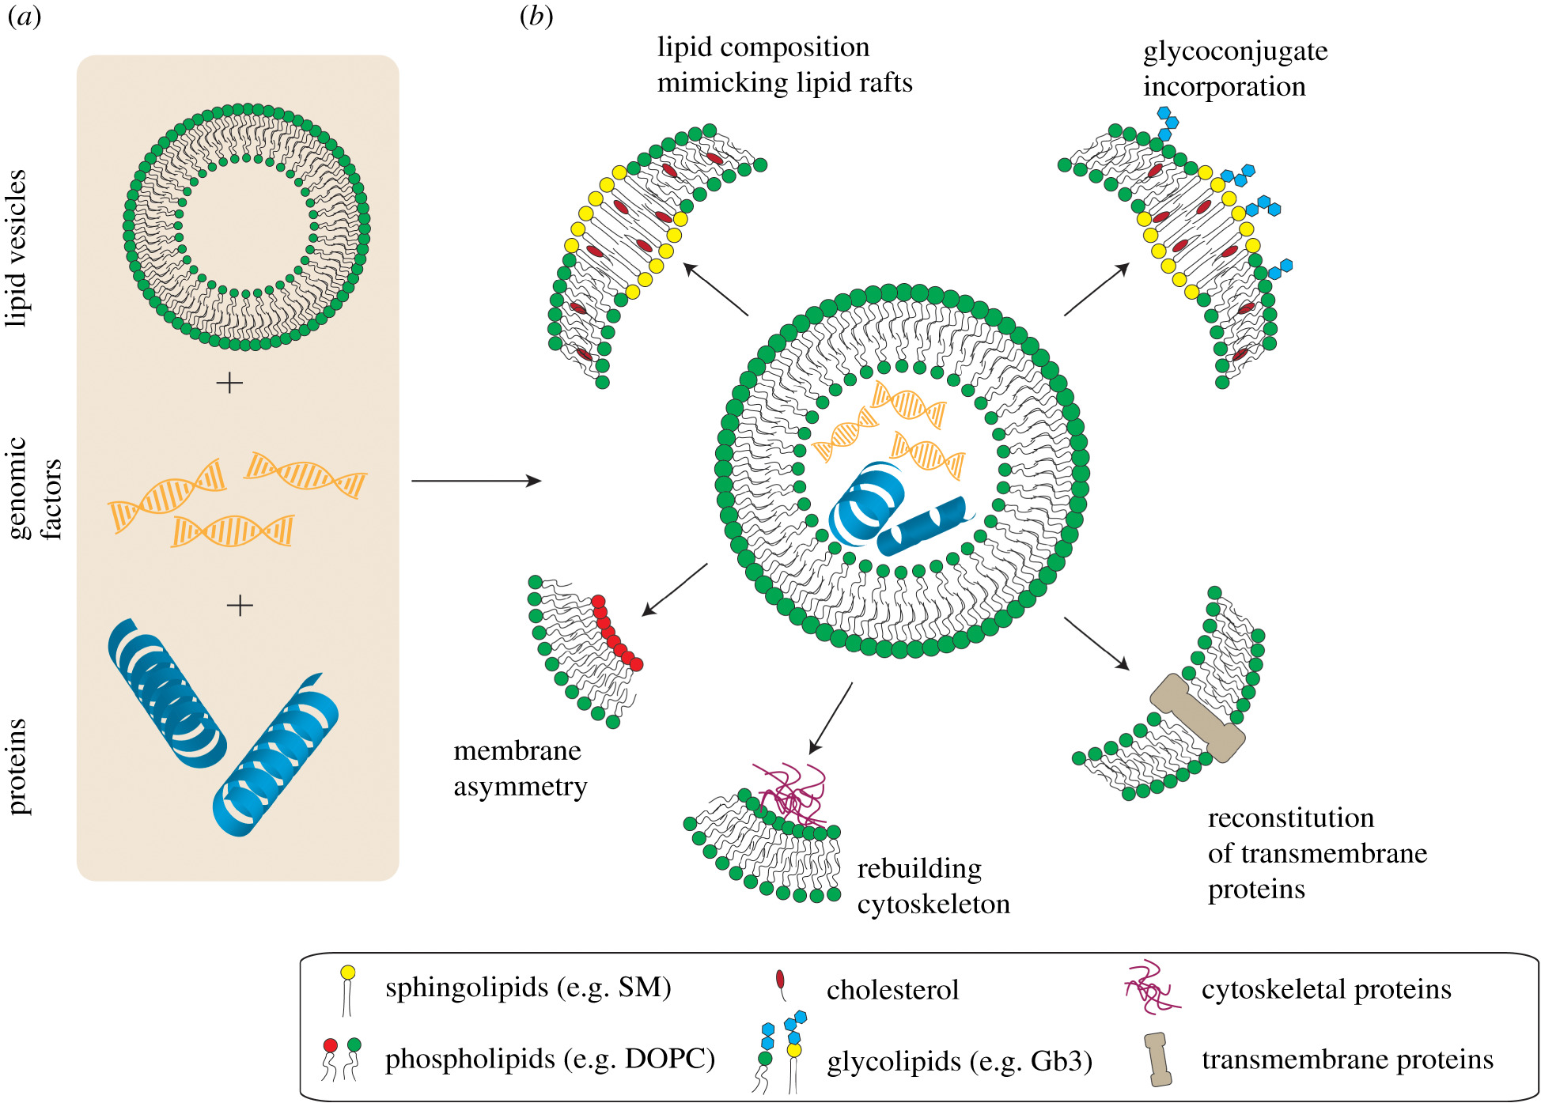
Membrane Asymmetry
Figure from: Omidvar, R., and Romer, W. (2019) Interface Focus 10.1098
Notes:
Due to the fluid and asymmetric nature of the plasma membrane, different regions of the plasma membrane can accumulate differential protein and lipid concentrations. This gives rise to unique sub-structures within the plasma membrane such as lipid rafts. Lipid rafts have higher concentrations of glycosphingolipids and cholesterol than in other regions and are distinguished by the types of proteins that cluster together. Other regions of the plasma membrane may be marked by higher lipid asymmetry, connections with intracellular cytoskeletal components or transport proteins.

Slide 15
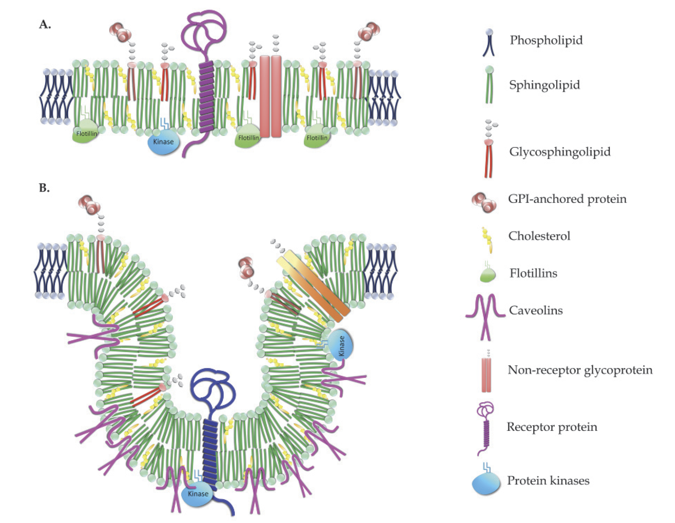
Lipid Rafts and Disease
Figure from: Babina, I., et al (2011) From Breast Cancer – Carcinogenesis, Cell Growth and Signaling, DOI 10.5772/21324
Notes:
Depending on the types of lipids and proteins associated within a lipid raft region, they can take on unique characteristics. An example of this is the sub-population of lipid rafts characterized by flask-shaped membrane invaginations termed caveolae, or ‘little caves’ shown here in (B). Lipid rafts and caveolae have different proteins associated with them, but their lipid compositions are very similar. Interestingly, raft-enriched lipids preferentially localize to the outer leaflet of the membrane. The Caveolae are characterized by association with peripheral membrane proteins called Caveolins that are localized on the cytoplasmic side of the lipid bilayer. Lipid rafts are starting to be identified as features that are altered during disease progression. For example, lipid rafts appear to play a role in the development of chemoresistance in tumors that have been treated by chemotherapy, leading to increased export of the drug from the tumor cell and less overall sensitivity of the tumor to treatment.

Slide 16
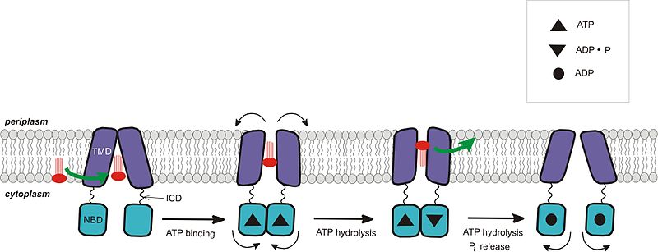
ABC Transporters
Figure from: Star Gonzales
Notes:
ATP Binding Cassette (ABC) Transporter proteins are a superfamily of proteins that are involved in the transport of molecules either into or out of the cell (importers or exporters, depending on the type). During the export process, shown in this diagram, A molecule specific for the transporter binds in the active site on the cytoplasmic side of the membrane. ATP then binds, causing a the conformation change in the protein such that the protein opens outwardly facing the extracellular matrix. Hydrolysis of ATP causes the release of the drug into the extracellular space, and release of the Pi group returns the ABC Transporter to the inward facing conformation. Of note, tumors that have been treated with chemotherapeutic agents often increase the expression of ABC transporters that are involved with the export of drug molecules out of the cell. This provides the tumor cells with resistance to the chemotherapeutic agents, making the cancer more difficult to treat. Within these systems the ABC transporters often assemble into the lipid raft regions within the plasma membrane.

Slide 17
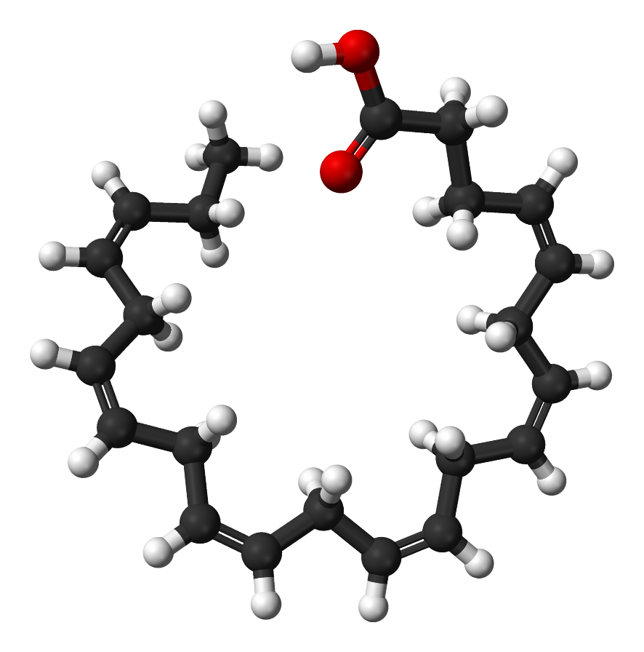
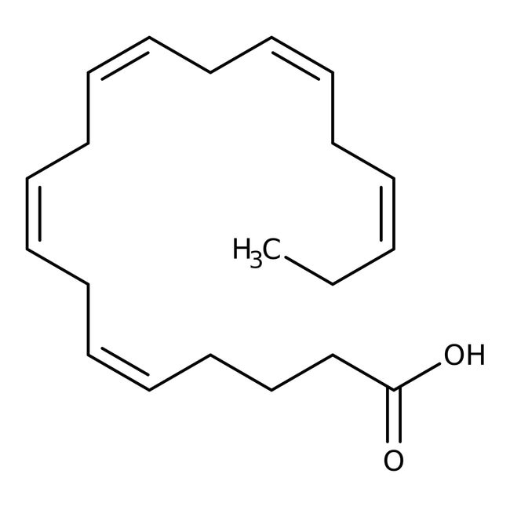
Lipid Rafts, Tumor Resistance to Chemotherapy, and ω-3 fatty acids
EPA
DHA
Figure from: Ben Mills
Notes:
In vivo and in vitro studies indicate that ω-3 long chain polyunsaturated fatty acids (LCPUFAs) [such as eicosapentaenoic acid (EPA) and docosahexaenoic acid (DHA) found in cold wáter fish] enhance the sensitivity of cancer cells to chemotherapy.

Slide 18
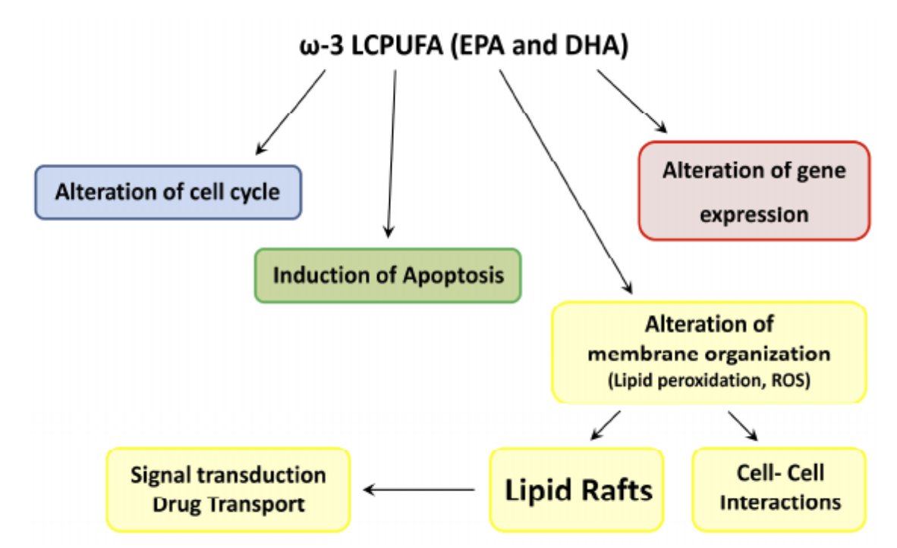
Lipid Rafts, Tumor Resistance to Chemotherapy, and ω-3 fatty acids
Figure from: Corsetto, P., et al. (2017) International Journal of Molecule Sciences 18(12):2770
Notes:
The effects of the ω-3 LCPUFAs in reducing the development of tumor resistance to chemotherapy is likely caused by pleiotropic effects in the body. LCPUFAs have been demonstrated to alter cell cycle control, gene expression patterns and sensitivity to apoptosis. LCPUFAs have also been shown to alter the organization of the plasma membrane affecting lipid raft assembly and cell-cell interactions. We will focus on their role in lipid raft formation .

Slide 19
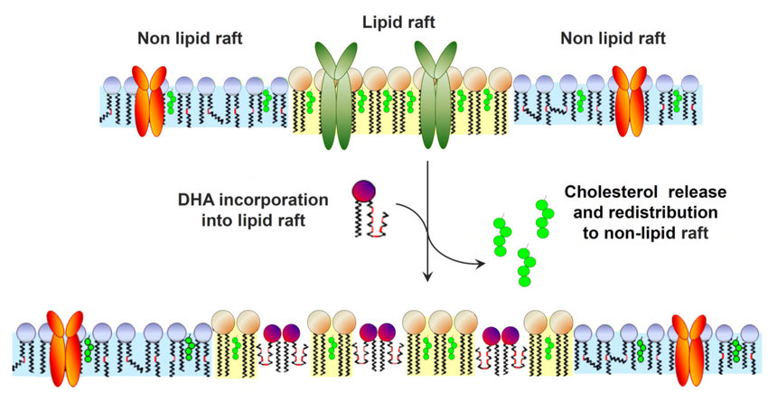
Lipid Rafts, Tumor Resistance to Chemotherapy, and ω-3 fatty acids
Figure from: Corsetto, P., et al. (2017) International Journal of Molecule Sciences 18(12):2770
Notes:
In the upper diagram, the outer leaflet of the plasma membrane is shown, indicating the formation of the lipid raft containing ABC transporter proteins involved in chemotherapy drug resistance, as well as other proteins regulating oncogenic and apoptotic signaling pathways. Increased consumption of ω-3 LCPUFAs, causes these fatty acids to be incorporated into phospholipid and sphingolipid macromolecule structures. Once incorporated into the plasma membrane the ω-3 LCPUFAs incorporate into lipid raft regions and cause the release and redistribution of cholesterol from the lipid raft region. The presence of the ω-3 LCPUFAs in the membrane have a de-clustering effect on the raft leading to higher flexibility within the region. This is correlated with increased sensitivity of tumor cells to chemotherapeutic agents, possibly by increasing the sensitivity of cells to apoptosis or by decreasing drug efflux through ABC transporter proteins. This is just one example of how diet and on a larger scale our environment and exposures can alter cellular processes occurring within the body. 010

