Slide 1
Lipids
Beta Oxidation of Unsaturated Fatty Acids
Notes:
Welcome to our lecture series on Lipids. Here we will learn about the beta oxidation of unsaturated fatty acids.

Slide 2
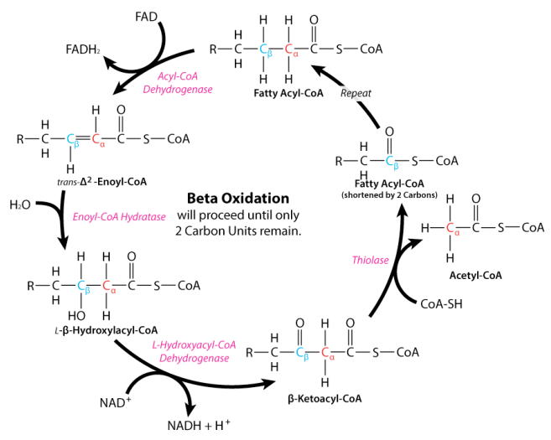
Overview of β-Oxidation
Notes:
In the previous lecture, we discussed the standard beta oxidation pathway for saturated fats. This consists of four enzymatic steps that first create a trans double bond between the alpha and beta carbon positions. This generates one molecule of FADH2. The second reaction is an addition of water across the double bond to form the beta hydroxy intermediate. The second oxidation converts the alcohol to the ketone creating beta-ketoacyl-coA and one molecule of NADH. The thiolase cleaves the C-C bond between the alpha and beta position, creating a molecule of Acetyl-CoA and a Fatty-Acyl-CoA two carbons shorter.

Slide 3
What about Unsaturated Fats?
6
6
α
α
5
4
2
5
2
1
4
3
1
3
β
β
ODD Cis Double Bonds
EVEN Cis Double Bonds
Notes:
So what happens when you have unsaturated fatty acids? How do the double bonds affect beta oxidation? There can be two possible scenarios. One where the cis double bond starts at an odd numbered carbon or one that starts between an even numbered carbon. If it is odd, the beta oxidation rounds will continue until the bond is between carbon 3 and 4, and then it must deal with the double bond before completing the oxidation process. For even bonds, the double bond moves down until it is between carbon 4 and 5. Let’s take a look at the odd situation first.

Slide 4
ODD Double Bonds
6
α
5
2
4
3
1
β
ODD Cis Double Bond
Notes:
You just need one additional enzyme to deal with an unsaturated fatty acid with the double bond in the odd position. As the fatty acid undergoes beta-oxidation, the double bond will move closer to the thioester end of the molecule until it is positioned between carbons 3 and 4. When it reaches this state, the Acyl-CoA Dehydrogenase will no longer recognize this as a substrate and will be unable to create the double bond between the 2 and 3 position. Instead, an isomerase enzyme is required to shift the cis-3-4 double bond into a trans-2-3 double bond.

Slide 5
ODD Double Bonds
6
α
5
2
4
3
1
β
Cis-Δ³ Enoyl-CoA
Cis-Δ³ Enoyl-CoA
Isomerase
α
6
4
2
5
3
1
β
Trans-Δ² Enoyl-CoA
Notes:
The isomerase enzyme is called cis-delta-3 enoyl-CoA Isomerase, named for the substrate that it recognizes. This isomerase converts the cis delta 3 double bond to the trans delta 2 double bond. This IS the exact same product as the normal beta oxidation reaction after step 1 with the Acyl-CoA Dehydrogenase enzyme. Thus, this reaction intermediate skips the first reaction in the beta oxidation cascade, but can then pick up with the second reaction in the beta oxidation pathway. Since the first reaction is skipped, it will NOT produce the FADH₂. It will only produce 1 molecule of NADH during this round of the beta oxidation pathway.

Slide 6
What about Unsaturated Fats?
6
α
5
4
2
3
1
β
EVEN Cis Double Bond
Notes:
With the even cis double bonds, two enzymatic steps are required.

Slide 7
What about Unsaturated Fats?
6
α
6
α
5
4
2
5
4
2
3
1
3
1
β
β
FAD
Δ^{2,4} Dienoyl-CoA
Acyl-CoA
Dehydrogenase
NADPH
+ H⁺
FADH₂
2,4 – Dienoyl-CoA
Reductase
NADP⁺
6
α
5
4
2
α
3
1
4
2
5
3
1
β
β
6
Δ^{2,4} Dienoyl-CoA
Trans-Δ³ Enoyl-CoA
Notes:
When the cis double bond reaches the 4-5 position, it still does not hinder the action of the first enzyme in the beta oxidation pathway. The acyl-CoA dehydrogenase enzyme still recognizes this substrate and generates a trans double bond between the alpha and beta carbon positions. However, the hydratase in the second step cannot recognize the dienoyl intermediate that is created. This is where the 2,4-Dienoyl-CoA Reductase does its work! This reduction adds two electrons and two protons to the molecule to remove the two double bonds and replace them with one trans double bond between carbons 3 and 4. With the diene, one hydrogen and one electron are added at the alpha carbon position, and one hydrogen/electron are added to the carbon 5 position. An electron from the 3 carbon and from the 4 carbon each fold inward and create the new double bond between the 3 and 4 carbons.

Slide 8
α
6
α
4
2
5
2
5
3
1
4
3
1
6
β
β
Trans-Δ³ Enoyl-CoA
Cis-Δ³ Enoyl-CoA
Cis-Δ³ Enoyl-CoA
Isomerase
α
6
4
2
5
3
1
β
Trans-Δ² Enoyl-CoA
Notes:
This intermediate is very similar to the situation that we just looked at with the Cis double bond between carbons 3 and 4 of the fatty acid. However, this bond is in the trans conformation. Fortunately, the Enoyl-CoA Isomerase can recognize both of these isomers and convert both the cis and the trans double bonds to the 2-3 carbon position. From here it can enter back into the beta oxidation pathway.

Slide 9
What about Unsaturated Fats?
6
α
6
α
5
4
2
5
4
2
3
1
3
1
β
β
FAD
Δ^{2,4} Dienoyl-CoA
Acyl-CoA
Dehydrogenase
NADPH
+ H⁺
FADH₂
2,4 – Dienoyl-CoA
Reductase
NADP⁺
6
α
5
4
2
α
3
1
4
2
5
3
1
β
β
6
Δ^{2,4} Dienoyl-CoA
Trans-Δ³ Enoyl-CoA
Notes:
Do note that even though one FADH2 molecule is produced in the first step, that the Dienoyl-CoA reductase enzyme requires the use of an electron carrier molecule in the second reaction to perform the reduction. Thus, these two steps cancel eachother out and there is no net gain of electron carrier molecules from these steps. Thus, just as we saw with the odd cis double bonds, we lose making one FADH2 molecule in that beta oxidation round.

Slide 10
Compensating for Energy Load
  1 FADH₂ = 1.5 ATP
  1 NADH = 2.5 ATP
6
6
α
α
5
4
2
5
2
1
4
3
1
3
β
β
ODD Cis Double Bonds
EVEN Cis Double Bonds
Notes:
Overall, unsaturated fats contain less energy than saturated fats. This is because they have less C-H content than saturated fats.

Slide 11
Compensating for Energy Load
  1 FADH₂ = 1.5 ATP
  1 NADH = 2.5 ATP
6
6
α
α
5
4
2
5
2
1
4
3
1
3
β
β
ODD Cis Double Bonds
EVEN Cis Double Bonds
Notes:
Essentially, they are each losing the FADH2 energy carrier made during the first step of the beta-oxidation pathway. Thus, each double bond in the fatty acid reduces the ATP generating potential by 1.5 molecules of ATP, compared with the ATP potential of a saturated fatty acid of the same length.

