Slide 1
Lipids
Introduction to Fatty Acid
Structure, Nomenclature, and Physical Properties
Notes:
Welcome to our lecture series on Lipids. Here we will learn about the basic structure and function of lipids in biological systems.

Slide 2
Types of Lipids
Lipids with fatty acids
Waxes
Fats and oils (trigycerides)
Phospholipids
Sphingolipids
Lipids without fatty acids
Steroids
Notes:
The class of macromolecules known as lipids consists of two major classes, lipids containing fatty acids, and the steroids. Fatty acid containing lipids include the waxes, fats and oils (or triglycerides), phospholipids and sphingolipids. In this lecture we will focus on learning about the structure, nomenclature, and physical properties of the fatty acid building blocks that make up this lipid class.

Slide 3
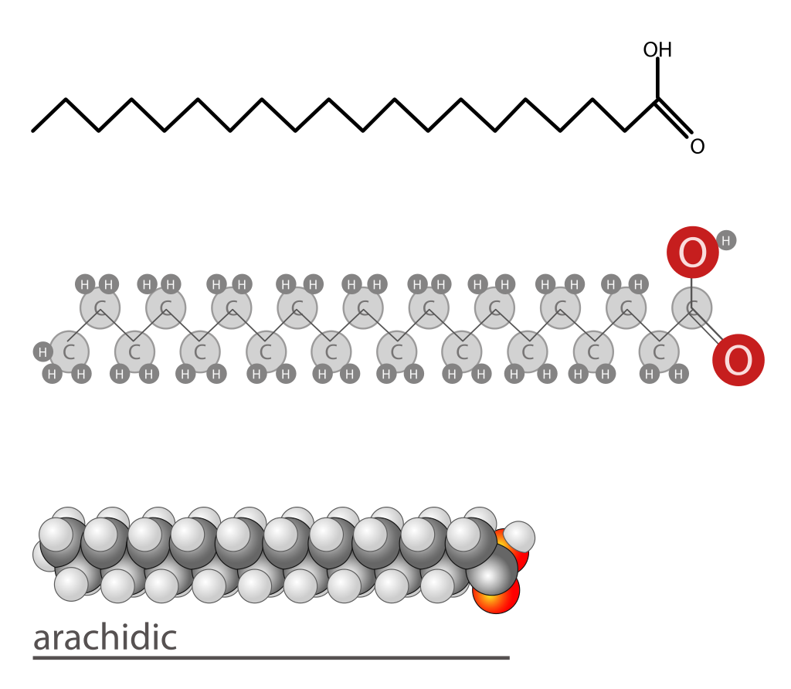
Fatty Acids
Structures from: LadyofHats
Notes:
Fatty acids consist of a long hydrocarbon chain (mostly saturated carbons) with a terminal carboxylic acid functional group. Fatty acids have four major physiologic roles: (1) They are building blocks of membrane phospholipids, (2) They can be covalently attached to proteins and serve as targeting signals, (3) They are the major fuel molecules in most animals, and (4) Fatty acids derivatives serve as hormones and intracellular messengers. Fatty acids are insoluble in water, vary in chain length (typically 12 – 18 C) and degree of unsaturation (C=C double bonds).

Slide 4
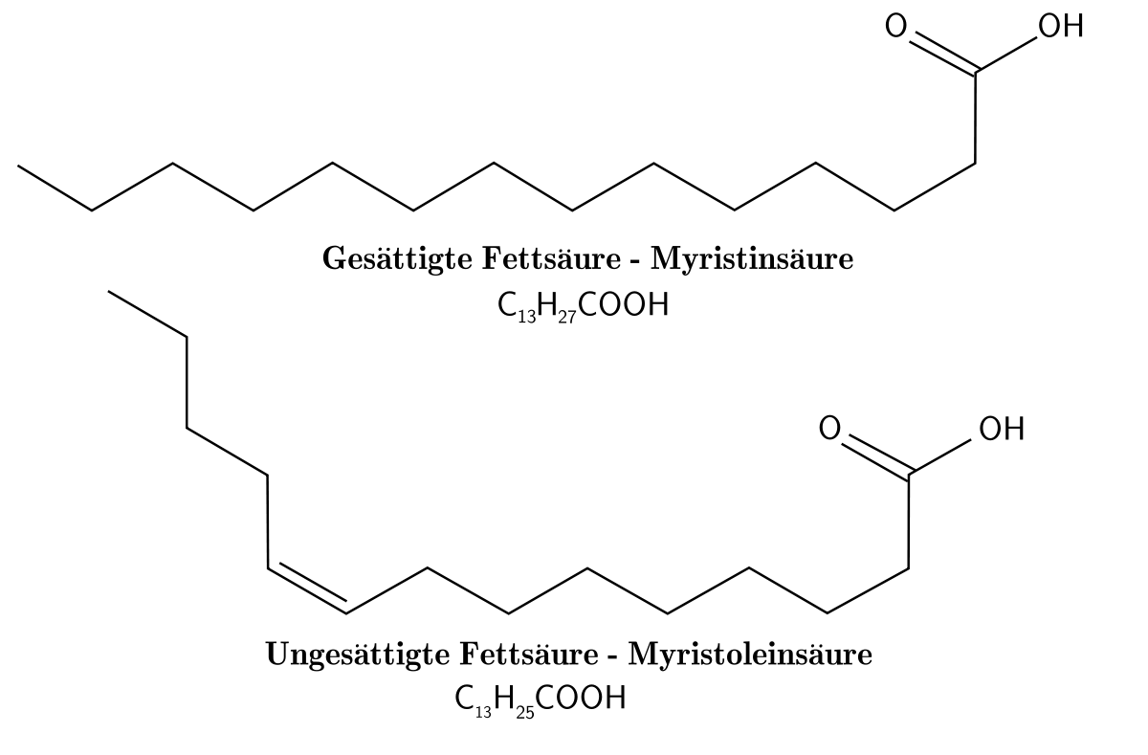
Saturated vs. Unsaturated Fatty Acids
Saturated fatty acids have no double bonds
Unsaturated fatty acids have one or more double bonds
Structures from: Lennert, B.
Notes:
Fatty acids can either be saturated with hydrogens and contain no double bonds, or they can be unsaturated and contain one or more C=C double bonds.

Slide 5
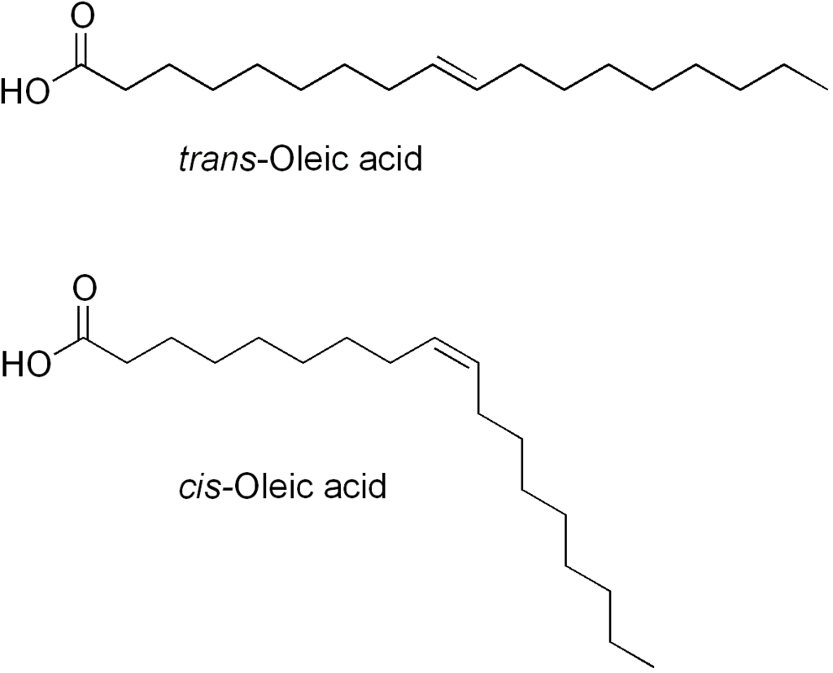
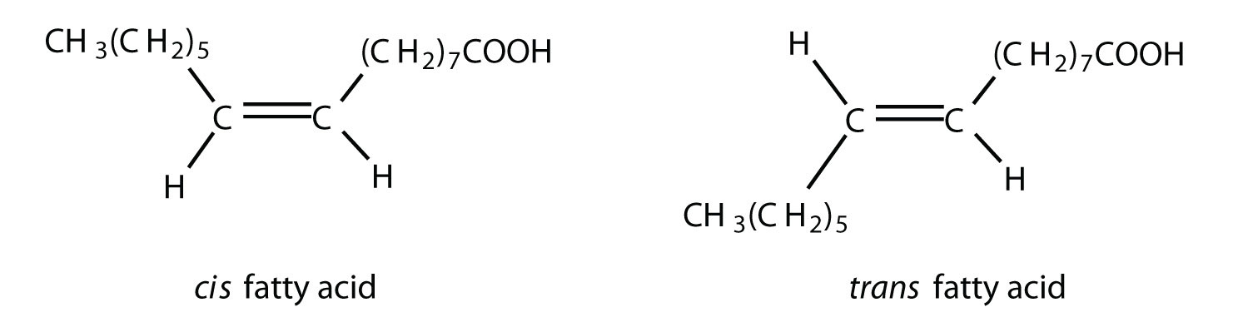
Cis and Trans Fatty Acids
v
Structures modified from: Edgar181
Structures modified from: LumenLearning
Notes:
This diagram compares the two isomeric forms of fatty acids that can result from introducing a double bond into the carbon backbone: the cis and trans isomers. Recall that in a trans double bond, the major constituents are located on opposite sides of the double bond, whereas in a cis double bond, both of the major constituents are on the same side of the double bond. Cis double bonds are the ones that are most prevalent in naturally occurring fatty acids. Trans fatty acids are generally created as byproducts in industrial processing (such as in the partial hydrogenation of vegetable oils to produce margarines) or during deep fat frying where oils are reaching very high temperatures.

Slide 6
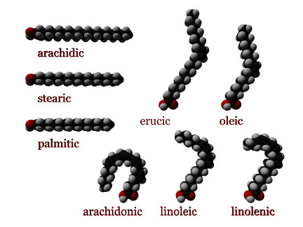
3D Structure of Fatty Acids
Structures from: Wikipedia
Notes:
Since most of the double bonds present within fatty acids are in the cis-conformation, this has a large impact on the three-dimensional structure of the fatty acids. Saturated fatty acids tend to form linear structures without any permanent bends, whereas double bonds cause bends in the fatty acid chain. The more double bonds present in a fatty acid, the more bends will be present. Note that trans fatty acids do not cause bends, but are able to retain the saturated linear conformation. This has major effects on the health impact of these fat sources, that we will discuss in more detail in a later lecture.

Slide 7
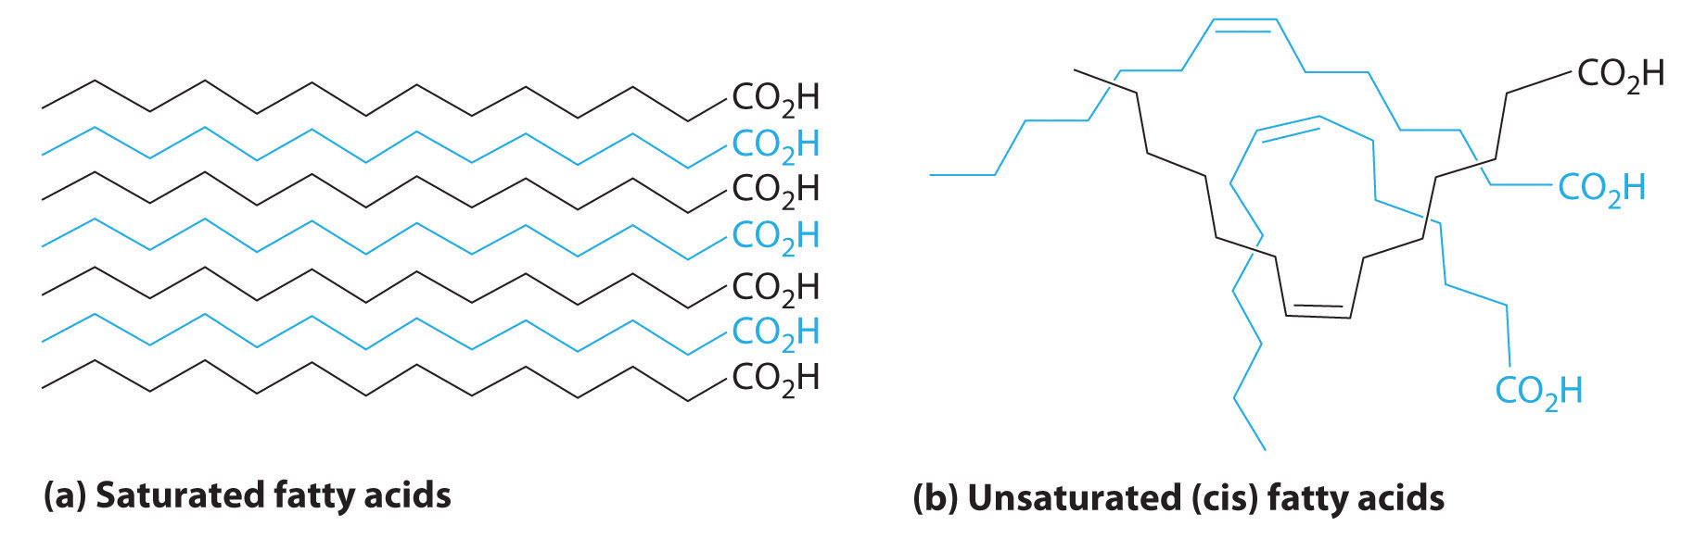
Properties of Saturated vs. Unsaturated Fatty Acids
Figure from: Averill, B.A., and Eldredge, P.
Notes:
Molecules of saturated fatty acids, which contain no carbon–carbon double bonds, can stack in a regular array. This close packing enables strong London Dispersion forces to form between the chains causing these compounds to have higher melting temperatures. Thus, they are typically solids at room temperature.
Molecules of unsaturated fatty acids, which contain one or more cis carbon–carbon double bonds, have kinked structures that cannot pack closely together. Compared to saturated fatty acids, unsaturated fatty acids have fewer intermolecular force attractions between strands giving them lower melting temperatures. Thus, most unsaturated fats are liquids at room temperature.

Slide 8
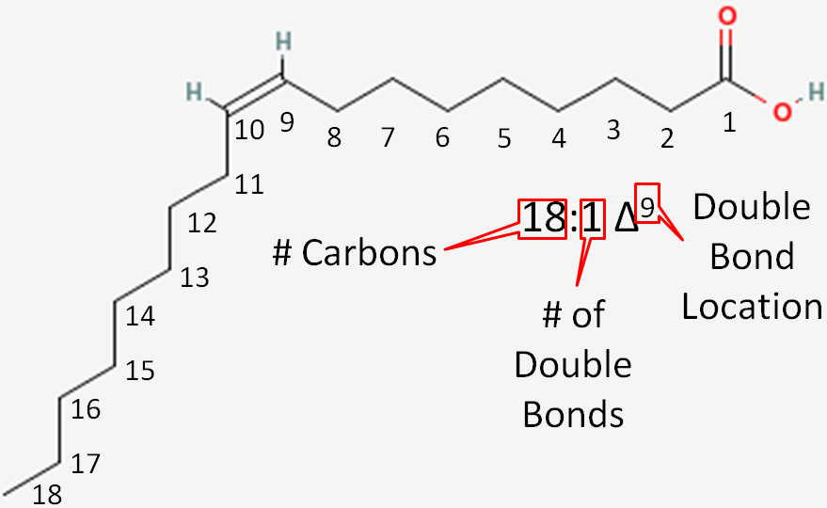
Naming Fatty Acids - IUPAC
Carbon 1 is always the carbonyl carbon of the carboxylic acid functional group.
Double bond positions are determined by the carbon closest to the carbonyl carbon position – this fatty acid has a double bond at C-9, NOT at C-10!
Notes:
As you will see, common names for fatty acids are often used instead of the IUPAC names, as the IUPAC nomenclature can quickly become unwieldy. However, the IUPAC nomenclature is descriptive of the structure, whereas the common names require rote memorization to learn and thus, you will be required to know the basic naming constructs of the IUPAC system. I do not require you to memorize the common names.
Within the IUPAC system, the numbering of the fatty acid, begins with the carbonyl carbon from the carboxylic acid functional group. The example above contains 18 carbon units.

Slide 9
Naming Fatty Acids - IUPAC
Suffix for carboxylic acids = ‘oic acid’ and the conjugate base = ‘oate’
The base name is determined by the number of carbons in the chain
Notes:
Within the IUPAC system, the suffix used for naming fatty acids is derived from the carboxylic acid functional group, which changes the base name to the ‘-oic acid’ ending, or the ‘-oate’ ending for the conjugate base or ester. The base name is determined from the number of carbons present and is further modified if double bonds are present.

Slide 10
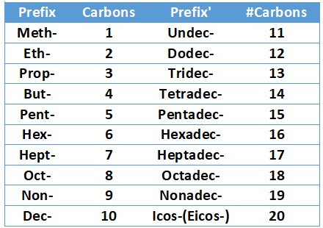
IUPAC Prefixes
Notes:
The prefixes used for carbon length are the same that you learned for organic chemistry, although you may not have had such long carbon chains before. The prefix ‘Icos’ is used for a 20 carbon chain, although you may also still see ‘Icos’ spelled with the older, E-I spelling for ‘Eicos’. I will accept either as being correct. You may also see carbon chains longer than 20 carbon units. The prefix, ‘docosa-’ is used for a 22 carbon chain.

Slide 11
Naming Fatty Acids - IUPAC
Octadecanoic Acid is the base. How are double bonds incorporated into the name?
Double bonds need to be given the number position where they occur as well as their conformation and the designation ‘-ene’ instead of ‘-ane’ must be incorporated.
9-cis-Octadecenoic Acid / Common name = oleic acid
Notes:
For the 18 carbon fatty acid shown here, the base name is derived from ‘Octadecane’ except that this is not the saturated fatty acid. It contains a double bond, making it an alkene, rather than an alkane. Thus, we must convert the base name to ‘Octadecene’ with the –ene nomenclature to represent the double bond being present. We then need to alter the suffix to ‘oic acid’. This would give us ‘Octadecenoic Acid’. Finally, we would need define where the double bond is located. In the IUPAC system, recall that chain numbering starts from the position of the major functional group, which in this case is the carboxylic acid, carbon position. Counting until we reach the double bond, we can see that the double bond is positioned between carbon’s 9 and 10. Thus, we will designate the beginning of the double bond. In this case, carbon 9. It is also best to indicate that the double bond is cis, to complete the name. Thus, our compound is 9-cis-Octadeceneoic Acid. If you do not see the cis designation shown for a fatty acid with double bonds, you should assume that they are in the cis conformation.

Slide 12
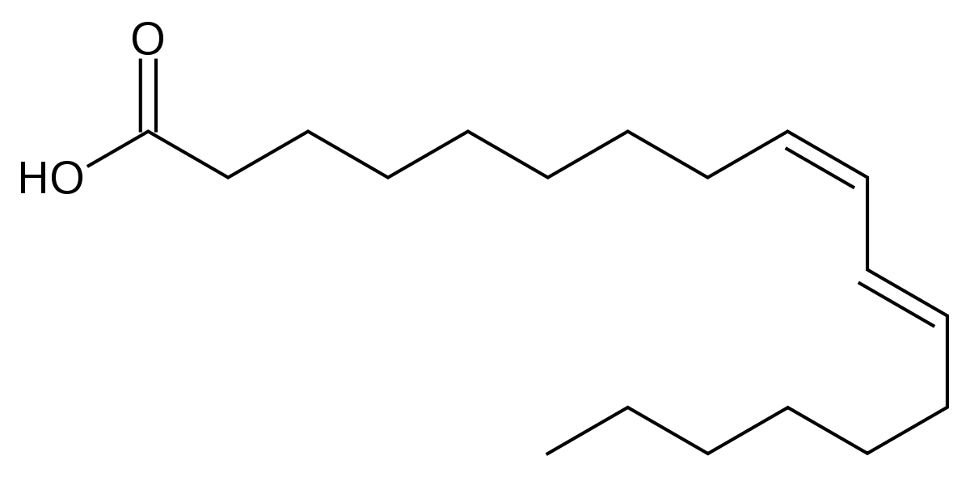
Naming Fatty Acids - IUPAC
What about Fatty Acids with more than one double bond?
Add in ‘di, tri, tetra, penta, etc before the ‘-ene-’ for fatty acids with multiple double bonds.
9-cis, 11-trans-Octadecadienoic Acid
Notes:
What about fatty acids with more than one double bond? You must indicate how many they have, not only in the numbering, but also in the main name…ie ‘dienoic’ is used for two, ‘trienoic’ for three, ‘tetraeneoic’ for four, etc. So for the fatty acid above, the double bond at the 9 position is in the cis conformation and the double bond at the 11 position is in the trans conformation. Thus, the name should be 9-cis,11-trans-octadecadienoic acid

Slide 13

Delta Nomenclature
Figure from: Lindshield, B. – Kansas State University Human Nutrition Flexbook
Notes:
There are also two fatty acid shorthand notations that I would like you to be familiar with. The first is the delta nomenclature. For this system, the first number indicates the number of carbons in the fatty acid (18 in this case) Then add a colon. The number after the colon is the total number of double bonds (1 in this case) Next add a delta symbol followed by the positions of the C=C double bonds in superscript notation next to the delta symbol. The double bond positions are separated by commas, if there is more than one. The shorthand nomenclature for this fatty acid is 18:1 delta, superscript 9

Slide 14
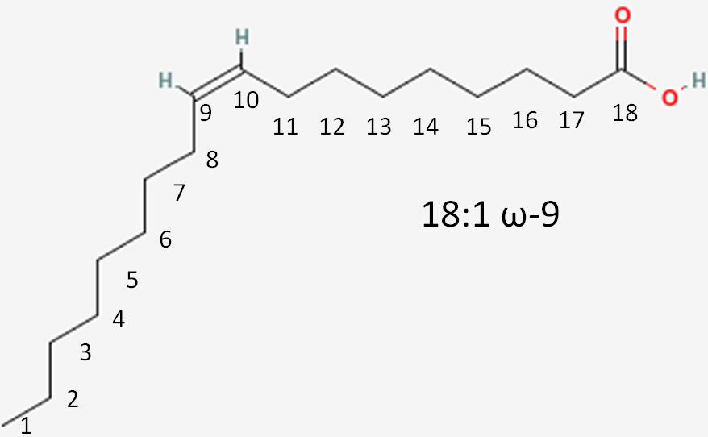
Omega Nomenclature
β
α
ω
Figure from: Lindshield, B. – Kansas State University Human Nutrition Flexbook
Notes:
The other shorthand is the Omega nomenclature. In this system, the carbons are numbered from the methyl end of the fatty acid. The methyl carbon is known as the omega carbon, or the ‘last’ carbon in the chain, as omega is the last letter in the Greek alphabet. The carbon next to the carbonyl carbon is the alpha carbon, and the one next to that is the beta carbon. These two positions will also be useful to know later when we learn about fatty acid oxidation and use in the Kreb cycle.
For the omega nomenclature, write down the number of carbons in the fatty acid (= 18 in our example) followed by a colon and the total number of double bonds present (=1 in our example). This is followed by the omega symbol, a dash, and the positions of the C=C double bonds in relation to the omega carbon. For example, if we have an omega-3 fatty acid, the double bond would be down here, next to the omega carbon position. Not up here, close to the alpha and beta positions.

Slide 15
Highly Unsaturated Fatty Acids
Pentaenoic acid (5 double bonds)
    20:5; 5,8,11,14,17 ω3: timnodonic acid or EPA (all-cis-5,8,11,14,17-eicosapentaenoic acid)*
Hexaenoic acid (6 double bonds)
    22:6; 4,7,10,13,16,19 ω3: cervonic acid or DHA (all-cis-4,7,10,13,16,19-docosahexaenoic acid)*
Both FAs are found in cold water fish oils
Notes:
Consumption of long chain polyunsaturated fatty acids, such as those found in cold water fish, appear to have many health related benefits, showing reduced risk of breast, prostate, colon and renal cancers, cardioprotective effects (reduced platelet aggregation and inflammation), and neurological health benefits, especially when combined with exercise and weight control programs.

Slide 16
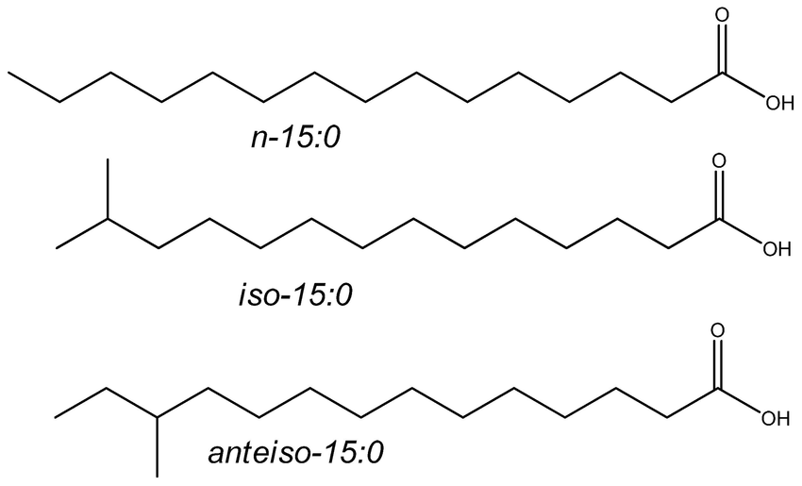
Less Common Fatty Acids
Branched Chain Fatty Acids
No Branches
Iso- Branch
Anteiso- Branch
Figure from: Ran-Ressler, R.R., et al. (2011) PLoS ONE 6(12) e29032
Notes:
Branched-chain fatty acids are common constituents of the lipids of bacteria and to a lesser extent of animals and plants. iso-Methyl branched fatty acids have the branch point on the penultimate carbon (one from the end or (ω-1)), while anteiso-methyl-branched fatty acids have the branch point on the ante-penultimate carbon atom (two from the end or (ω-2)). Branched chain fatty acids and short chain fatty acids (1 – 4 carbons in length) are produced by microflora found in the gut and may play an important role in maintaining gut health and resistance to pathogen colonization.

Slide 17
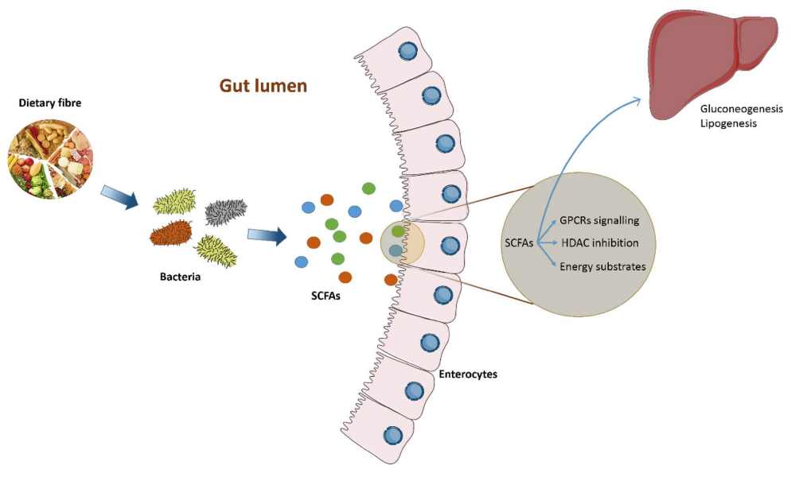
Short Chain Fatty Acids (SCFAs)
Figure from: Rahim, M., et al (2019) Acta Diabetologica 56:493-500
Notes:
The human gut is a home for more than 100 trillion bacteria, far more than all other microbial populations resident on the body’s surface. The human gut microbiome is considered as a microbial organ symbiotically operating within the host. It is a collection of different cell lineages that are capable of communicating with each other and the host and has an ability to undergo self-replication for its repair and maintenance. As the gut microbiota is involved in many host processes including growth and development, an imbalance in its ecological composition may lead to disease and dysfunction. Dietary fiber is often converted to SCFAs by gut microflora. Butyrate has been shown to have a protective role against colon cancer and colitis and also provides 60 – 70% of the energy requirements of colonocytes. Butyrate has also been shown to inhibit HDACs and can therefore modulate gene expression in target cells. SCFAs have also been shown to bind with G-protein coupled receptors and initiate signaling pathways in target cells. The exact roles of these fatty acids in promoting or maintaining health is currently not well understood, but is an interesting avenue of research.

Slide 18

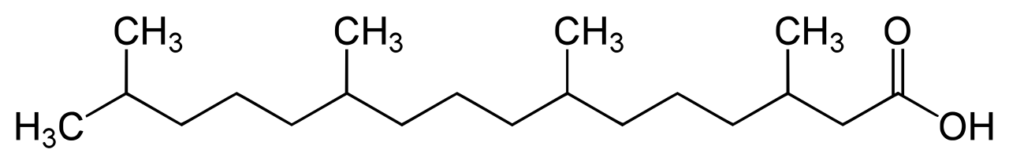
Less Common Fatty Acids
Odd carbon fatty acid – propionic acid
Phytanic acid
Heptadecaenoic Acid
Phytanic Acid
Notes:
Odd chain fatty acids are found particularly in ruminant fat and milk (e.g. heptadecanoic acid). Some plant-based fatty acids, also have an odd number of carbon atoms, and Phytanic fatty acid absorbed from the plant chlorophyll has multiple methyl branch points.

Slide 19
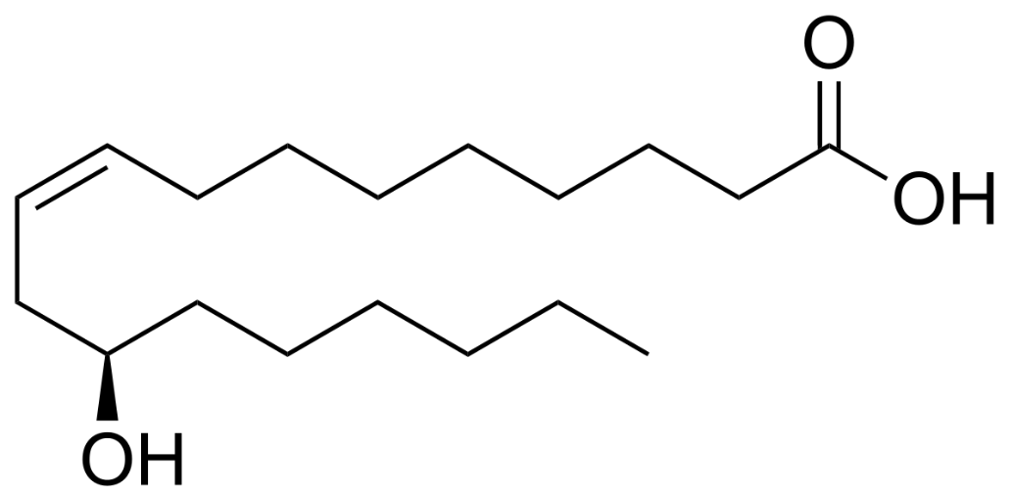
Less Common Fatty Acids
hydroxy fatty acids
Ricinoleic Acid
Notes:
Ricinoleic acid is a major component of the seed oil obtained from mature Castor plant. It exerts analgesic and anti-inflammatory effects. It can also act as an algicide for the control of cyanobacterial growth.

Slide 20
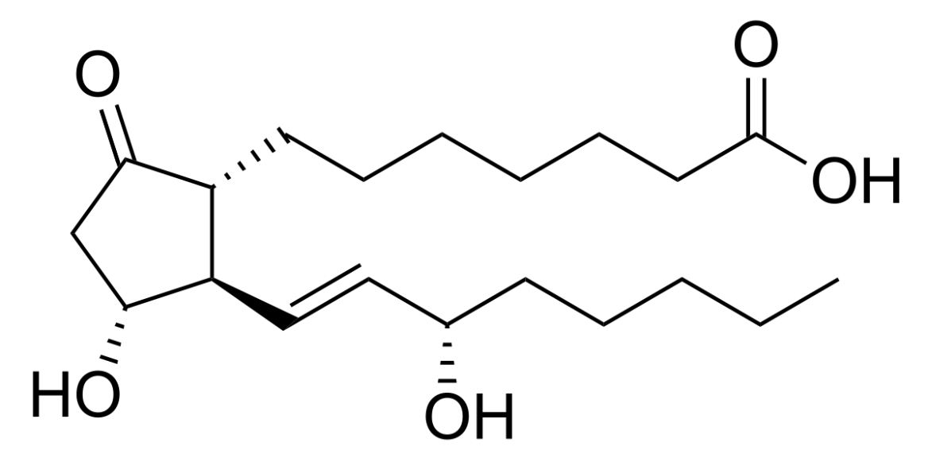
Less Common Fatty Acids
cyclic fatty acids
Prostaglandin E1
Notes:
Prostaglandin E play an important role in thermoregulation of the human brain, for example, increasing temperature during infection. Decreased formation of prostaglandin E through inhibition of cyclooxygenase is the basis for the antipyretic of nonsteroidal anti-inflammatory drugs (NSAIDs). Hopefully, our introduction to some of the less common fatty acids allows you to glimpse the unique roles that lipids can also play in cell signaling and communication. We will continue to investigate these properties in later lectures.

Slide 21
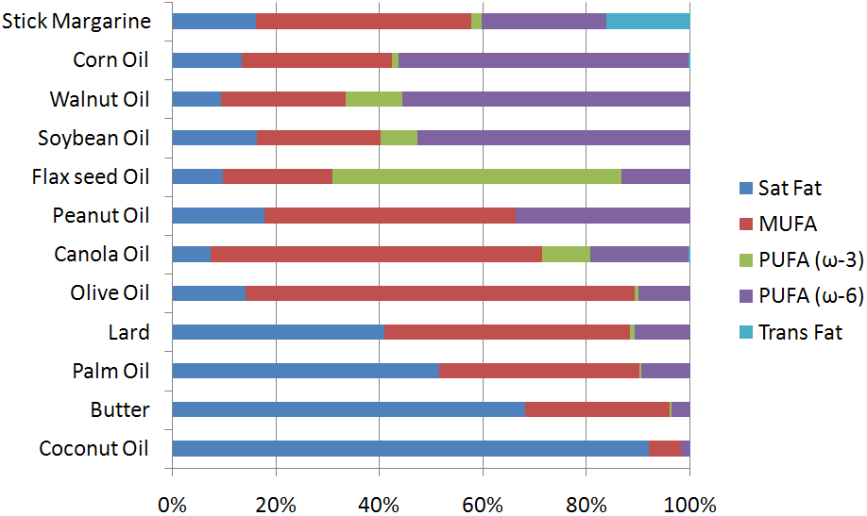
Food Sources of Fatty Acids
Figure from: Lindshield, B. – Kansas State University Human Nutrition Flexbook
Notes:
Here is a nice chart showing the level of saturated vs. unsaturated fatty acids present in different food sources. Saturated fat levels are shown in dark blue (sat fat), monounsaturated fats (MUFA) shown in red, polyunsaturated fatty acids with omega-3 double bonds (PUFA) shown in green, and polyunsaturated fatty acids with omega-6 double bonds (PUFA) shown in purple. The turquoise bar represents fatty acids with trans double bonds. In the next section, you will learn how fatty acids are used as monomer building blocks to make the triacylglycerides (fats and oils).

