Slide 1
Lipids
Adipose Tissue and Fatty Acid Release
Notes:
Welcome to our lecture series on Lipids. Here we will learn about lipid storage and digestion in adipose tissue and the transportation of free fatty acids in the bloodstream.

Slide 2
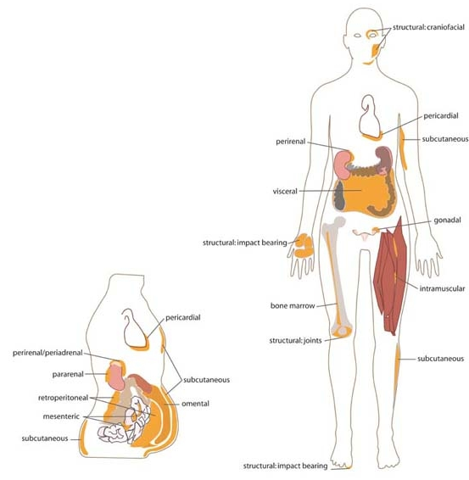
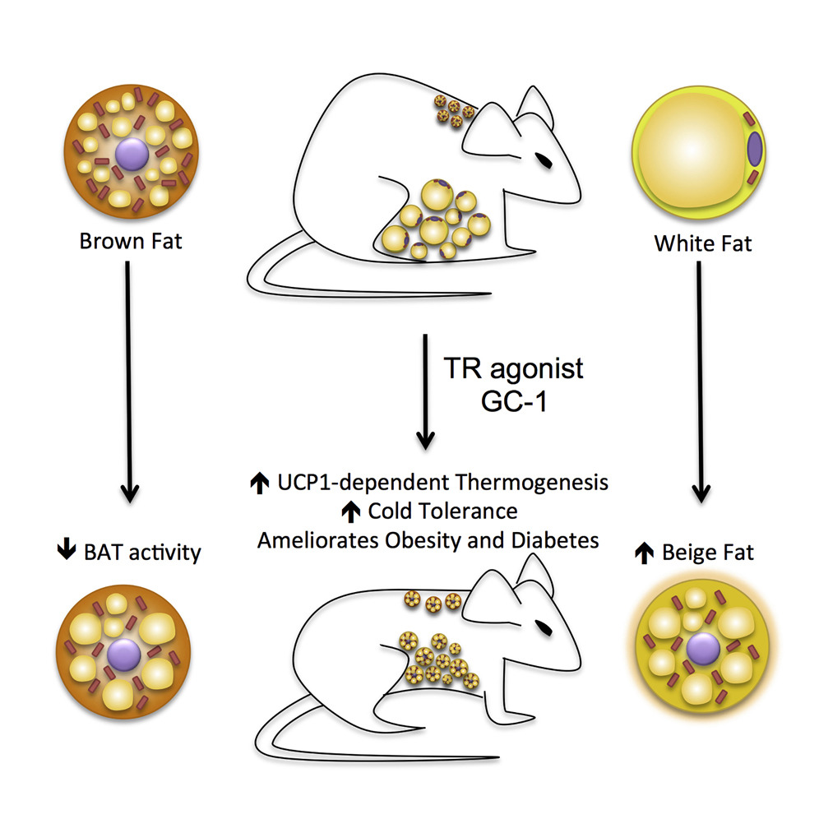
White Fat Cells
structural:
craniofacial
pericardial
perirenal
subcutaneous
visceral
gonadal
structural: impact bearing
bone marrow
intramuscular
pericardial
periadrenal
structural: joints
subcutaneous
pararenal
subcutaneous
retroperitoneal
omental
mesenteric
subcutaneous
structural: impact bearing
Figure modified from:
Lin, J.Z., et. al., (2015) Cell Reports 13(8):1528-1537 and Cook, A. and Cowan, C. (2009), Stembook, ed.
Notes:
Adipose tissue, body fat, or simply fat is a loose connective tissue composed mostly of adipocytes. White fat cells or monovacuolar cells contain a large lipid droplet surrounded by a layer of cytoplasm. The nucleus is flattened and located on the periphery. The fat stored is in a semi-liquid state, and is composed primarily of triacylglycerides and cholesteryl esters. An average human adult has 30 billion fat cells with a weight of 30 lbs or 13.5 kg. If excess weight is gained as an adult, fat cells increase in size about fourfold before dividing and increasing the absolute number of fat cells present. White fat cells form the predominant form of fat in the adult body.
Text modified from: Wikipedia contributors. (2020, March 5). Adipose tissue. In Wikipedia, The Free Encyclopedia. Retrieved 15:35, March 8, 2020, from https://en.wikipedia.org/w/index.php?title=Adipose_tissue&oldid=944026994

Slide 3
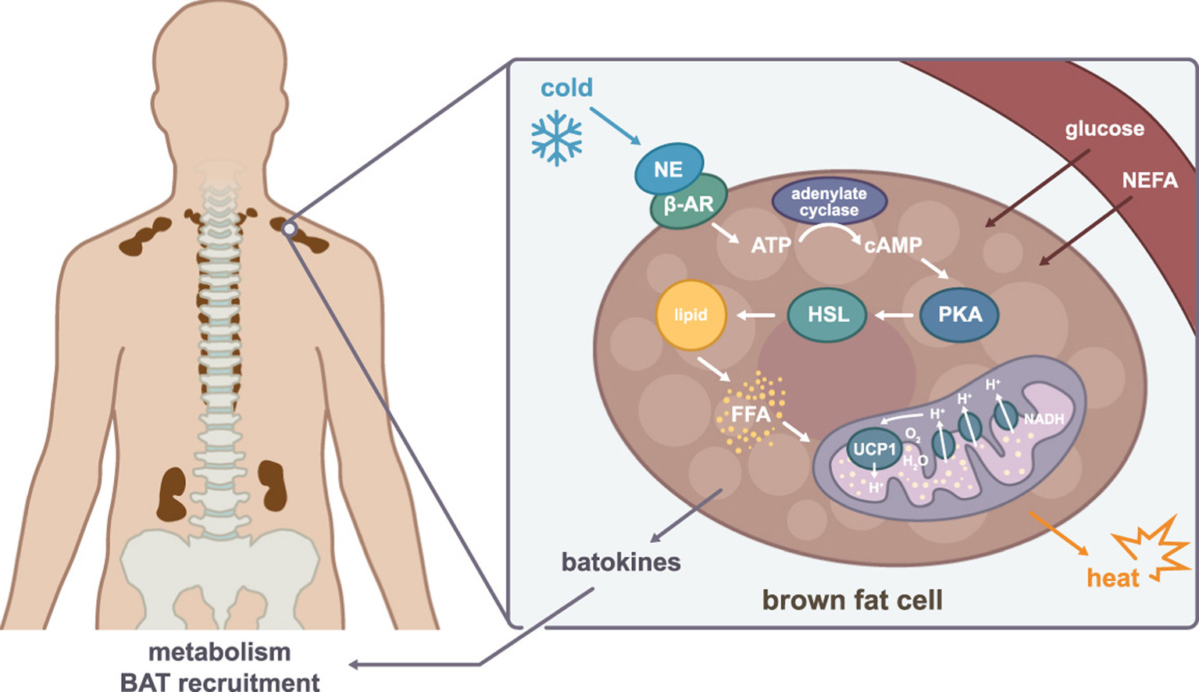
Brown Fat Cells
Figure modified from:
Scheele, C. and Nielsen, S. (2017) Redox Biology 12:770-775 and Lin, J.Z., et. al., (2015) Cell Reports 13(8):1528-1537
Notes:
Brown fat, also known as "baby fat," is used to generate heat. Adults only have limited quantities of brown adipose tissue.Brown fat cells are plurivacuolar and have considerable cytoplasm, with lipid droplets scattered throughout. The nucleus is round and is not in the periphery of the cell. The brown color comes from the large quantity of mitochondria.
Text modified from: Wikipedia contributors. (2020, March 5). Adipose tissue. In Wikipedia, The Free Encyclopedia. Retrieved 15:35, March 8, 2020, from https://en.wikipedia.org/w/index.php?title=Adipose_tissue&oldid=944026994

Slide 4
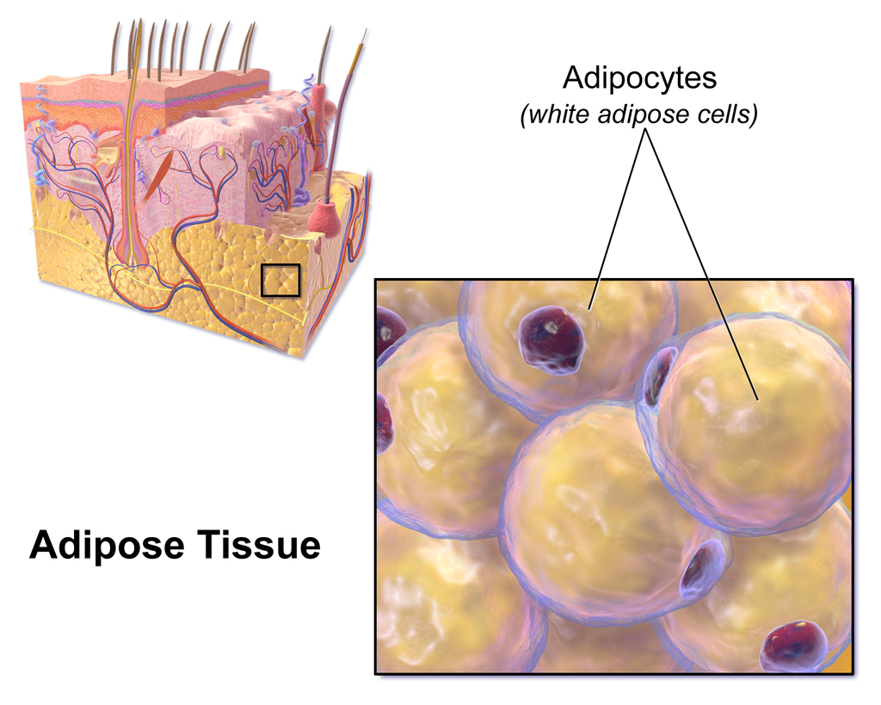
The Energy in Adipose Tissue
Figure from: BruceBlaus
Notes:
The energy available from stored fats is about 85% of the total energy available in the body.

Slide 5

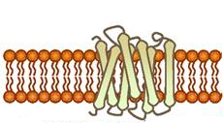


Epinephrine Signaling in Adipose Cells
Into Blood Stream
GTP
FATP
cAMP
FABP
Glycerol
cAMP
monoacylglyceride
Lipase
cAMP
FABP
cAMP
PKA
MAG
P
+ H₂O
Triacylglyceride
Lipase
DAG
Diacylglyceride
Lipase
Protein Kinase A
(PKA)
FABP
FFA
Figure modified from Yan, A., et al (2016) In J Biol Sci 12(12):1544-1554 and Servier Medical Art
The CREB protein is also activated when bound to the cAMP molecule. This causes the CREB protein to translocate from the
Notes:
In adipose tissue, especially White Fat Cells, fatty acids are liberated and released in response to hormone stimulation. For example, the binding of epinephrine to adipose tissue behaves in a similar way to the activation of energy releasing pathways in the liver. In adipose tissue, epinephrine binds with a G-protein coupled receptor that activates a downstream G-protein. The activated G-protein turns on Adenylate Cyclase leading to the production of the second messenger, cAMP. cAMP in turn, binds with Protein Kinase A to activate many downstream target pathways. One target is the Triacylglyceride Lipase. PKA mediates the phosphorylation of this enzyme increasing its activity. This enzyme hydrolyzes one of the fatty acids from the TAG yielding one free fatty acid (FFA) and one diacylglyceride (DAG). Other constituitively active lipases cleave the other two remaining fatty acids from the glycerol backbone. Fatty acid binding proteins chaperone the FFAs within the cytoplasm. Proteins such as the fatty acid transport protein (FATP) are used to excrete the free fatty acids into the blood stream.

Slide 6
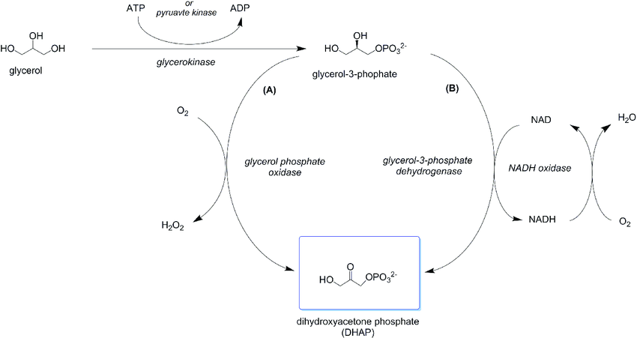
Glycerol can enter Glycolysis and is Gluconeogenic
Figure from: Hartley, C., et al (2017) PLoS ONE 10.1371
Notes:
Digestion of TAGs also releases the glycerol backbone. Glycerol can be converted to glycerol 3-phosphate by a glycerol kinase enzyme. The glycerol 3-phopshate can then be oxidized to DHAP by either an L-glycerol-3-phosphate oxidase enzyme (A) or a glycerol-3-phosphate dehydrogenase enzyme (B). Here it can enter into the glycolytic or gluconeogenic pathways.
Text modified from: https://doi.org/10.1371/journal.pone.0184183.g002

Slide 7
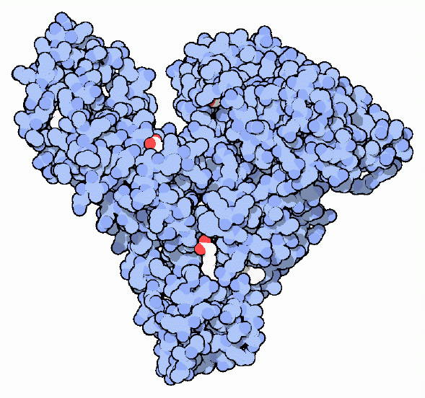
Tranporting Fatty Acids in Blood
Protein Serum Albumin
Can bind to 7 Fatty Acids
Most plentiful protein in the blood plasma
Chaperones fatty acid delivery to cells
Image from : Goodsell, D. (2012) Molecule of the Month, Protein Database
Notes:
When your body needs energy or needs building materials, fat cells release fatty acids into the blood. There, they are picked up by serum albumin and delivered to distant parts of the body where they are utilized for energy.
Text modified from : Goodsell, D. (2012) Molecule of the Month, Protein Database

Slide 8
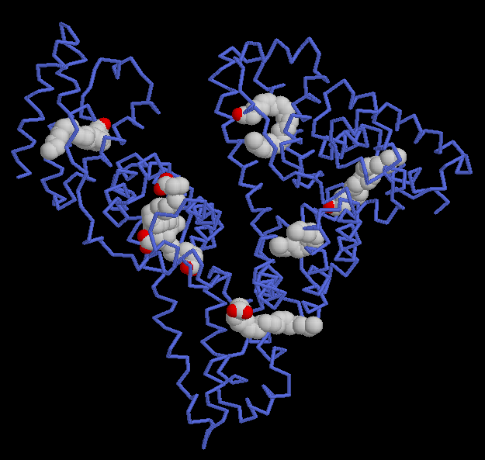
Serum
Albumin
Image from : Goodsell, D. (2012) Molecule of the Month, Protein Database
Notes:
Serum albumin is the most plentiful protein in blood plasma. Each protein molecule can carry seven fatty acid molecules. They bind in deep crevices in the protein, burying their carbon-rich tails safely away from the surrounding water. Serum albumin also binds to many other water-insoluble molecules. In particular, serum albumin binds to many drug molecules, such as ibuprofen, and can strongly affect the way they are delivered through the body. In the next section, we will examine how cells that receive these free fatty acids utilize them for energy production.
Text from : Goodsell, D. (2012) Molecule of the Month, Protein Database

