Slide 1
Glycolysis
Part 5 - The Final Four Reactions and the End of Glycolysis!
Notes:
Welcome to part 5 in our Glycolysis series. In this lecture we will visit the final four reaction steps in the glycolytic pathway and focus on the pathway regulation at the pyruvate kinase step.

Slide 2
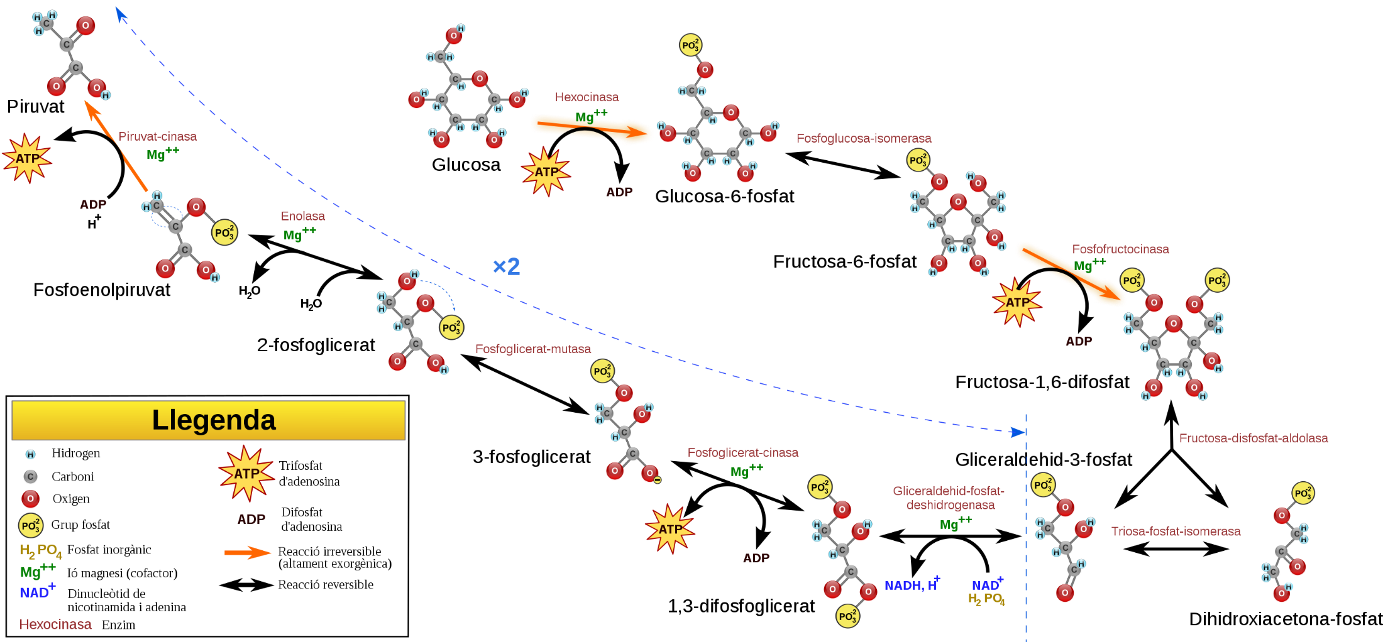





Second Half of Glycolysis – Energy Generating
7
Glyceraldehyde 3-phosphate
3-Phosphoglycerate
Kinase
Mg²⁺
NAD⁺
Pi
6
Glyceraldehyde
3-phosphate Dehydrogenase
10
NADH
+ H⁺
9
8
7
Pyruvate
Kinase
Mg²⁺
Phosphoglycerate Mutase
Enolase
Phosphoglycerate Kinase
Mg²⁺
Pyruvate
Phosphoenol-
Pyruvate
2-Phosphoglycerate
3-Phosphoglycerate
3-Phosphoglycerate
1,3-Bisphosphoglycerate
1,3-Bisphosphoglycerate
Figure modified from YassineMrabet
Notes:
Step 7 of the pathway is the first kinase reaction that is working in the reverse direction than we are used to seeing. In this reaction, the phosphate is being transferred from 1,3-Bisphosphate to a molecule of ADP to form ATP. The other product formed is 3-phosphoglycerate. When ATP is formed through a kinase reaction, this is known as substrate-level phosphorylation. Note that the enzyme is named for the reverse reaction like other traditional kinase enzymes would be named. Perhaps it is more aptly thought of as an ADP Kinase. However, this name is not descriptive enough, as we will see that other kinase enzymes can also preferentially mediate the reverse reaction and generate ATP. The other substrate then becomes important for distinguishing these enzymes from one another.

Slide 3
Second Half of Glycolysis – Energy Generating
Glyceraldehyde 3-phosphate
8
NAD⁺
Pi
6
Phosphoglycerate
Mutase
Glyceraldehyde
3-phosphate Dehydrogenase
10
NADH
+ H⁺
9
8
7
Pyruvate
Kinase
Mg²⁺
Phosphoglycerate Mutase
Enolase
Phosphoglycerate Kinase
Mg²⁺
Pyruvate
Phosphoenol-
Pyruvate
2-Phosphoglycerate
3-Phosphoglycerate
3-Phosphoglycerate
2-Phosphoglycerate
1,3-Bisphosphoglycerate
Figure modified from YassineMrabet
Notes:
Step 8 is a mutase reaction that rearranges the phosphate group from position 3 to position 2 of the substrate. This is similar to the mechanism used by phosphoglucomutase that can convert the glucose-1-phosphate to glucose-6-phosphate. Thus, we will not spend further time on this reaction mechanism.

Slide 4
Second Half of Glycolysis – Energy Generating
Glyceraldehyde 3-phosphate
9
NAD⁺
Pi
6
Glyceraldehyde
3-phosphate Dehydrogenase
Enolase
NADH
+ H⁺
10
8
9
7
Pyruvate
Kinase
Mg²⁺
Phosphoglycerate Mutase
Enolase
Phosphoglycerate Kinase
Mg²⁺
Phosphoenol-
Pyruvate
Pyruvate
2-Phosphoglycerate
3-Phosphoglycerate
2-Phosphoglycerate
Phosphoenolpyruvate
1,3-Bisphosphoglycerate
Figure modified from YassineMrabet
Notes:
Enolase is involved in step 9 of the glycolytic process converting 2-phosphoglycerate to phosphoenolpyruvate. Enolase belongs to the family of lyases, specifically the hydro-lyases, which cleave carbon-oxygen bonds. Note that this reaction is also a redox reaction. The next slide shows the reaction mechanism involved.

Slide 5
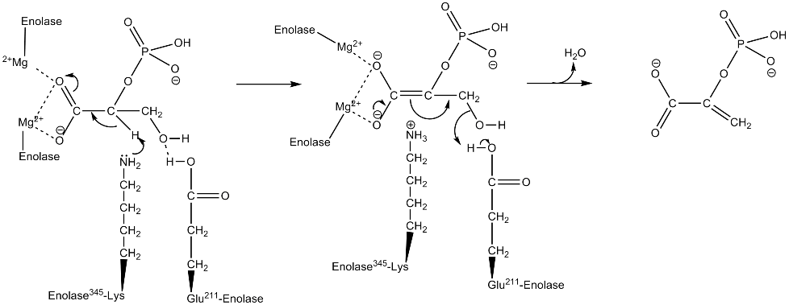
Enolase Enzyme
Notes:
Enolase is a highly conserved family of enzymes with five active-site residues being especially important for activity. These include a critical lysine and glutamate residue that are directly involved in the reaction mechanism shown above. When the substrate, 2-phosphoglycerate, binds to enolase, its carboxyl group coordinates with two magnesium ion cofactors in the active site. This stabilizes the negative charge on the deprotonated oxygen while increasing the acidity of the alpha hydrogen. Enolase's Lys residue deprotonates the alpha hydrogen, and the resulting negative charge is stabilized by resonance to the carboxylate oxygen and by the magnesium ion cofactors. Following the creation of the carbanion intermediate, the hydroxide on C3 is eliminated as water with the help of the Glu residue, and phosphoenolpyruvate (PEP) is formed.

Slide 6
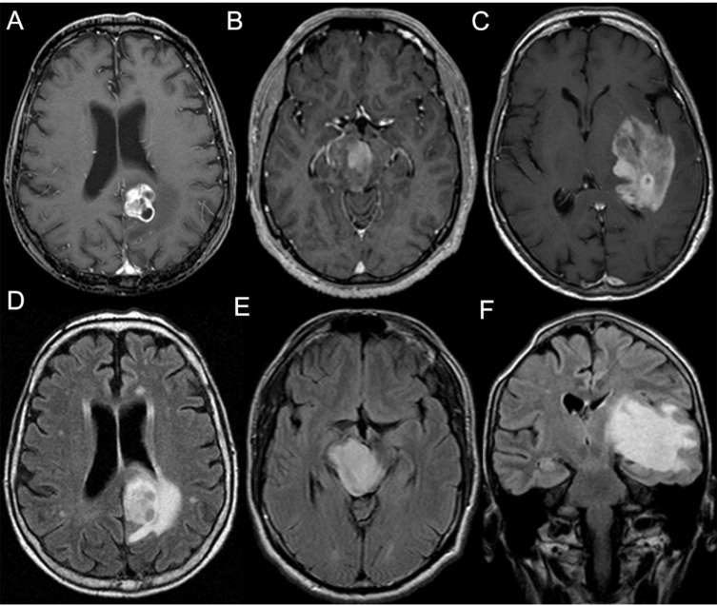
Enolase can be used Diagnostically
Testing for enolase in cerebrospinal fluid
The fastest rate of tumor growth occurred in patients with the highest levels of CSF enolase.
Astrocytoma
Image from Fiechter, M. et al (2016) Clin Neur and Neurosurg 147:98-104
Notes:
Enolase detection is also being used diagnostically to help determine the presence and aggressiveness of astrocytoma brain cancer. Higher concentrations of enolase in cerebrospinal fluid more strongly correlated to low-grade astrocytoma than did other enzymes tested. The same study showed that the fastest rate of tumor growth occurred in patients with the highest levels of CSF enolase. Astrocytoma Study (Royds JA, Timperley WR, Taylor CB (December 1981). "Levels of enolase and other enzymes in the cerebrospinal fluid as indices of pathological change". Journal of Neurology, Neurosurgery, and Psychiatry. 44 (12): 1129–35. doi:10.1136/jnnp.44.12.1129. PMC 491233. PMID 7334408.)

Slide 7
Second Half of Glycolysis – Energy Generating
Glyceraldehyde 3-phosphate
10
Pyruvate
Kinase
NAD⁺
Pi
6
Glyceraldehyde
3-phosphate Dehydrogenase
10
Mg²⁺
NADH
+ H⁺
8
9
8
7
Pyruvate
Kinase
Mg²⁺
Phosphoglycerate Mutase
Enolase
Phosphoglycerate Kinase
Mg²⁺
Pyruvate
Phosphoenol-
Pyruvate
Phosphoenolpyruvate
3-Phosphoglycerate
2-Phosphoglycerate
Pyruvate
1,3-Bisphosphoglycerate
Figure modified from YassineMrabet
Notes:
The last step in glycolysis is catalyzed by the enzyme pyruvate kinase which results in the production of a second ATP molecule by substrate-level phosphorylation. Similar to PFK-1 this enzyme is also a key regulatory component within the pathway

Slide 8
Pyruvate Kinase Isozymes
4 Major isozymes L (Liver), R (erythrocytes), M1 (muscle and brain), and M2 (early fetal tissue and most adult tissues)
The L and R forms are splice variants from the same gene (PKLR gene)
The M1 and M2 forms are splice variant from the same gene (PKM2 gene)
Notes:
The pyruvate kinase enzyme exists as a tetramer, that is built from the combination of different isozymes expressed in different tissues. There are three major isozymes of pyruvate kinase, the L form that is predominantly found in Liver, the R form that is predominantly found in erythrocytes, and the M1 form in muscle and brain, and the M2 form that is expressed in fetal tissue and at some level in most adult tissues. The L and R forms are splice variants that arise from the same gene locus, and the M1 and M2 forms are also splice variants that arise from the same gene locus.

Slide 9
Pyruvate Kinase Isozymes
Activators of the L, R, and M2 isozymes:
Fructose 1,6-bisphosphate
Inhibitors of all the isozymes:
ATP (the product of the reaction)
Alanine (which can be converted to pyruvate)
Notes:
We will focus on some of the general regulatory mechanisms common to most of the isozymes of Pyruvate Kinase, starting with the activator, fructose-1,6-bisphosphate (FBP). Because FBP is an earlier product within the same metabolic cascade, the activation of pyruvate kinase enzymes by FBP is known as feedforward stimulation. All of the isozymes, except for the M1 form are stimulated by the binding of FBP to the enzyme. Similarly, all of the pyruvate kinase isozymes are inhibited by the product of the reaction, ATP (or high energy load) and high levels of alanine. Alanine can be converted to pyruvate in one enzymatic step. Thus, pyruvate serves as a metabolic intermediate in the formation of alanine. If high levels of alanine are present, this indicates that there is high energy load within the cell (ie that the cell is full of building blocks to make new macromolecules and is not in the need for more energy). Thus, high levels of alanine serve as a negative regulator of the pyruvate kinase family of enzymes.

Slide 10
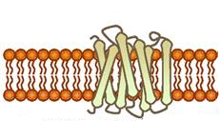


Glucagon Signaling in Liver Cells
Glycolysis
GDP
F6P
F2,6BP
Protein Kinase A
(PKA)
P
P
P
cAMP
PKA
P
P
PFK2/FBPase2
Pyruvate
Kinase
F6P
F2,6BP
Phosphoenolpyruvate
+ ADP
Pyruvate + ATP
Figure modified from Yan, A., et al (2016)
Notes:
The liver isozyme of pyruvate kinase is also regulated through protein phosphorylation. Similar to the PFK2 activity of the PFK2/FBPase2 enzyme, the liver isozyme of Pyruvate Kinase is also downregulated during glucagon signaling. Protein kinase A phosphorylates Pyruvate Kinase inhibiting its activity and preventing the conversion of phosphoenolpyruvate to pyruvate. Dual regulation of the glycolytic pathway during glucagon signaling, helps to ensure that glucose resources will be diverted away from cellular use by the liver and released into the blood stream to restore homeostatic blood glucose levels.

Slide 11
Fructose Regulatory Bypass
GLYCOLYSIS
Glucose 6-phosphate
Sucrose
Sorbitol
Hexokinase
Fructose 6-phosphate
Fructose
PFK1
Fructokinase
Fructose 2,6-bisphosphate
Fructose-1-phosphate
Aldolase A
Triose Isomerase
Aldolase B
Triose Isomerase
Glyceraldehyde 3-phosphate
Dihydroxyacetone Phosphate
Glyceraldehyde
Triokinase
Pyruvate
Notes:
Other sugars from the diet can also enter into the glycolytic pathway. Galactose is converted in a four step process to Glucose-6-phosphate and mannose can be converted to fructose-6-phosphate. Within most of the body’s tissues fructose can also be converted into fructose-6-phosphate by hexokinase. However, in the liver and kidneys, there is an alternative route that fructose from the diet can take to enter into the glycolytic pathway. This pathway is concerning because it bypasses two of the major regulatory steps of the glycolytic pathway, the hexokinase step and the PFK1 step. Within the liver and kidneys, fructose can also be converted into fructose-1-phosphate by the enzyme fructokinase. From there another isozyme of Adolase, known as Aldolase B, can cleave the fructose-1-phosphate into 2 three carbon units, dihydroxyacetone phosphate and glyceraldehyde. Dihydroxyacetone phosphate can be converted to glyceraldehyde 3-phosphate by Triose Isomerase and then continue into the glycolytic cascade. Glyceraldehyde can be phosphorylated to Glyceraldehyde 3-phosphate by Triokinase. This is an unregulated system that can flood the Kreb Cycle with high levels of pyruvate is high levels of fructose enter the cell (ie from high fructose corn syrup, sucrose and other sweeteners common to the Westernized diet). The excess pyruvate can then be shunted into fatty acid biosynthesis for long term storage in the form of triglycerides. If the pathway is over utilized by consuming too much sucrose and high fructose corn syrup, this can lead to the development of Hypertriglyceridemia (or the heightened increase of body fat). With this, we will end our discussions of glycolysis. In the next section we will look at the complimentary and opposite pathway of Gluconeogenesis.

