Slide 1
Glycolysis
Part 2 - Hexokinase Isozymes and the Regulation of Glucose Metabolism
Notes:
Welcome to part 2 in our Glycolysis series. Today we will be investigating one of the regulatory mechanisms that control the first enzymatic step in the glycolysis process, the hexokinase activity.

Slide 2
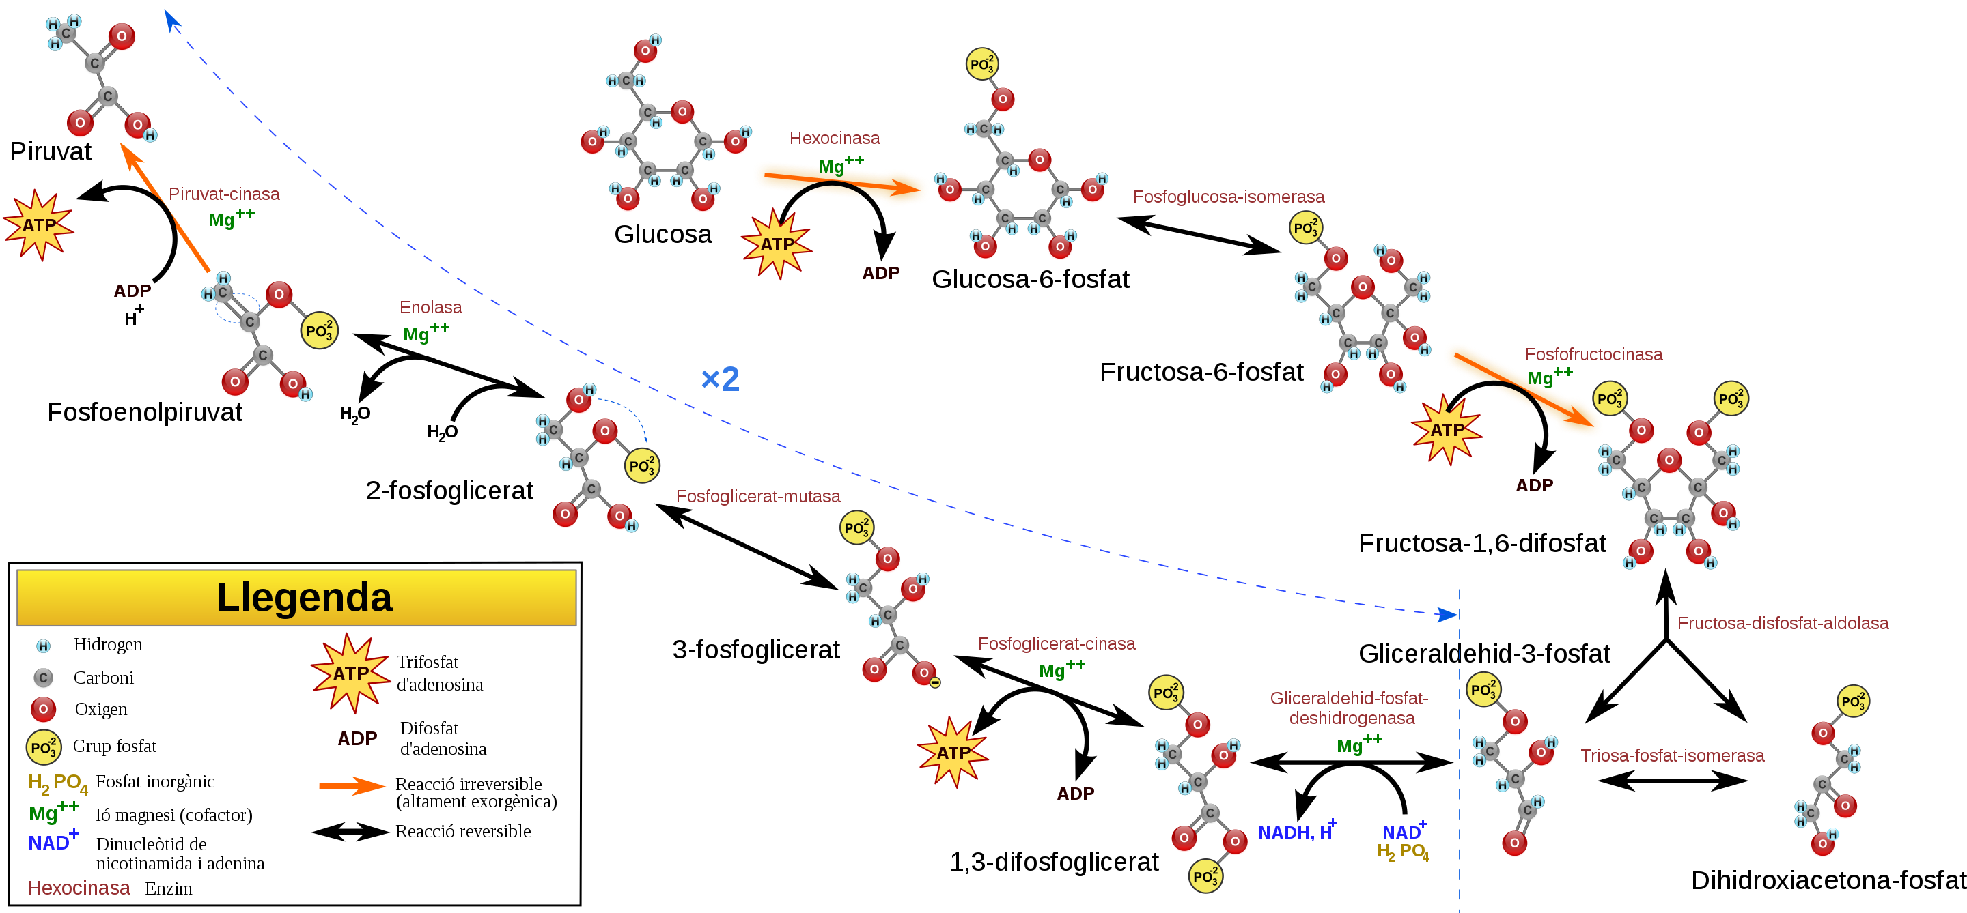

Isozymes of Hexokinase
1
Hexokinase
Mg²⁺
Hexokinase I
Hexokinase II
Hexokinase III
Hexokinase IV (also called Glucokinase)
Make it possible for different organs/systems to regulate glucose-mediated processes differently
Notes:
Isozymes, if you will recall from last semester, are proteins that are encoded by different genes, but perform the same function. They can have different enzyme kinetics, expression patterns in different tissues, have different post-translational modifications and bind with different allosteric effectors. This affords the body to have differential control over the same processes in different locations within the body. Within vertebrates, there are four important hexokinase isozymes that vary in subcellular locations and kinetics parameters. This allows the differential phosphorylation of hexoses in the body with respect to different local conditions, and physiological function. They are designated hexokinases I, II, III, and IV. All of the Hexokinases can use multiple hexoses as substrates, in addition to glucose. These include mannose, fructose, and 2-deoxyglucose. Hexokinase IV is also often referred to as Glucokinase and is specific to the Liver and Pancreas.

Slide 3
Fate of Glucose-6-Phosphate
Glycogen
Hexosamine Biosynthesis
Glucose 1-phosphate
PENTOSE PHOSPHATE
PATHWAY
Glucose 6-phosphate
Ribose +
NADPH
GLYCOLYSIS
Most cells (esp.
Muscle and Brain)
Most cells
Liver
Pancreas
Pyruvate
Anaerobic
Aerobic
Glucose
G6P = sensor for
Insulin release
Lactate
CO₂ and H₂O
To Blood Stream
Notes:
Recall that glucose-6-phosphate (G6P) has several potential fates within the body. It can be used as an energy source through the pathways of glycolysis and aerobic respiration. Short bursts of anaerobic respiration can also be sustained in animals that convert pyruvate into lactate. G6P can also be dephosphorylated in the liver and released back into the bloodstream to maintain homeostatic balance. Within this process the pancreas uses G6P as a sensor to determine when to secrete insulin and glucagon. The G6P can also serve as a building block for anabolic processes. It can be converted to ribose through the Pentose Phosphate Pathway where it will be used in the construction of nucleotide monomers. It can also be used for the formation of hexosamines used in proteoglycan and glycoprotein formation.

Slide 4

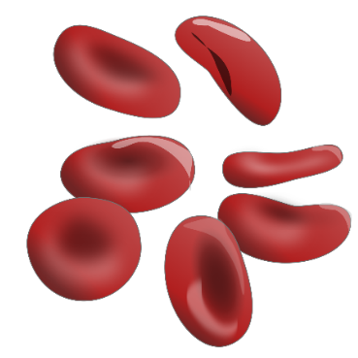
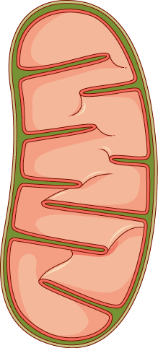
Hexokinase I
Primarily in Brain and Red Blood Cells
Low Km and is inhibited by the product, G6P
Negative feedback inhibition is overcome by low levels of inorganic phosphate
Glucose + ATP
G6P + ADP
HKI
Brain
Red Blood Cells
Mitochondria
Images from Smart Servier Medical Art and Jessica Polka
Notes:
Now let’s take a look at the different isozymes of hexokinase in a little more detail. Hexokinase I (HKI) is found widely distributed throughout the body, and is the main form expressed in brain tissue and red blood cells. In brain cells, this protein is localized to the mitochondria. This colocalization aids in the efficient coupling of glycolysis with the kreb cycle and oxidative phosphorylation pathways inside the mitochondria. It also ties the activity of HKI with oxidative phosphorylation and energy load, as HKI preferentially uses mitochondrially-derived ATP in its reaction mechanism. HK association with the mitochondria also has a cellular protective effect, reducing the potential for programmed cell death or apoptosis to occur. We will explore this role of HKs in a later lecture. Red Blood Cells (RBCs), on the other hand, are highly differentiated cells with a very short lifespan. They are replaced in humans approximately every two weeks. RBCs are enucleated and do not have mitochondria, and thus, only generate ATP through the process of glycolysis. the HKI protein is free floating in the cytoplasm in this system. HKI has a low Km, meaning that it has high affinity for glucose and is active at low substrate concentrations. It is also inhibited by the product Glucose-6-Phosphate (G6P) in the process of negative feedback inhibition. Essentially, you do not want to waste time and energy making more than you need. Low to moderate levels of free inorganic phosphate can overcome this negative feedback inhibition.

Slide 5
Hexokinase II
Primarily in Skeletal Muscle, Heart Muscle, and Adipose tissue (insulin-sensitive tissues)
Low Km or high activity when low substrate concentration
Negative feedback inhibition by G6P
Inorganic phosphate (P_{i}) does NOT relieve G6P inhibition.
Localizes to the outer membrane of the mitochondria
Protective Role in Programmed Cell Death (Apoptosis)
Upregulated in many types of tumors
Notes:
HKI and HKII are expressed in Skeletal Muscle, Heart Muscle, and other insulin sensitive tissues. While it is thought that HKI is providing a predominantly catabolic role for the use of G6P in energy production, HKII may play a more pertinent role in anabolic processes, providing G6P for conversion to G1P and subsequent utilization in Glycogenesis. Both HKI and HKII are localized to the outer membrane of the mitochondria. However, while 95% of HKI is associated with mitochondria, only about 70% of HKII is associated, with the remaining HKII fractionating with the cytosolic proteins. This could help to explain the heightened role of HKII in anabolic glycogenesis processes within skeletal muscle, that is not found in brain tissue only expressing the HKI enzyme. HKII is also often overexpressed in tumor cells, where it is associated with higher mortality rates. It has also been linked with the processes of metastasis and with the development of drug resistance. Similar to HKI, HKII also has a low Km and is inhibited by G6P, although this inhibition is not released by the presence of inorganic phosphate.

Slide 6
Hexokinase III
is substrate-inhibited by glucose at physiologic concentrations. Little is known about the regulatory characteristics of this isoform.
Either not expressed or only minor expression within most tissues
But may be involved with cellular stress response, such as hypoxia
Notes:
Not a lot is known about the functions of HKIII. It may be an inactive gene duplication or remnant. Under basal conditions, it is not expressed to appreciable levels in any major tissues and in studies on its biological activity it is inhibited by glucose as physiological concentrations. However, there are some studies that suggest it may be expressed during cellular stress responses, such as hypoxia, although its function in these types of responses are not currently understood.

Slide 7
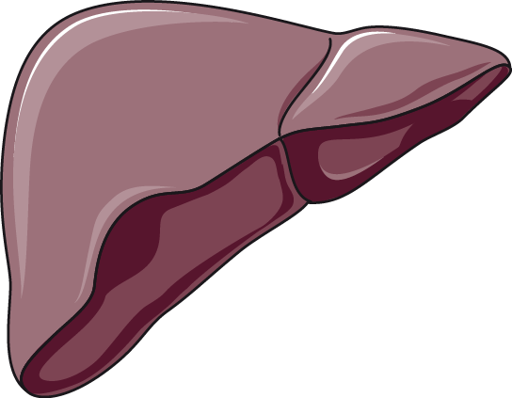
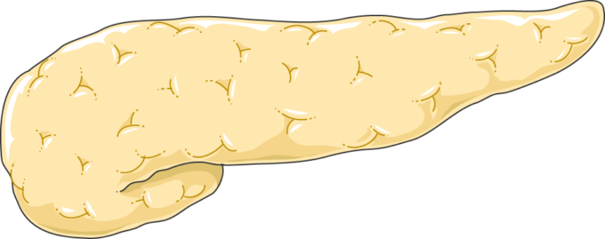
Hexokinase IV (Glucokinase)
Primarily in Liver and Pancreas
  Acts as a sensor in the pancreas to elicit insulin release
  In liver, glucose-6-phosphate used primarily for production of glycogen
  Has a lower affinity for glucose (higher Km).
  It operates only when blood glucose levels are high
  But it is NOT inhibited by Glucose-6-phosphate
Liver
Pancreas
Images from Smart Servier Medical Art
Notes:
Hexokinase IV or Glucokinase is specifically expressed within the liver and pancreas. HKIV is cytoplasmic and not tethered to the mitochondria. Activity within the pancreas serves as a sensor for the release of insulin, and in the liver for the production of G6P that will fuel glycogen production. HKIV has a higher Km than HKI and HKII, thus it does not work efficiently at low concentrations of glucose. However, it is NOT inhibited by the product, G6P. Thus, it will continue to make G6P, even when levels are high. This helps to explain the high levels of glycogen that are stored within liver tissue, but not elsewhere in the body. This also ensures that the sensor system in the pancreas will accurately read blood glucose levels.

Slide 8
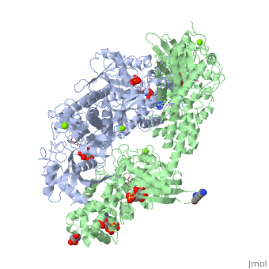
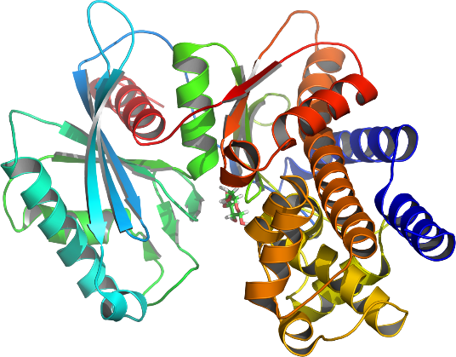
Genetic Structure of Hexokinase Isoforms
HK I
Mitochondrial
Binding Domain
N-Terminal Domain
C-Terminal Domain
Linker
HK I
HK II
HK III
HK IV
HK IV
Catalytically Inactive
Catalytically Active
Figures from Proteopedia and JAG123
Notes:
The four isozymes of HK share high homology with one another and appear to have arisen from gene duplication events. The left hand panel shows the linear protein domains of the different HK isozymes. Both HKI and HKII contain an N-terminal domain that localizes the protein to the mitochondrial membrane. HKI, II, and III all contain two repeating catalytic domains in the N- and C-terminals. However, mutations in the N-terminal domain in HKI and HKIII render them inactive (they are shown in red above). Both catalytic domains in HKII retain activity. HKIV (Glucokinase) is the most truncated isozyme, only containing the C-terminal catalytic domain. The lower right diagram shows the ribbon diagram of HKIV. Upstream promoter regions of HKIV (not shown in this diagram) also differ, allowing for controlled expression in the liver and pancreas. Feedback inhibition in HKI and HKII occur through the N-terminal catalytic domain. The upper diagram on the right shows an HKI dimer complexed with an ATP analog, glucose, G6P, and Mg²⁺ ion. HKI dimerizes when concentrations of the inhibitor, G6P, are high enough. Dimerization reduces the biological activity of the enzyme in brain tissue. Dimerization of HKI can be reversed in the presence of low levels of inorganic phosphate.

Slide 9
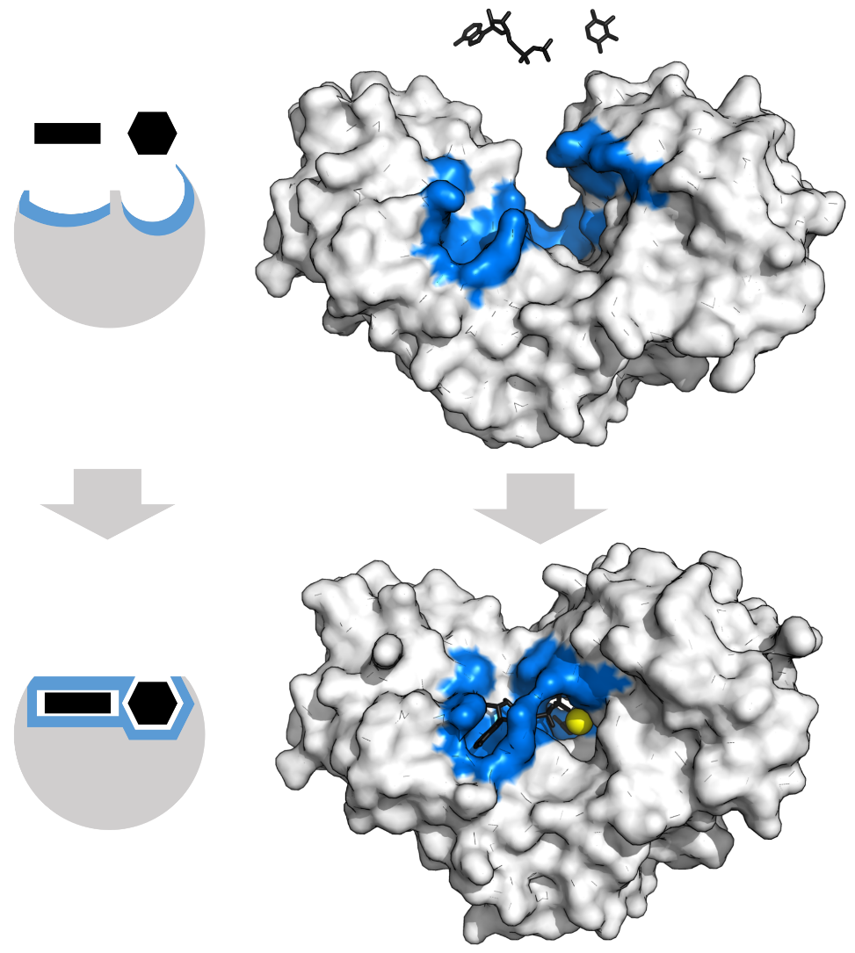
Hexokinases use Induced Fit
Figure from Thomas Shafee
Notes:
In the above diagram, HKIV is used as a model for understanding enzyme conformation during the reaction. HKs change shape by induced fit upon substrate binding. HK has a large induced fit motion that closes over the substrates ATP and xylose. The binding sites are shown in blue, substrates in black and the Mg²⁺ cofactor in yellow (PDBs:2E2N,2E2Q).

Slide 10
Summary of Hexokinases
Isozyme expression patterns of HKI to HKIV in different regions of the body help to differentially regulate the processes of glycolysis, glycogenesis, and the homeostatic regulation of blood glucose levels by the liver and pancreas.
HKI – high expression in brain and RBCs (primary catabolic processes – glycolysis)
HKII – high expression in insulin-dependent tissues (possible role in anabolic processes of glycogenesis)
HKIV (Glucokinase) – Liver and pancreas specific; control blood glucose levels.
Notes:
In summary, the isozyme expression patterns of HKs differentially regulate the fate of glucose within those tissues. Within brain tissue and red blood cells where only HKI is present, glucose is predominantly used in the glycolytic pathway for energy production. In muscle tissue, the presence of HKII allows for increased use of glucose for the formation of glycogen. HKIV expression in the pancreas and liver allow for the homeostatic regulation of blood glucose levels.

