Slide 1
Glycogen Biosynthesis and Metabolism – Part 4
Mechanism of Glycogenolysis
Notes:
Welcome to part 4 of our series on Glycogen Biosynthesis and Metabolism. In the previous section, you learned that glucagon signaling downregulates glycogen synthesis. Glucagon signaling also upregulates glycogen breakdown, called glycogenolysis. In this section, we will take a look at the enzymes involved with glycogen breakdown. Then in section 5, we will take a look at how this pathway is regulated during glucagon signaling.

Slide 2
Mechanism of Glycogenolysis
Requires Two Enzymes
Glycogen Phosphorylase
Glycogen Debranching Enzyme
Notes:
Only two enzymes are required for the breakdown of glycogen, the glycogen phosphorylase enzyme, and the glycogen debranching enzyme.

Slide 3
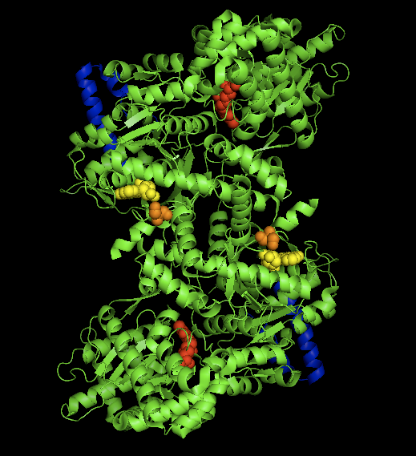
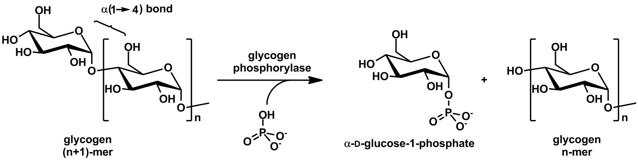
Glycogen Phosphorylase
Catalyzes the release of single glucose molecules from α1→4 linkages at the nonreducing ends of the molecule
Image from Ascherer730
Image from Michal Sobkowski
Notes:
Glycogen phosphorylase catalyzes the release of glucose 1-phosphate from the alpha 1→4 non-reducing ends of glycogen

Slide 4
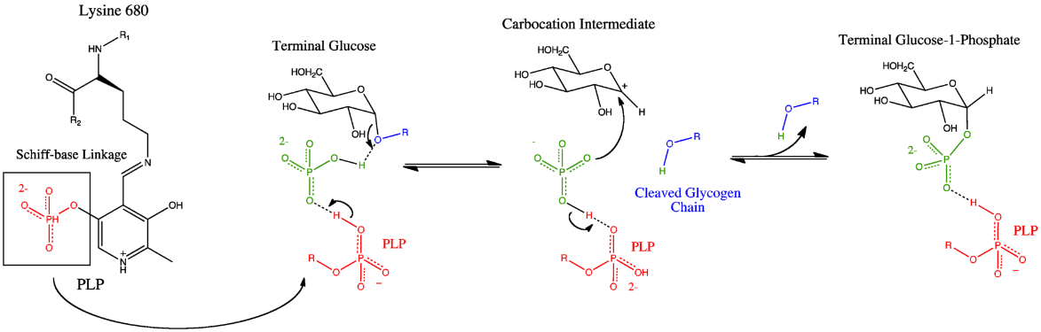
Glycogen Phosphorylase Mechanism
Glycogen Phosphorylase
Is a dimer with two active sites
has a pyridoxal phosphate (PLP, derived from Vitamin B₆) at each catalytic site.
PLP is linked to a K residue via a Shiff-base
Image modified from Ascherer730
Notes:
The enzyme is a homodimer with two active sites. It also requires a cofactor, pyridoxyl phosphate (PLP) to be functional. The PLP is derived from the Vitamin B_{6.} You may have heard previously that if you are low on B-vitamins a common symptom is lethargy or a lack of energy. We will continue to see that the B-vitamins provide essential cofactors for enzymes involved in the production of ATP. Thus, if you lack B-vitamins, you are, in fact, not efficiently producing ATP. The PLP cofactor of GP is attached covalently to the enzyme through a Schiff-base linkage with a Lysine (K) residue.

Slide 5
Glycogen Phosphorylase Mechanism
Image modified from Ascherer730
Notes:
When glycogen phosphorylase binds with glycogen a free inorganic phosphate anion is positioned by the PLP and the enzyme active site in proximity with the anomeric carbon position of the non-reducing end residue of the glycogen molecule. The oxygen involved in the glycosidic bond attacks the partially charged hydrogen associated with the phosphate ion, leading to the cleavage of the glycosidic bond. The cleaved glycogen chain leaves the active site and one of the phosphate oxygens attacks the carbocation intermediate created during the cleavage.

Slide 6
Glycogen Phosphorylase Mechanism
Image modified from Ascherer730
Notes:
This results in the release of the terminal glucose residue as glucose 1-phosphate

Slide 7
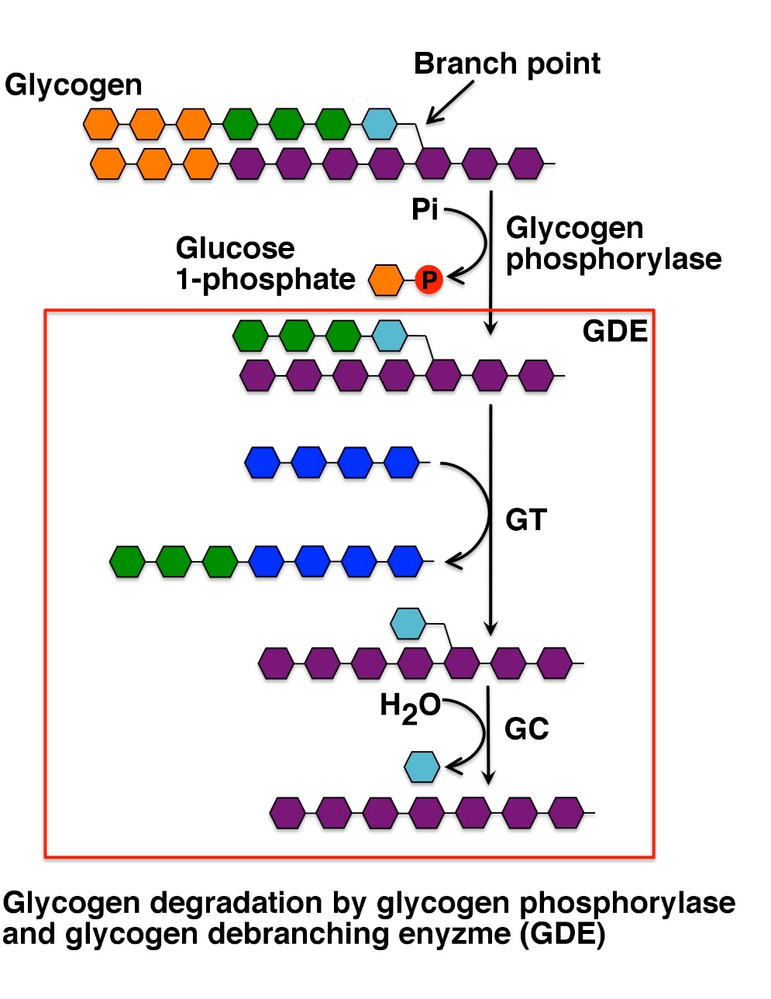
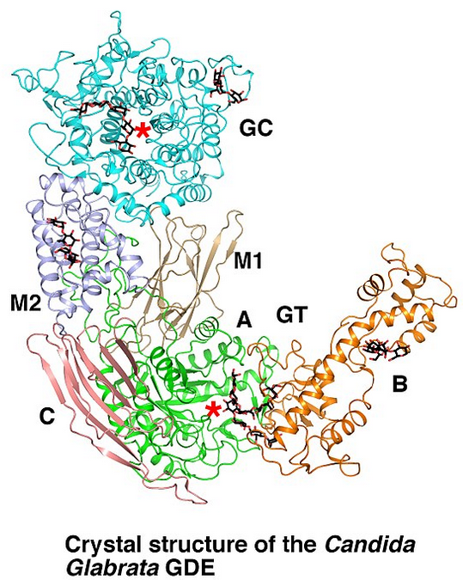
Glycogen Debranching Enzyme
has:
Transferase Activity (GT)
Glucosidase Activity (GC)
Image modified from XiangSong
Notes:
Glycogen phosphorylase cannot cleave the alpha 1→6 linkages, and it also cannot cleave alpha 1→4 linkages that are within 4-residues of an alpha 1→6 linkage (the glycogen chain will no longer fit into the active site of the enzyme) The Glycogen Debrancing Enzyme (GDE) has two catalytic activities that enable it to deal with this problem. The first catalytic activity is a Glycosyl Transferase (GT) activity. In this process the three remaining alpha 1→4 extended units on the branch site (colored in green) are clipped off of the branch site and are attached onto a straight chain of alpha 1→4 extended glucose residues. The second part of the reaction requires the Glucosidase (GC) activity that mediates the hydrolysis of the alpha 1→6 glycosidic bond and release of free glucose in the process. Glycogen Phosphorylase can then resume the breakdown of the remaining alpha 1→4 chain.

Slide 8
Glycogenolysis in Liver Cells
Results in the release of large amounts of Glucose 1-phosphate
Glucose 1-phosphate
Phosphoglucomutase
Glucose 6-phosphate
Glucose 6-phosphatase
(only in Liver Cells!)
Glucose
Released into Bloodstream
Notes:
The liver cell has now released large quantities of glucose 1-phosphate from glycogen, as well as a smaller amount of free glucose from the clipped branch residues. The free glucose can be transported to the blood stream straight away, but the glucose 1-phosphate must be dephosphorylated prior to release.

Slide 9

Dephosphorylation of Glucose in Liver
P
Glucose
6-phosphate
To the blood
P
Cytoplasm
T1
SP
T2
T3
G-6-Pase
Lumen of the ER
P
P
Notes:
The dephosphorylation of glucose only occurs in liver cells, as this is the primary location for the regulation of blood glucose levels. Free glucose can exit the cell while phosphorylated forms are trapped inside the cell. To mediate the dephosphorylation of glucose, glucose 6-phosphate is transported from the cytoplasm into the lumen of the endoplasmic reticulum (ER) through transporter 1 (T1). The glucose 6-phosphatase (G-6-Pase) then cleaves the phosphate from the substrate, releasing inorganic phosphate (P) and glucose (red molecule). The inorganic phosphate is then transported back into the cytoplasm through transporter 2 (T2) and glucose is transported through Transporter 3 (T3). Free glucose is then transported back into the bloodstream through a glucose (GLUT) transporter (not shown)

