Slide 1
Gluconeogenesis
Part 2: Malate-Aspartate Shuttle System
Notes:
Welcome to part 2 of our lecture series on Gluconeogensis. This tutorial will cover the functions of the malate-aspartate shuttle in the transport of oxaloacetate from the matrix of the mitochondria to the cytosol.

Slide 2
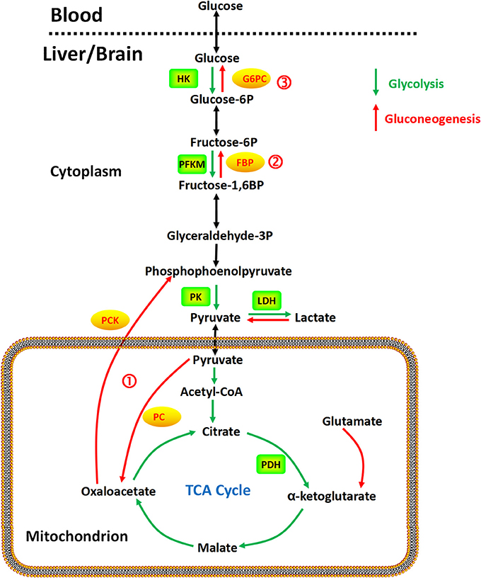
Gluconeogenesis Overview
Step 1
  Pyruvate to Phosphenolpyruvate
Figure from: Yip, J, et al (2017) Front. Pharmacol. 10.3389
Notes:
In the last section, we discussed the pyruvate carboxylase enzyme reaction mechanism in the formation of oxaloacetate from pyruvate. This intermediate is required to generate phosphoenolpyruvate in a cytosolic reaction mediated by the phosphoenolpyruvate carboxykinase enzyme.

Slide 3
Next Reaction….
Conversion of oxaloacetate to phosphoenolpyruvate by the Phosphoenolpyruvate Carboxykinase (PEPCK)
  Carboxy = removal of CO₂
  Kinase = addition of phosphate group
Problem:
  Oxaloacetate is produced in the Matrix of the Mitochondria
  PEPCK is is the Cytosol
Notes:
PEPCK will mediate the removal of the carbon dioxide from oxaloacetate, followed by the phosphorylation of the intermediate to yield phosphoenolpyruvate. However, the transport of oxaloacetate from the matrix to the cytosol where it can be used as a substrate for this reaction, is a problem! Oxaloacetate cannot cross the innermembrane of the mitochondria.

Slide 4

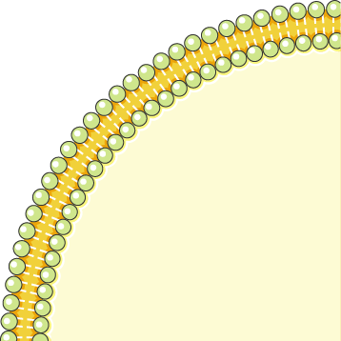
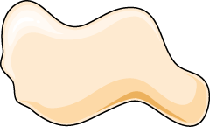
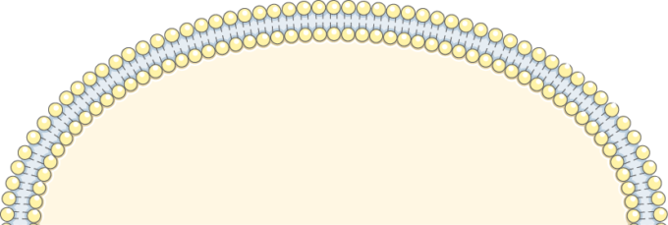
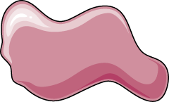
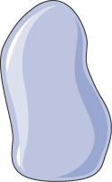
Oxaloacetate to Aspartate to Oxaloacetate
GDP
Phosphoenolpyruvate
PEPCK
GTP
Aspartate
Oxaloacetate
AAT
Aspartate
Glutamate
Aspartate
ADP
ATP
AAT
Pyruvate
Glutamate
Oxaloacetate
Pyruvate Carboxylase
Image modified from: SMART Servier Medical Art
Notes:
To leave the mitochondrial matrix, oxaloacetate has to first be converted to aspartate by the aspartate aminotransferase enzyme (AAT). It can then be transported to the intermembrane space of the mitochondria through an antiporter that transports one molecule of aspartate out of the matrix and one molecule of glutamate into the matrix. Once in the intermembrane space, the aspartate can pass freely through a pore in the outer mitochondrial membrane. Once in the cytoplasm, aspartate is reconverted to oxaloacetate using the cytoplasmic aspartate aminotransferase enzyme. Oxaloacetate can then be used as a substrate by the Phosphoenolpyruvate carboxykinase enzyme. (PEPCK)

Slide 5
Oxaloacetate to Aspartate to Oxaloacetate
GDP
Phosphoenolpyruvate
PEPCK
GTP
Aspartate
Oxaloacetate
AAT
Aspartate
Glutamate
Aspartate
ADP
ATP
AAT
Pyruvate
Glutamate
Oxaloacetate
Pyruvate Carboxylase
Image modified from: SMART Servier Medical Art
Notes:
The glutamate/aspartate transporter has some additional complexities associated with it. It cannot function on its own. It requires the coordinate functioning of the malate/αλπηα-ketoglutarate antiporter. Together, these antiporters are known as the Malate-Aspartate Shuttle System. We will focus on the details of this system in the next few slides.

Slide 6
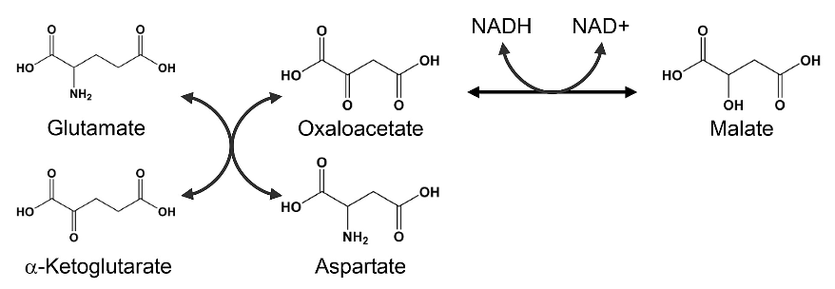
Malate – Aspartate Shuttle System
Malate Dehydrogenase
Aspartate Aminotransferase
Figure modified from: Son, H.F. and Kim, J-J. (2016) PLoS One 10.1371
Notes:
The Malate-Aspartate Shuttle System is dependent on the functioning of two enzymatic processes. The first is the aspartate aminotransferase that was indicated more simplistically on the previous two slides. The aspartate aminotransferase enzyme can utilize glutamate as an amine donor to generate aspartate from oxaloacetate. Alpha-ketoglutarate is also formed in this process. Depending on substrate concentrations and other regulatory mechanisms, this enzyme can also work in the reverse reaction to produce glutamate and oxaloacetate. In a different reaction using Malate Dehydrogenase, oxaloacetate can be reduced to form malate using a molecule of NADH as the electron donor.

Slide 7

Malate – Aspartate Shuttle System
Aspartate Aminotransferase
Oxaloacetate
Glutamate
Malate Dehydrogenase
Malate
α-ketoglutarate
NADH
Aspartate
NAD⁺
IM Space
Matrix
Aspartate
Glutamate
Malate
α-ketoglutarate
Malate Dehydrogenase
Oxaloacetate
NAD⁺
Aspartate Aminotransferase
NADH
Notes:
The malate dehydrogenase enzyme is expressed to high levels in the cytoplasm of liver cells as well as in the matrix of the mitochondria. This enzyme is a component of the Kreb Cycle where it mediates the formation of oxaloacetate in the last step of the cycle. Within the cytoplasm it predominantly converts oxaloacetate to malate. The malate can then be shuttled into the matrix of the mitochondria through the malate/alpha-ketoglutarate antiporter. In this antiporter, malate moves into the mitochondrial matrix while alpha-ketoglutarate moves into the intermembrane space (and subsequently into the cytosol of the cell). Together with aspartate, it can be used by cytoplasmic aspartate aminotransferase to produce glutamate and oxaloacetate. This is the oxaloacetate pool that is then utilized in the gluconeogenic pathway when PEPCK is active. The glutamate generated from this reaction is transported back into the matrix of the mitochondria through the aspartate/glutamate antiporter. The pool of aspartate in the matrix of the mitochondria is supplied by the reaction of the aspartate aminotransferase enzyme, which completes the reverse reaction from the one seen in the cytoplasm. In the matrix, aspartate aminotransferase uses glutamate and oxaloacetate as substrates to generate aspartate and alpha-ketoglutarate. This enables the transport of aspartate and glutamate through their specific antiporter. Within the gluconeogenic pathway, heightened levels of oxaloacetate are produced in the matrix of the mitochondria. Oxaloacetate is then converted to aspartate and transported across the innermembrane, where it can subsequently be converted back into oxaloacetate and used for the production of glucose.

Slide 8
Sugar Phosphate Reactions
Glucose
P_{i}
ATP
Hexokinase
Glucose
6-phosphatase
ADP
Glucose 6-phosphate
H₂O
ATP
Fructose 6-phosphate
P_{i}
PFK-1
FBPase-1
ADP
H₂O
Fructose 1,6-bisphosphate
Kinases (Transferases)
Hydrolases
Glycolysis
Gluconeogenesis
Notes:
The final two novel reactions in the gluconeogenic pathway are both hydrolase reactions involving the hydrolysis of the phosphate group from the sugar. This is notable, as it does not produce energy, the way the reverse kinase reactions do in the second half of the glycolytic pathway. Thus, there is no substrate level phosphorylation that occurs in the gluconeogenic pathway.

Slide 9
Energy Demands of Gluconeogenesis
6 moles of ATP equivalents required to make 1 mole of Glucose
2 ATP + 2 Pyruvate → 2 Oxaloacetate + 2 ADP
2 GTP + Oxaloacetate → 2 Phosphoenolpyruvate + 2 GDP
2 ATP + 2 (3-Phosphoglycerate) → 2 (1,3-Bisphosphoglycerate) + 2 ADP
2 NADH + 2 (1,3 Bisphosphoglycerate) → 2 Glyceraldehyde 3-P + 2 NAD⁺
Over 3 times as much energy required to make glucose from pyruvate than you generate breaking glucose down into pyruvate
Notes:
Overall, there are approximately 6 molar equivalents of ATP required to make 1 mole of glucose. Over 3 times as much energy is consumed during glucose formation than is generated from glycolysis during the breakdown of glucose. Per glucose molecule made, 2 ATP are used in the Pyruvate Carboxylase step, 2 GTP are used in the Phosphoenolpyruvate Carboxykinase step, and 2 ATP are used in the kinase reaction to create 1,3-bisphosphoglycerate from 3-phosphoglycerate. There is also the loss of 2 moles of NADH during the reverse reaction to create Glyceraldehyde 3-phosphate from 1,3-Bisphosphoglycerate, which reduces energy potential through oxidative phosphorylation in the mitochondria. Plus there are energy costs to changing the metabolite pools in the matrix of the mitochondria and for transporting molecules across the mitochondrial membrane that we have not considered here. With that, we will now leave our discussions of glycolysis and gluconeogenesis. In the next lecture series, we will move into the matrix of the mitochondria and focus on the Kreb Cycle and Electron Transport Chain.

