Slide 1
Carbohydrates – Part 1
Monosaccharide Structure
Notes:
Welcome to Part 1 in our series of Carbohydrate lectures. In this section, you will learn about monosaccharide structure. The building blocks of larger carbohydrate polymers.

Slide 2
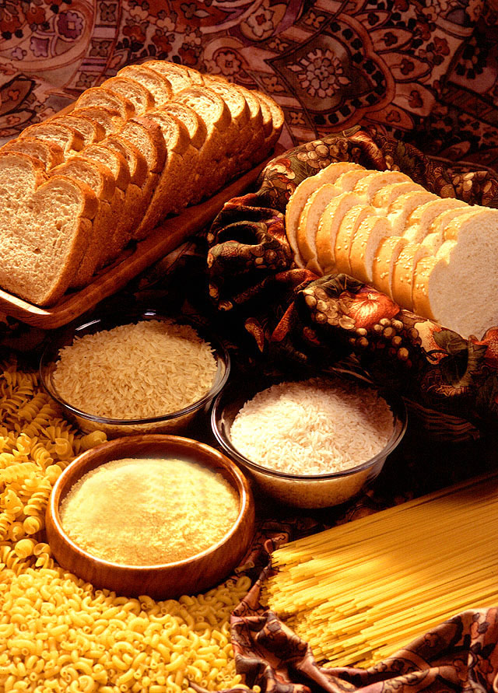
Major Uses of Carbohydrates
Energy, fuels and metabolic intermediates
Precursor of DNA and RNA (Deoxyribose/Ribose)
Structural Support (Cell wall of plants, bacteria, and fungi; cytoskeleton of insects; provide cushion for joints)
Cell-Cell Communication (attached to proteins and lipids, especially in the plasma membrane)
Image By: US Department of Agriculture
Notes:
First, let’s review why learning about carbohydrates is important. Carbohydrates are used by biological systems as fuels and energy resources. Carbohydrates typically provide quick energy and are one of the primary energy storage forms in animals. Carbohydrates also provide the precursors to other major macromolecules within the body, including the deoxyribose and ribose required for nucleic acid biosynthesis. Carbohydrates can also provide structural support and cushioning/shock absorption, as well as cell-cell communication, identification, and signaling.

Slide 3
Basic Carbohydrate Structure
All carbohydrates (or hydrates of carbon) have the following core structure:
Notes:
Carbohydrates, as their name implies, are water hydrates of carbon, and they all have the same basic core formula (CH₂O)_{n} and are always found in the ratio of 1 carbon to 2 hydrogens to 1 oxygen (1:2:1) making them easy to identify from their molecular formula.

Slide 4
Basic Carbohydrate Structure
Monosaccharides – single, simple sugars that are the building blocks of all larger carbohydrate structures.
Disaccharides – Two monosaccharides covalently linked together
Oligosaccharides – A few monosaccharides covalently linked together
Polysaccharides – large polymers consisting of chains of monosaccharide or disaccharide units
Notes:
Carbohydrates can be divided into subcategories based on their complexity. The simplest carbohydrates are the monosaccharides which are the simple sugars required for the biosynthesis of all the other carbohydrate types. Disaccharides consist of two monosaccharides that have been joined together by a covalent bond called the glycosidic bond. Oligosaccharides are polymers that consist of a few monosaccharides covalently linked together, and Polysaccharides are large polymers that contain hundreds to thousands of monosaccharide units all joined together by glycosidic bonds. The remainder of this lecture will focus on monosaccharides

Slide 5
Aldoses and Ketoses
Are named based on:
  Their functional group (aldehyde or ketone)
    Aldoses contain aldehydes
    Ketoses contain ketones
  How many carbons that they contain, with the most common being:
    3 carbons = Triose
    4 carbons = Tetrose
    5 carbons = Pentose
    6 carbons = Hexose
    7 carbons = Heptose
Notes:
Monosaccharides all have alcohol functional groups associated with them. In addition they also have one additional functional group, either an aldehyde or a ketone. Monosaccharides containing an aldehyde are called aldoses, while monosaccharides containing ketones are called ketoses. Monosaccharides are also named for the number of carbons that they contain. 3 carbon sugars are trioses, 4 are tetroses, 5 are pentoses, 6 are hexoses and so on.

Slide 6
Fischer Projections
Are a way to visualize a 3-dimensional molecule in 2-dimensions
1
1
2
2
3
3
4
4
5
5
D-Ribose
D-Ribose
Fischer Projection
3-D View
http://leah4sci.com/converting-sawhorse-to-fischer-projections-tutorial-video/
Notes:
Fischer projections are a useful way to represent the 3-dimensional structure of sugars in only two dimensions. The diagram on the right shows the 3-dimentional view of D-ribose (an aldopentose – a sugar containing 5 carbons and an aldehyde functional group). On the left hand side is the Fischer projection. This is a simplified drawing of the 3-D model. In the Fischer projection it is always noted that the horizontal bonds are in the orientation where they are coming out of the plane of the paper, towards the viewer and that this projection represents the 3-D view shown on the right. Also note the carbon numbering scheme matches that of the IUPAC system that you learned in organic chemistry. The #1 carbon is located nearest the highest priority functional group. For a sugar monomer, this will be the end with the aldehyde or ketone. Thus, D-ribose carbons are numbered 1, 2, 3, 4, and 5 and have the molecular formula C₅H₁₀O₅

Slide 7


Converting Fischer Projection to Line Angle
1
1
2
2
D-Ribose
3
3
4
4
5
5
Fischer Projection
5
4
3
2
1
4
3
2
5
1
Conversion to Line Angle
5
4
3
2
1
Notes:
So how do you convert the Fischer projection back into a line angle drawing, that you are used to doing in organic chemistry? First, you need to think about the perspective that you are looking at the sugar functional groups. In the Fischer projection and subsequent 3-D ribbon view, you are looking at the sugar from the front vantage point (as is our little penguin friend on the slide. See how his back is facing us, as he is looking at the sugar molecule.) In the line angle form, you are laying the sugar down on its side, like the little –OH legs are sticking up into the air. Now your vantage point for looking at the molecule has shifted, and the bee represents the same orientation that our little penguin friend has in the upper diagram. See how all of the OH and H bonds are folding up towards the bee? To finish the conversion to the line angle, all you need to do is rotate the bonds, so that the correct bond angles are shown. For ribose, imagine rotating the 2 carbon to shift it into the down position, as shown in the bottom diagram. When you rotate it, the -H comes our towards you from the plane of the paper, while the –OH goes backwards from the plane of the paper. The same thing occurs when you shift the 4-carbon into the down position….the –H comes out towards you from the plane of the paper and the –OH goes back away from you. This is the correct stereochemistry for D-ribose written in the line angle form. You could also imagine flipping the whole thing over in space, as shown in the top diagram. Both of these line angle drawings represent D-ribose. Drawing line angle presentations of sugars from the Fischer projection takes a little practice, but stereochemistry is very important in sugar chemistry.

Slide 8
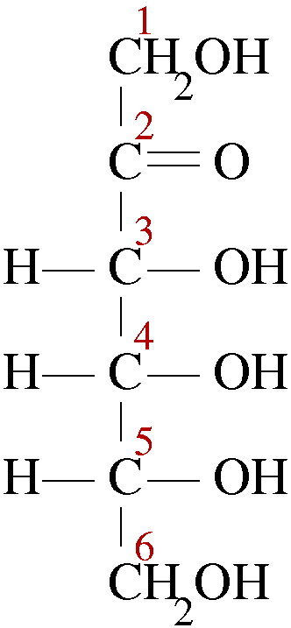
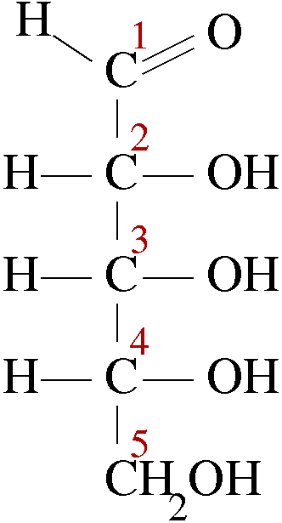
Aldoses and Ketoses
Ketone
Aldehyde
Aldopentose
Ketohexose
Notes:
Hopefully now you can recognize Aldoses from Ketoses, and name them according to how many carbons they contain. The aldopentose on the left with an aldehyde and 5 carbons and the ketohexose on the right with the ketone and 6 carbons.

Slide 9
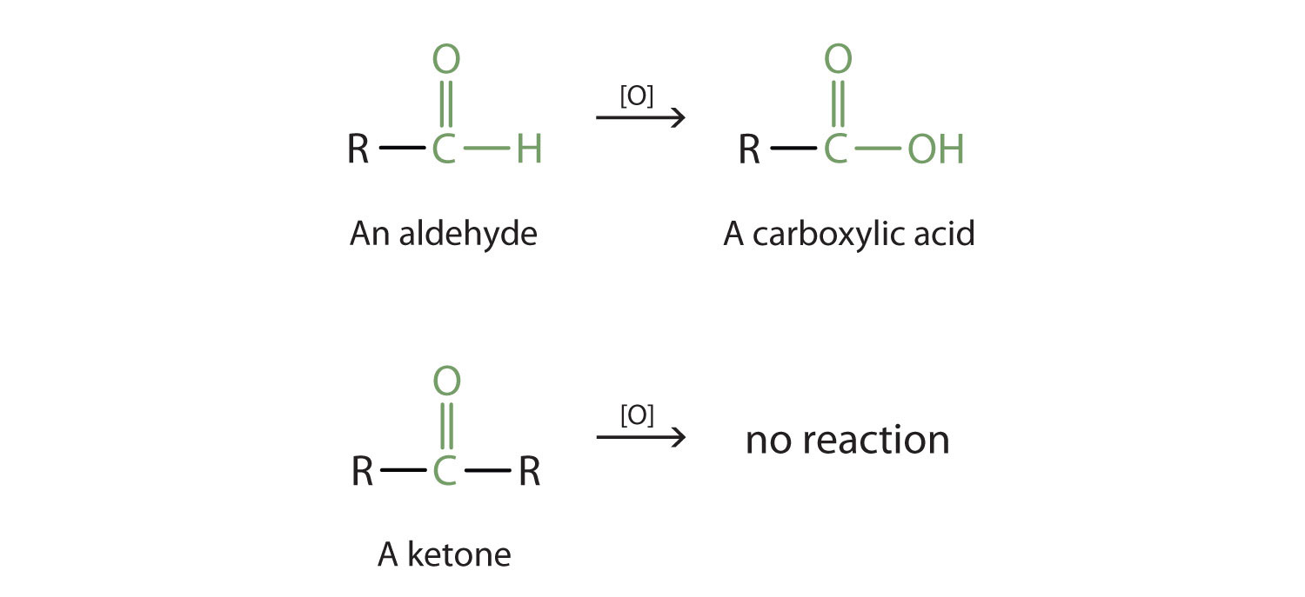
Reactivity of Aldoses vs. Ketoses
Aldoses can be further oxidized to carboxylic acids
Ketones CANNOT be further oxidized
Notes:
Recall that aldehydes and ketones have different oxidative potential. Aldehydes can be further oxidized to a carboxylic acid, whereas the ketone cannot. The ketone is already fully oxidized. These reactions are the same for the aldehydes and ketones found in sugar monomers. Sugars with aldehydes can act as reducing sugars (ie as they are oxidized, they reduce another molecule or act as a reducing agent). Recall that oxidation reactions lose electrons, while reduction reactions gain electrons. Because electrons do not just disappear, these reactions are coupled together. You cannot have oxidation without reduction (or vice versa).

Slide 10
Reactivity of Aldoses vs. Ketoses
Aldoses can be further oxidized to carboxylic acids
Aldoses can act as Reducing Agents
Notes:
The conclusion, aldoses can act as reducing agents, whereas ketoses cannot.

Slide 11
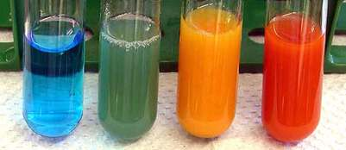
Benedict’s Test for Aldose Sugars
+ 2 Cu²⁺ + 5OH⁻
+ 2 Cu₂O + 3 H₂O
Can be used to test for
Glucose/Sugars in Urine
No Rxn
Trace Aldose
Moderate Aldose
High Aldose
Image Modified From: Brilliant Biology Student
Notes:
This feature has been useful in the detection of aldoses in the urine. Normally, urine does not contain detectable quantities of glucose or other sugar monomers. However, in disease states such as diabetes, glucose is excreted by the kidneys into the urine. The Benedict’s test for aldose sugars can be used clinically to test for aldoses in urine. Note that this reaction reduces the copper from the 2+ state to the 1+ state changing the color of the copper from blue to brick red. Partial reduction of the copper is seen as green to orange.

Slide 12
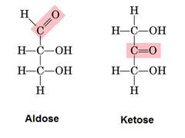
Aldose/Ketose Isomers
Aldoses and Ketoses can be constitutional (structural) isomers – ie they have the same molecular formula, but their atoms are bonded in a different order
Isomerase
Enzymes
C₃H₆O₃
C₃H₆O₃
Notes:
Due to the high number of chiral centers within the sugar structures, they generate a lot of potential isomers. For every aldose structure, there exists a ketose with the same molecular formula. These are known as constitutional or structural isomers (ie they have the same molecular formula but a different bonded order of the atoms).

Slide 13
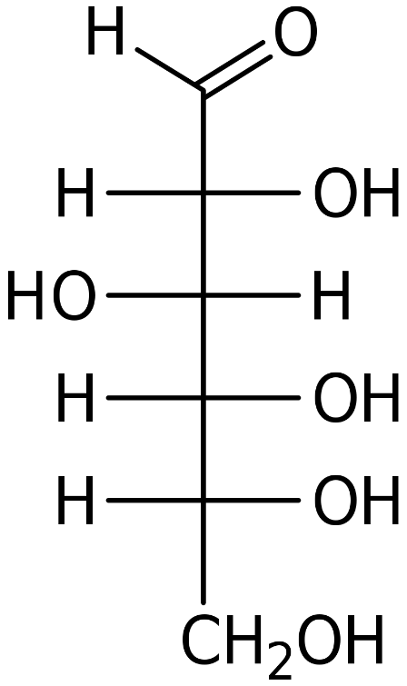
Stereoisomers
Monosaccharides can also have many stereoisomers, depending on how many chiral carbon centers are present.
The number of stereoisomers = 2^{n},
where n = the number of chiral
centers
Glucose has four chiral centers,
therefore there are 2⁴ = 16
stereoisomers for this class of sugar.
2
3
2.
= Achiral
1
D-Glucose
Notes:
Sugars can also form many stereoisomers, ie the sugars have the same molecular formula and the same bonded order, but a different 3-dimensional arrangement in space. To determine how many stereoisomers exist for a particular sugar, you need to first determine how many chiral centers the sugar has. It is best to evaluate every possible carbon for chirality and then count up how many are present. If we start with carbon-1, we can look at the groups that are attached to it. There are only three different groups. Since the oxygen is double bonded to the carbon, the carbon is found to be achiral and does not generate a stereocenter.

Slide 14
Stereoisomers
Monosaccharides can also have many stereoisomers, depending on how many chiral carbon centers are present.
The number of stereoisomers = 2^{n},
where n = the number of chiral
centers
Glucose has four chiral centers,
therefore there are 2⁴ = 16
stereoisomers for this class of sugar.
2.
3
= Chiral
2
4
1
D-Glucose
Notes:
Moving down, lets examine carbon-2. This time, we see that carbon two has four different groups bonded to it, the –H, the –OH, and those two larger groups. Thus, carbon-2 is chiral and does generate a stereocenter.

Slide 15
Stereoisomers
Monosaccharides can also have many stereoisomers, depending on how many chiral carbon centers are present.
The number of stereoisomers = 2^{n},
where n = the number of chiral
centers
Glucose has four chiral centers,
therefore there are 2⁴ = 16
stereoisomers for this class of sugar.
= 4 Chiral
Centers
D-Glucose
Notes:
Following the examination of the remaining carbons, you can see that there are a total of 4 chiral centers in glucose. To determine the number of stereoisomers use the formula, 2^{n}, where n = the number of chiral carbons in the molecule. For glucose, this would be a total of 16 stereoisomers. Note that this only refers to stereoisomers and not to constitutional isomers.

Slide 16
Visualizing Monosaccharides
Position of the –OH to the right or to the left designates the stereochemistry of the sugar
D-Glucose
D-Glucose
Fischer Projection
Rosanoff Projection
(only shows –OH)
Notes:
To look at all the stereoisomers, we will simplify the Fischer projections further to Rosanoff projections. In Rosanoff projections only the direction of the OH group is given by the horizontal bonds. The –H bonds are implied. So for glucose, you can see that the –OH is on the right, the left, and the right and the right.

Slide 17
Visualizing Monosaccharides
Position of the –OH to the right or to the left designates the stereochemistry of the sugar
D-Glucose
D-Glucose
Fischer Projection
Rosanoff Projection
Notes:
The position of the –OH group to the right or to the left designates the stereochemistry of the sugar.

Slide 18
Stereoisomers of Aldohexoses
D-Allose
D-Altose
D-Glucose
D-Mannose
D-Gulose
D-Idose
D-Galose
D-Talose
L-Allose
L-Altose
L-Glucose
L-Mannose
L-Gulose
L-Idose
L-Galose
L-Galose
Notes:
Here are the 16 stereoisomers of glucose or more broadly, aldohexoses.

Slide 19
Stereoisomers
Stereoisomers have the same molecular formula and same bonding order of the atoms. They differ in their orientation in space.
Differ at least at one chiral center (NOT optical)
Stereoisomers
Optical Stereoisomers = mirror images
Diastereomers
Enantiomers
Notes:
Stereoisomers can be classified further as either diastereomers or enantiomers. Enantiomers are a special type of stereoisomers that are also optical isomers. This means that they are the mirror image of the molecule, but that they are not superimposable. Diastereomers differ at one or more stereocenters, but they are not optical isomers (ie. They are not mirror images).

Slide 20
Enantiomer Pairs
D-Allose
D-Altose
D-Glucose
D-Mannose
D-Gulose
D-Idose
D-Galose
D-Talose
L-Allose
L-Altose
L-Glucose
L-Mannose
L-Gulose
L-Idose
L-Galose
L-Galose
Notes:
Interestingly, you may notice that the enantiomer pairs are given the SAME name! They only differ in the designation of D- or L-. This is because enantiomer pairs have the same chemical and physical properties, except for the way that they rotate plane polarized light. They either rotate it in the dextrorotary (right handed or D-) or levorotary (left handed or L-) directions. Thus, enantiomer pairs are very difficult to separate from one another and are given the same name. However, their biological activities are often dramatically different, as enzymes require the correct structure to bind with a molecule. The wrong stereoisomer will not bind an enzyme of interest.

Slide 21
Enantiomer Pairs
D-Allose
D-Altose
D-Glucose
D-Mannose
D-Gulose
D-Idose
D-Galose
D-Talose
L-Allose
L-Altose
L-Glucose
L-Mannose
L-Gulose
L-Idose
L-Galose
L-Galose
Notes:
Each sugar has a mirror image or an enantiomer

Slide 22
Enantiomer Pairs
D-Allose
D-Altose
D-Glucose
D-Mannose
D-Gulose
D-Idose
D-Galose
D-Talose
L-Allose
L-Altose
L-Glucose
L-Mannose
L-Gulose
L-Idose
L-Galose
L-Galose

Slide 23
Enantiomer Pairs
D-Allose
D-Altose
D-Glucose
D-Mannose
D-Gulose
D-Idose
D-Galose
D-Talose
L-Allose
L-Altose
L-Glucose
L-Mannose
L-Gulose
L-Idose
L-Galose
L-Galose

Slide 24
Enantiomer Pairs
D-Allose
D-Altose
D-Glucose
D-Mannose
D-Gulose
D-Idose
D-Galose
D-Talose
L-Allose
L-Altose
L-Glucose
L-Mannose
L-Gulose
L-Idose
L-Galose
L-Galose

Slide 25
Enantiomer Pairs
D-Allose
D-Altose
D-Glucose
D-Mannose
D-Gulose
D-Idose
D-Galose
D-Talose
L-Allose
L-Altose
L-Glucose
L-Mannose
L-Gulose
L-Idose
L-Galose
L-Galose

Slide 26
Enantiomer Pairs
D-Allose
D-Altose
D-Glucose
D-Mannose
D-Gulose
D-Idose
D-Galose
D-Talose
L-Allose
L-Altose
L-Glucose
L-Mannose
L-Gulose
L-Idose
L-Galose
L-Galose

Slide 27
Enantiomer Pairs
D-Allose
D-Altose
D-Glucose
D-Mannose
D-Gulose
D-Idose
D-Galose
D-Talose
L-Allose
L-Altose
L-Glucose
L-Mannose
L-Gulose
L-Idose
L-Galose
L-Galose

Slide 28
Enantiomer Pairs
Same Molecular Formula
Mirror Images
Same Chemical and Physical Properties (Except for rotation of plane polarized light)
Given the SAME NAME!!
D-Glucose
L-Glucose
Notes:
In summary, enantiomer pairs have the same molecular formula, are mirror images of one another, have the same chemical and physical properties (except for the rotation of plane polarized light AND their ability to interact with biological molecules!). Thus they are given the same name with the D- or L-designation.

Slide 29
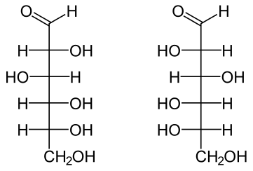
D- and L- Conformations
D- and L- conformations determined the position of the –OH at the chiral center farthest away from the aldehyde or ketone group
D- = the –OH to the right
L- = the –OH to the left
D-Glucose
L-Glucose
Notes:
How are the D- and L- conformations determined? To determine D- or L-designation, look at the chiral center the farthest away from the major functional group (the aldehyde or the ketone). For glucose, this is carbon-5. one, two, three, four, five. If the –OH is on the right side, it is the D-conformation. If the –OH is on the left, it is in the L-conformation.

Slide 30
D- and L- Conformations
Most sugars in nature are in the
D-conformation
D-Glucose
L-Glucose
Notes:
Most of the sugars found in nature are in the D-conformation.

Slide 31
Stereoisomers
Stereoisomers have the same molecular formula and same bonding order of the atoms. They differ in their orientation in space.
Differ at least at one chiral center (NOT optical)
Stereoisomers
Optical Stereoisomers = mirror images
Diastereomers
Enantiomers
Notes:
How about the diastereomers? These are the stereoisomers that differ in one or more chiral centers, but are not mirror images.

Slide 32
Diastereomers
D-Allose
D-Altose
D-Glucose
D-Mannose
D-Gulose
D-Idose
D-Galose
D-Talose
L-Allose
L-Altose
L-Glucose
L-Mannose
L-Gulose
L-Idose
L-Galose
L-Galose
Notes:
All of the other pairings on the slides are classified as diastereomers.

Slide 33
Diastereomers
D-Allose
D-Altose
D-Glucose
D-Mannose
D-Gulose
D-Idose
D-Galose
D-Talose
L-Allose
L-Altose
L-Glucose
L-Mannose
L-Gulose
L-Idose
L-Galose
L-Galose
Notes:
Note that diastereomer pairs all have the same formula, but they do have different physical and chemical characteristics, and thus, have different names.

Slide 34
Diastereomers
D-Allose
D-Altose
D-Glucose
D-Mannose
D-Gulose
D-Idose
D-Galose
D-Talose
L-Allose
L-Altose
L-Glucose
L-Mannose
L-Gulose
L-Idose
L-Galose
L-Galose

Slide 35
Diastereomers
Differ only at 1 stereocenter
D-Allose
D-Altose
D-Glucose
D-Mannose
D-Gulose
D-Idose
D-Galose
D-Talose
Differ at multiple stereocenters
L-Allose
L-Altose
L-Glucose
L-Mannose
L-Gulose
L-Idose
L-Galose
L-Galose
Notes:
Some diastereomers differ only at one position, while others differ at multiple stereocenters.

Slide 36
Stereoisomers
Stereoisomers
Diastereomers
Enantiomers
Special subclass of diastereomer that only differ in stereochemistry at one chiral center
Epimers
Notes:
The pairs that differ at only one chiral center are given a special name. They are called epimers. Enzymes in the class of isomerases that alter a compound into its epimer are called Epimerases.

Slide 37
Can you identify the epimer pairs of D-Allose?
D-Allose
D-Altose
D-Glucose
D-Mannose
D-Gulose
D-Idose
D-Galose
D-Talose
L-Allose
L-Altose
L-Glucose
L-Mannose
L-Gulose
L-Idose
L-Galose
L-Galose
Notes:
Come back to this slide and try to find all of the Epimer pairs of D-allose. You should find four (since there are four chiral centers).

Slide 38
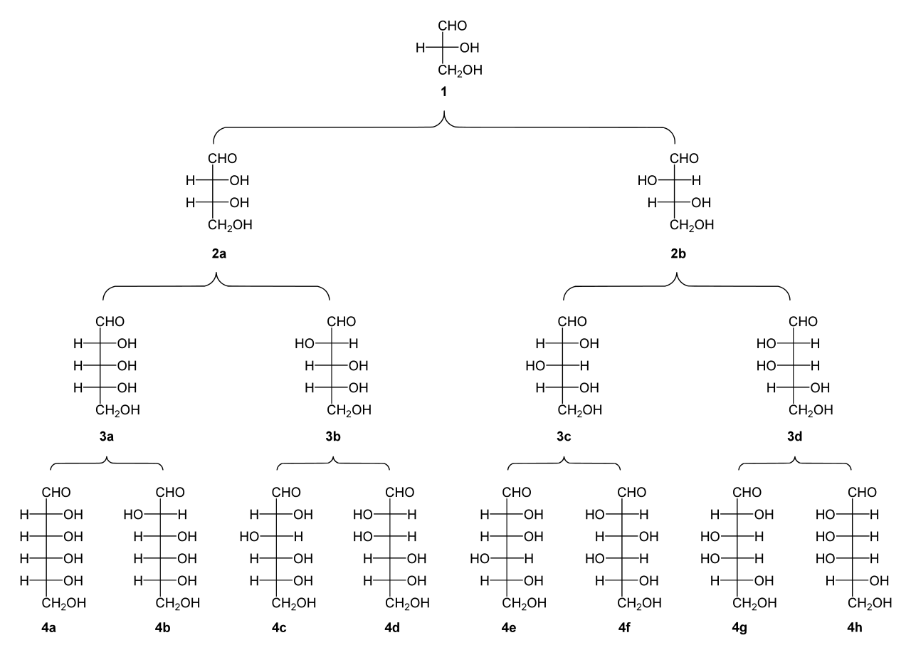
Common Aldoses in Nature
D-(+)-glyceraldehyde
Be Able to Site Recognize the highlighted sugars
D-(−)-erythrose
D-(−)-threose
D-(−)-ribose
D-(−)-arabinose
D-(+)-xylose
D-(−)-lyxose
D-(+)-allose
D-(+)-altrose
D-(+)-glucose
D-(+)-mannose
D-(−)-gulose
D-(−)-idose
D-(+)-galactose
D-(+)-talose
Image Modified from: Yikrazuul
Notes:
Here is a slide of some common aldoses in nature. You will need to be able to site recognize the ones that are highlighted in yellow. These ones play a significant role in cellular metabolism or signaling pathways. They are D-glyceraldehyde, D-ribose, D-glucose, D-mannose, and D-galactose.

Slide 39
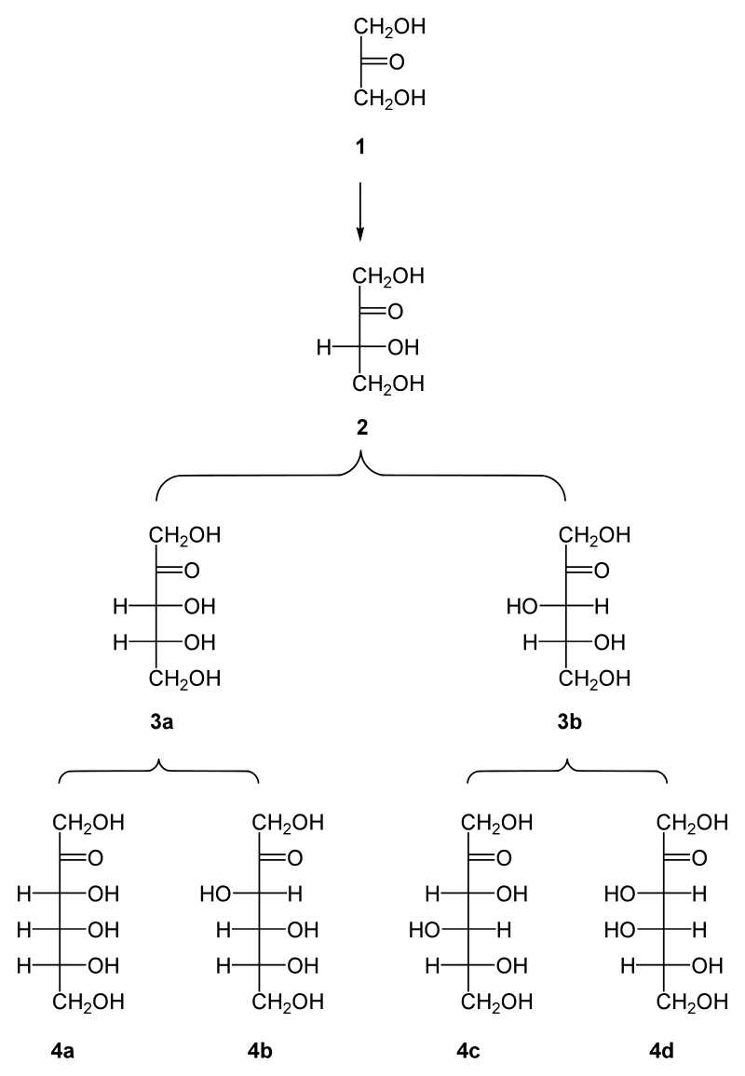
Common Ketoses in Nature
Dihydroxyacetone
Be Able to Site Recognize the highlighted sugars
D-erythrulose
D-ribulose
D-xylulose
Image modified
from Yikrazuul
D-psicose
D-fructose
D-sorbose
D-tagatose
Notes:
You only need to know two important ketoses, dihydroxyacetone and D-fructose.

Slide 40
Section Review
Structure of Monosaccharides
  Aldose vs Ketose
  Class Naming
  Number of Isomers
  Type of Isomers (constitutional vs stereo; within stereo - diastereomers, epimers, enantiomers)
Notes:
In this section, you learned about important characteristics of monosaccharides. These include the concepts of aldose/ketose and class naming, finding the number of isomers a sugar should have and determining the type of isomers present. You also learned how to alter a sugar appearance from the Fischer projection to the line angle drawing (although I won’t ask you to perform this skill on a term exam).

