Slide 1
Biochemical Energy Generation and Utilization
Part 2: The ATP Currency and Cellular Movement
Notes:
Welcome to part 2 in our Biochemical Energy Generation and Utilization section. In this section we will discuss the role of ATP in processes that require cellular movement.

Slide 2
What is NTP Currency Used For?
Enzymatic Reactions (Energy Potential)
Phosphate Donor (Kinase-specific Reactions)
Cellular signaling pathways (movement; messengers)
Neuronal Signaling
Movement
  Molecular level
    Across membranes
    Internally through the cell (through cytoplasm; transfer to organelle)
    Assembly of structures (ribosome; signaling complexes, etc)
  Gross motor level (muscle contraction)
Notes:
In the previous section, we have seen that neurons use a lot of energy to generate the movement of ions across the membrane against their concentration gradient. Neurons (and other cell types) also have energy demands to move molecules from one cellular location to another.

Slide 3
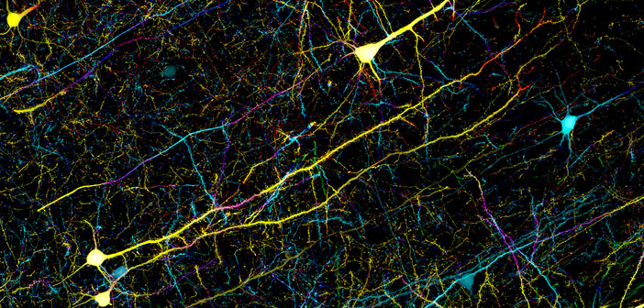
ATP Use in the Brain
Intracellular movement of molecules (such as neurotransmitters) from cell body to the axon terminal
Image from Zeiss Microscopy
Notes:
Within neurons this can be especially energy intensive due to the potential length of the cell. Imagine having to move neurotransmitters made in the soma at the base of the spine all the way to the axon terminal at the big toe! That is a long way for a very small molecule to move.

Slide 4
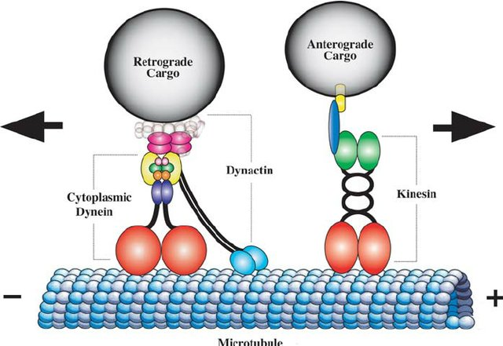
Molecular Motor Proteins
Image by Duncan, J., and Goldstein, L.S.B. (2006) PLoS Genetics 2(9):e124
Notes:
Neurons are specialized cells with a complex architecture that includes elaborate dendritic branches and a long, narrow axon that extends from the cell body to the axon terminal. The organized transport of essential biological materials throughout the neuron is required to support its growth, function, and viability. Simplistically, the axonal transport system comprises cargo, motor proteins that power cargo transport, cytoskeletal filaments or ‘‘tracks’’ along which the motors generate force and movement, linker proteins that attach motor proteins to cargo or other cellular structures, and accessory molecules that initiate and regulate transport. Long-distance transport in the axon is primarily a microtubule-dependent process. The microtubule tracks within an axon possess inherent polarity and are uniformly oriented with the fast-growing (plus) ends projecting toward the synapse and the slow-growing (minus) ends toward the cell body. The motor proteins that power axonal transport on microtubules are members of the kinesin and cytoplasmic dynein superfamilies. Kinesins are generally plus-end–directed motor proteins that transport cargoes such as synaptic vesicle precursors and membranous organelles anterogradely toward the synapse. Cytoplasmic dyneins are minus-end–directed motor proteins that transport cargoes including neurotrophic signals, endosomes, and other organelles and vesicles retrogradely toward the cell body.

Slide 5
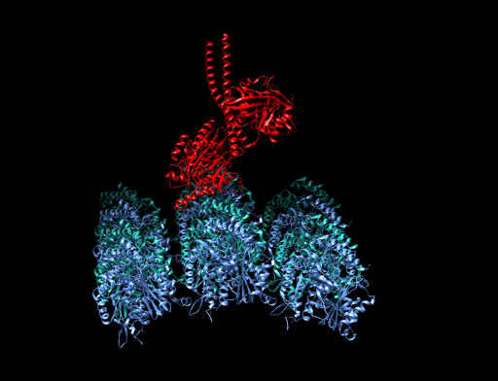
Kinesin Dimer on Microtubule
Image by Kaden.Rawson, MarisaAsadian, Stevengparkin
Notes:
This slide shows the Kinesin Dimer (shown in red) attached to a microtubule (shown in blue)

Slide 6
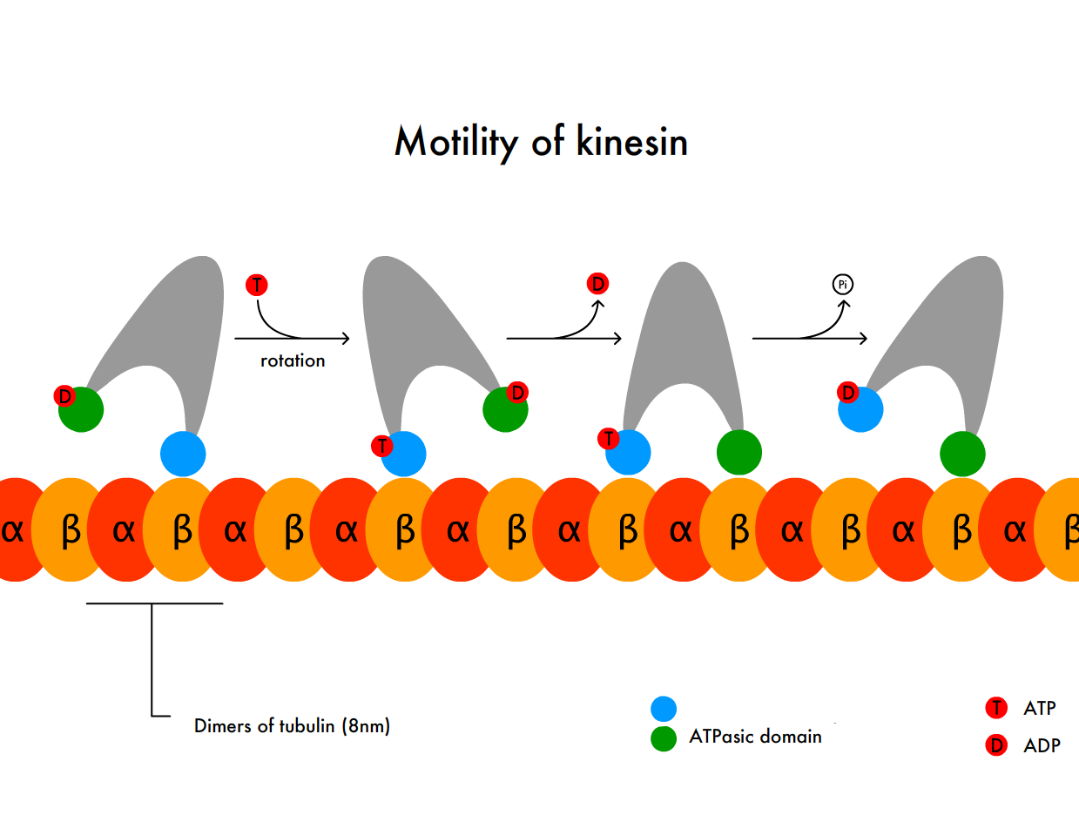
Motility of Kinesin
Rotation
Dimers of Tubulin
(8 nm)
ATPase
Domain
ATP
ADP
Image modified from Bcjordan
Notes:
The motility of the kinesin motor along the microtubule uses a rotational process that is ATP-dependent. Each portion of the kinesin dimer that contacts the microtubule is shown above in blue for one dimer and green for the other dimer. When the kinesin binding domain is attached to the microtubule, a molecule of ATP can associate with it causing the protein to rotate or swivel towards the + end of the microtubule. Following the rotation, the molecule of ADP that is attached to the other dimer binding site is released from the kinesin. This allows the second microtubule binding site to attach to the microtubule. Double binding to the microtubule causes the hydrolysis of the ATP molecule bound to the downstream kinesin binding domain. ATP hydrolysis causes the release of that binding domain from the microtubule completing one round of movement. ATP can then associate with kinesin binding domain that is still attached to the microtubule. In this fashion, the kinesin ‘walks’ down the microtubule towards the axon terminal.

Slide 7
What is NTP Currency Used For?
Enzymatic Reactions (Energy Potential)
Phosphate Donor (Kinase-specific Reactions)
Cellular signaling pathways (movement; messengers)
Neuronal Signaling
Movement
  Molecular level
    Across membranes
    Internally through the cell (through cytoplasm; transfer to organelle)
    Assembly of structures (ribosome; signaling complexes, etc)
  Gross motor level (muscle contraction)
Notes:
In addition to the transport of molecules throughout the cell, NTP energy is required for the assembly of many cellular structures.

Slide 8
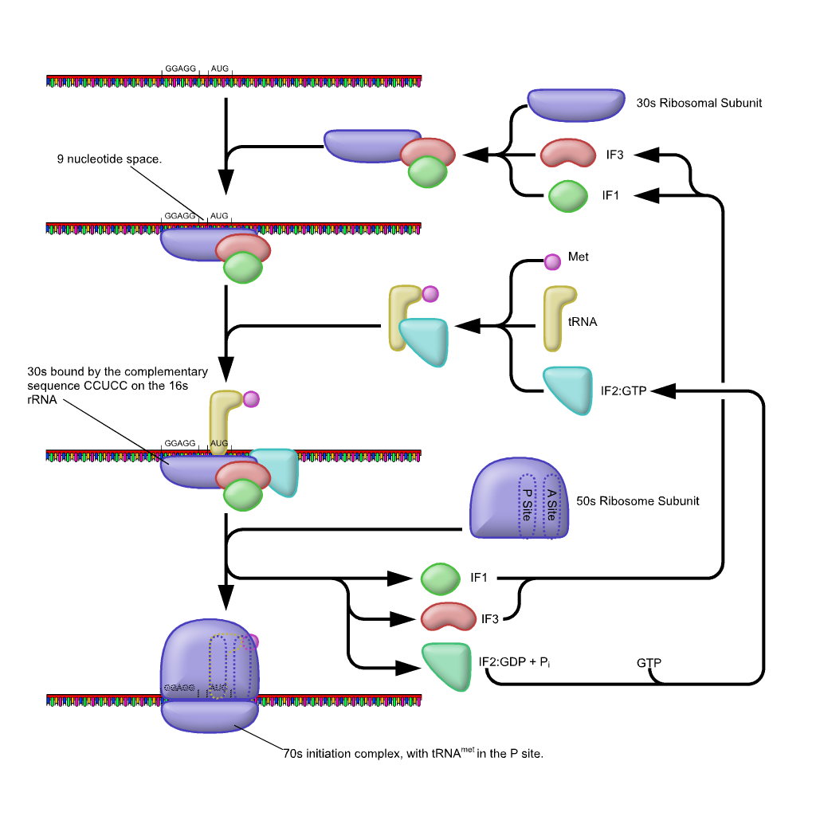
Ribosome Assembly
mRNA
30S Subunit
Start Codon
IF3
IF1
Initiation Factors (IFs) are used to assemble the ribosome
Met
tRNA
30S Subunit bound to mRNA
By Complementary Sequence
IF2-GTP
The input of GTP Energy is required to assemble the 70S Initiation Complex
50S
Subunit
IF1
IF3
IF2-GDP
GTP
70S Initiation Complex
Notes:
A good example is one that you have seen from last term, the ribosome. Assembly of the ribosome begins with the association of the mRNA with the small subunit (the 30S subunit) of the ribosome. This process is aided by the association of initiation factors 1 and 3 (IF1 and IF3). Initiation factor 2 (IF2) chaperones the transport of the Met t-RNA to the start codon position of the mRNA. This allows the docking of the large subunit of the ribosome and cleavage of the GTP that is bound to the IF-2 protein. Cleavage of the GTP to GDP allows the release of the initiation factors and full assembly of the completed ribosome structure. If you’ll recall the elongation phase of protein synthesis was also energy intensive.

Slide 9
What is NTP Currency Used For?
Enzymatic Reactions (Energy Potential)
Phosphate Donor (Kinase-specific Reactions)
Cellular signaling pathways (movement; messengers)
Neuronal Signaling
Movement
  Molecular level
    Across membranes
    Internally through the cell (through cytoplasm; transfer to organelle)
    Assembly of structures (ribosome; signaling complexes, etc)
  Gross motor level (muscle contraction)
Notes:
NTP energy is also required for the gross motor movements that we can consciously mediate through muscle contraction.

Slide 10
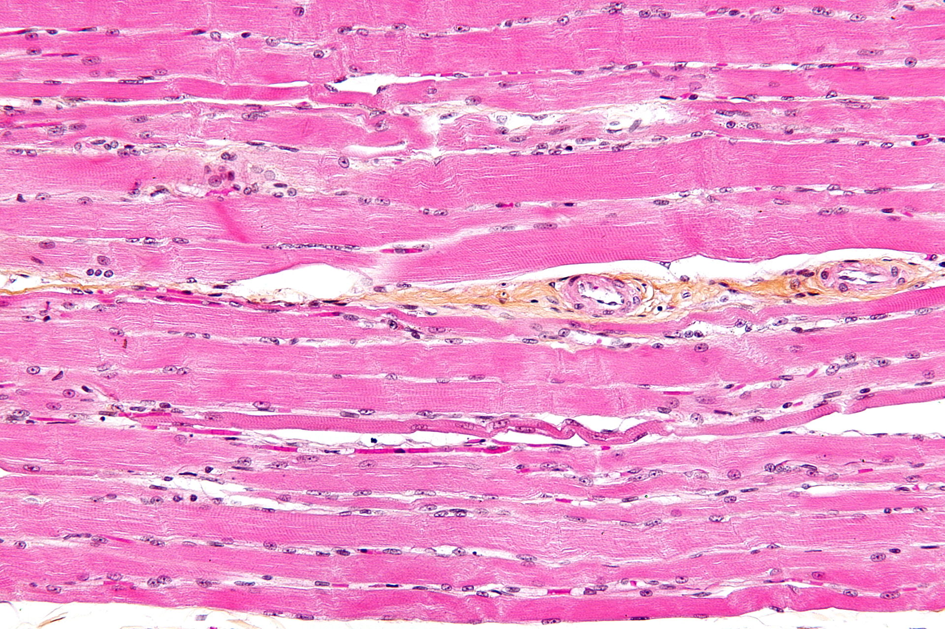
Skeletal Striated Muscle
Image by Nephron
Notes:
Skeletal muscles are composed of tubular muscle cells. Muscle cells are called myocytes, muscle fibers, or myofibers) and are formed in a process known as myogenesis. The slide above is a longitudinal section of skeletal muscle. As cells go, myocytes are weird. These ‘cells’ are actually many cells that have merged together for form a long myofiber complex. In the slide section above, less then 20 myocytes are shown, and none of them are complete cells. They continue off the slide section in both directions. They have multiple nuclei associated with them that are stained in dark purple. They typically are squished to the sides of the tube. A single myocyte (myofiber) may have over 100 nuclei!

Slide 11
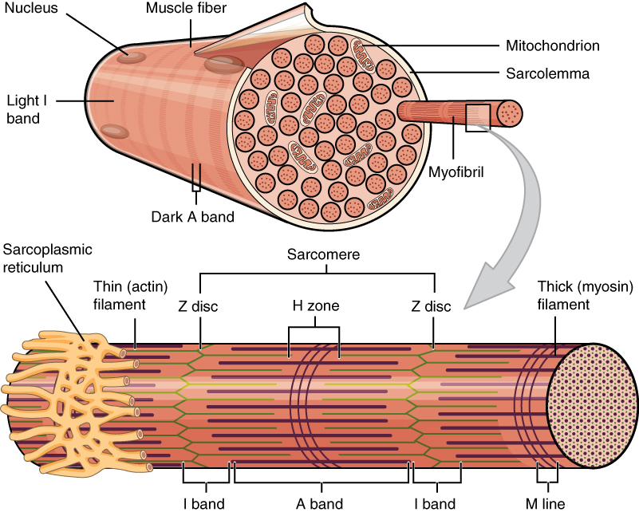
Skeletal Muscle Fiber
Image by OpenStax Anatomy and Physiology
Notes:
Each myocyte contain numerous tubular myofibrils, or tubelike bundles of fiber proteins. The top diagram shows a cross-sectional view of a single muscle cell with its many myofibrils. In between the myofibrils, you may also notice that the muscle cells also contain numerous mitochondria powering the energy demand of the tissue. The lower diagram shows a longitudinal section of one of the myofibrils. Myofibrils are composed of repeating sections called sarcomeres, which appear under the microscope as alternating dark and light bands (this will be shown on the next slide). Also surrounding each myofibril is a lattice network of a specialized organelle called the sarcoplasmic reticulum (shown in yellow above). One of the main functions of the sarcoplasmic reticulum is to sequester Ca^{2+,} that will be transiently released into the myofibril during the firing and contraction of a muscle fiber.

Slide 12
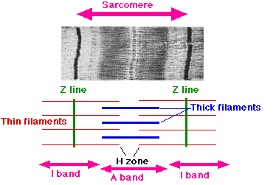
Sarcomere Muscle Fibers
Image by Sameerb
Notes:
Here is a microscopic view of a sarcomere from a striated myofibril. The sarcomere unit is defined as the region between two Z-lines. Sarcomeres are composed of long, fibrous proteins as filaments that slide past each other when a muscle contracts or relaxes. Two of the important proteins are myosin, which forms the thick filament, and actin, which forms the thin filament.

Slide 13
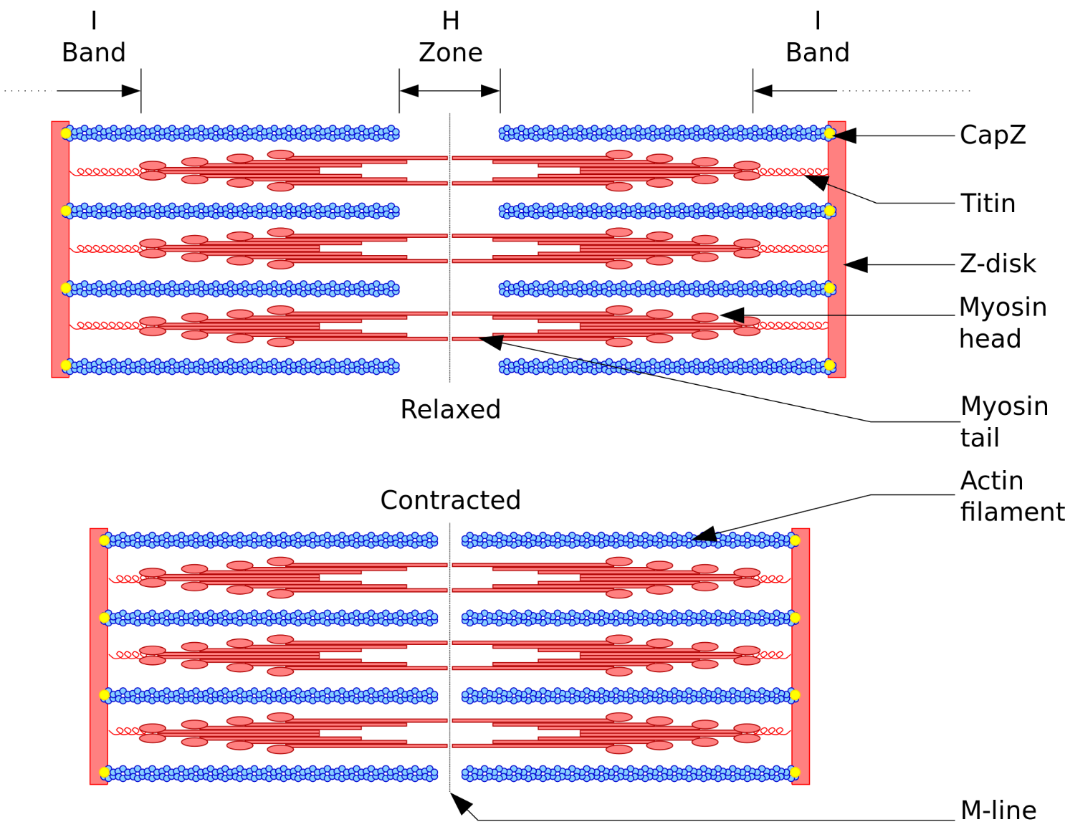
Image by David Richfield
Notes:
The actin filaments (shown in blue above) are covalently bound to the macromolecules found at the Z-line (which is actually a dense disc of proteins and carbohydrates). The myosin or thick filaments shown in orange above can attach to the actin filaments and pull them into a contracted state.

Slide 14
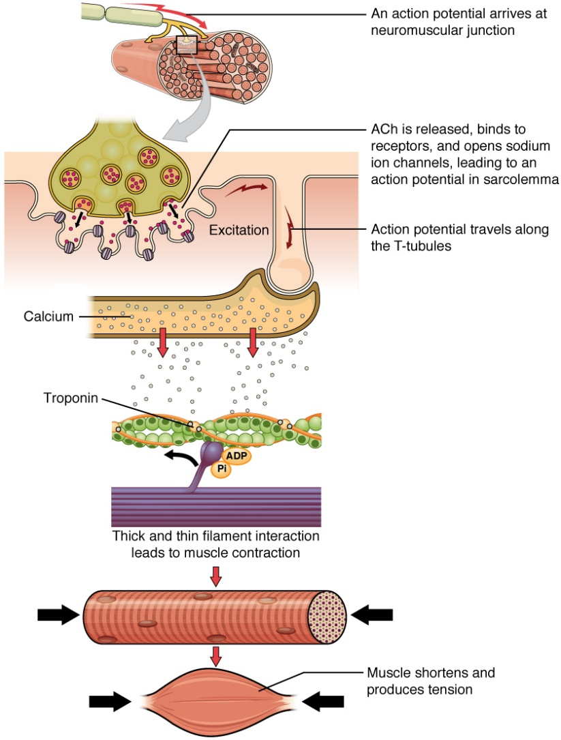
How to Muscle Cells Contract
Image by OpenStax Anatomy and Physiology
Notes:
This diagram gives an overview about how muscle contraction is initiated.

Slide 15
How to Muscle Cells Contract
Image by OpenStax Anatomy and Physiology
Notes:
To begin, muscle cells are stimulated by neuronal signals. As an action potential arrives at a neuromuscular juncture, Acetylcholine Neurotransmitters (Ach) are released and bind with receptors on the myocytes. A G-protein cascade is initiated that results in the release of calcium from the sarcoplasmic reticulum.

Slide 16
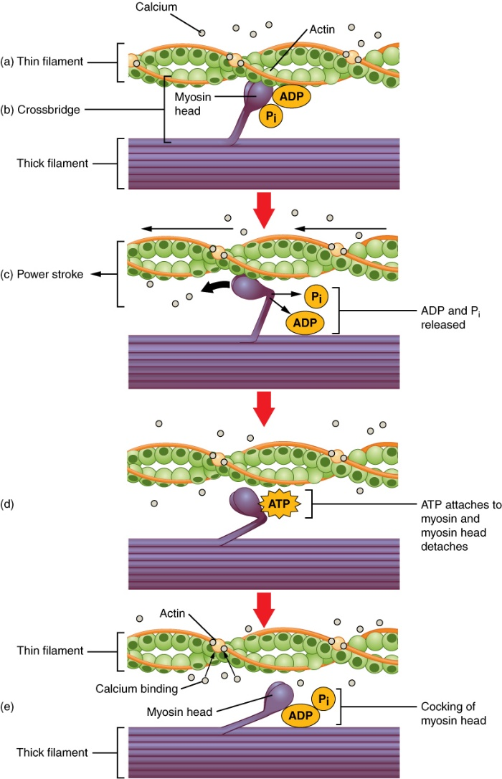
Calcium is required for muscle contraction
Image by OpenStax Anatomy and Physiology
Notes:
Calcium that is released from the sarcoplasmic reticulum is required to initiate muscle contraction.

Slide 17
Calcium is required for muscle contraction
Image by OpenStax Anatomy and Physiology
Notes:
Calcium binds to a protein associated with the actin filament called troponin. Troponin forms a complex with a fibrous protein called tropomyosin that wraps around the actin filament. The troponin is shown in yellow above, and the tropomyosin in orange. Upon calcium binding, the troponin protein changes shape and moves the tropomyosin filament uncovering a binding site on the actin filament for the for the myosin head group of the thick filament (shown in purple).

Slide 18
Image by OpenStax Anatomy and Physiology
Notes:
The myosin head group is bound with a molecule of ADP and Pi (ie a hydrolyzed ATP molecule). To release the ADP and Pi, the myosin head group must bind with the actin filament. Binding of the actin filament causes the myosin/ADP/Pi complex to shift conformation causing the powerstroke that draws the actin filaments in towards the center of the sarcomere structure and causes muscle contraction.

Slide 19
How to Muscle Cells Contract
Image by OpenStax Anatomy and Physiology
Notes:
During this time, all of the myocytes within the muscle fiber become activated at the same time and the muscle shortens into the contracted state.

Slide 20
Image by OpenStax Anatomy and Physiology
Notes:
Back at the microscopic level…Following the ‘power stroke’ of the myosin head group, it releases the ADP and Pi molecule.

Slide 21
Image by OpenStax Anatomy and Physiology
Notes:
The release of the ADP + Pi by myosin, opens up the binding site for ATP. As ATP enters this binding site, it disrupts the myosin crossbridge with the actin filament and muscle contraction is released. Without the binding of a new ATP molecule, the muscle would be stuck in the contracted state. This is seen after death, when the muscles of the body go into a stiffened state called rigor mortis due to the depletion of cellular ATP within the system.

Slide 22
Image by OpenStax Anatomy and Physiology
Notes:
Hydrolysis of the ATP to ADP + Pi causes the myosin head group to shift back into the pre-contracted state, and it is now loaded for another round of muscle contraction. If the neuronal signal for muscle contraction stops and calcium levels in the cytoplasm drop, the troponin/tropomyosin complex will again block the myosin-binding site on the actin filament, and muscle contraction will not occur.

Slide 23
What is NTP Currency Used For?
Enzymatic Reactions (Energy Potential)
Phosphate Donor (Kinase-specific Reactions)
Cellular signaling pathways (movement; messengers)
Neuronal Signaling
Movement
  Molecular level
    Across membranes
    Internally through the cell (through cytoplasm; transfer to organelle)
    Assembly of structures (ribosome; signaling complexes, etc)
  Gross motor level (muscle contraction)
Notes:
Overall in this section, you have seen many examples of how NTPs are utilized during cellular movement processes.

