Slide 1
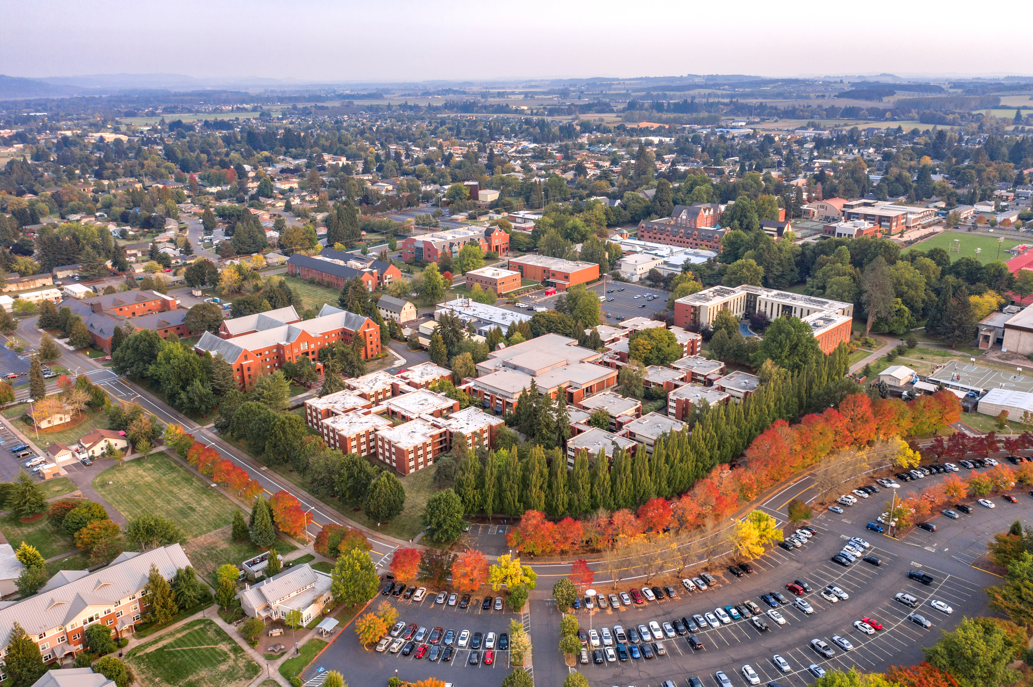

Click to edit
Budget Town Hall
April 8, 2025
Pacific Room

Slide 2
Introduction
President Comments
VPFA Viewpoints
Future Town Halls
Other Updates

Slide 3
Overview
FY25 E&G Adjusted Budget Revenues & Expenditures
Management Report – E&G Actuals and Projection (March 31, 2025)
Historical Enrollment, E&G Revenues, and E&G Expenses
Enrollment M-Report (Spring 2025)
Five-Year Plan
Measures to Balance the Budget
Q&A

Slide 4
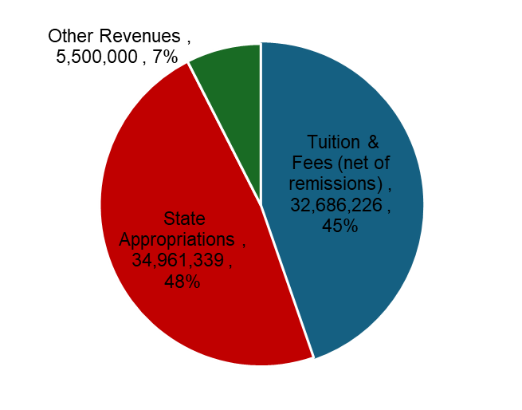
FY25 E&G Adjusted Budget Revenues

Slide 5
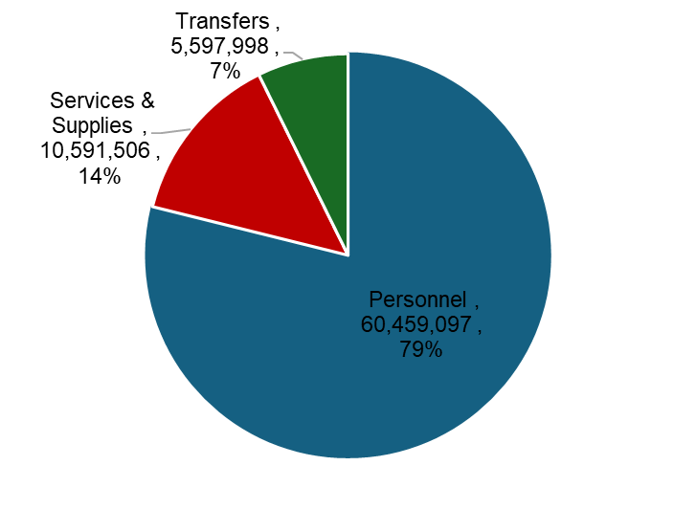
FY25 E&G Adjusted Budget Expenditures

Slide 6
FY25 E&G Adjusted Budget Summary

Slide 7
Management Report (March 31, 2025)
E & G Actuals

Slide 8
Management Report (March 31, 2025)
E & G Projection

Slide 9
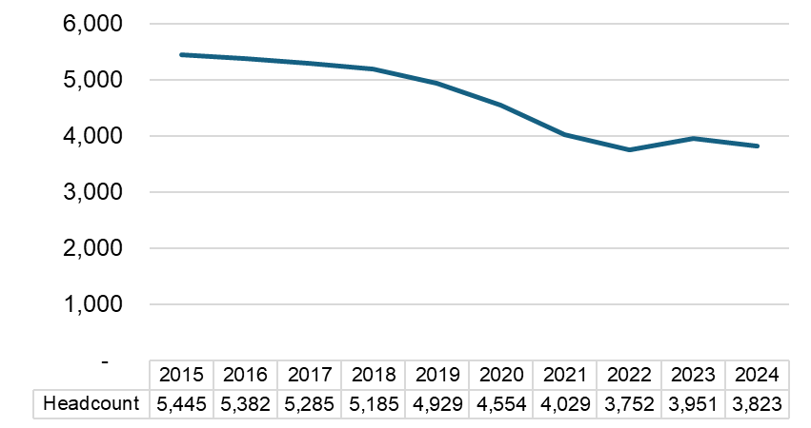
Enrollment Trend

Slide 10
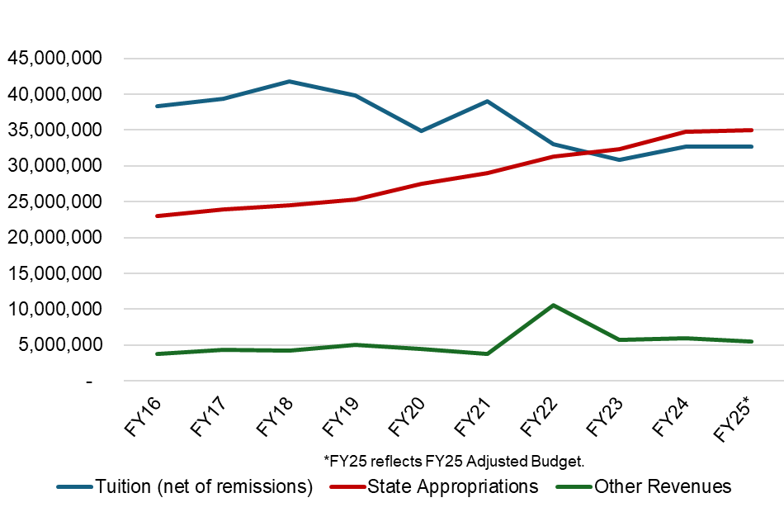
E&G Revenue Trend

Slide 11
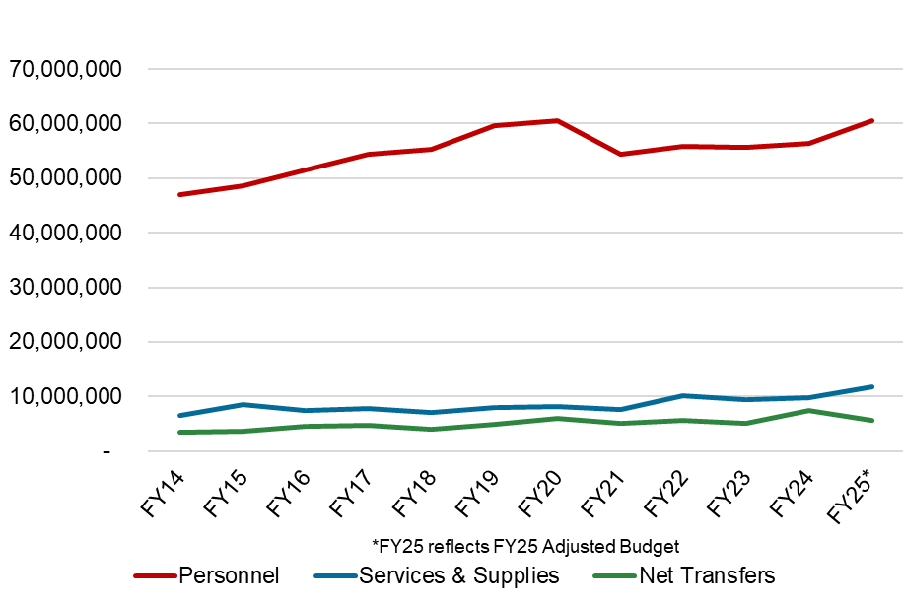
E&G Expenses Trend

Slide 12
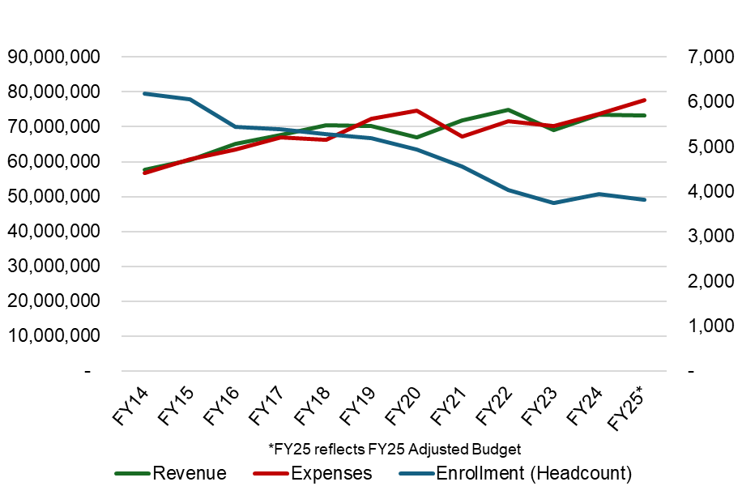
Enrollment, E&G Revenues & Expenses

Slide 13
Enrollment M-Report (March 31, 2025)

Slide 14
Five-Year Plan

Slide 15
Measures to Balance the Budget
Continue hiring by presidential approval process
Evaluate & eliminate unfilled vacant positions
Continue sweeping salary savings centrally
Review and identify duplicated cost commitments for elimination
Maximize revenue billings and collection efforts
Limit purchasing to essential critical needs
Continue enrollment management efforts
Strengthen budget monitoring and accountability
Identify shared service and central support services opportunities
Enrich data for decision making

Slide 16


Click to edit
Questions

